Slide 2
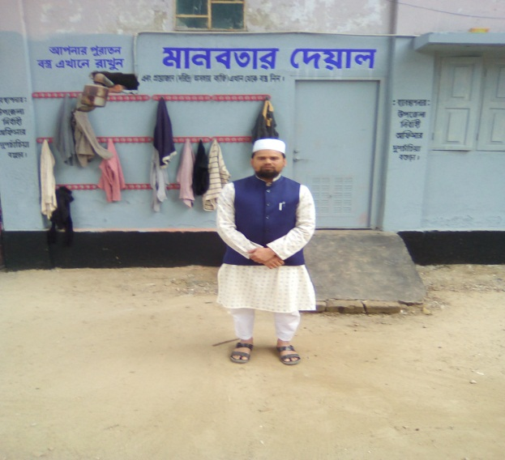
Introduction
Md .Farid Uddin
ASSISTANT TEACHER DUPCHANCHIA D.S FAZIL MADRASAH, BOGURA. | Class-8 English First Paper

Slide 3
So, Our Today’s Lesson is-
River Gypsies
in Bangladesh-2
Unit-7, Lesson-4

Slide 4
Learning outcomes
After we have studied this lesson. we will be able to---
ask and answer questions
read and understand the text
participate them in a short composition
Notes:
This will cover both speaking, listening, reading & writing skills.

Slide 5
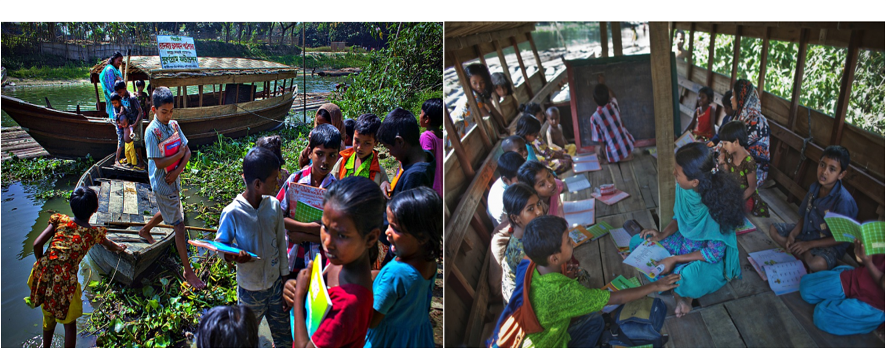
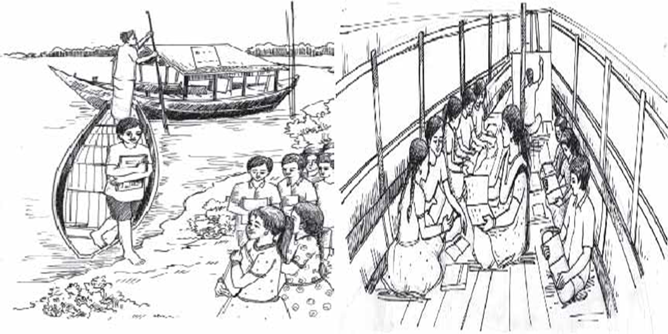
A Look at the pictures. Discuss with your partner and say who they are, where they are, what they are doing, etc.

Slide 6
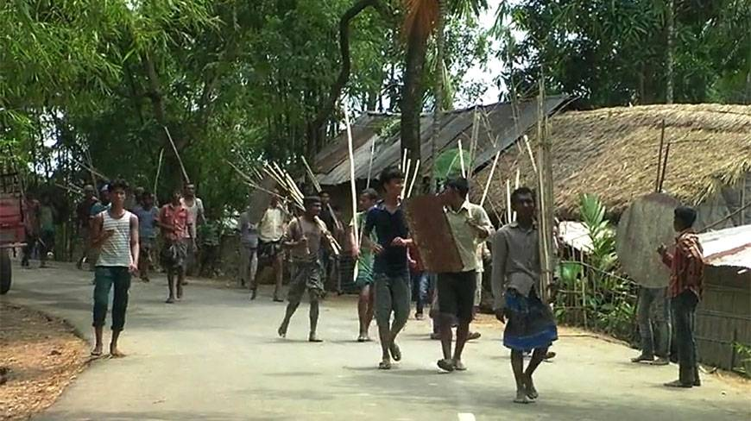
Used to
Meaning : in the habit of/ habit
I used to play football in my childhood.
Mainstream
Meaning : locality, normal place,
In winter they came to mainstream.

Slide 7
Inherit
Meaning : Heir, take over, get
She inherited a house from her mother.
Trick
Meaning : Fake, false, bogus
I have understood your tricks.

Slide 8
Petty
Meaning : small, miniature, little
All these are petty creatures.
Survive
Meaning : Continue, stay alive, last
How beautifully the flower plant survives in such a rough soil!

Slide 9
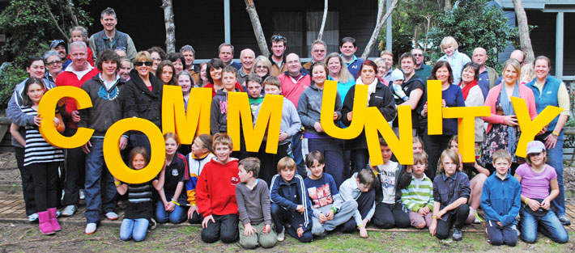
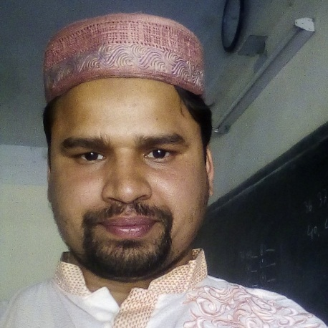
Integral part
Meaning : Thickened, integrate, undivided, unabated, undisputed, integral
Head is the integral part of the body.
Community
Meaning: Community, people, sect, denomination, brotherhood, race
We live in a community.

Slide 10
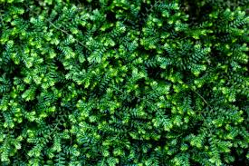
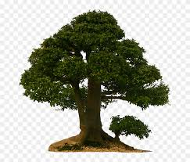
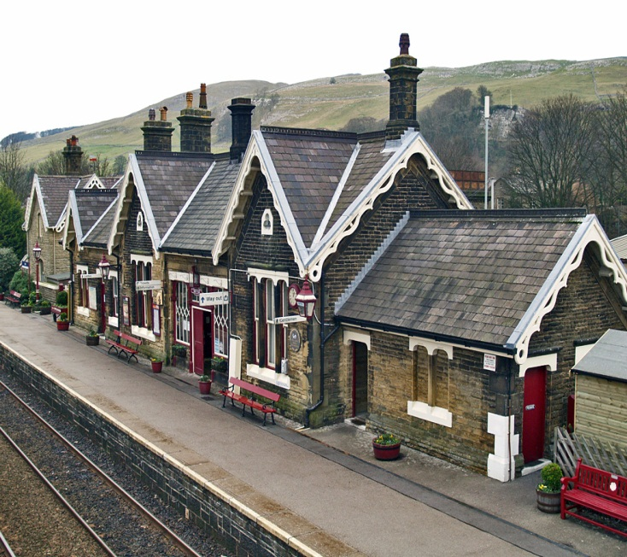
settle
Meaning: settle, colonize, colonialize
I was settled in London in 1970.

Slide 11
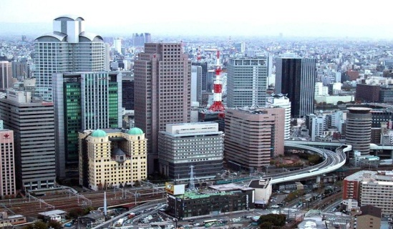
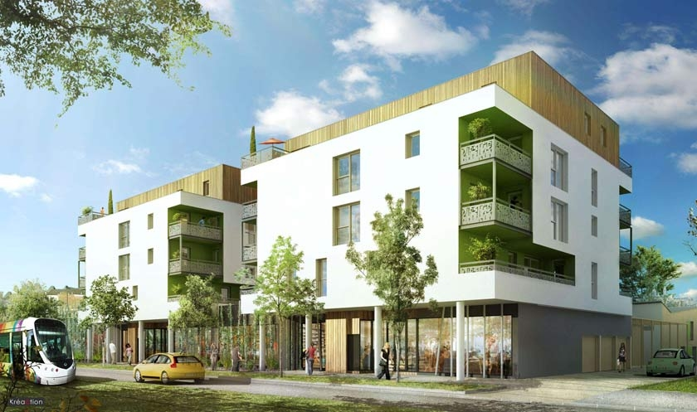
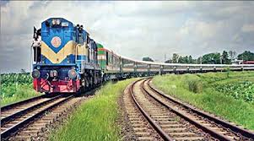
Urban
Meaning : City, town, corporation
We live in an urban area.
Urbanise
Meaning : Turn into city
All the places around Dhaka are urbanised.

Slide 12
B Read the text and answer the following questions.
River gypsies in Bangladesh are having various problems.
Let us see……

Slide 13
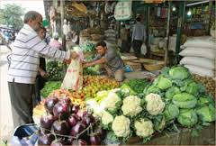
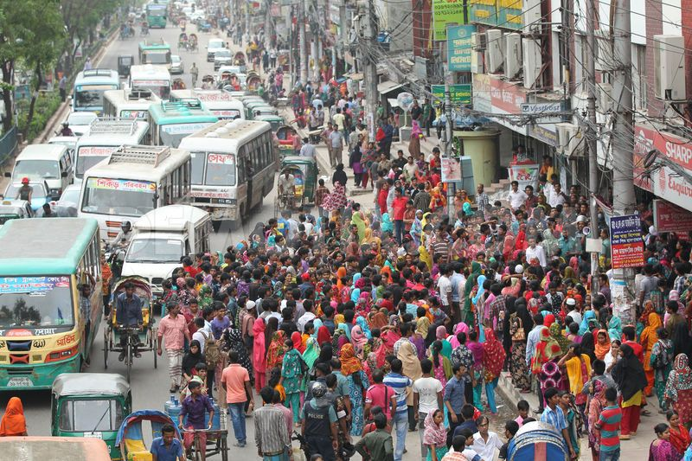
Losing
Firstly:
income is threatened.
Urbanisation
Coustomer
for urban people.

Slide 14
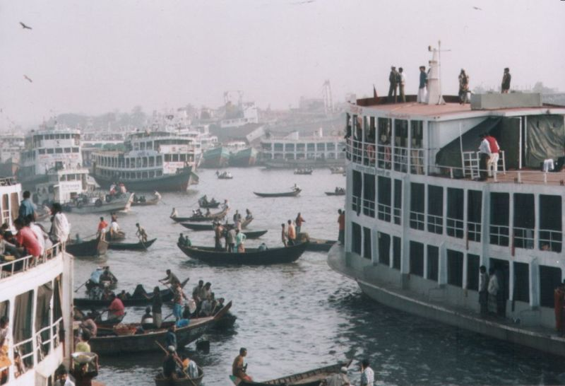
Secondly
Previous waterways
24,000 km
Present waterways
6,000 km
in dry season
These waterways are decreasing rapidly which is not favourable to the gypsies.

Slide 15
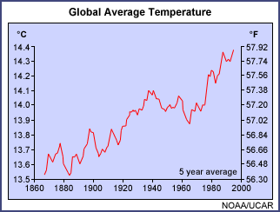
Scientists believe that Bangladesh will be worst affected by global climate change.
Notes:
Teacher may go according to animation.

Slide 16
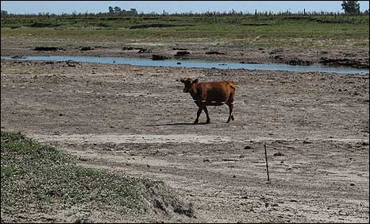
The unpredictable rain and drying out of rivers have made boat movement heavily restricted.
Notes:
Teacher may show the picture, then ask the students to say something about it and at last teacher may show the text and read out with proper sound, stress and intonation. He may explain the subject matter then.

Slide 17
Dear students!
Open your book page at 78 and go through from ‘Thirdly, many river gypsies are changing their………….children in some areas. Read silently.
Notes:
Teacher may ask the students to open their books to read silently.

Slide 18
Individual work
1 Bedeys catch snakes during the
winter/rainy/summer season.
Females of the bedey families contribute to
the family income/education/health with petty trades.
3 They sometimes go vending far away from home
by rickshaw/ on foot/ by cart.
Many bedeys have settled near the
riverbanks/lakesides/sea shore.
5 Bedeys are an integral part of our history and literature/culture/tradition.

Slide 19
Group work
1 What are the main problems that river gypsies are facing?
2 What is the effect of global climate change in Bangladesh?
3 Why are many river gypsies thinking of changing their lifestyle?
4 Why can’t river gypsy children go to conventional schools?
5 Who are running special schools for river gypsy children? Why?

Slide 20
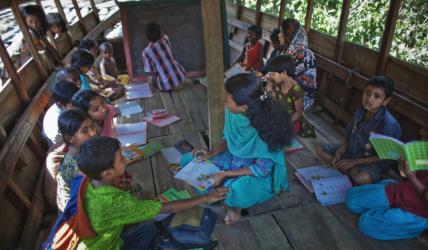
Home Work
D Imagine there is a boat-school in your area to teach river gypsy children.
Write a short composition about how you can help the gypsy children with learning.

Slide 21
Thank you very much
See you again

