Slide 1
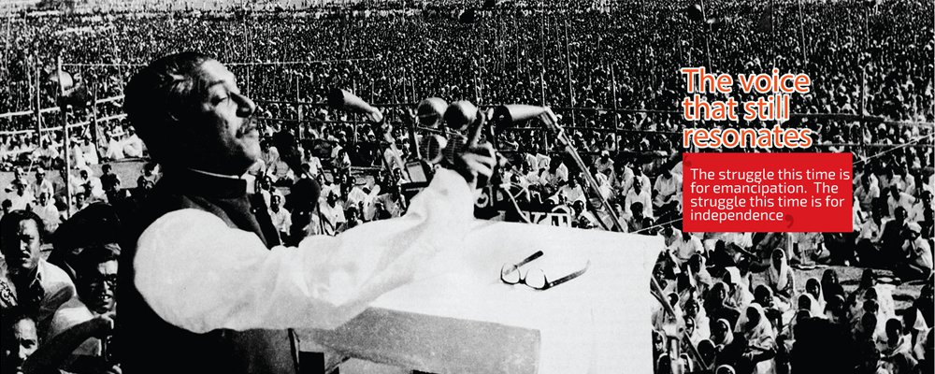
WELCOME

Slide 2
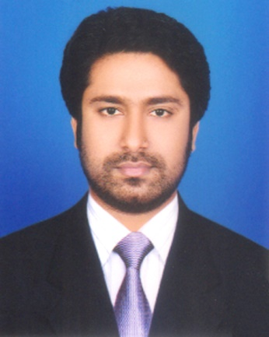
Presented by
M Humayun Kabir
English Teacher
Bhayeta Abdul Quddus Dakhil Madrasah, Tangail Sadar
Cell : 01727-425565 ; 01924-320532
E-mail : hkabir082009@gmail.com

Slide 3
Lesson Identity
Future Continuous Tense
Class Six
Unit Two
23 January 2020

Slide 4
Learning outcomes
After we have studied this lesson, we will be able to
know about the Future Continuous Tense.
make the questions and their answers on Future Continuous.
give the name of sentences and
use them properly.

Slide 5
Let’s Check Our V1,2,3
Recite আবৃত্তি করা recited recite
Read পড়া read read
Study অধ্যয়ন করা studied studied
Learn লেখা learned / learnt learned / learnt
Teach শেখানো; শিক্ষা দেওয়া taught taught

Slide 6
11 WH Words
What - কী ?
Whom - কাকে ?
How - কীভাবে ?
Where - কোথায় ?
When - কখন ?
Why - কেনো ?
Who - কে ?
Who - কে কে / কারা ?
Which- - কোন- টি ?
Whose- - কার- টি ?
WH Prepositions - WH Prepositions ?

Slide 7
Continuous
Present Continuous : I am reciting a poem.
Past Continuous : I was reciting a poem.
Future Continuous : I shall be reciting a poem.
am; is; are Ving
was ; were Ving
shall; will be Ving

Slide 9
Let’s Start our Today’s Topic

Slide 10
TOPIC
Future Continuous
Subject : English 2nd Paper
Lesson : 3 (Part-A)
Period : 3rd
Time : 50 minutes
Date : 20 January 2020

Slide 11
Let’s Try to Learn from the Video

Slide 12
Future Continuous
1.
I
shall be
reciting a poem. =
আমি একটি কবিতা আবৃত্তি করতে থাকবো।
2. I
shall not be
reciting a poem. =
আমি একটি কবিতা আবৃত্তি করতে থাকবো না ।
3.
Shall
I
be
reciting a poem ? =
আমি কি একটি কবিতা আবৃত্তি করতে থাকবো?
4.
Shall
I
not be
reciting a poem?=
আমি কি একটি কবিতা আবৃত্তি করতে থাকবো না ?
5.
What
shall I be reciting ? =
আমি কী আবৃত্তি করতে থাকবো ?
6.
What
shall I not be reciting ? =
আমি কী আবৃত্তি করতে থাকবো না ?

Slide 13
Let’s Name these 6 Sentences
According to
Primary Sentence (Structure)

Slide 14
01. Affirmative
(হ্যাঁবোধক)
02. Negative
(নাবোধক)
03. Interrogative
(প্রশ্নবোধক/ হ্যাঁবোধক প্রশ্ন)
04. Negative-Interrogative
(নাবোধক-প্রশ্ন)
05. WH Interrogative
WH (প্রশ্নবোধক/ হ্যাঁবোধক প্রশ্ন)
06. WH Negative-Interrogative
WH (নাবোধক-প্রশ্ন)

Slide 15
Assessment-1
Dear Students ! Tell me-
How many questions are there ? Who are they ?
Answer those questions.

Slide 16
Let’s Build up our Career. But how… ?
Let’s Get by Heart and Practise these 6 Sentences
With 101 Verbs (V123)

Slide 17
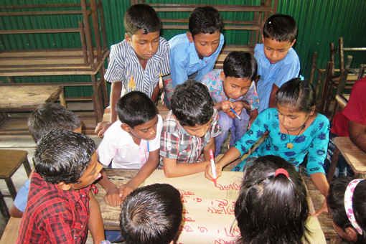
Group Work
Make 6 sentences on Future Continuous with following verbs-
Learn
Eat
Teach
Write
Draw

Slide 18
Individual Work
Make Future Continuous with following verbs using objects.
Do
Take
Drink
Like
Invite

Slide 19
Assessment-2
Open your Text Book and find out the
Future Continuous Tense.

Slide 20
Home Task

Slide 21
Home Task
Remember our class at a glance
and try to find out the
Future Continuous
in your text books and journals
And make a list.
1. Text Book (English for Today)
Newspaper (The Daily Star / Others)

Slide 22
Thank You All
May Allaah swt learn and expert in the Future Continuous Tense.

