Slide 1
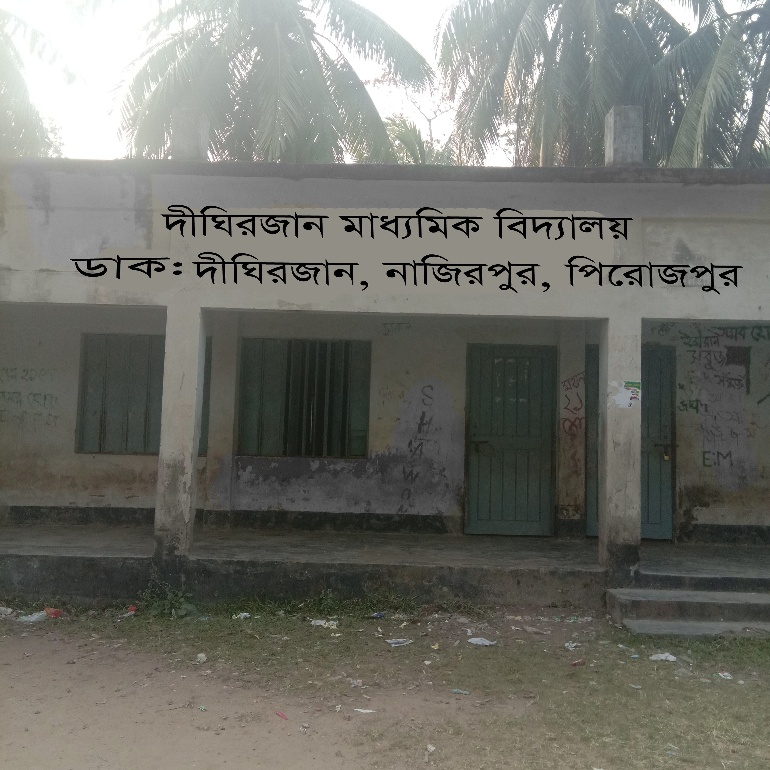
Welcome

Slide 2
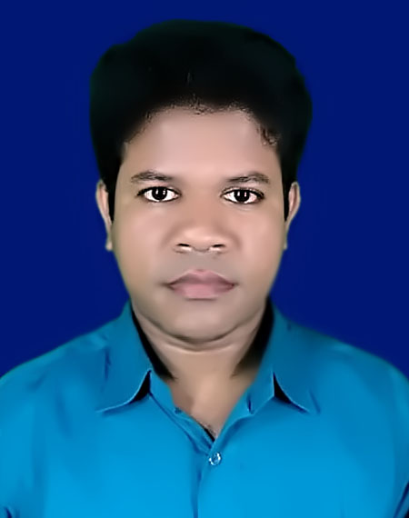
Identity
Unite: 1
Lesson: 1
Azizul Fakir
Assistant teacher
Dighirjan Secondary School
Naizrpur, Pirojpur
Email: azizul.nk@gmail.com
Mobile: 01710745128

Slide 3
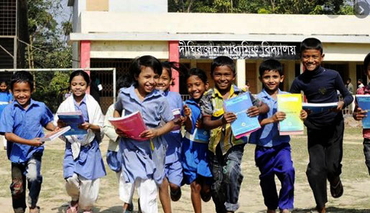
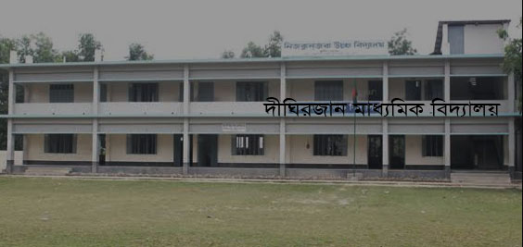
Let us watch the picture
What did you see here?
School’s picture
When did you admit in this school?
1st January in 2020

Slide 4
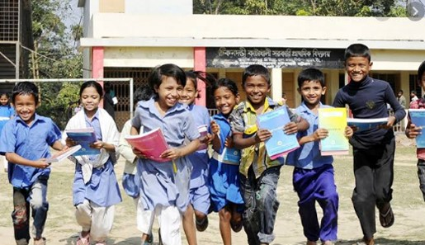
Our todays topic
Going to a new school

Slide 5
Learning outcomes
After completing the lesson students will be able to
read and understand text
talk about people, places and familiar objects in short and simple sentences
write short paragraphs

Slide 6
Open at page no. 1 your “English For Today” book
And
Read the form and see what Tarun has written about himself.

Slide 7
Now fill the form about what Tarun has written about himself.
My name is ________________
I am____years old.
I have_____ eyes, _______hair, and I am 4__________ I am good at _____________ and _______
My hobbies are ______________and ________
I like to read __________and eat _________
I really don’t like ___________________
Tarun Chowdhury.
11
Feet, 3 inches tall
brown
brown
playing football
drawing.
collecting stamps
reading.
comic books
peanuts.
any kind of soft drinks.

Slide 8
Now write down similar information about yourself.
My name is ----------------------------------.
I am ----- years old.
I have ------eyes, ------ hair, and I am 4 --------------.
I am good at ----------- and ---------.
My hobbies are -------------and ---------.
I like to read ------------ and eat -------- .
I really don’t like ------------------------- .

Slide 9
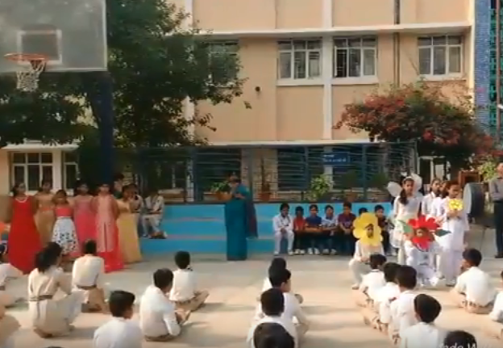
My first day at the school was interesting.

Slide 10
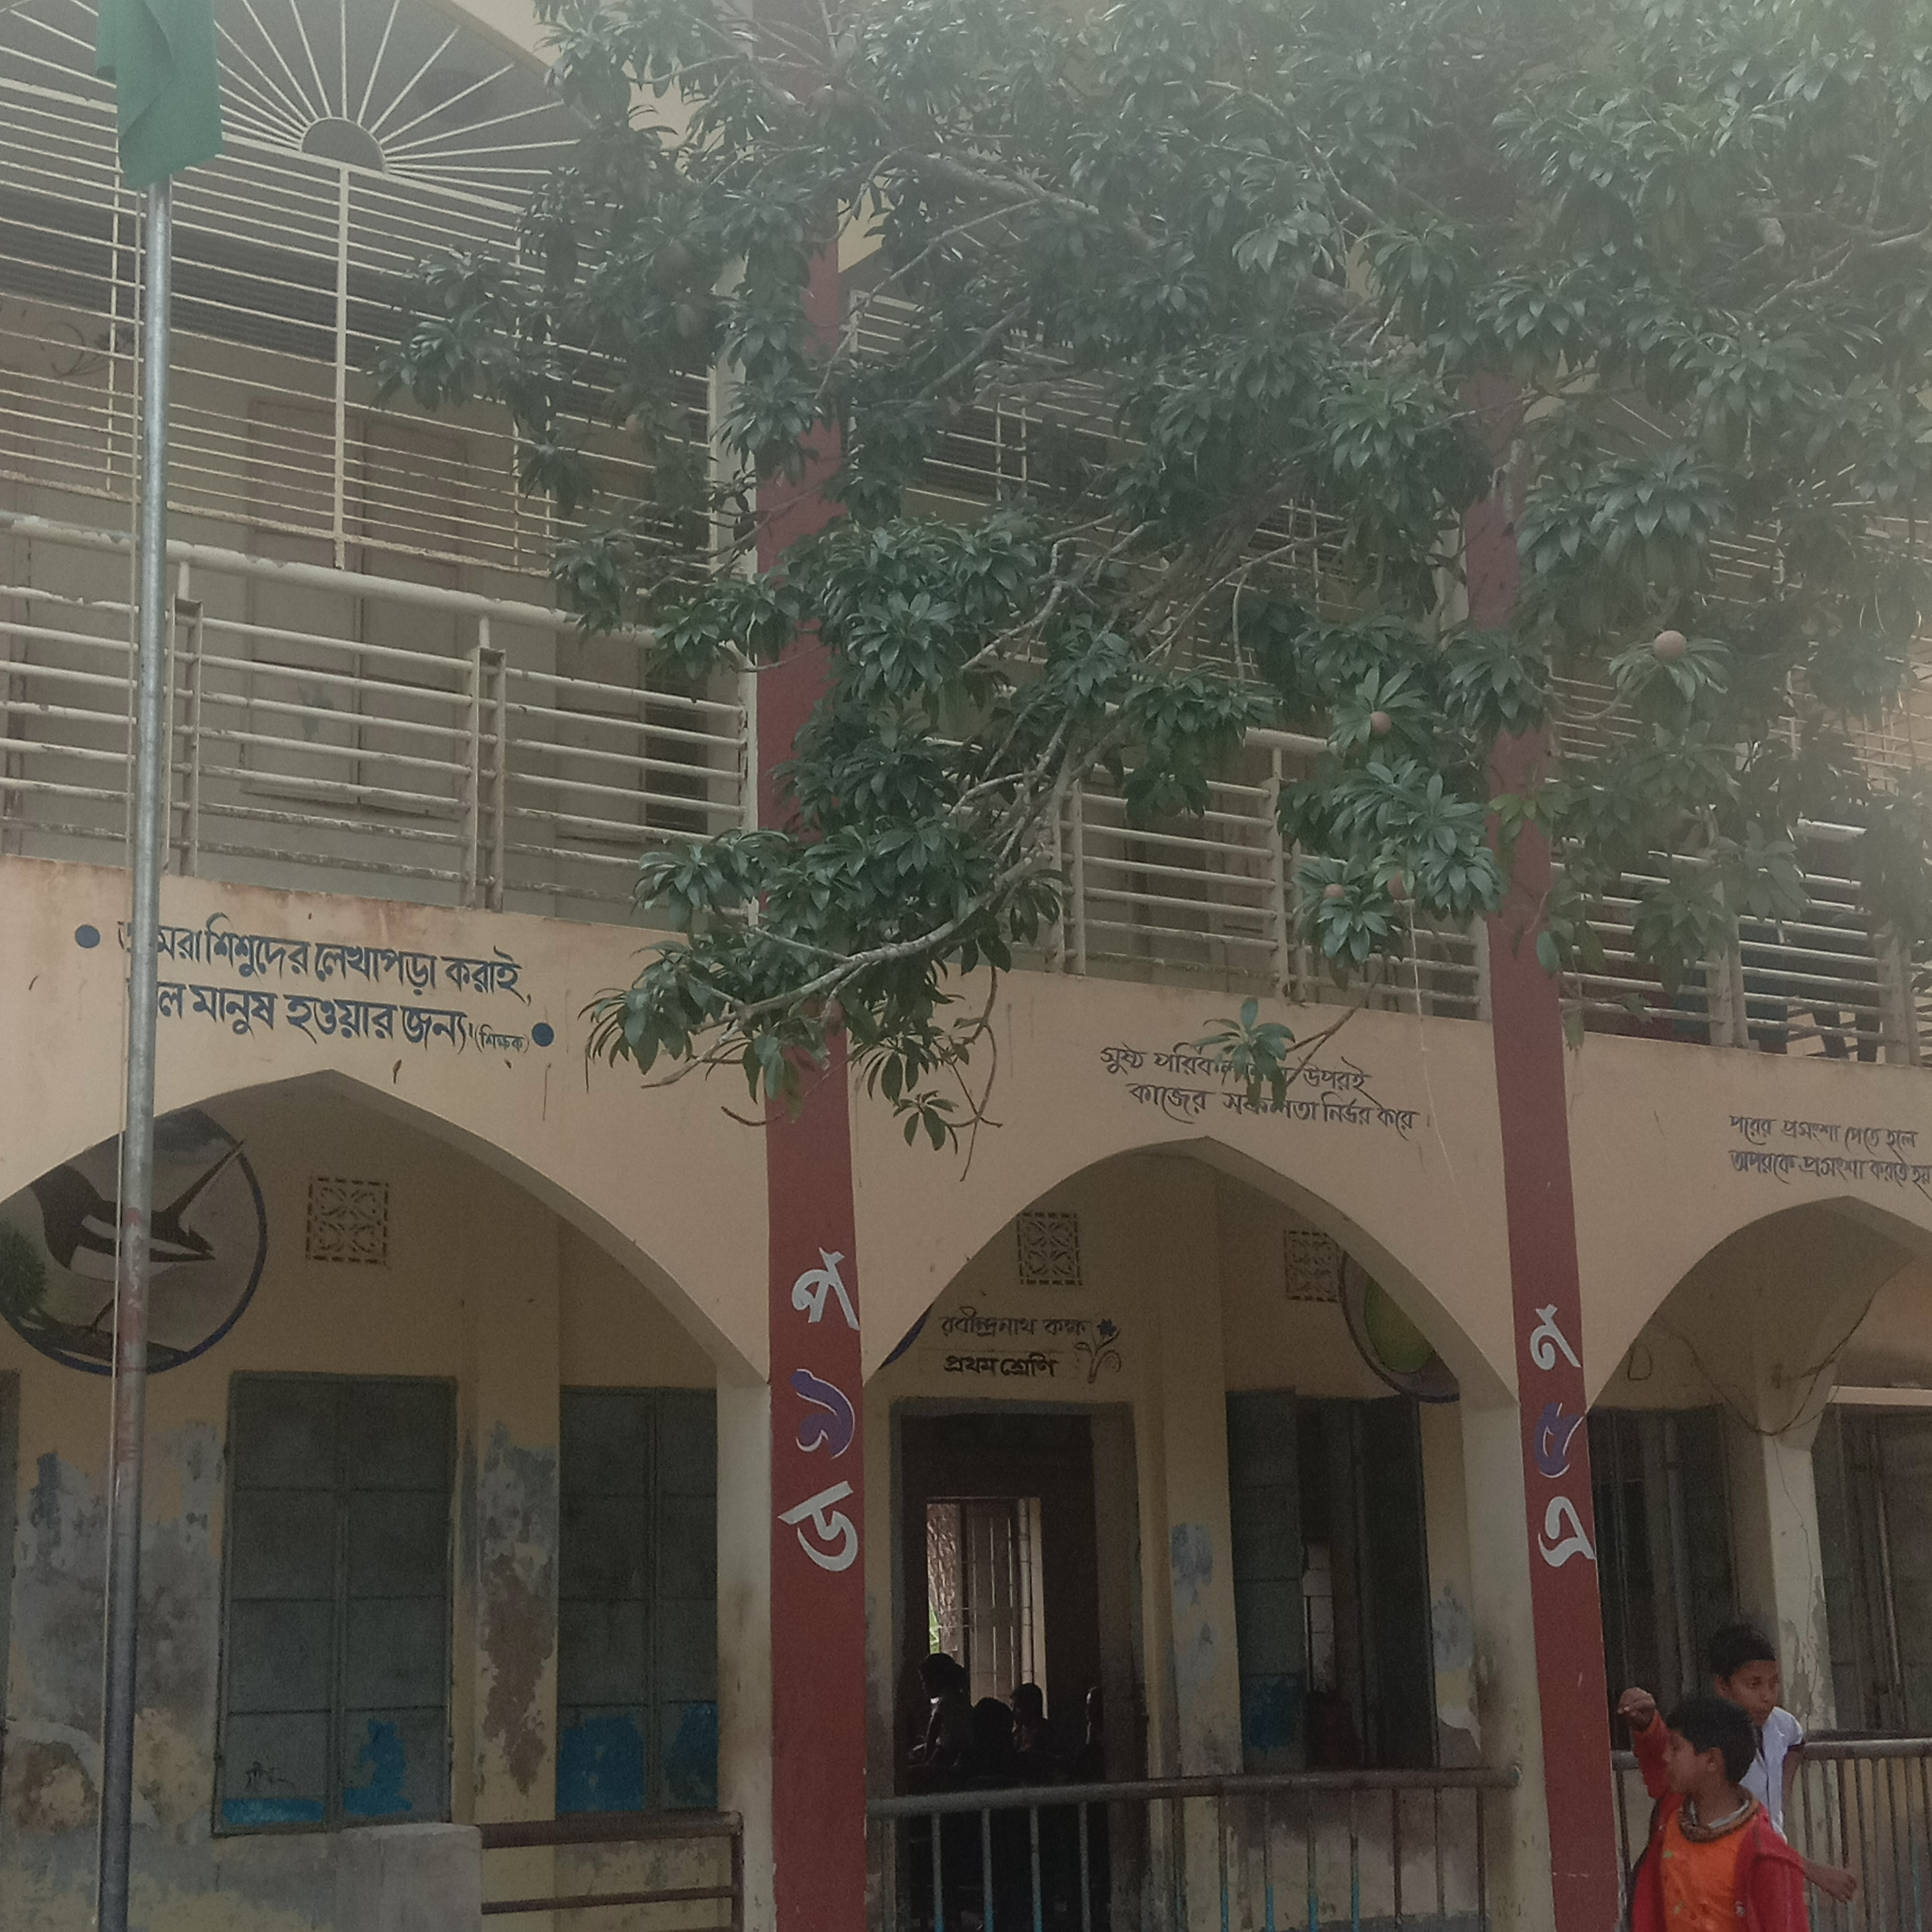
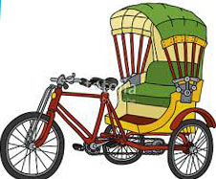
I was going to school with my father in a rickshaw.

Slide 11
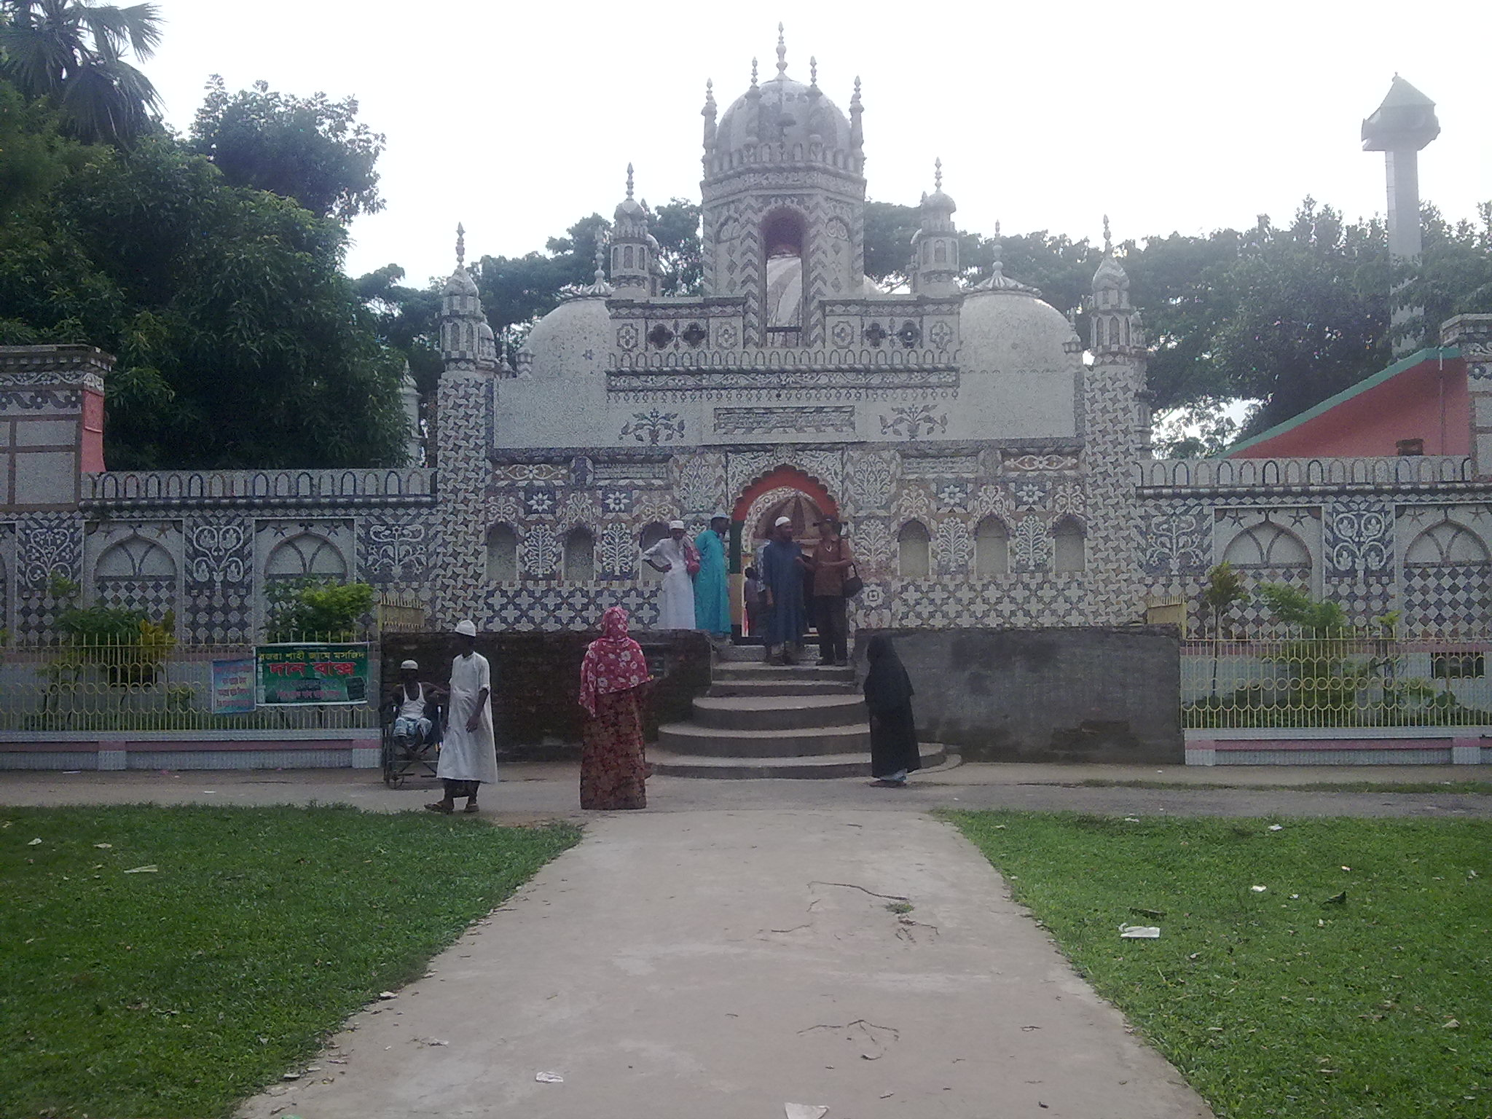
We reached school after fifteen minutes.

Slide 12
My father said good bye and left me at the school gate.

Slide 13
I went in and found that everyone had gone to class.

Slide 14
I walked into my classroom and found a seat.

Slide 15
After sometimes a teacher came and warmly greeted us.

Slide 16
I found the students very friendly in my new class.

Slide 17
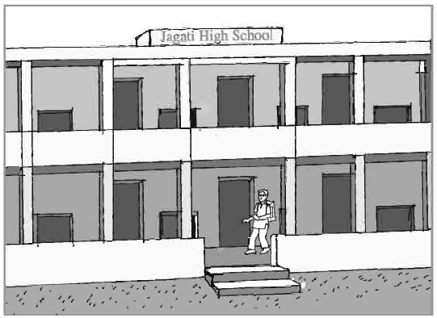
B. Read the following passage about Tarun’s first day in the new school
My first day at the school was interesting. I was going to school with my father in a rickshaw. We reached school after fifteen minutes. My father said good bye and left me at the school gate. I went in and found that everyone had gone to class. I walked into my classroom and found a seat. After sometimes a teacher came and warmly greeted us. I found the students very friendly in my new class.

Slide 18
Now choose the correct answer to each questions from the alternatives given below.
(a) My first day at the new school was interesting. Here the word ‘interesting’ is
similar to -
(i) amusing (ii) boring (iii) dull (iv) unexciting
(b) We reached school after fifteen minutes. Here ‘reached’ means –
(i) arrived (ii) left (iii) advanced (iv) cut
(c) My father said, “Good bye. Which of the following words is bot a synonym of the
word ‘goodbye’?
(i) bye (ii) reunion (iii) farewell (iv) adieu
(d) A teacher came and warmly greeted us. The term ‘warmly greeted’ means –
(i) welcomed cordially (ii) thanked (iii) said good bye (iv) delivered a nice
speech
(e) I found the students very friendly. Which of the following words has opposite
meaning to ‘friendly’
(i) matily (ii) antagonistic (iii) amicable (iv) intimate

Slide 19
B1. Choose the right answer:
The passage is about
a. who took Tarun to school the first day.
b. how Tarun felt on the first day in school and why he felt so.
c. what happened in the school on the first day.

Slide 20
B2 Match a word from Column A with a word (or words) from Column B that has (or have) similar meaning.
Column A | Column A
interesting | lovingly
frightened | amusing
happy | afraid
excited | glad
warmly | thrilled
interesting
lovingly
frightened
amusing
happy
afraid
excited
glad
warmly
thrilled

Slide 21
Group works
Talk about your first day in the school and how you felt – happy, frightened, thrilled or shy.

Slide 22
Read the following poem and end this lesson with fun and laughter
- Kate Greenway
School is over,
Oh, what fun!
Lesson finished,
Play begun.
Who’ll run fastest,
You or I?
Who’ll laugh loudest?
Let us try.

Slide 23
Home work
Write a paragraph on how you felt on your first day at school and why you felt so.

Slide 24
Thank you

