Slide 1
Wellcome to the Multimedia Class
Well come

Slide 2
INTRODUCING
Belayet Hossain
Assistant Teacher
05 No South Jonardondi Government Primary School
Kalkini, Madaripur.
G-mail : belayet01715205765@gmail.com
Call : 01715205765

Slide 3
INTRODUCING
Class : Three
Subject : English
Unit : 34
Lesson : 1-3
Activity : A, B, C
Page : 68
Time : 45 minutes

Slide 4
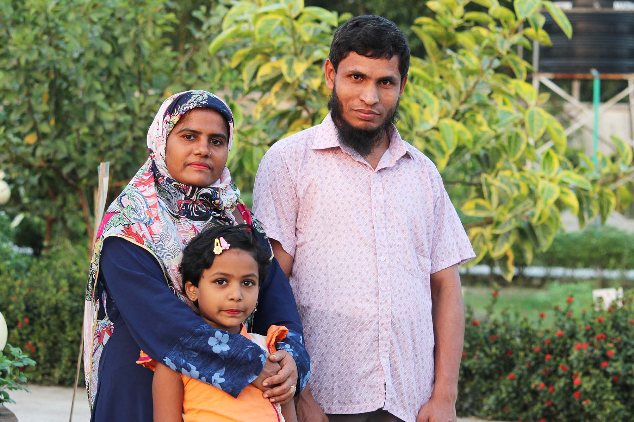
Can you guess what is our today’s lesson?
What is the relationship between them?

Slide 5
Today's Our Lesson
My family
Unit - 34.
Lessons – 1 - 3.

Slide 6
Learning Outcomes
Students will be able to:-
Listening:-
4.3.1 - enjoy and understand simple stories.
Speaking:-
3.1.1 - ask and answer Wh questions.
Reading:-
5.1.1 - read simple paragraphs.
Writing:-
8.1.3 - write sentence from the text book or model.
10.1.1 - write short and simple paragraphs answering a
set of questions.

Slide 7
New Words
What can you see in the picture?
Family
A person with whom one has a bond of mutual affection.
I`m Tisha. I`m a student.

Slide 8
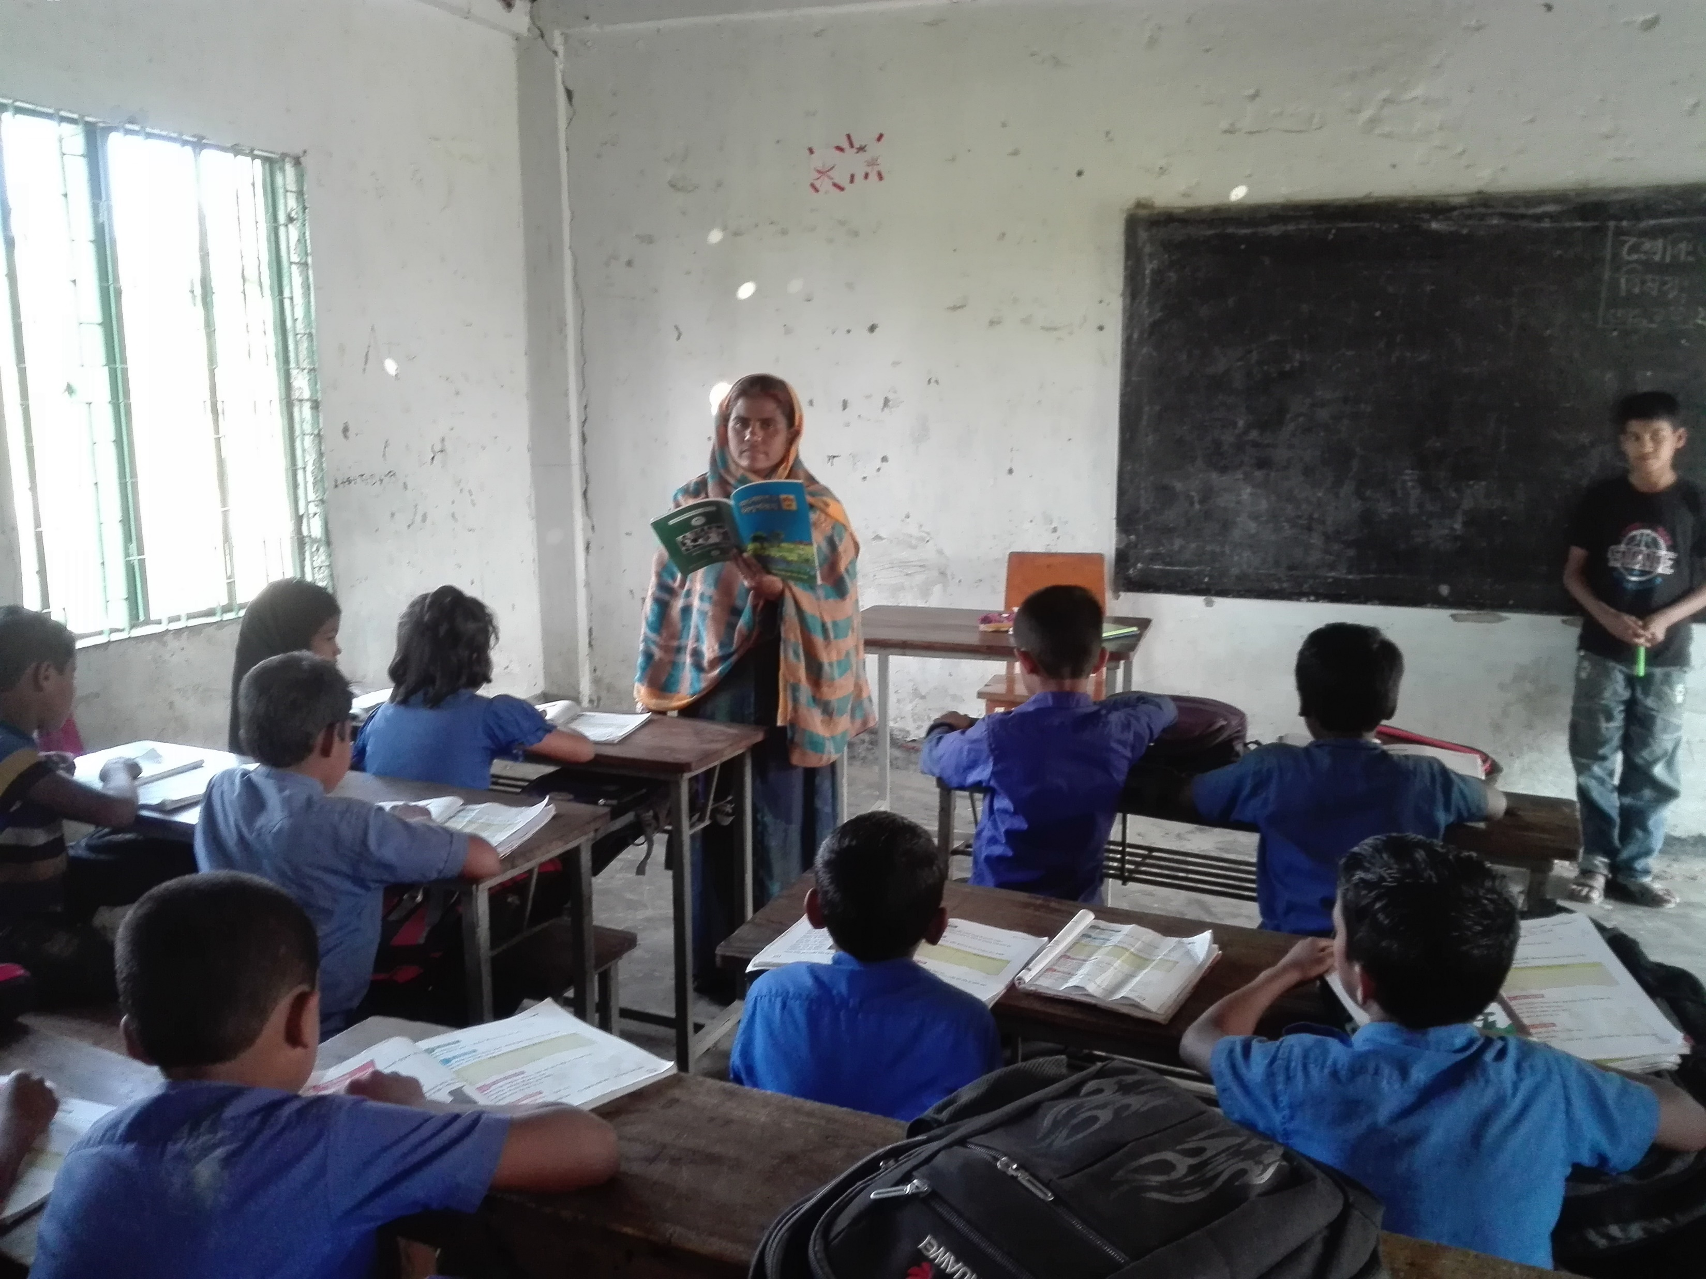
New Words
What can you see in the picture?
Teacher
A person who teach in a school or college.
I’m in class 3. There are four people in my family. My mother is a teacher.

Slide 9
New Words
What can you see in the picture?
Banker
A person who works in a bank.
My father is a banker. My brother is two years old.

Slide 10
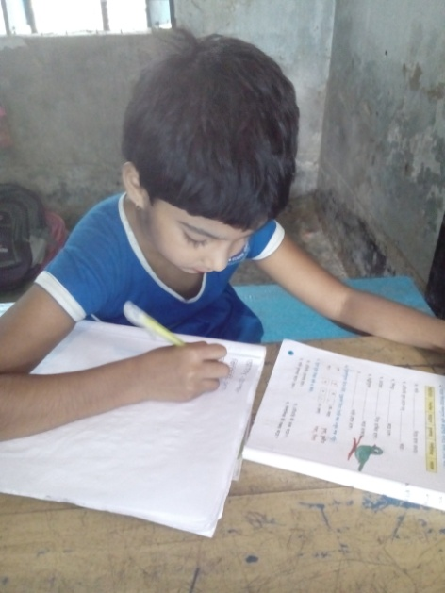
Individual Work
Make sentence by the words:
Family
Teacher
Banker

Slide 11
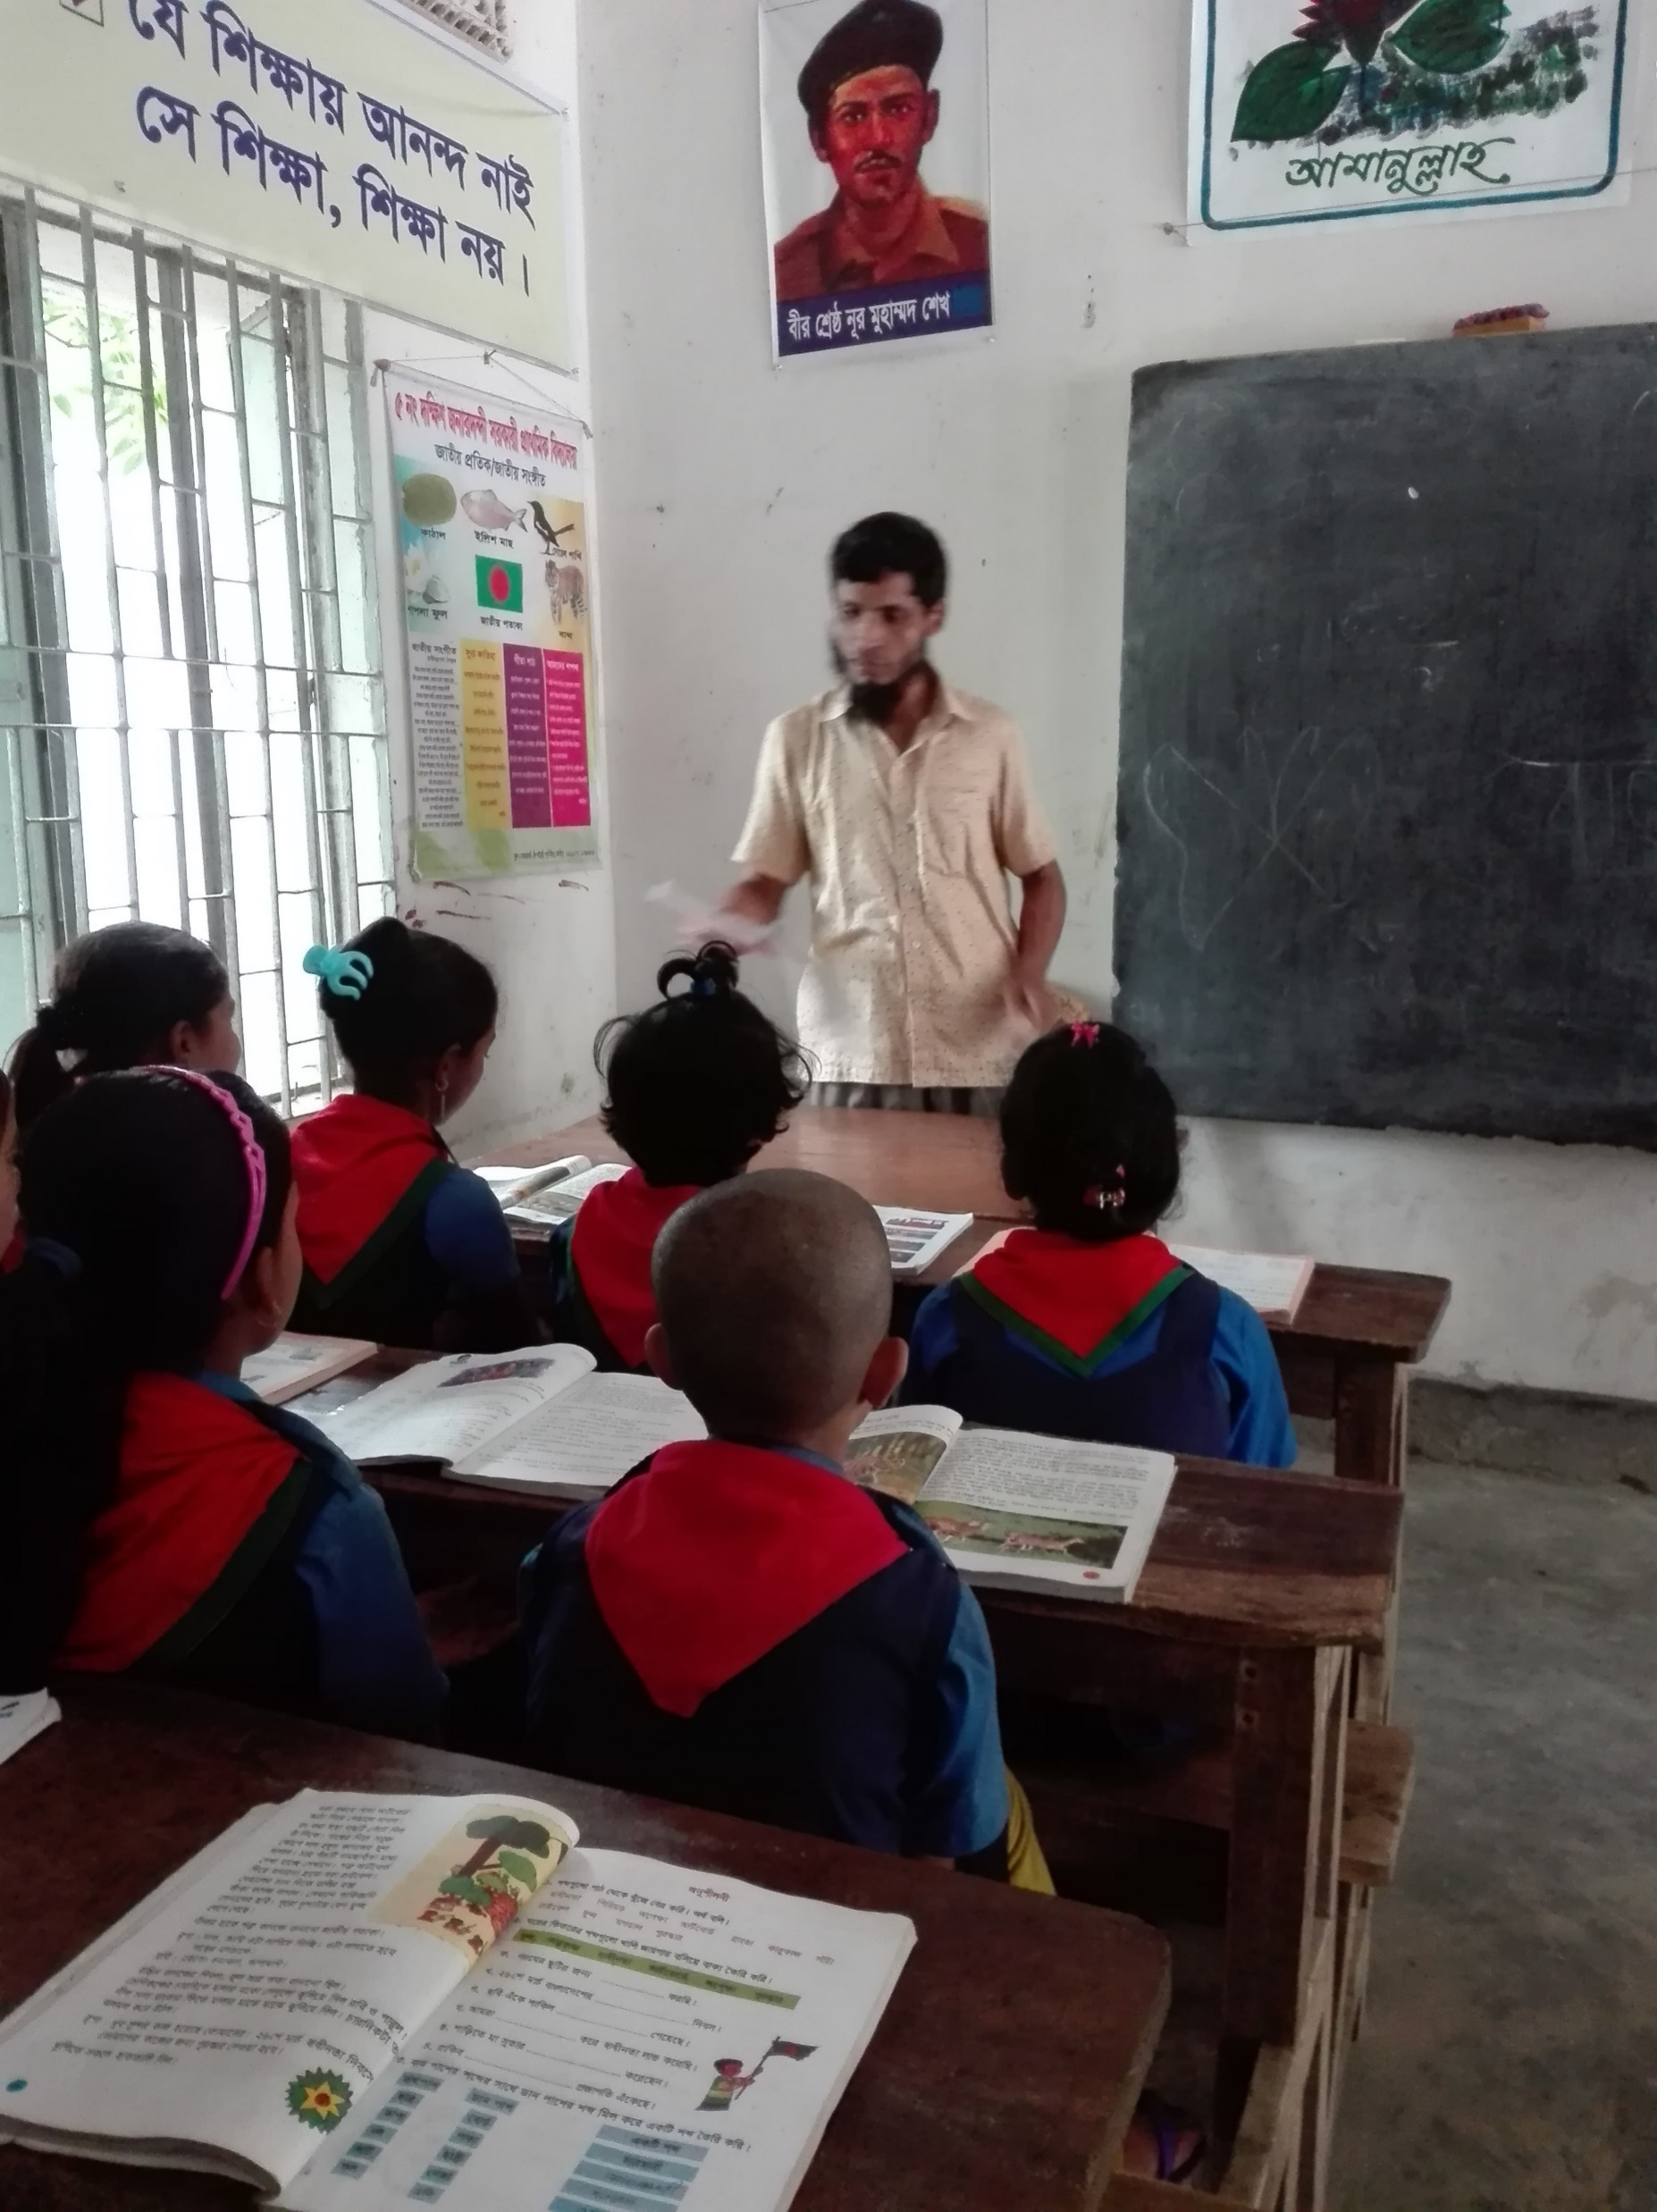
Teacher’s reading

Slide 12
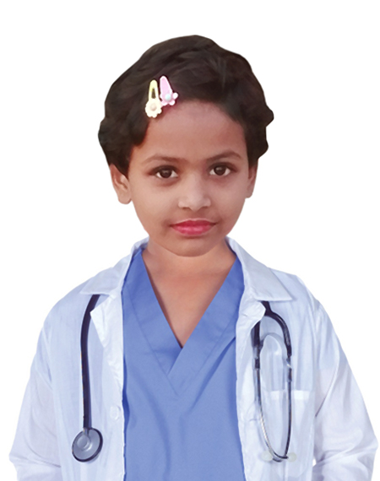
My family
I’m Tisha. I’m a student. I`m in class 3. There are four people in my family.

Slide 13
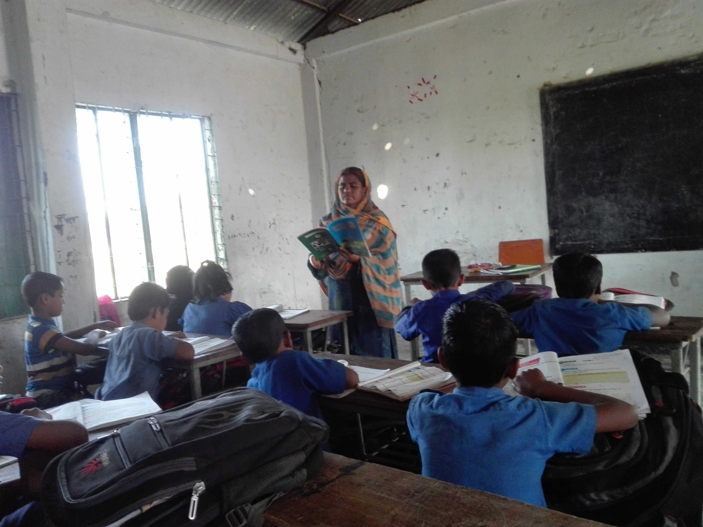
My family
My mother is a teacher.

Slide 14
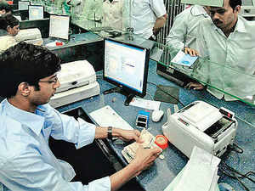
My family
My father is a banker.

Slide 15
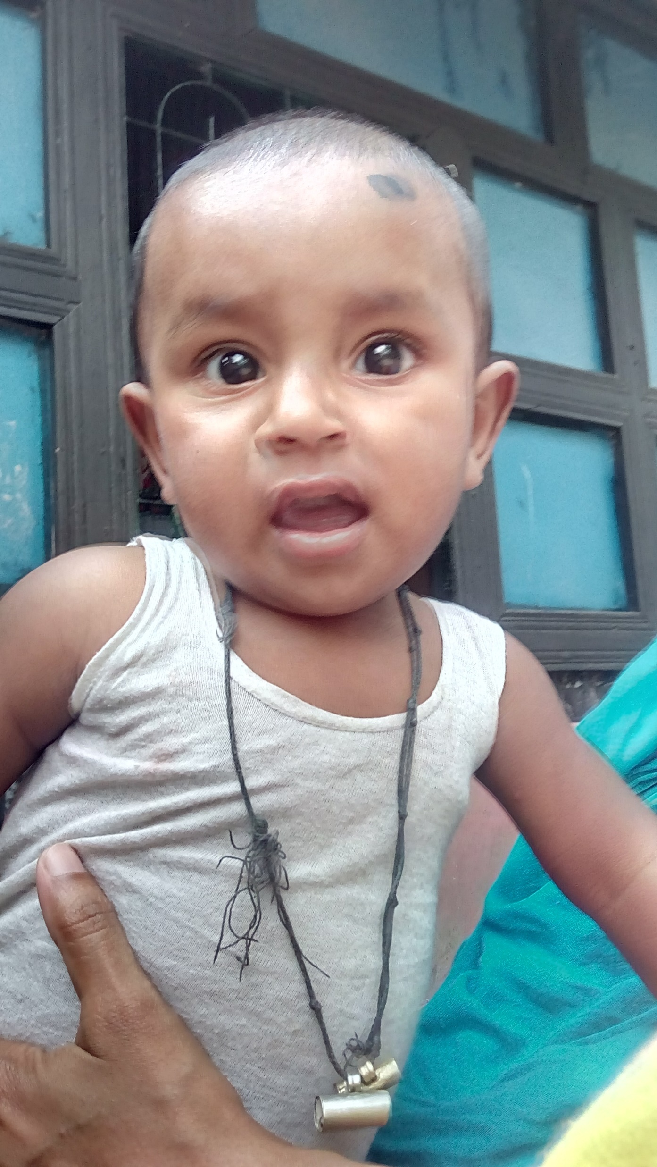
My family
My brother is two years old.

Slide 16
I’m Tisha. I’m a student. I`m in class 3. There are four people in my family. My mother is a teacher. My father is a banker. My brother is two years old.
What is the girl`s name?
What class is she in?
How many people are there in her family?
What does her mother do?
Where does her father do?
How old is her brother?
Answer
Please click answer button for answer
Answer
Pair Work
Answer
Time: 5 minute's
Answer
Answer
Answer

Slide 17
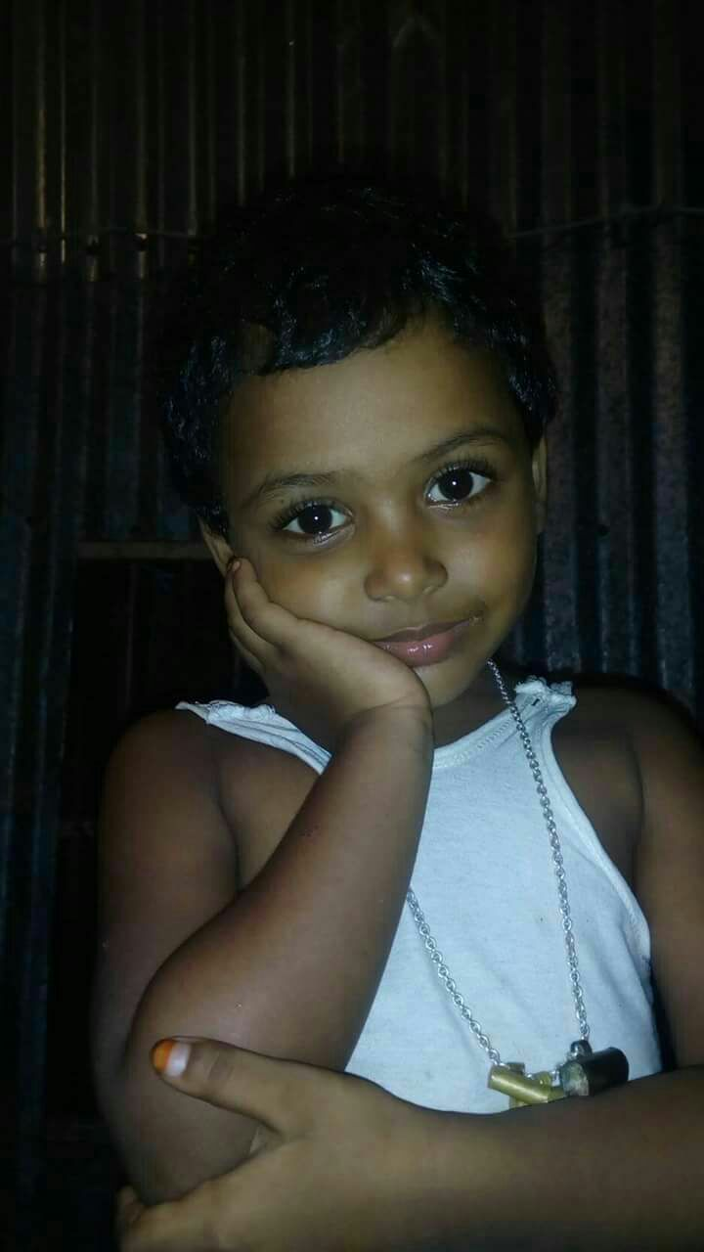
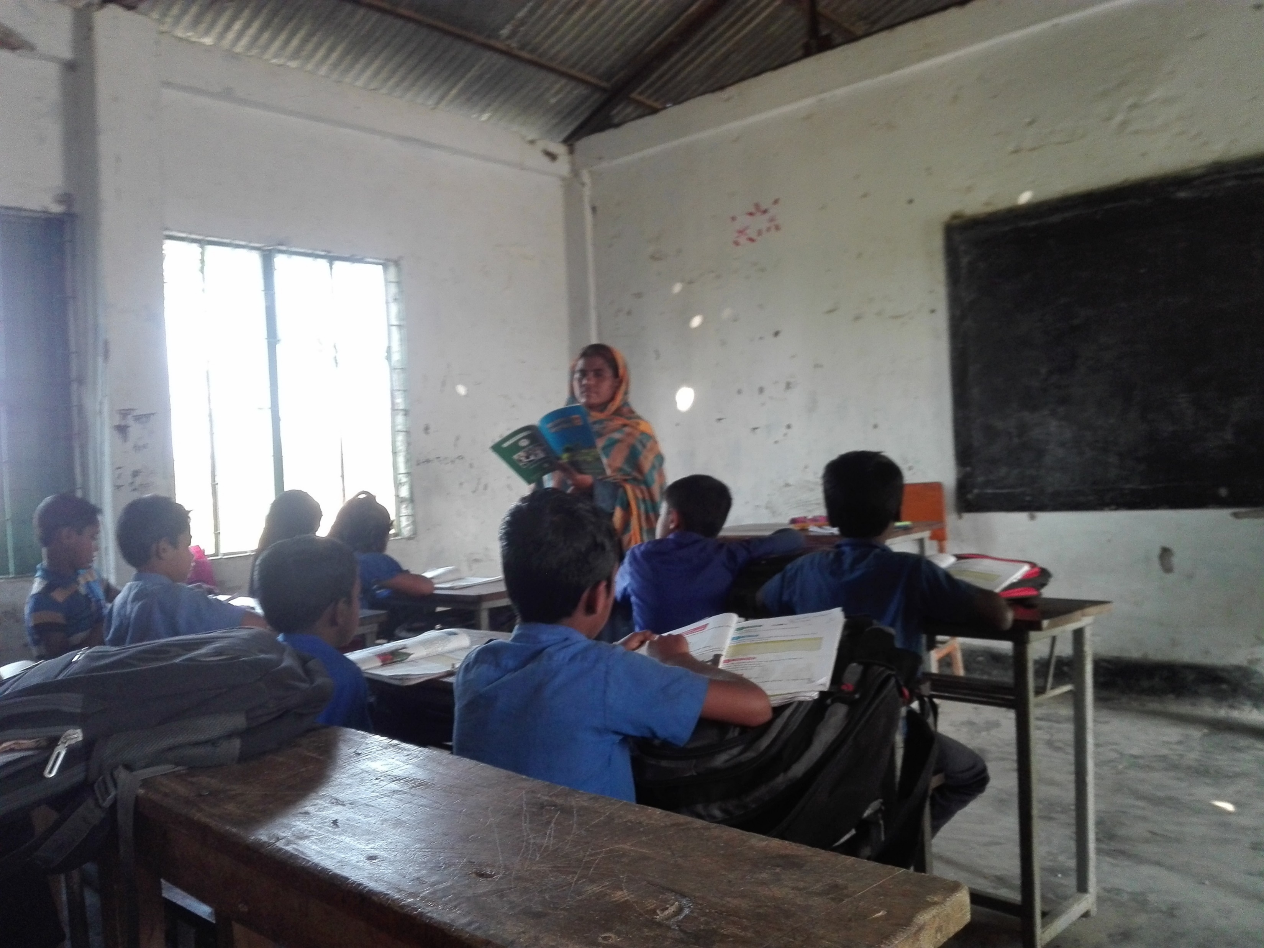
Group Work
Time: 10 minute's
Talk about Family:

Slide 18
Evaluation
Look attentively. Now we play a game. Everybody close your eyes.
Which word is missing?
Open your eyes.
Family
Teacher
Banker

Slide 19
Home Work
Write a paragraph about your family.
What is your name?
What class are you in?
How many people are in your family?
What does your mother do?
What does your father do?
Do you have brothers or sister?

Slide 20
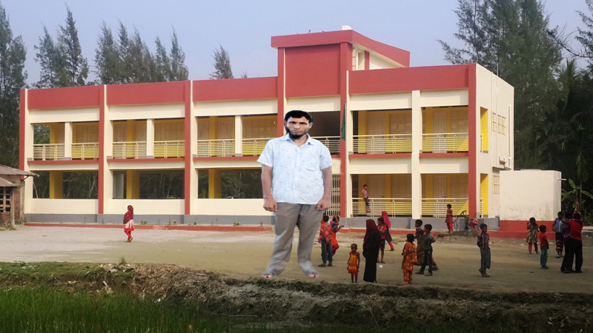
See you again, Bye.
০৫ নং দঃ জনারদন্দী সঃ প্রাঃ বিদ্যালয়

