Slide 1
TO
my multimedia class

Slide 2
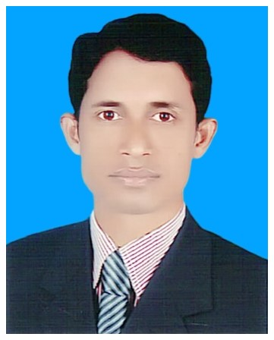
TEACHER
I
D
E
N
T
I
T
Y
LEASSON
Class:Five
Unit:3
Lesson: 1 & 2
Lesson title: Saikat’s family
Today’s lesson: Saikat’s family ……….tiger’s and lion’s.
Time :35 minute
Date:
Mohammod Abdul Hannan
Assistant teacher
Ashroygram Govt. Primary School
Kulaura, Moulvibazar.

Slide 3
Learning outcomes:
By the ends of the lesson the students will be able to ----
Listening:
1.1.1. recognize which syllable in a word is stressed.
Speaking:
1.1.1. say words. Phrases and sentence with proper sounds, stress, and intonation.
6.2.1. talk about the people.
Reading:
1.5.1. read words, phrases and sentences.
1.5.1. read the text silently for giving answer asked by teacher.
Writing:
1.7.1. to make sentence using words and phrases following instruction.

Slide 4
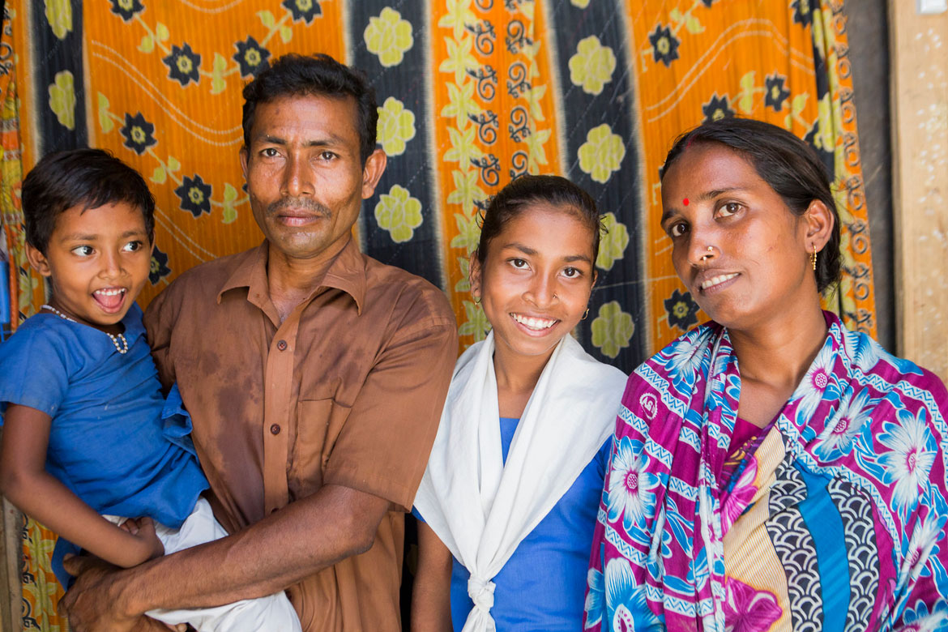
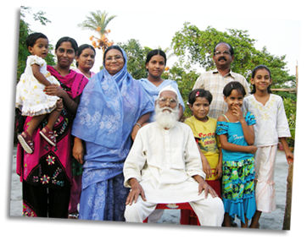
Look at the picture and think about these
What do we call these ?

Slide 5
Todays Lesson:
Saikat’s family

Slide 6
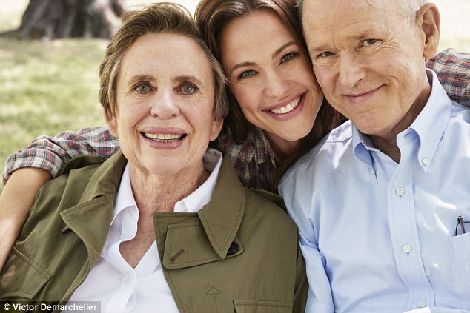
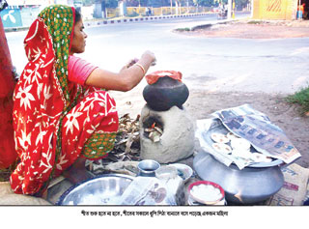
New words
Word
Meaning
Sentence
Parents
(Father and mother)
We should love our parents.
Housewife
(Housemother)
MY mother is a housewife.
Sew
(Stitch)
Saikat’s mother enjoys sewing.

Slide 7
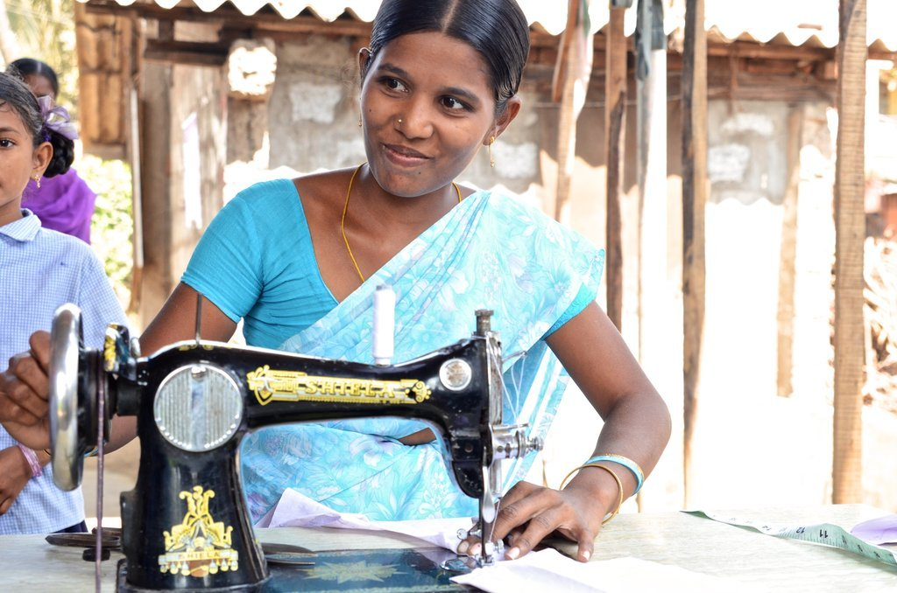
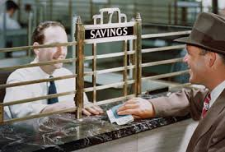
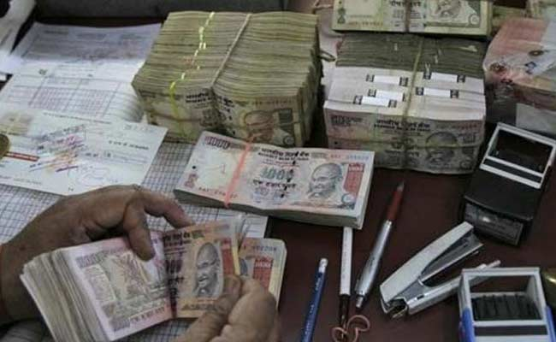
Sewing
Banker
She is Saikat’s mother
He is Saikat’s father

Slide 8
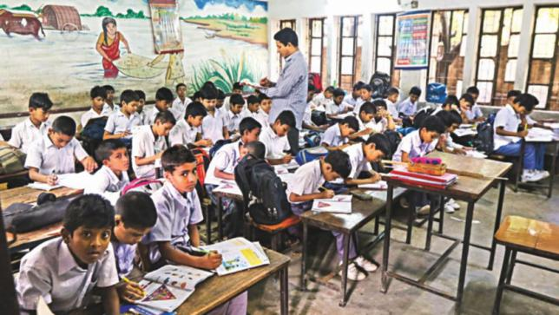
Teacher’ s reading

Slide 9
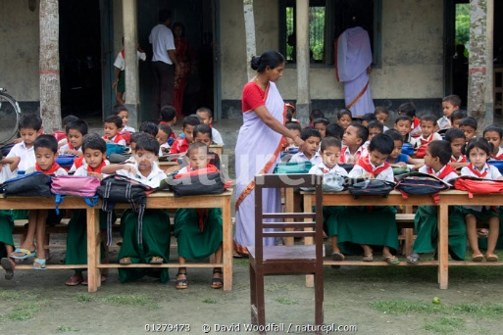
Students silent reading

Slide 10
Pair work
Ask and answer the question.
1.What is Saikat’s father’ name?
2.What is Saikat’s mother’ name?
3.What does Saikat do in his free time?
4.What kind of books does Saikat like?

Slide 11
Evaluation
Match with column A and column B
Column A | Column B
Clothes | Develop
Parents | Dresses
Free time | Father and mother
Improve | Leisure

Slide 12
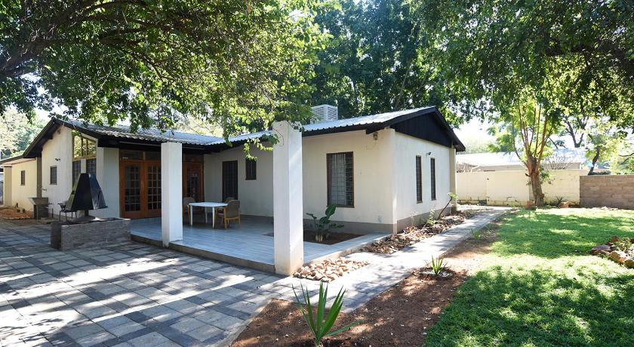
Home work
Write five sentences about your family.

Slide 13
See you the next class

