Slide 2
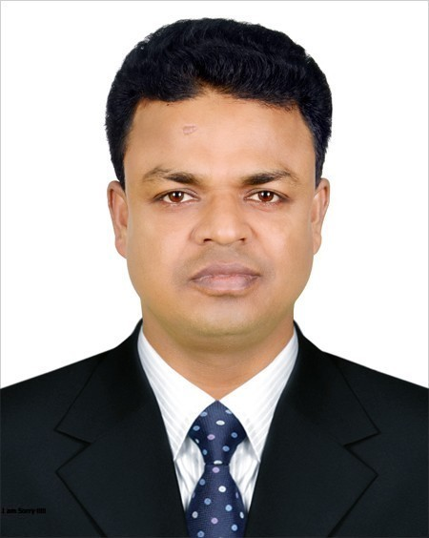
INTRODUCING
Md. Shakhawat Hossen
Assistant Teacher
Pakuria Government Primary School,
Singra - Natore.
E-mail: shakhawathossengps@gmail.com
Mobile: 01724025641
Class: Five
Subject: English for Today
Unit: 17
Lesson: Sport
Parts Of the lesson: Baichong: Do you…sport.

Slide 3
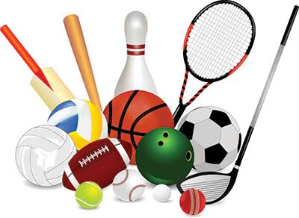
Learning outcomes
Students will be able…
1. to get some idea of varieties games.
2. to enrich their vocabulary.
3. to know correct form of verbs & use them in sentences.

Slide 4
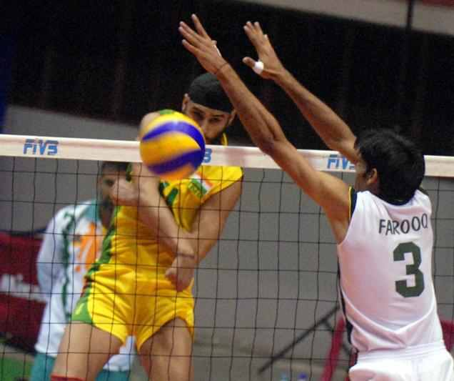
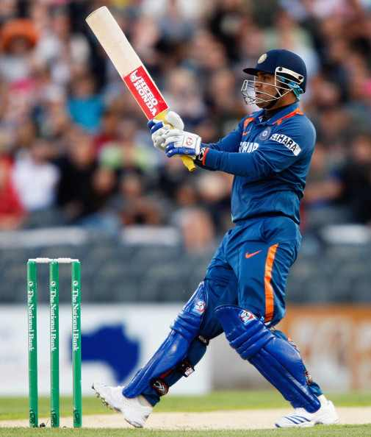
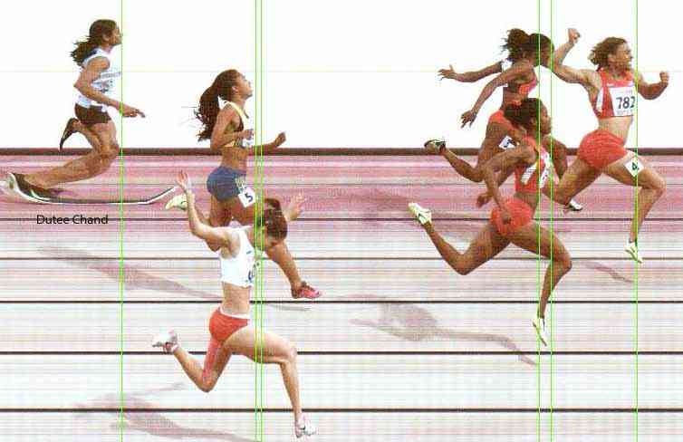
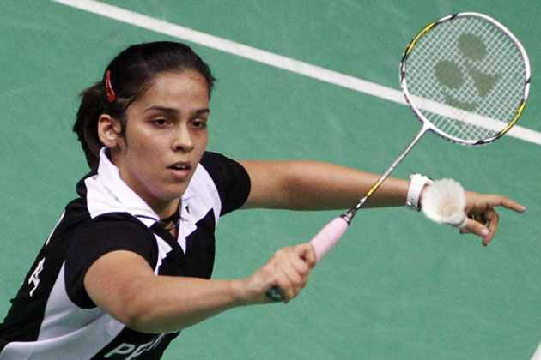
Look very attentively:
‘Sports’
What type of pictures have you seen?

Slide 5
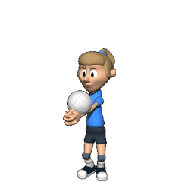
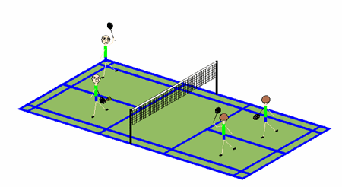
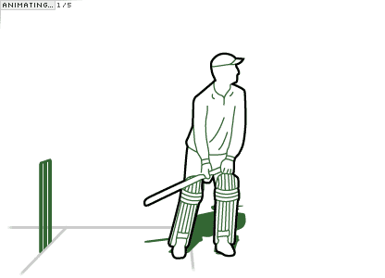
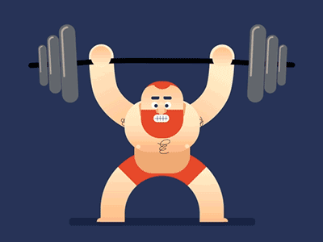
What type of sports do you like best ?
Do you play any sports ?
Different kinds of sports

Slide 6
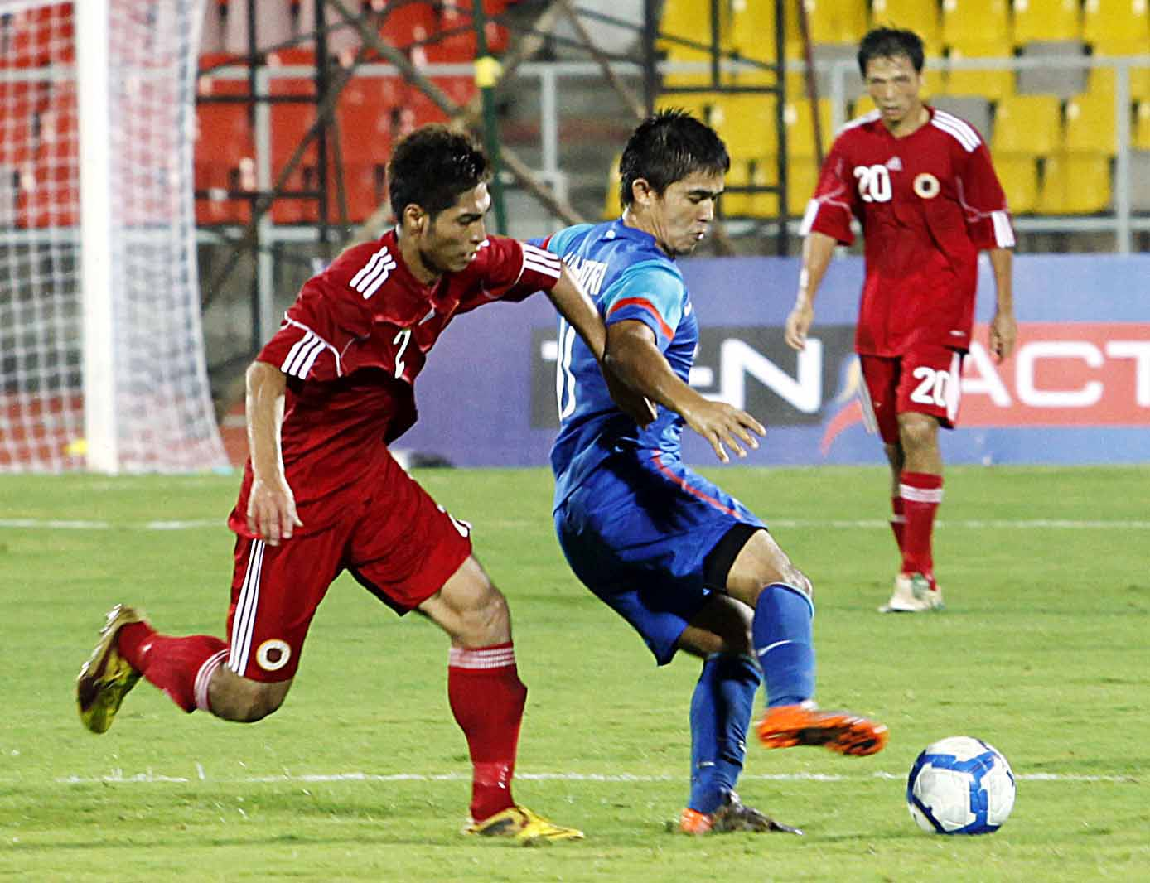
Today’s Lesson:
“What Sports Do you Like?”

Slide 7
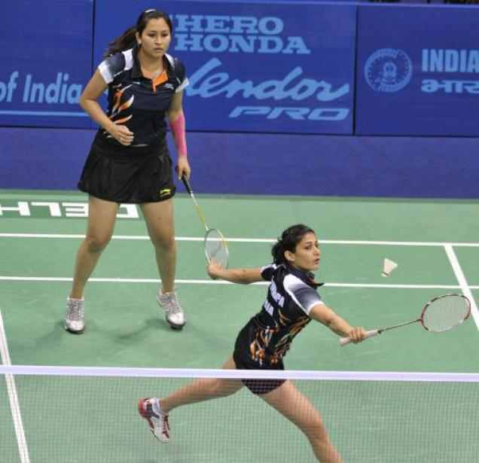
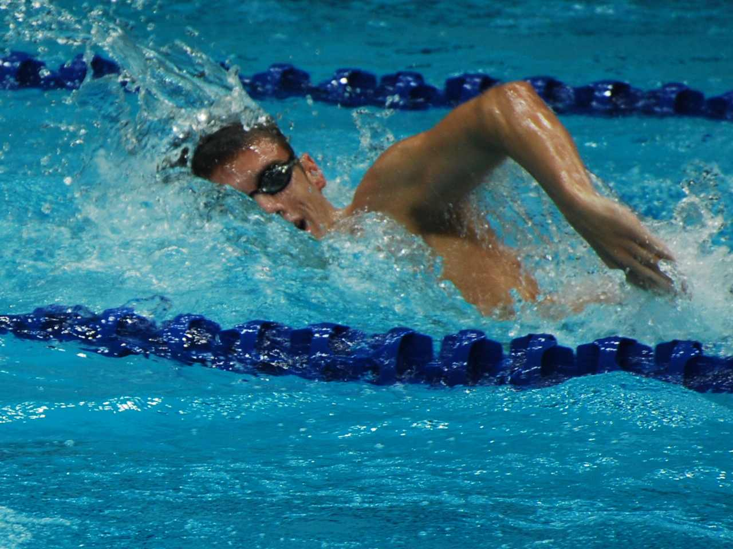
Look & say
Volleyball
Swimming
Badminton
Cycling

Slide 8
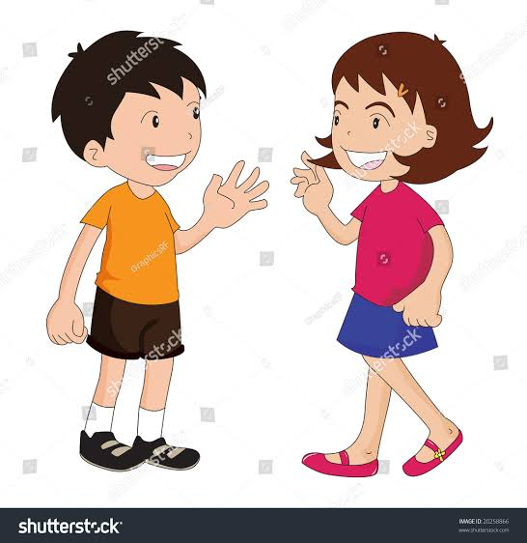
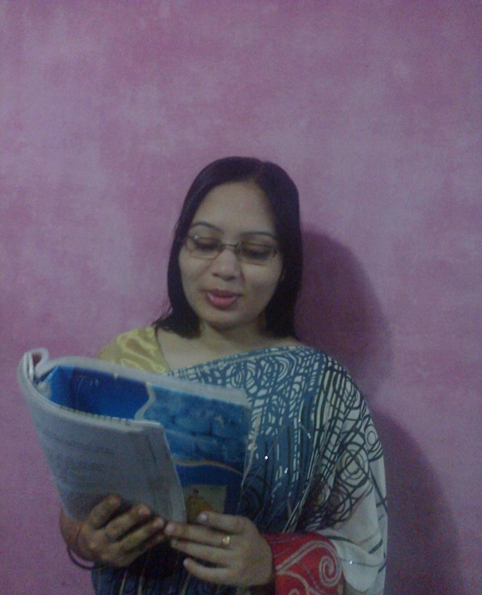
Text audio
Teachers loud reading & discuss the lesson

Slide 9
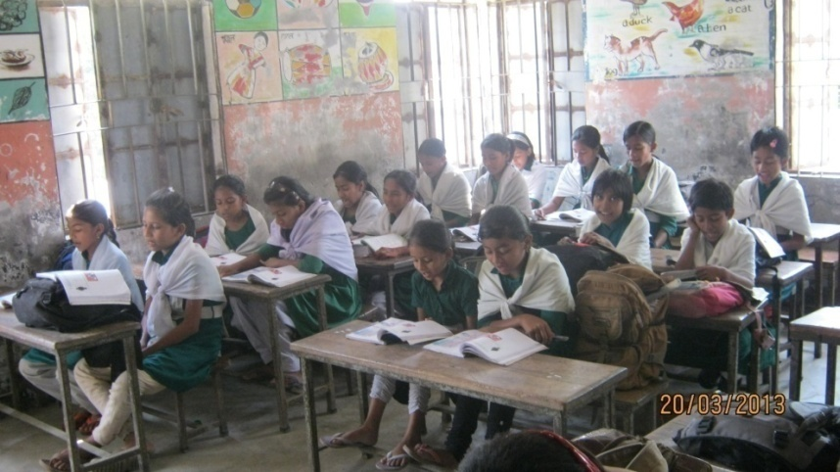
Students loud reading help by Teacher

Slide 10
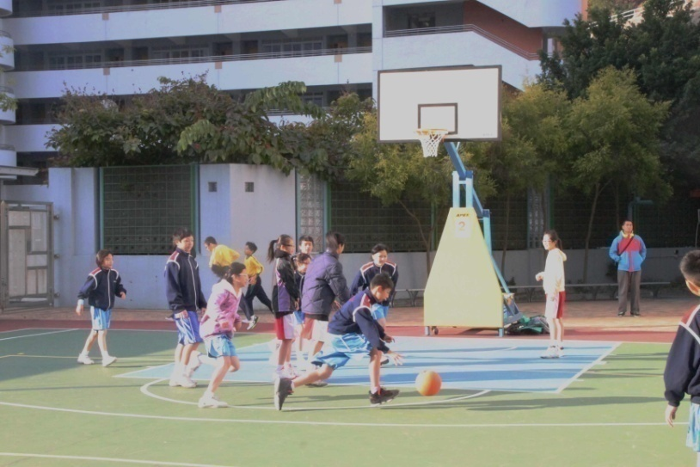
New words with sentences by using picture
Sports
Sports means play or game with other person.
Rana likes sports very much.

Slide 11
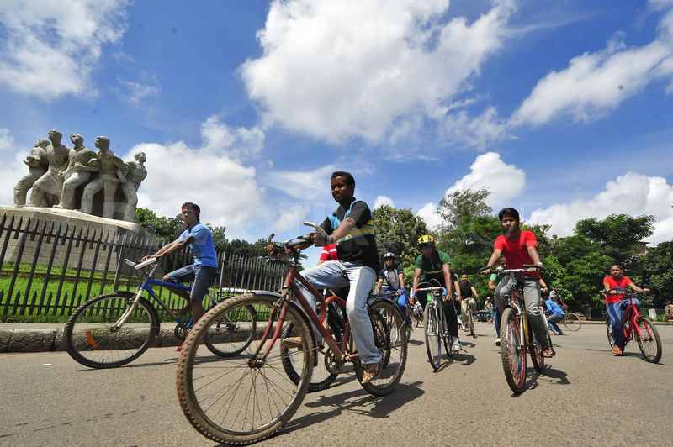
New words with sentences by using picture
Cycling
Ride on the cycle for competition.
Cycling is a very hard competition.

Slide 12
Let’s look and see the video attentively.

Slide 13
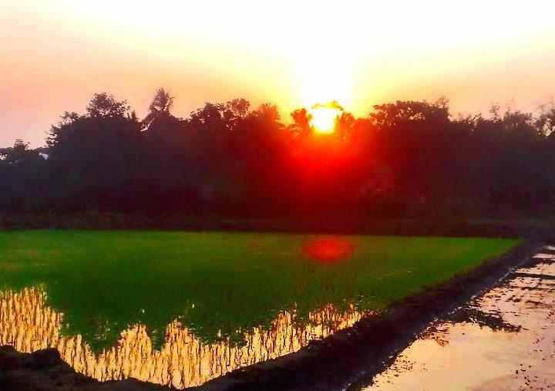
New words with sentences by using picture
Fantastic
This word express our good feeling about an object or person.
What a fantastic day!

Slide 14
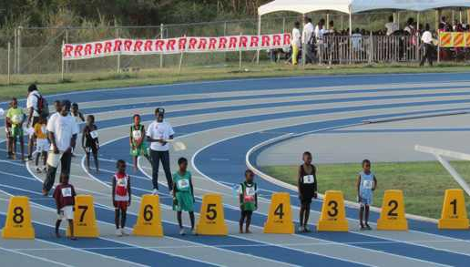
New words with sentences by using picture
Competition
It means contest the game for win.
I took part in race competition.

Slide 15
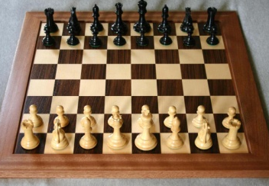
Answer the following questions.
ﬞTell name of five games of Bangladesh.
ﬞWhich game is very fantastic?
ﬞDo you like football and why?

Slide 16
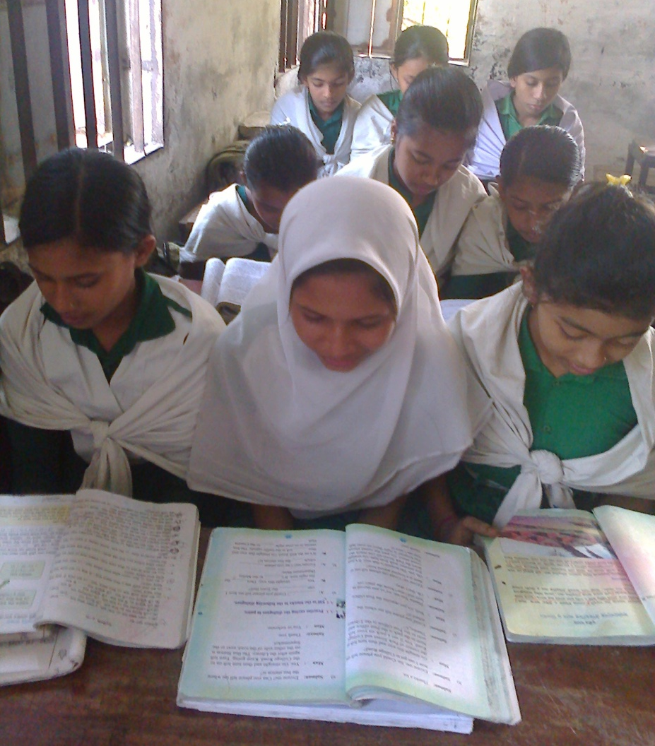
‘Silent Reading’

Slide 17
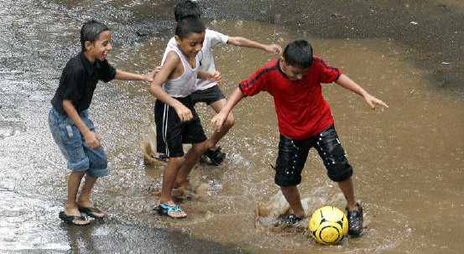
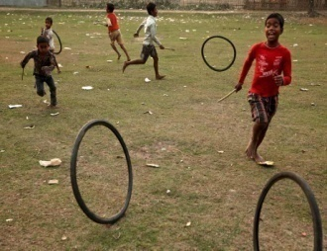
Choose the best answer:
What sport Anousha loves ?
1.
Kabadi
2.
badminton
3.
Cricket
4.
Football
Cycling is a very fantastic sport. Here the word ‘fantastic’ is
1.
adjective
2.
verb
3.
noun
4.
adverb

Slide 18
Make another five sentences use these words.
Cycling
Fantastic
Sports
Dislike
Junior

Slide 19
: Ask your partner what games or sports does he or she like? Use the following questions.
What games or sports do you play or like?
How often do you play/ watch it?
When do you do it?
Who do you play with?

Slide 20
Write five sentences about a popular game of Bangladesh.

Slide 21
Thank You

