Slide 1
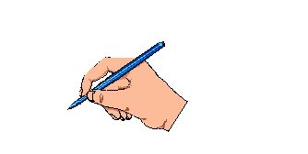
WELCOME

Slide 2
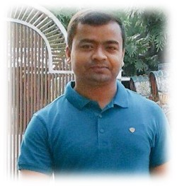
Purnendu Chakrabarty
Assistant teacher
Chandipur Govt PrimarySchool
Derai, Sunamgonj.

Slide 3
Do you want to see some pictures ?

Slide 4
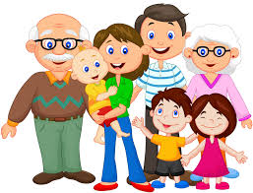
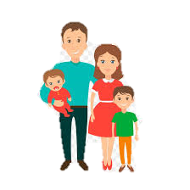
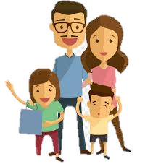
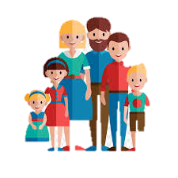
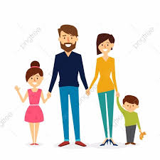
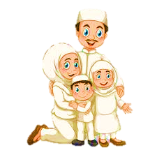
Alomgeer’s Family
Jasim’s Family
Dilip’s Family
Santana’s Family
Priti’s Family
Nazrul’s Family

Slide 5
Lessons’ Identity
Class – Four
Subject- English
Tittle: Sagar and his family.
Part of the lesson: Hi....................Delicious.

Slide 6
Learning outcomes
After the lesson the learner’s will be able to
Listening
Speaking
Reading
Writing
1
2
3
4
4.2.1. enjoy and understand about the text.
5.1.3. read about the text
8.1.1. to write answer of some questions.
6.2.2. talk about the text.

Slide 7
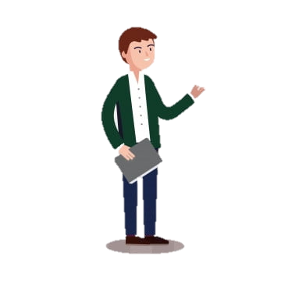
Now we are going to get acquainted with a few new words-

Slide 8
New words
Try again
Correct
Old
Year
Age
Click option

Slide 9
New words
Correct
Try again
Doctor
Physician
Who Teaches
Click option

Slide 10
New words
Correct
Try again
Wonderful
Amaging
Ordinary
Click option

Slide 11
New words
Correct
Try again
Neighbourhood
Yard
Surroundings
Click option

Slide 12
New words
Correct
Try again
Delicious
Bitter
Tasteful
Click option

Slide 13
New words
Correct
Try again
Grow
Generate
Buy
Click option

Slide 14
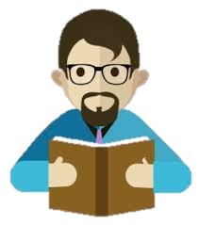
Teacher’s loud reading

Slide 15
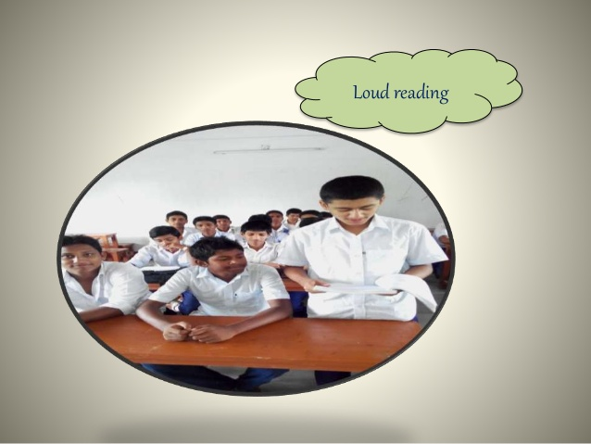
Students’ loud reading
loud reading

Slide 16
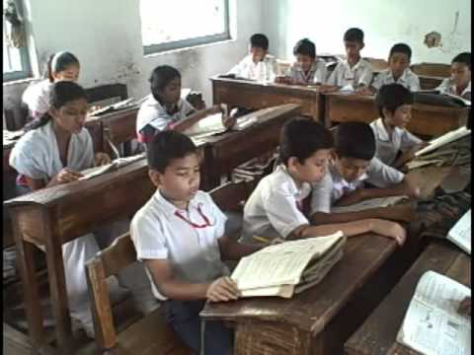
Students’ silent reading
Silent
Reading

Slide 17
How
Who
What
Where
Who
Group Work
Why

Slide 18
Assessment:
Write the following four questions:
1 | How old is Sagar ?
2 | Who is Keya?
3 | What Class does Sagar in?
4 | What is Sagar’s father?

Slide 19
THANK YOU

