Slide 1
welcome

Slide 2
Teacher’s introduction
Beauty talukdar
Assistant teacher
Horinogor govt primary school
Nabiganj ,Hobiganj

Slide 3
Class :two
Subject :English
Unit :22
Lesson’s :1-3
Time :45 minute

Slide 4
Good morning ,students.
Good morning , teacher.
How are you today?
Fine, and you?
Fine, thank you.

Slide 5
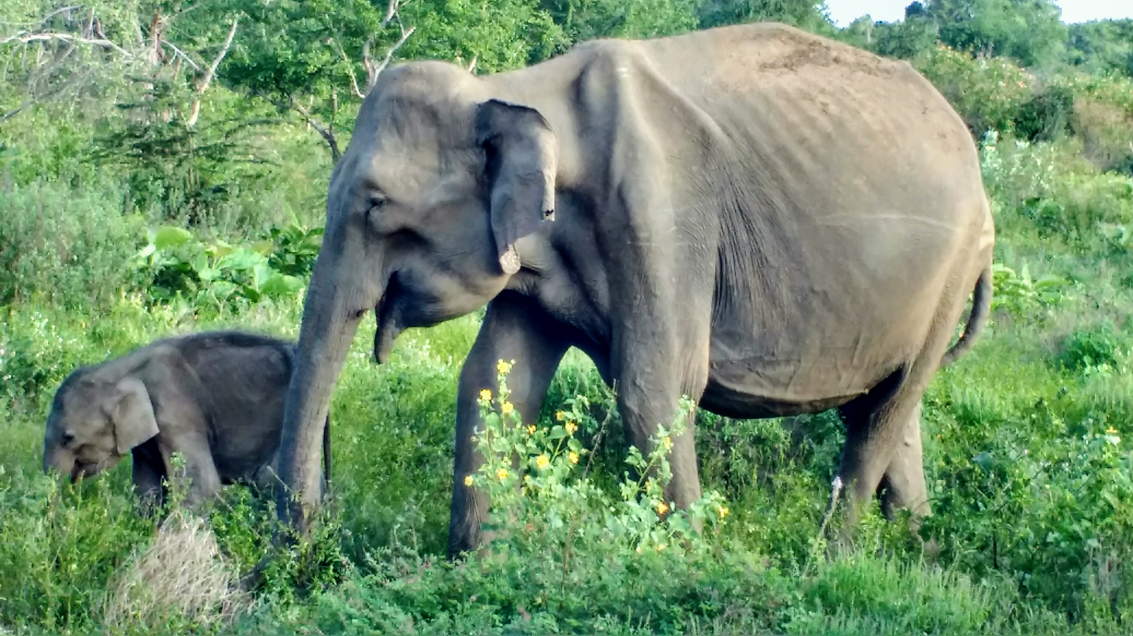
Look at the pictures

Slide 6
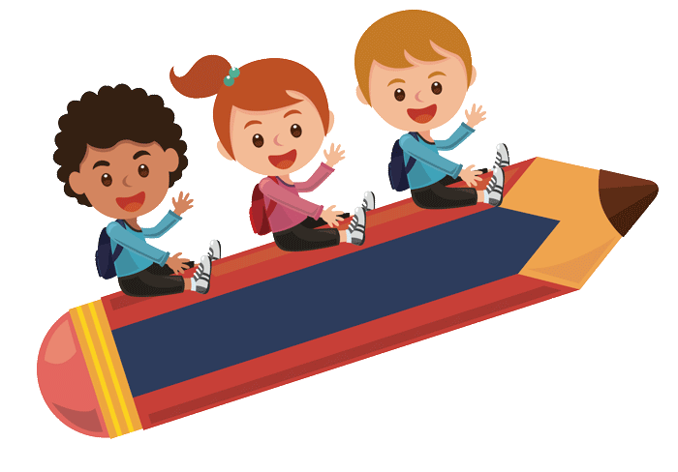
Size

Slide 7
Learning outcomes
Listening :
1.1.1 become familiar with English sounds by listening to common english words.
Speaking :
1.1.1 repeat after the teacher simple words and phrases with proper sounds and stress.
Reading :
1.3.1 recognize and read the names of objects having the same initial and final sounds.

Slide 8
Take your book
Open your book at page 44

Slide 10
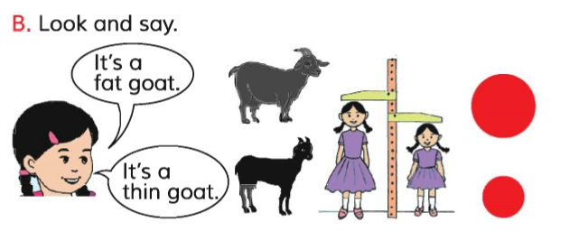

Slide 11
c

Slide 12
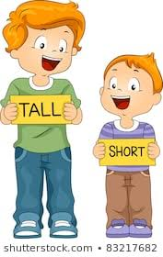

Slide 13
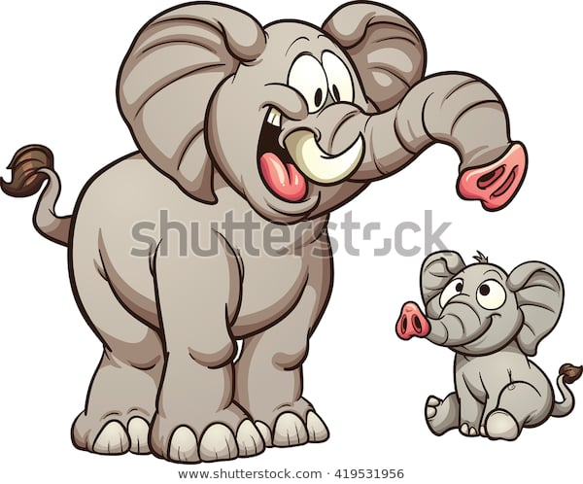
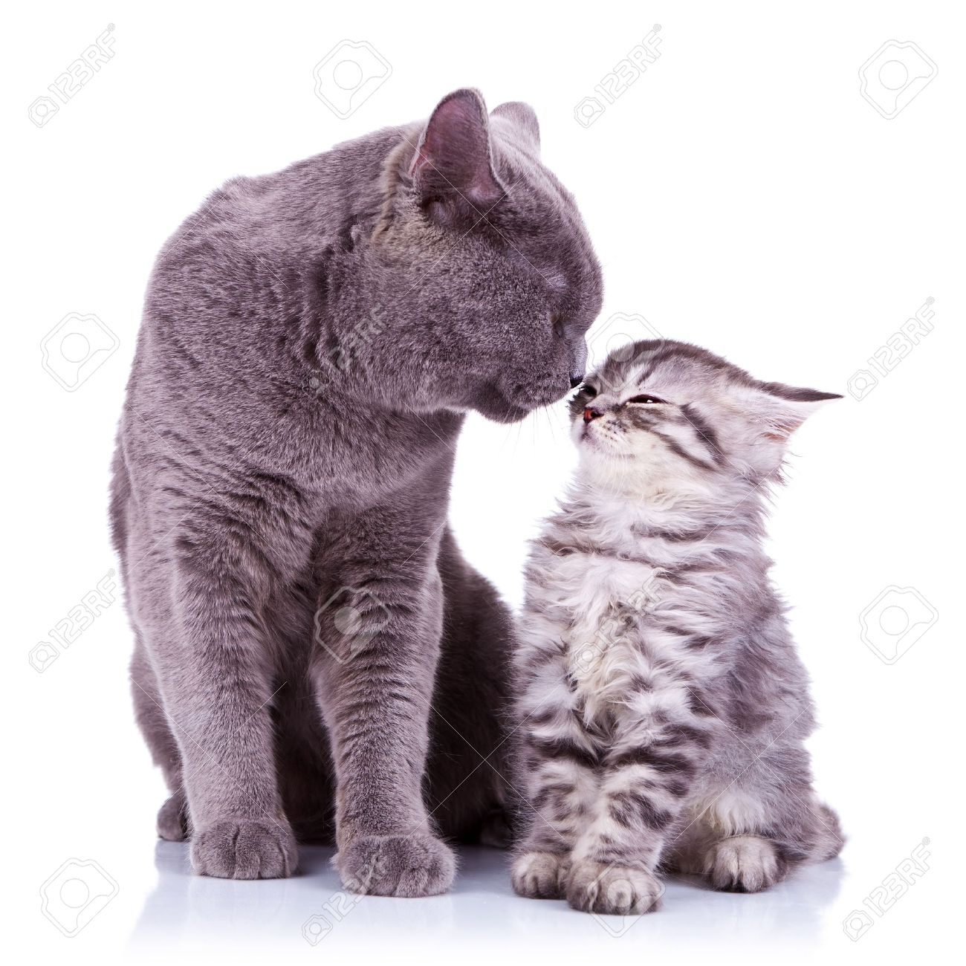
Look ,listen and say .

Slide 14
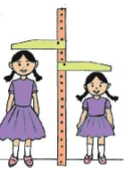
Group A :
Who is tall ?
Who is short ?
Group B ?
Which is big ?
Which is small ?

Slide 15
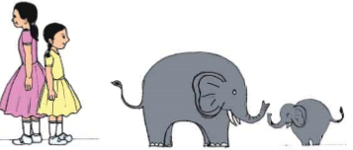
Evulation
Which is big?
Who is short?

Slide 16
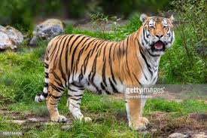
Home work
Which is big ?
Which is small ?

Slide 17
Thank you

