Slide 1
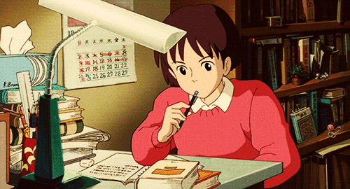
WELCOME

Slide 2
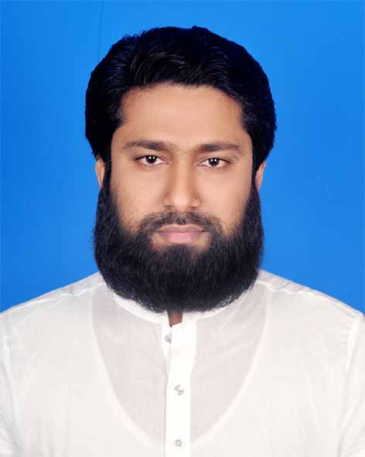
Presented by
M Humayun Kabir
English Teacher
Bhayeta Abdul Quddus Dakhil Madrasah, Tangail Sadar
Cell : 01727-425565 ; 01924-320532
E-mail : hkabir082009@gmail.com

Slide 3
Lesson Identity
Present Perfect Continuous Tense
Class Six
Unit Two
26 January 2020

Slide 4
Learning outcomes
After we have studied this lesson, we will be able to
know about the Present Perfect Continuous Tense.
make the questions and their answers on Present Perf Continuous.
give the name of sentences and
use them properly.

Slide 5
Let’s Check Our V1,2,3
Recite আবৃত্তি করা recited recite
Read পড়া read read
Study অধ্যয়ন করা studied studied
Learn লেখা learned / learnt learned / learnt
Teach শেখানো; শিক্ষা দেওয়া taught taught

Slide 6
11 WH Words
What - কী ?
Whom - কাকে ?
How - কীভাবে ?
Where - কোথায় ?
When - কখন ?
Why - কেনো ?
Who - কে ?
Who - কে কে / কারা ?
Which- - কোন- টি ?
Whose- - কার- টি ?
WH Prepositions - WH Prepositions ?

Slide 7
Perfect Continuous
P. P. Continuous : I have been reciting a poem for 10 minutes.
P. P. Continuous : I had been reciting a poem for 10 minutes.
F.P. Continuous : I shall have been reciting a poem for 10 mn.
have / has been Ving Time
had been Ving Time
shall / will have been Ving Time
For = যাবৎ / ধরে (for 3 hours/days)
Since = হতে / থেকে (since morning/2000 years)

Slide 10
Let’s Start our Today’s Topic

Slide 11
TOPIC
Present Perfect Continuous
Subject : English 2nd Paper
Lesson : 3 (Part-A)
Period : 3rd
Time : 50 minutes
Date : 26 January 2020

Slide 12
Let’s Try to Learn from the Video

Slide 13
Present Perfect Continuous
1.
I
have been
reciting a poem for 10 m. . =
আমি ১০ মি. ধরে একটি কবিতা আবৃত্তি করছি।
2. I
have not been
reciting a poem for 10 m. . =
আমি ১০ মি. ধরে একটি কবিতা আবৃত্তি করছি না ।
3.
Have
I been reciting a poem for 10 m. ? =
আমি কি ১০ মি. ধরে একটি কবিতা আবৃত্তি করছি ?
4.
Have
I not been reciting a poem for 10 m. ?=
আমি কি ১০ মি. ধরে একটি কবিতা আবৃত্তি করছি না ?
5.
What
have I been reciting for 10 m. ? =
আমি ১০ মি. ধরে কী আবৃত্তি করছি ?
6.
What
have I not been reciting for 10 m. ? =
আমি ১০ মি. ধরে কী আবৃত্তি করছি না ?

Slide 14
Let’s Name these 6 Sentences
According to
Primary Sentence (Structure)

Slide 15
01. Affirmative
(হ্যাঁবোধক)
02. Negative
(নাবোধক)
03. Interrogative
(প্রশ্নবোধক/ হ্যাঁবোধক প্রশ্ন)
04. Negative-Interrogative
(নাবোধক-প্রশ্ন)
05. WH Interrogative
WH (প্রশ্নবোধক/ হ্যাঁবোধক প্রশ্ন)
06. WH Negative-Interrogative
WH (নাবোধক-প্রশ্ন)

Slide 16
Assessment-1
Dear Students ! Tell me-
How many questions are there ? Who are they ?
Answer those questions.

Slide 17
Let’s Build up our Career. But how… ?
Let’s Get by Heart and Practise these 6 Sentences
With 101 Verbs (V123)

Slide 18
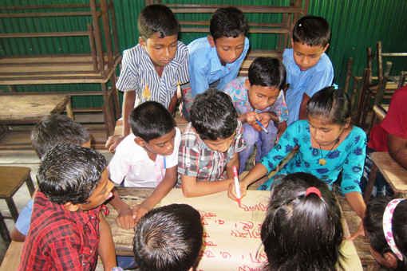
Group Work
Make 6 sentences on Present Perfect Continuous with following verbs-
Learn
Eat
Teach
Write
Draw

Slide 19
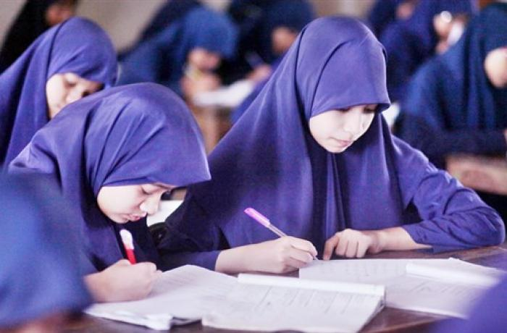
Individual Work
Make Present Perfect Continuous with following verbs using objects.
Do
Take
Drink
Like
Invite

Slide 20
Assessment-2
Open your Text Book and find out the
Present Perfect Continuous Tense.

Slide 21
Home Task

Slide 22
Home Task
Remember our class at a glance
and try to find out the
Present Perfect Continuous
in your text books and journals
And make a list.
1. Text Book (English for Today)
Newspaper (The Daily Star / Others)

Slide 23
Thank You All
May Allaah swt learn and expert in the Present Perfect Continuous Tense.

