Slide 2
Identity
Hemia Afrin
Assistant Teacher
Digholia (south) Govt. Primary school.
Digholia,Khulna.
Email : hemia1922@gmail.com

Slide 3
Introduction of the lesson
Class: Two
Subject: English For Today
Unit-2
Topic- Alphabet.
Lesson- (4-6).A. Look,listen and say.
(Ff----Jj)

Slide 4
Learning Outcomes:
Students will be able to--------
Listening:1.1.1 become familiar with English sounds by listening to common English words.
Speaking: 1.1.2 say simple words and phrases with proper sounds and stress.
Reading:1.2.1 recognize and read the alphabet both small and capital letters( non-cursive)
1.3.1recognize and read the names of objects having the same initial and final sounds.

Slide 5
Video

Slide 6
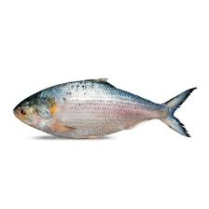
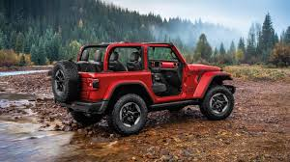
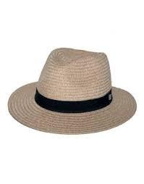
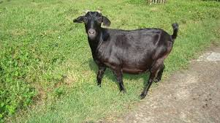
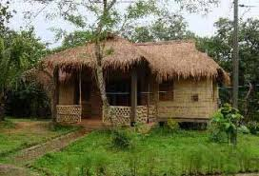
What we see in the pictures?

Slide 7
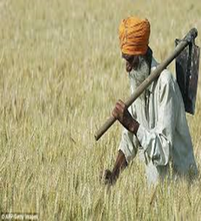
Look, listen and say.
F f
farmer

Slide 8
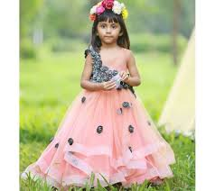
Look,listen and say.
Gg
girl

Slide 9
Look,listen and say
Hh
hut

Slide 10
Look, listen and say
J j
jeep

Slide 11
Look, listen and say.
I i
igloo

Slide 12
Evaluation

Slide 13
Group Work
Match the words with picture
Hat
Ice-cream
goat
fish
jug

Slide 14
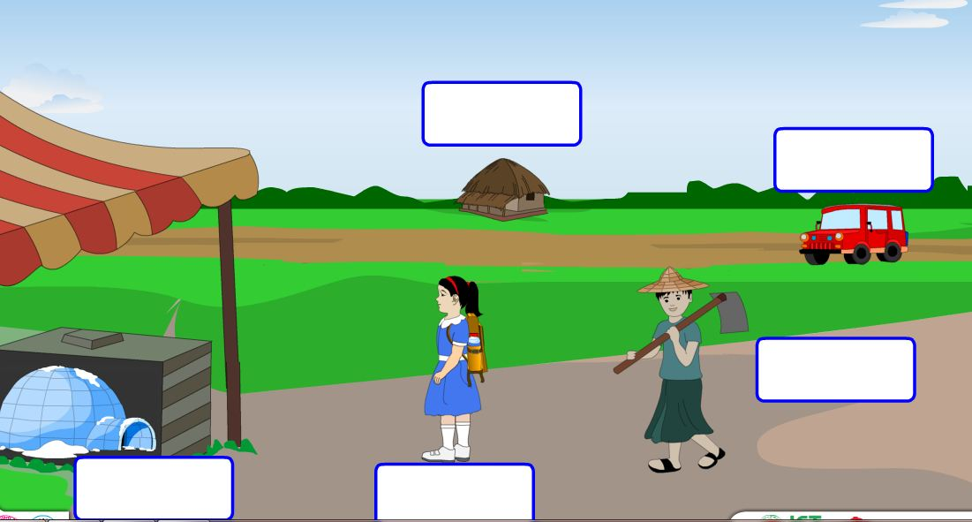
Group work
Fill in the box.
Hut
Jeep
igloo
Farmer
girl

Slide 15
Thanks Everybody

