Slide 1

Welcome
To my class

Slide 2

INTRODUCE
Md. Ikramul Haque
B.Sc, M.A in English
Assistant Teacher( English)
Mirzapur Islamia Dakhil Madrasah
Dapunia, Pabna sadar, Pabna.
E-mail: mirzapur_madrasah@yahoo.com
01716845666
Class viii
Sub: English 1st
Time 50 minute

Slide 3
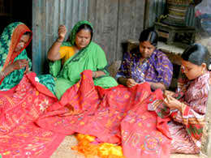
Look at the picture and tell what is the picture about?
The women are making kantha

Slide 4
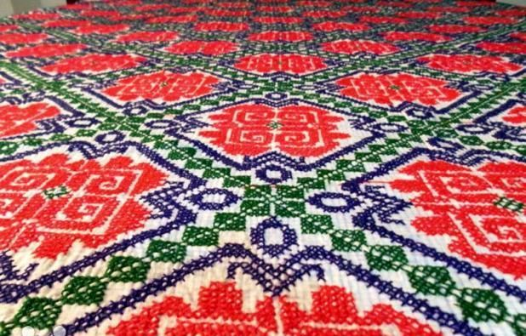
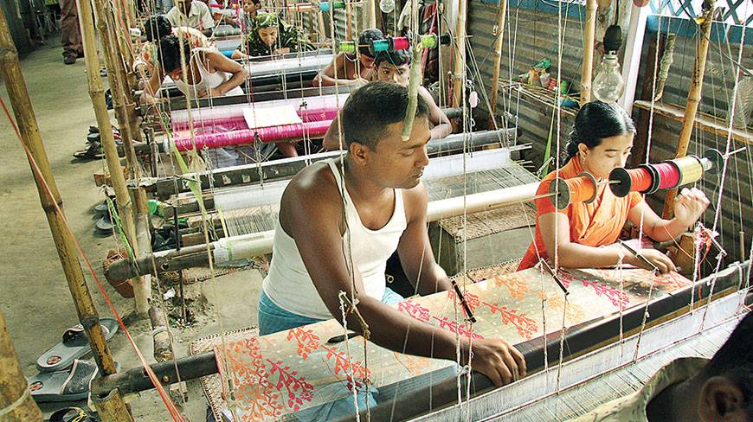
Now look at these pictures.
What is this ?
What are they doing?
This is NAKSHI KANTHA.
They are making naksha.

Slide 5
To day we are going to discuss about
NAKSHI KANTHA
Unite-1
Lesson-2

Slide 6
Learning out comes
After reading the lesson the learners will be able to:-
Describe some specific informations.
Read and understand text through silent reading.
and answer the questions.
Describe the Bangladeshi ‘Nakshi kantha’.

Slide 7
A.Look at the picture. work in pairs.
Talk about the picture and answer the following the questions.
1.What do you see in the picture?
2.Have you seen it before?
3.What kind of craft is it?

Slide 9
Text analysis
NAKSHI KANTHA
Nakshi kantha is a embroidered quilt. the name was taken from the Bengali word ‘naksha’ which means artistic pattern.It is kind of traditional craft.The name ‘nakshi kantha’ became popular after the poet Jashimuddin’s poem’ Nakshi kanthar math’ was published in 1929.

Slide 10
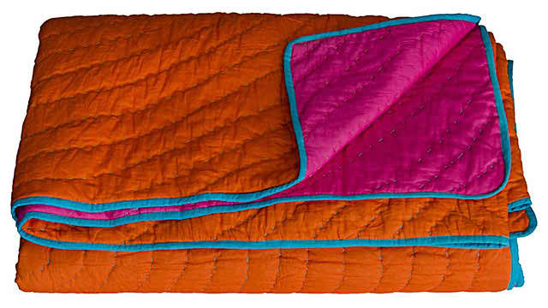
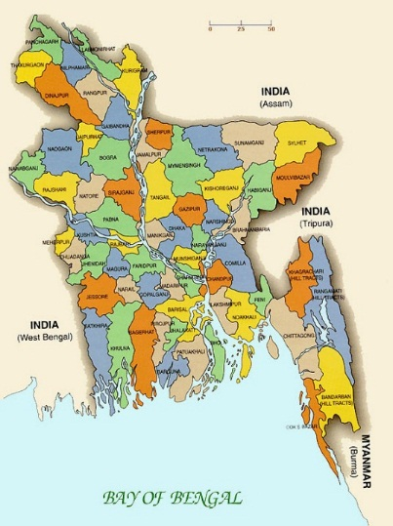
Let us learn some word meaning.
Nakshi kantha
A kind of embroidered quilt.
Native
Indigenous

Slide 11
Design
Naksha
Make
Build

Slide 12
Now complete the sentences with the clues given below:-
Bengali, patterns ,embroidered ,fashion, designs ,commerercially, noksha,handicrafts.
1.Nakshi kantha is a kind of ............quilt
2.The name of taken from a.............word.............
3.Nakshi kanthas are now sold in.......shops.
4.nakshi kanthas are in great demand because of their colourful........and.........
5 Now it is produced............
Answers:-
1)embroidered
2)Bengali , noksha.
3)handicrafts
4)patterns, designs
5)commercially

Slide 13
Choose the best answer from the alternatives:-
a) Nakshi Kantha is a -----kind of kantha.
i)Normal ii)special iii)ordinary iv) simple
ii)special
b)The word “indigenous” refers to----
i) Foreign ii)native iii)hand-made iv)all the above
ii) native
c)Naksha means-------
i)Artistic pattern ii) traditional pattern iii)ancient pattern iv)modern pattern
i)Artistic pattern

Slide 14
d)The art has been practised in ------ for centuries.
i) Town ii) elite society iii)rural Bengal iv) village market
iii)Rural Bengal
e)Nakshi Kanthar Math was published in -----
i)1930 ii) 1929 iii) 1928 iv) 1927.
ii)1929

Slide 15
Guess the meaning of the following words and choose the correct meaning closest to the text:-
a)traditional
i)Conventional ii) rule iii) custom iv) convention.
it)conventional
b) artistic
i) Arts ii)of art iii) fine iv) nice.
ii)Of art
c)pattern
i) Decoration ii) mark iii) embellishment iv)design.
iv)design

Slide 16
d)produce
i)Give ii)create iii) supply iv) provide
ii)create
e) famous
i)big ii) renowned iii)famine iv) fume
ii) renowned

Slide 17
Evaluation
i) What is Nakshi Kantha?
ii) Where was the name taken from?
iii)What are used to make Nakshi Kantha?

Slide 18
Home work
Write the summary of the text in around 50 words.

Slide 19

Thanks
Everybody

