Slide 1
Hi! I am Mostafa Kamal Assistant Teacher. Govt: Primary School.
Welcome
All of you today’s Class

Slide 2
Presented By
Mostafa Kamal
Assistant teacher
Shikri Govt: Primary School

Slide 3
Todays Lesson
Class-One
Lesson- 4
Alphabet Part-A,A1

Slide 4
Learning outcomes
By the end of the lesson student will be able to
1.1.1 repeat after the teacher simple words
and phrases.
1.1.2 say simple words and phrases.
Reading :
1.2.1 recognize and read the alphabet both
small and capital. (non-cursive).

Slide 5
What do you see ?
F
G
H
J
I
ALPHABET

Slide 6
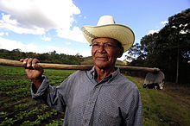
Let us see some picture!
F
Farmer

Slide 7
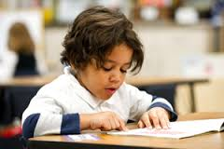
G
Girl

Slide 8
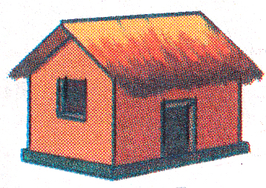
H
Hut

Slide 9
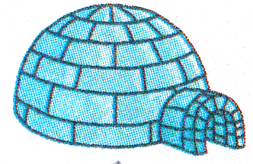
I
Igloo

Slide 10
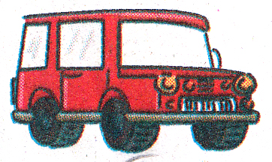
J
Jeep

Slide 11
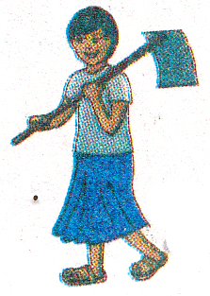
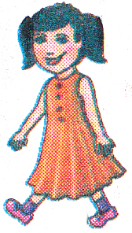
Farmer
Girl
Hut
Igloo
Jeep

Slide 12
What is for what?
F =
Farmer
G =
Girl
H =
Hut
I =
Igloo
J =
Jeep

Slide 13
Please open at page -15
Teacher’s Reading

Slide 16
Farmer
Girl
Hut
Igloo
Jeep

Slide 17
Hut
Jeep
Igloo
Girl
Farmer
Notes:
Missing Game

Slide 18
See you in the next class
THANKS

