Slide 1
Welcome

Slide 2
Md. Akter Hossain
Assistant teacher
Bhobani Caron Roaja Para Govt Primary school
Matiranga, Khagrachari

Slide 3
Subject Identity
English For Today
Class: Three
Unit: 9
Lesson: 1-3 ( A)
Time: 45 minutes
Date: 28 /01/ 2020

Slide 4
Learning outcomes
Students will be able to:
Listening 2.1.1 carry out commands and instructions.
Speaking: 1.1.1 repeat words, phrases and sentences after the teacher with proper sound and strees.
1.1.2 say words, phrases and sentences with proper sound and strees
Reading: 6.1.1 read instructions and carry them out.

Slide 5
Let’s listen the audio and sing.

Slide 6
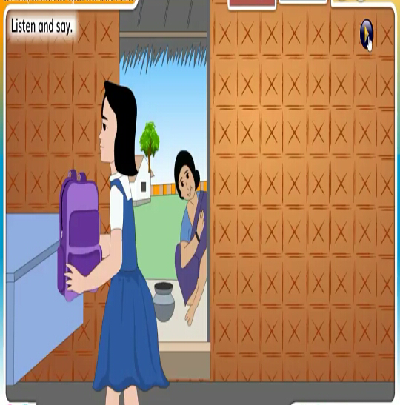
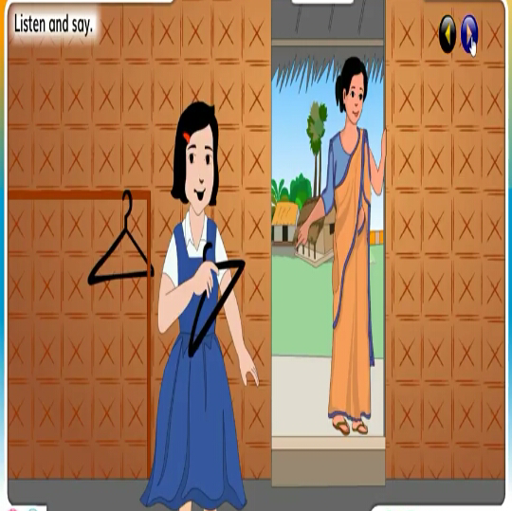
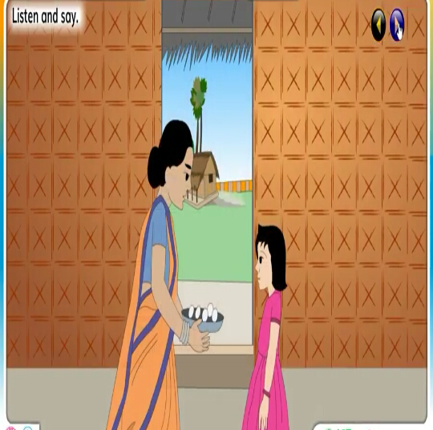
Let’s see the pictures.

Slide 7
Todays lesson
Commands, instructions and requests: at home and at school.

Slide 8
Put your bag down.

Slide 9
Change your clothes.

Slide 10
Help me in the kitchen.

Slide 11
Wash these eggs, please.

Slide 12
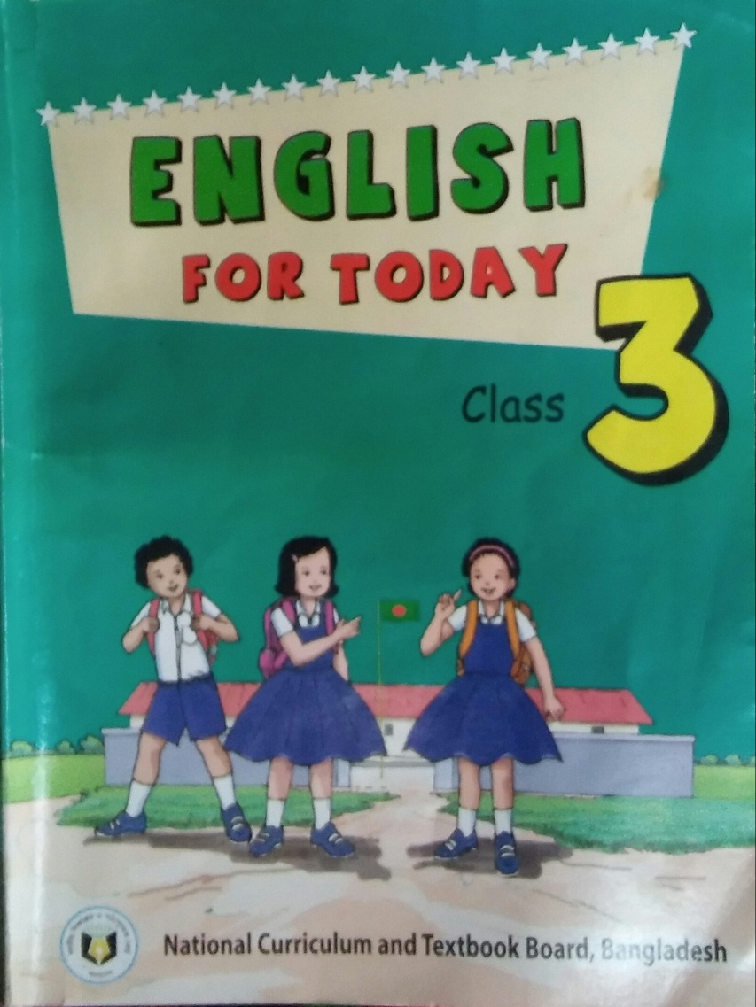
Open your book at page 19.

Slide 13
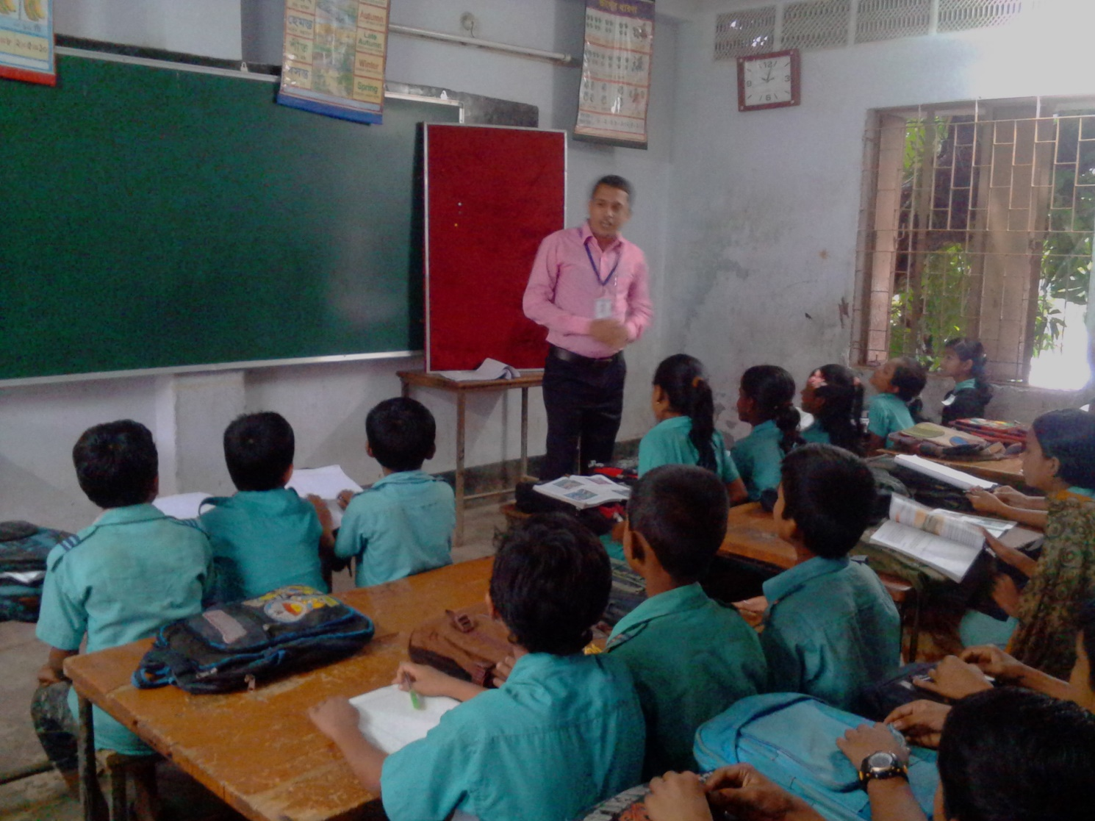
Teacher’s reading.

Slide 14
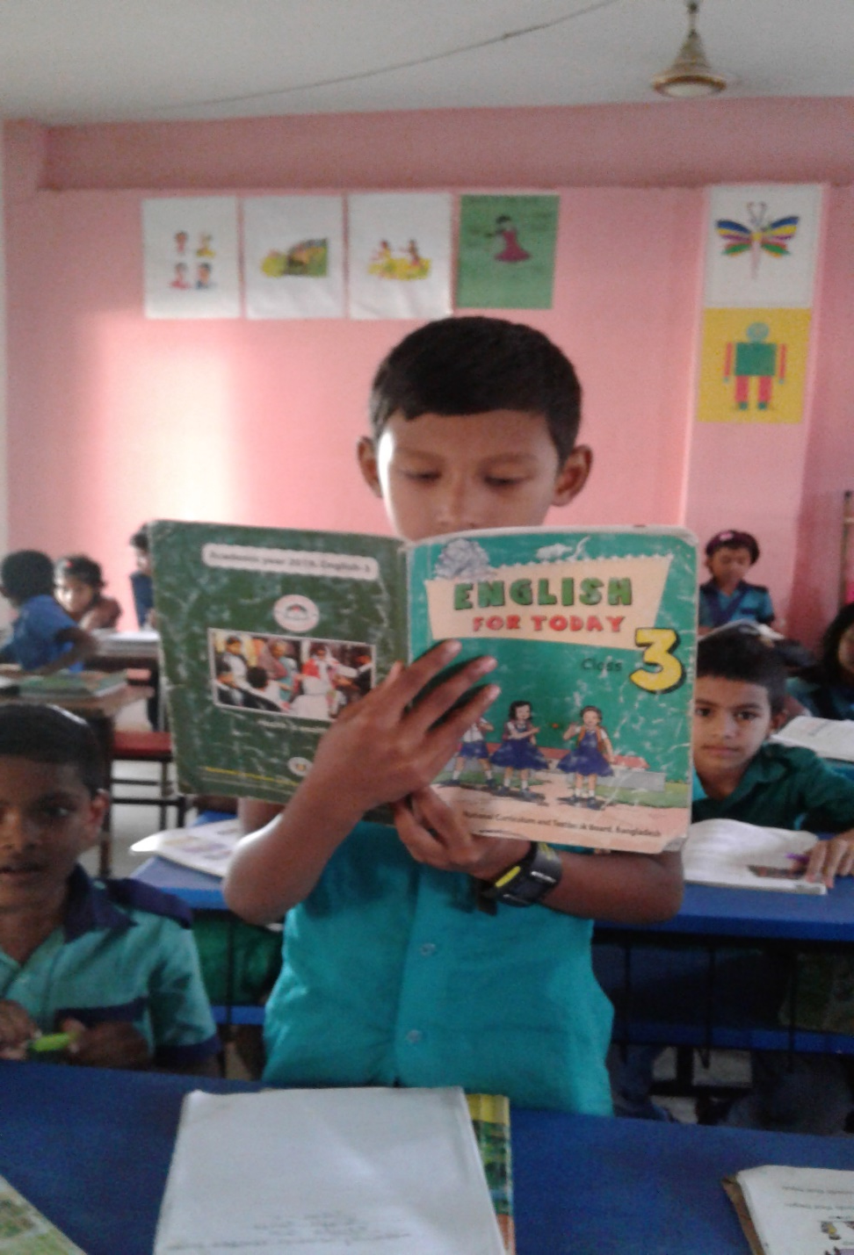
Student’s reading.

Slide 15
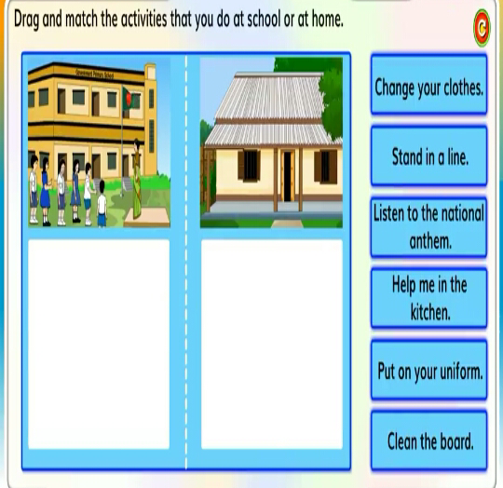
Group work.
Change your clothes.
Stand in a line.
Listen to the national anthem.
Help me in the kitchen.
Put on your uniform.
Clean the board.

Slide 16
Which sentences do you do at home?
Pair work.
Stand in a line.
Change your clothes.
Help me in the kitchen.
Listen to the national anthem.
Put on your uniform.
Clean the board.

Slide 17
Pair work.
Which sentences do you do at school?
Stand in a line.
Put on your uniform.
Listen to the national anthem.
Change your clothes.
Clean the board.
Help me in the kitchen.

Slide 18
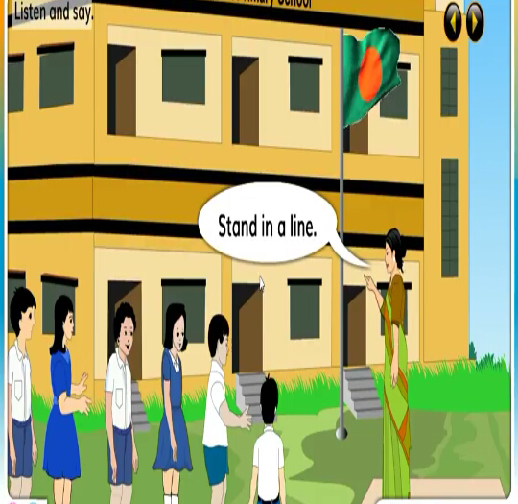
Evaluations.
Look at the picture. Say commands, instructions and requests.

Slide 19
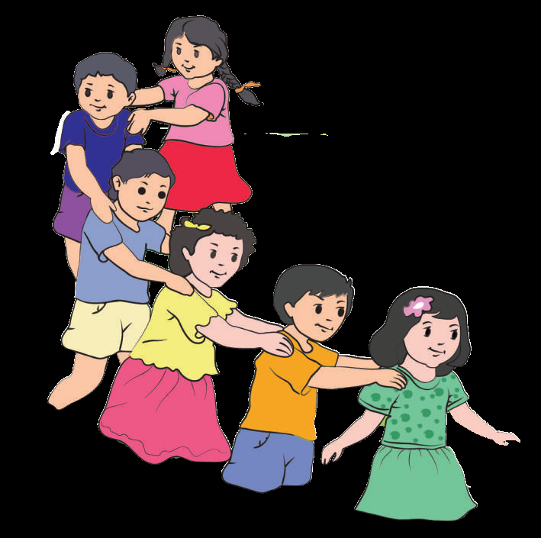
Good bye

