Slide 1
WELCOME TO ENGLISH CLASS

Slide 2
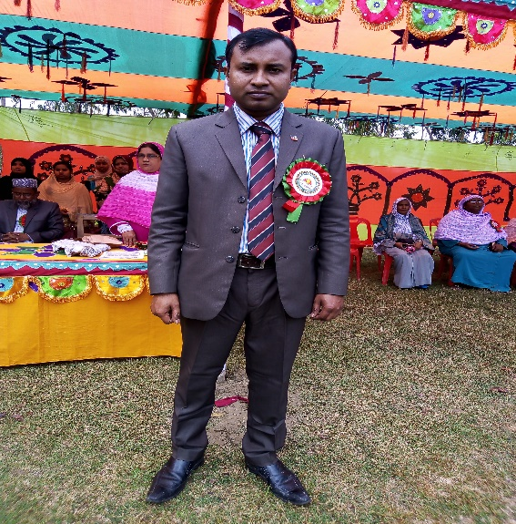
Md. Saifuddin Khan,
Lecturer in English, Hazi Goyes Uddin Mohila Fajil Madrasah, Bahngura, Pabna.
Mobile:01710-449379
Email:skhan84bd@gmail.com
Class:Xi English 1st Paper
Time:45 Minute
Date:

Slide 3
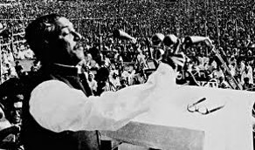
Do
You
Know
The
Man
?

Slide 4
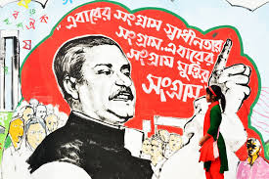
What do the above mentioned pictures remind us ?

Slide 5
Our Today’s topic is
The Unforgettable History
Bangabandhu’s historic 7 March speech in 1971.
Unit :1 , Lesson :1

Slide 6
Learning outcomes
After reading the lesson, students will be able to
Narrate the importance of historic 7 March speech in 1971 .
Say about different events that happened between in 1952 to 1971.
Write Bengal’s painful history under Pakistani rule.
Explain the necessity of “Independence War’’ in 1971.

Slide 7
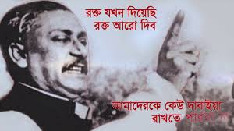

Slide 8
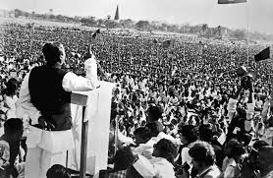
The struggle this time is a struggle for freedom– the struggle this time is a struggle for emancipation.

Slide 9
Single work
1.The word crimson mean …..
1.Reddish (ii) white (iii) blue (iv) green
2.Ayub Khan declared Martial Law…..
(i)In 1954 (ii) in 1966 (iii) in 1965 (iv) in 1958
3. In 1966 a movement was launched named ….
(i) six point demand (ii) language movement (iii) Martial Law (iv) assembly
4. He has even blamed the Bengali people! Here “He” is
(i)Mr . Bhutto (ii) Mr. Ayub Khan (iii) Mr. Yahya Khan (iv) Mr Tikka Khan
5. Yahya Khan assumed “the reins of the government”….
(i)in 1966 (ii)in 1967 (iii) in 1969(iv)in 1970

Slide 10
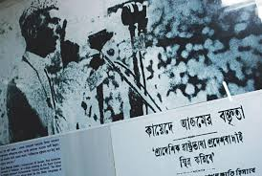
Who declared “Urdu and only Urdu will be the state language of Pakistan? When & Where?

Slide 11
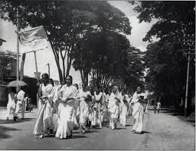
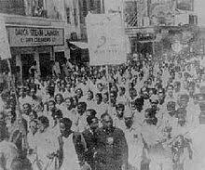
Procession demanding Bangla as mother tongue in 1952.
What did happen there?

Slide 12
Pair work
Discuss about language movement in 1952.

Slide 13
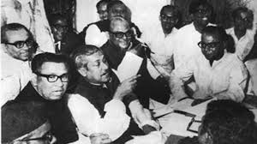
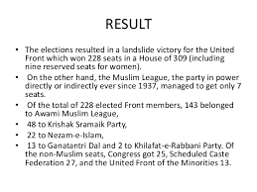
Who was the victor in the election of 1954 ?

Slide 14
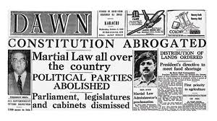
Ayub Khan declared Martial Law in 1958.

Slide 16
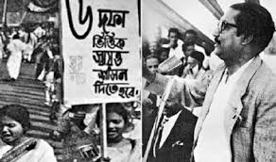
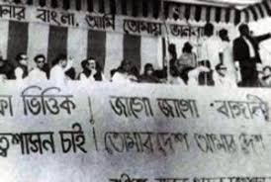

Slide 17
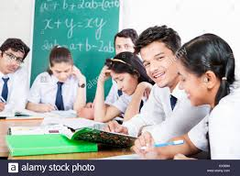
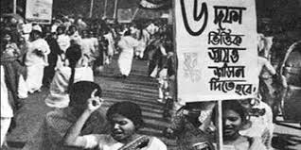
G
R
O
U
P
W
O
R
k
E
Explain the importance of six points movement in 1966.

Slide 18
What
Change
Do
You
Find
In
1969 ?

Slide 19
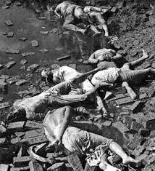
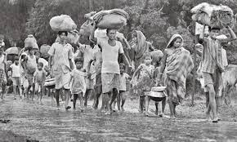
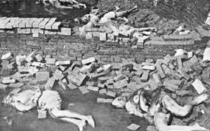
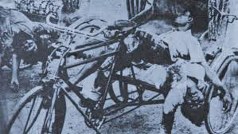

Slide 20
Evaluation
Which features of the speech do you appreciate most ? Why?
What does the slaughter house mean in the speech ?

Slide 21
Word Meaning
Main word | Meaning
Awash | Flooded
Downtrodden | Oppressed
External | Exotic,Alien
Enslave Constitution Freedom Repeatedly | Subjugate Set of laws Liberty Frequently

Slide 22
Agony | Suppressed Pain
Crimson | Reddish
Discussion | Conversation
Assume | Undertake
Observe | Notice
Spontaneously | Effortlessly, easily
Enemy | Foe
Conference | Convention
Suddenly | Abruptly
Withdraw | Diverge, shift
Remember | Recall

Slide 23
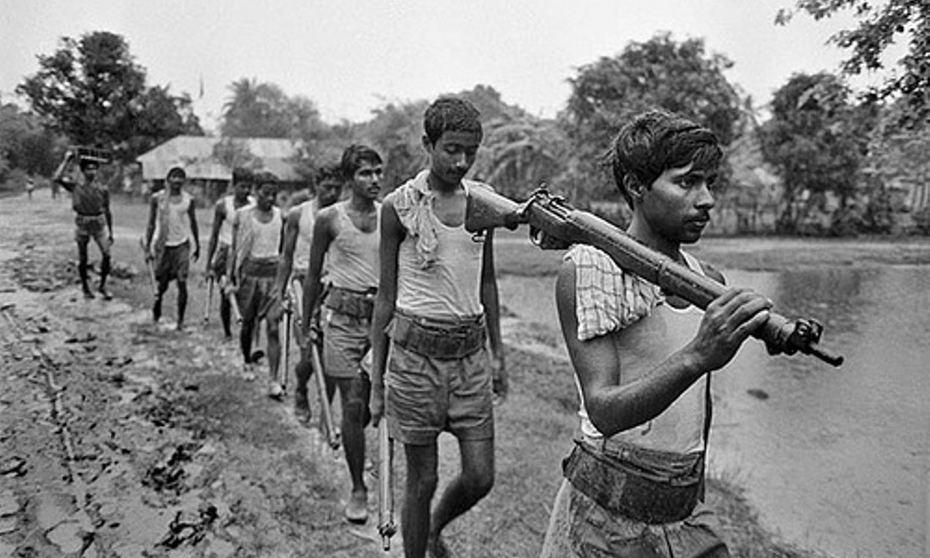
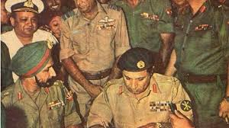
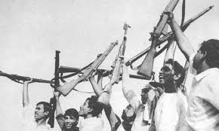

Slide 24
Home
TASK
Write a short note on various directives on 7 march speech by bangabandhu.

Slide 25
Thank You All

