Slide 1
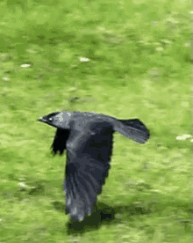
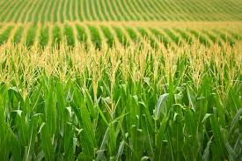
GOOD MORNING

Slide 2
Presented by
Al Amin (Nahid)
Assisant teacher
79 no.Chotobadura Govt. Primary School
Mobile : 01762592611
Email : alamin_nayon08@yahoo.com

Slide 3
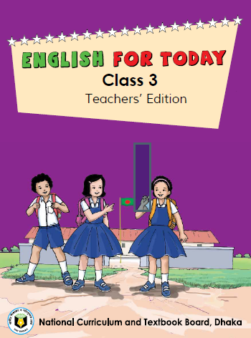
Introduction to lesson
Class : Three
Subject : English
Unit : 39
Lesson : Story : The Cow
Lesson Title : 1-2,A (It is ....the young crow)
Duration : 35 minutes
Date :28.02.2020

Slide 4
Learning outcomes
At the end of the lesson, Learners will be able to
Listening
Reading
4.3.1 enjoy and understand simple story
5.1.2 read simple stories .

Slide 5
Let us sing a song

Slide 6
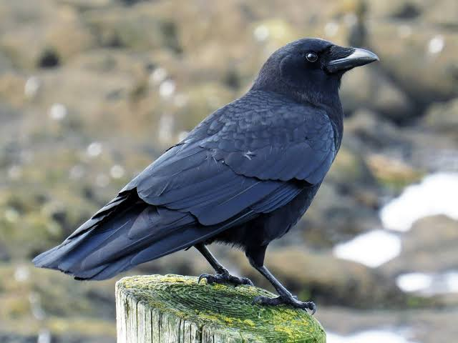
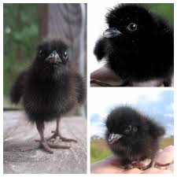
Do you know these birds ?
This is Crow
These are young crows

Slide 7
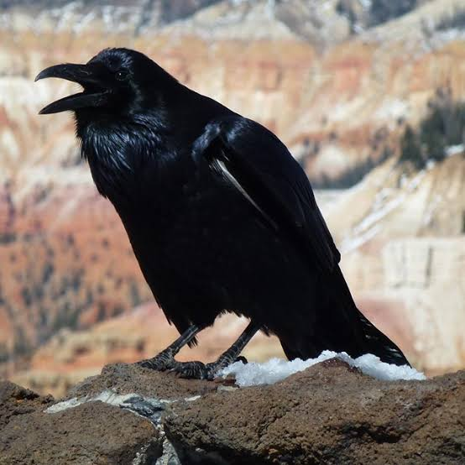
Story : The crow
Crow

Slide 8
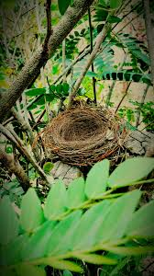
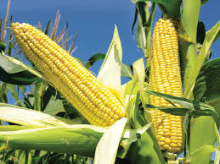
Let us learn some new words
Crow
A large bird with black color
Nest
Birds’ home
Corn
Grain

Slide 9
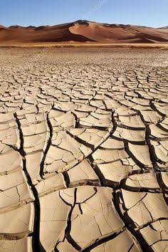
It is summer.

Slide 10
Mother Crow and her young crows are living in a nest.

Slide 11
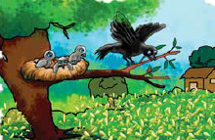
The nest is above a corn field.

Slide 12
Every morning, Mother Crow flies away to get corn.

Slide 13
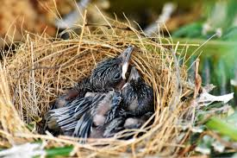
She leaves the young crows.

Slide 14
Teacher’s reading
Open page at 80

Slide 15
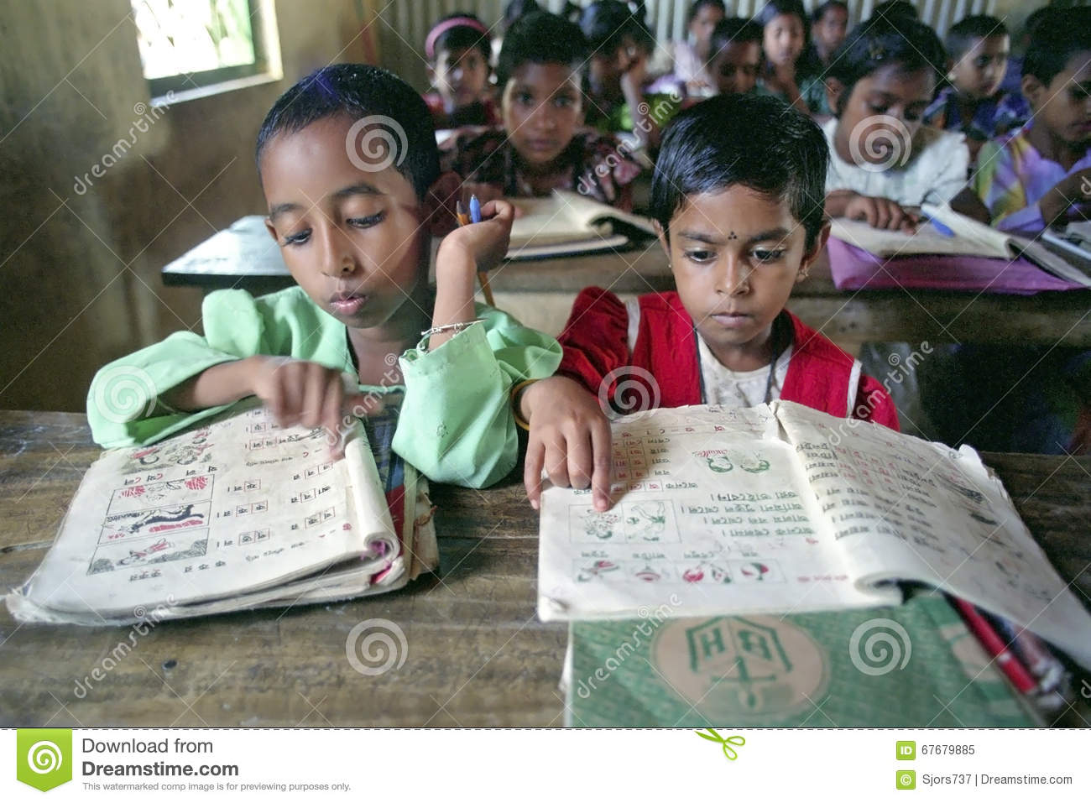
Students’ reading

Slide 16
Read one and listen another.
Group work
Three groups
3.Group
1. Group
2.Group

Slide 17
Evaluation
1.Why does the mother crow leave younger crows ?
2. What is color of crow ?
3.What have we learnt from this lesson ?

Slide 18
Home task
Write a story (that you know) that can say within ten sentences..

Slide 19
Thank you all
Get all pleasure .
Bye
Bye

