Slide 1
WELCOME

Slide 2
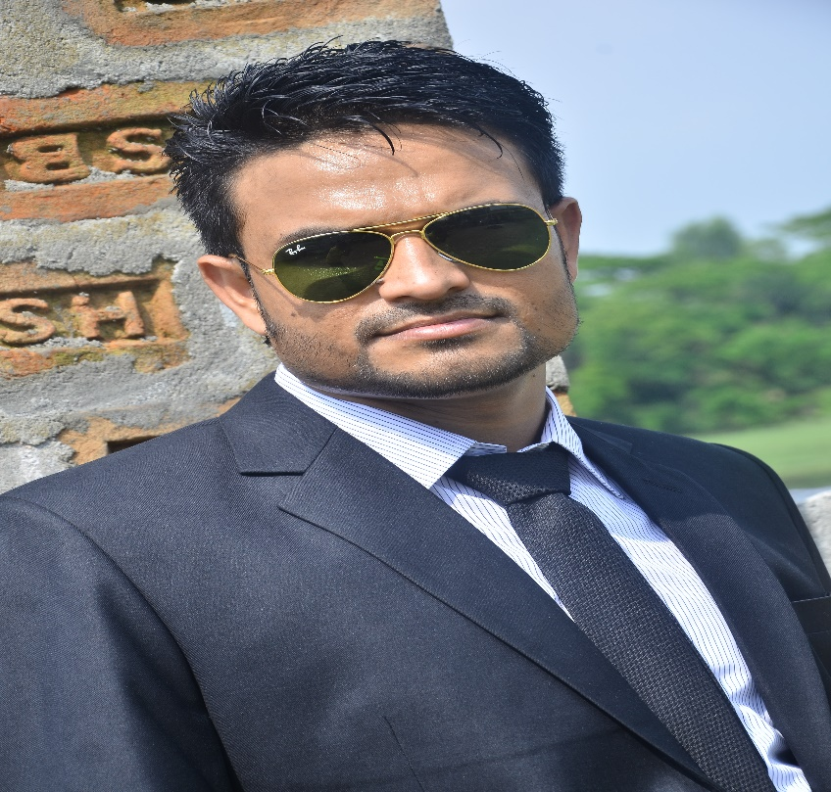
JUBAYER AHMAD
ASSISTANT TEACHER
SHAJALAL BAZAR GPS

Slide 3
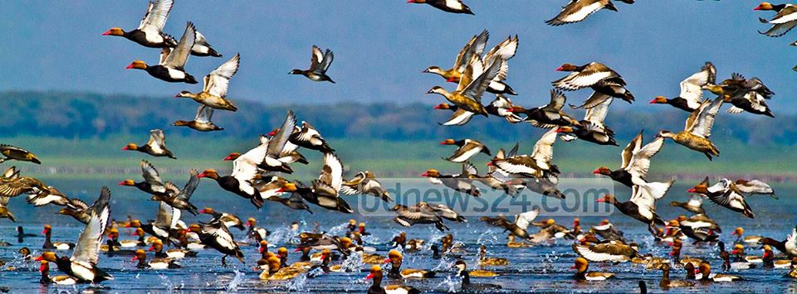
Safety environment by greetings song.
Hello’ hello’ how are you?
I’ m well, I’m good.
I’ m great,I’ m wonderful.
Hello’ Hello, How are you ?
I’m fine, I’m great today.

Slide 4
Read & Say.
A doll is on the bed.
A ball is under the table. The pen is in my pocket.

Slide 5
One day One word.
Doll - পুতুল

Slide 6
ON
IN
UNDER

Slide 7
Introduction to lesson
*Where is it ?
Lessons : 4-6
Page no: 47

Slide 8
*LEARNING OUTCOMES
Lisiening
1.1.1 become familiar with English sounds by lisiening to common English worads .
3.1.2 understand simple question and statements about familiar objects.
Speaking
1.1.1 repeat after the teacher simple wards and pharases with proper sound and stress .
3.1.2 say simple words pharses proper sound and stress.

Slide 9
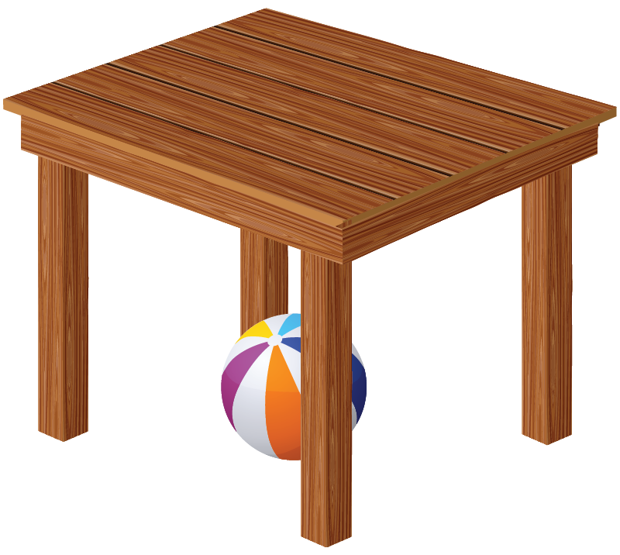
Where is the ball?

Slide 10
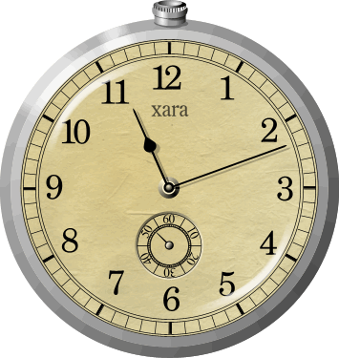
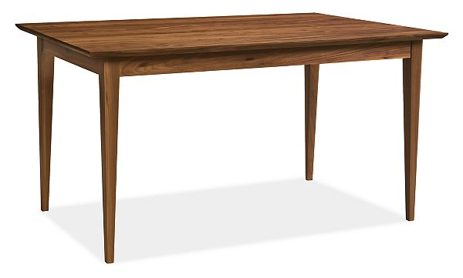
Where is the clock?

Slide 11
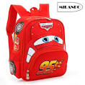
Where is your book?

Slide 12
Open your book.
Page no 47

Slide 13
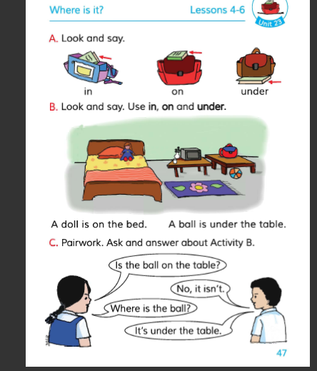

Slide 14
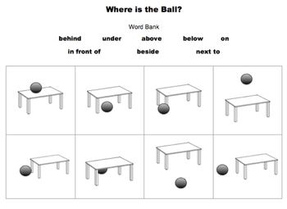
Task:
*Where is the ball?

Slide 15
Thank You ,
Good bye…..

