Slide 1
Welcome

Slide 2
Teacher introduce
Lang ching murung
Assistant teacher
Chioni para govt. Primary school.

Slide 3
Lesson introduce
Class: Two
Subject: English
Unit-1
Lesson: 1-3(A,B), page-3
Time: 40 minutes
Date:2/2/2020

Slide 4
Learning outcomes
Listening:
1.1.1-Become familiar with English sounds by listening to common English words.
Speaking:
1.1.1-Repeat after the teacher simple words and phrases with proper sounds and stress.
1.1.2-Say simple words and phrases with proper sounds and stress.
1.3.1-Recognize and read the names of objects having the same initial and final sounds.

Slide 5
WARM UP
Lets see to videos-

Slide 6
Lesson tittle
Alphabet

Slide 7
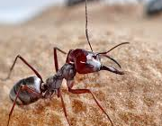
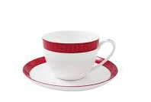
Input
Lets see the picture-
Aa
Ant
Bb
Bat
Cc
Cup

Slide 8
Students will play Bingo game
Ant
Bat
Cup

Slide 9
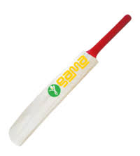
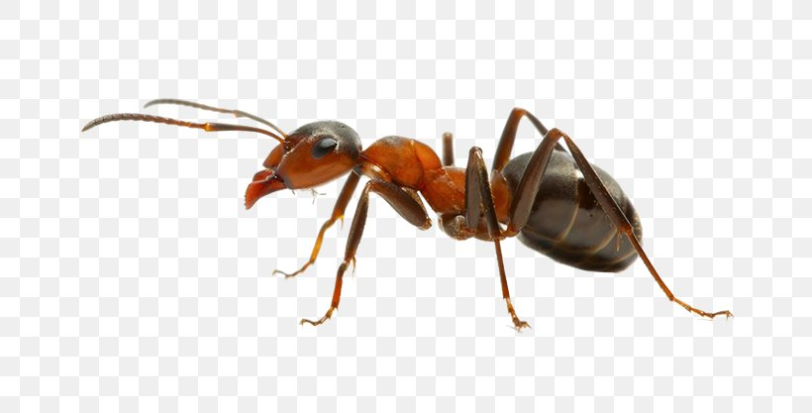
Teacher will reading the words and students trace with teacher.
Aa- Ant
Bb-bat
Cc- Cup

Slide 10
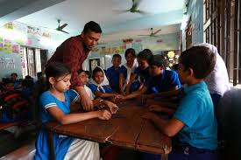
Practice
Students will be reading words by groups - ant, bat, cup.

Slide 11
Task
Teacher will be ask to students for write words ant, bat, cup from EFT book.

Slide 12
Evaluation
Fill in the gaps -
A---t
A
B---t
B
C
C---p

Slide 13
Home work
Students will be write words ant, bat, cup. Five lines from home.

Slide 14
One day one word
Afternoon

