Slide 2
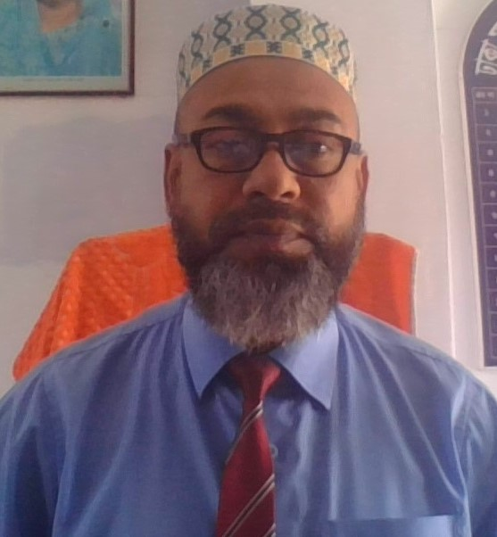
Teacher’s identity
MD FARID UDDIN GAZI
Headteacher
Dhaka Match Industries Secondary School

Slide 3
Lesson identity
Class :ten
subject:English
Time:45 minutes.

Slide 4
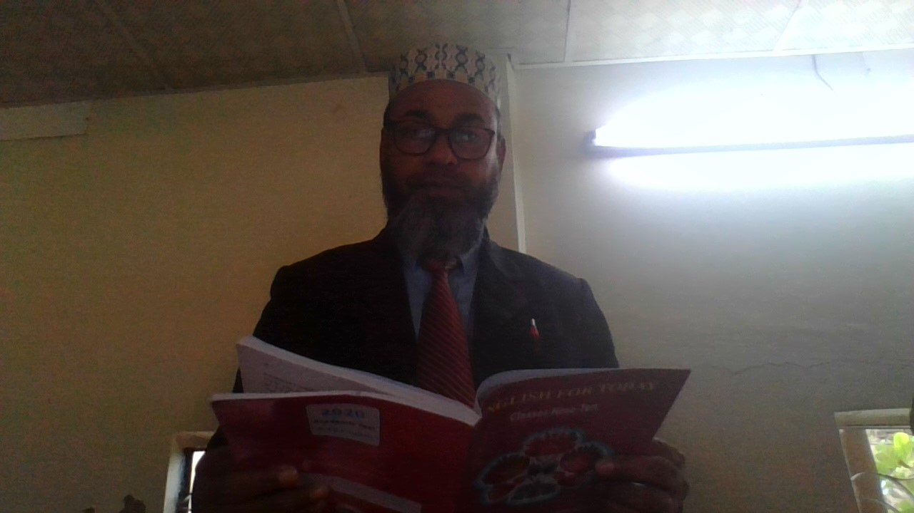
Teacher’s Loud Reading

Slide 5
Our today’s lesson
Knowledge ,skills and attitudes
Unit one,lesson two

Slide 6
By the end of the lesson, students will be able to:
describe the picture
narrate about knowledge skill and attitude

Slide 7
T
R
A
D
I
T
I
O
N
knowledge
Our geography and history
About I.C.T
C
U
L
T
u
R
E

Slide 8
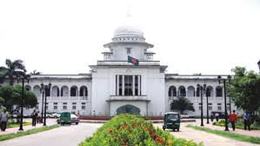

Slide 9
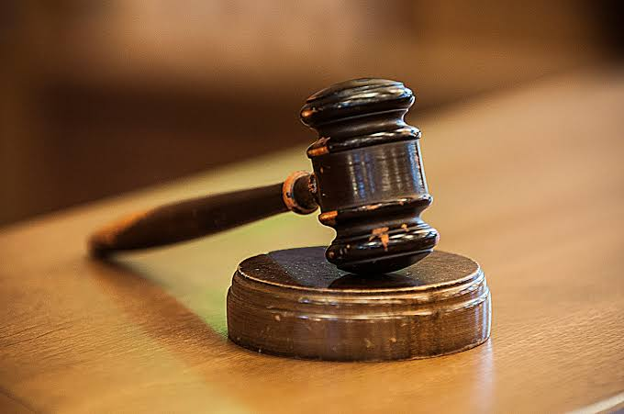
We have to know about judicial system of Bangladesh and other countries of the world.

Slide 10
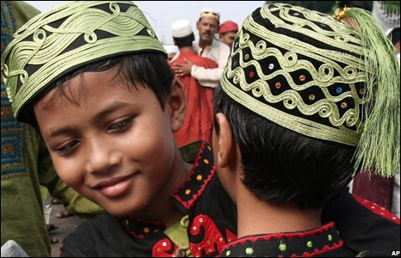
We should know about our history, culture,tradition and also religious and moral values.

Slide 11
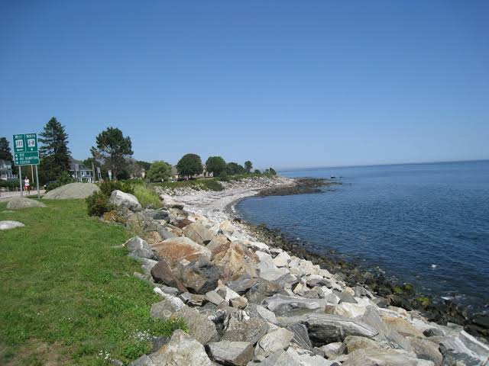
We have to know about sea wealth.

Slide 12
Individual Work
What is skill?
What do you know about attitude?
What is the difference between religious and moral values?

Slide 13
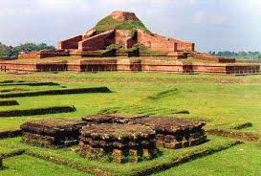
Describe the picture within 100 words
How can we have the knowledge?

Slide 14
1.The first two pictures are related to…………………….
2.The third picture is about……………………………………
3.Four and five no. pictures show us our………………..
4.Picture no six is about………………………
5.Last picture is about………………………………………….

Slide 15
Knowledge is not enough .We must apply our knowledge. If we apply knowledge, we will be skilled.
We must have positive “Attitude”

Slide 16
Describe about the three pictures within five sentences .

Slide 17
Homework
How skill and knowledge are related with each other?Write your own words.

