Slide 1
WELCOME TO ALL

Slide 2
INTRODUCTION OF THE TEACHER
Shohag Chowdhury
Assistant Teacher
Daudpur Govt. Primary School
Nawabganj, Dinajpur

Slide 3
SUBJECT IDENTITY
SUBJECT:ENGLISH FOR TODAY
CLASS:FIVE
UNIT:3
LESSONS1-2
LESSON TITLE:SAIKAT’S FAMILY
DATE:07-01-2020
TIME:40 MINUTES

Slide 4
WARM UP ACTIVITY
Now let’s see a video

Slide 5
What can you see ?

Slide 6
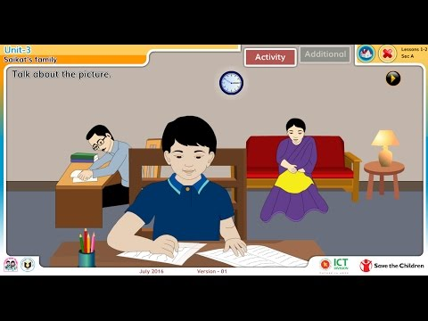
DICLARATION OF LESSON
SAIKAT’S FAMILY

Slide 7
Learning outcomes
The students will be able to-
Listening:
1.3.1 recognize which words in sentence are stressed.
3.1.1 understand questions asked by the teacher about them.
Speaking:
1.1.2 say sentence with proper intonation.
6.1.1 say what the speaker is doing.
Reading:
1.5.1 read words,prases and sentences in the text with proper
pronunciation,stress and intonation.

Slide 8
Teacher Reading

Slide 9
Now everyone open at page 10 from your Englisg for today text book.
Look at the book and read with me:

Slide 10
Saikat’s father Mr.Rashidul is a anker.

Slide 11
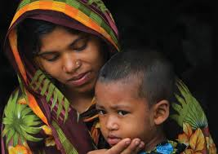
Saikat’s mother is Mrs.Monwara Islam.
She is a houswife.

Slide 12
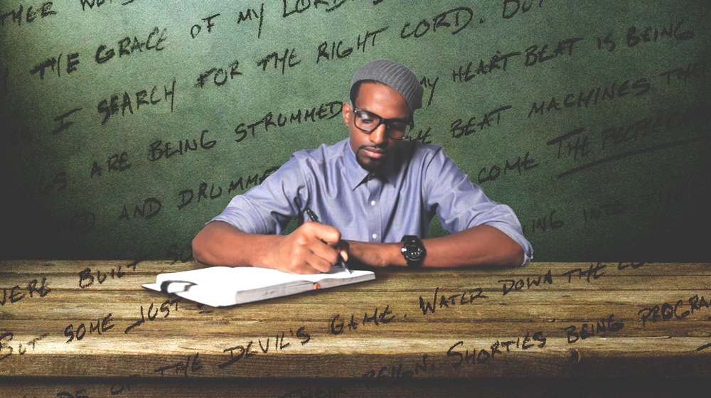
But in his free time Mr.Islam writes stories
And listens to music.

Slide 13
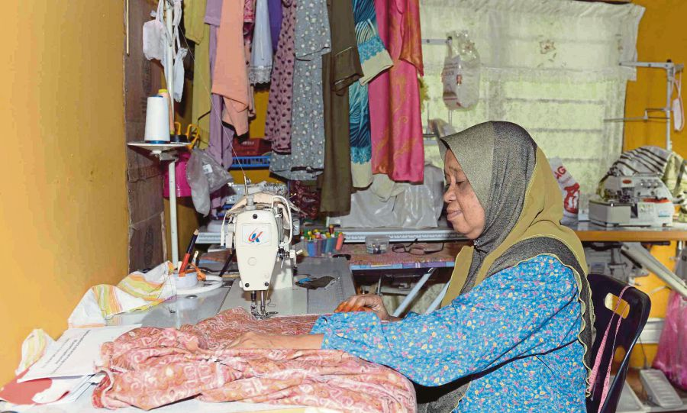
In her free time she enjoys sewing
She makes dresses.

Slide 14
Intruduce with new words and word meaning:
1] Listen
To give attention to hear something.
2 ] Housewife
A married woman who works in her house.
3 ] Enjoy
To get pleasure from something.
4 ] Neighbours
Someone who lives very near to you.

Slide 15
Individual Work
Each student will read one by one.

Slide 16
Group Activity
Matcing
Listen
Someone who lives very near to you.
Housewife
To get pleasure from something
.
Enjoy
To give attention to hear somthing
Neighbour
A married woman who works in her house.
.

Slide 17
Evaluation
What is Saikat’s parents occupation?
Ans:Banker and Housewife.

Slide 18
TASK
What do his parents do in their free time?

Slide 19
THANKS TO ALL SEE YOU TOMORROW.

