Slide 1
Journal Presentation
What have you learnt?
What was new to you?
How could you apply those in the classroom teaching?
What was not clear to you?
Which one did you find difficult?
Which one is not relevant to the contents of EfT books?
Write your comments on that day’s sessions?

Slide 2
Welcome
To
Forth
Day’s
Training
Session’s

Slide 3
DAY-4
Session-1
Teaching English to large classes
Activity-1: : Tounge twister revised using audio clip D4_S1_A1)
I scream, you scream, we all scream for ice-cream.

Slide 4
The most common feature of a primary classroom in Bangladesh is that there are more or less 60-70 students sitting in a room. At least 5 students sit on a long bench with another high bench in front of them to keep books on. There is a chair and a table in front of them for the teacher. It is very difficult to teach and assess students learning. In this session, participants will learn about how they can deal with major challenges

Slide 5
Activity-2: Identifying the challenges of teaching English to large classes
Collecting the challenges teaching English to a large class through brainstorming on the board. Encourage them to reflect on their experiences in classroom teaching.
Organise participants into 5 groups. Tell them to list the 7 major challenges of teaching English to large classes from the board list

Slide 6
Resource paper-23 (a)
Challenges of teaching large classes
To maintain discipline Lots of shouts and noise during speaking, chorus drilling Correcting and assessing student’s work Paying attention to each student, group/ pair Dealing different level of students- fast, average and weak learners Space for pair and group work Remember the name of students Teachers voice- teacher have to shout during WCW ...........

Slide 7
Activity-2: Describing the ways of dealing the challenges to teaching large classes
Organise the participants into 5 groups.
Give each group two different challenges from the ranked 7 major challenges to find out the possible solution in group discussion. Ask them to write the challenges in the left-hand column and the possible solution in the right-hand column.
Challenges of teaching English to large classes | Possible solutions

Slide 8
Ask each group to present their group work.
Resource paper-23(b)
Challenges of large classes | Possible solutions
It is difficult to keep discipline in a class of 50 or more students. For example-Some students talk among themselves at the back and not paying attention to the teachers while the teacher is talking in front of whole class. | The teacher will make house rules for the students to follow. They are : raise your hand when you want to speak. listen to others respect others opinion do not interrupt when some one is speaking. The teacher will monitor at random around the room. As a result he will keep eye contact with the students, not by turns. So the students will not get the chance to misbehave and the class will remain orderly.
Other teachers complain about the noise when we do speaking activities – or sing songs and rhymes | Make sure other teachers – and your head teacher – understand that the noise is because students are actively working. Tell them that children need to speak English to learn it. Perhaps it is possible to move classrooms, or move outside for some activities (for example, songs and rhymes).

Slide 9
It’s hard to control all of the students when they are playing a game or doing pair work | Make sure you do pair work often so that students get used to it. Make it part of a routine – for example, when you clap they get into pairs. Give clear time limits for pair work activities. Make them short! Explain rules of classroom behavior to students so that they understand what is acceptable and what is not. Use gestures/signals to make students quiet – or to look at you. For example, children must stop talking when you raise your hand. Move students around from time to time. Students could sit in a different place each term.
The students are all different levels – some are really good at English, some have problems | Identify the students who need your help and plan how you can help them. They could sit at the front of the class. Put students of different abilities together from time to time so students can help each other. Encourage students to ask for help. Monitor your students so that you can see who is having problems.
Pair work is difficult – there isn’t very much space | Perhaps you can move furniture. Students could use space outdoors. Ask students for suggestions.
I don’t know what all of the students are doing in pair work – it’s hard to check that | Establish classroom rules – make it clear to students when they should be speaking in they are practising English. In group work, make one student an ‘English policeman’. They have to make sure that students are speaking English. Walk around the room if it is possible. Use eye contact. Keep activities short, and use time limits.
It’s hard to assess all of the students | Assess some of the students some of the time (for example, assess three different pairs for each speaking activity). Keep notes. In case of control writing, write the answers on the board and ask the students to check their answers themselves or ask the students to change their exercise books to each other and to check. In case of guided and free writing, check the advance learners writing during monitoring and the rest at interval times. Make sure that you assess each student each term, or over the school year.

Slide 10
Activity-3: Developing an English for Today lesson plan
Organise participants into groups of 5 (5 participants per group).
write a lesson plan .The lesson should last 35 minutes.
The lesson MUST contain at least one example of a listening and a
speaking activity.
Tell groups to swap their poster (the lesson plan) with another group – each group should have a lesson plan that is not their own. Groups read the lesson plan, and answer the questions about it. Groups write notes for each other based on the questions. Ask the groups to hand back posters to the original group, and hand over their notes. Tell the groups to read the notes and ask questions if they need any clarifications.
Finally tell the groups to amend the lesson plan according to feedback if required and to preserve it for use in the next time.

Slide 11
The lesson plan questions
Look at the other group’s lesson plan and answer the following questions:
a) Are the learning outcomes included? Is it clear what language or skills are practised?
b) Has classroom language been included? Is it simple enough for students to understand?
c) Does the lesson include opportunities for students to listen to and speak English?
d) Is a listening activity included? Does the teacher introduce the text to the students?
What do the students do while they are listening?
e) Is a speaking activity included? Do all students get the opportunity to speak? What
support do students get for the activity? Is it clear from the lesson plan how the teacher
will correct and assess students’ speaking? How will the teacher help students with pronunciation?
f) Look at the learning outcomes again. Do you think the activities and tasks in this
lesson help students to meet the learning outcomes?
g) Is it possible to carry out all parts of this lesson with a large class?
h) Do you have any suggestions for ways to improve the lesson plan?

Slide 13
Day - 4
Session - 2
Early Reading and writing
Activity: 1: Warm up: Two little hands clap clap clap. Audio (additional) Class 1 Rhyme By showing and role playing

Slide 14
Activity-2: Introducing the stages of early reading and writing
Organise participants into pairs. Give/ show each pair a copy of worksheet-13.

Slide 15
Worksheet-13
Cat, red
help
Read in pair and fill in the gaps for the stages of early reading and writing
Activity 1: Learning to read
Below are eight stages in the process of learning to read English for most children. These stages don’t necessarily happen in exactly this order, and many of them happen at the same time. However, it is a useful guide. Complete the sentences with suitable example words.
1. The child learns the most common sounds for the letters of the alphabet. For example, the letter sounds in ‘cat’ and ‘hen ’.
2. He/she learns to put these together to form simple words such as ‘hand’, ____ and ______.
3. He/she learns how pairs of consonants work together to make new sounds. For example, ‘she’, __________ and __________.
4. He/she learns how pairs of vowels work together to make new sounds. For example, ‘good’, ‘rain’, __________ and _______ ’,
5. He/she learns how r and consonant + e can change the sound of the vowel that goes before. For example, ‘short’, ‘time’, __________ and __________.
6. He/she learns the less common sounds of some letters, such as the c in ‘ice’ and
__________ , the s in ‘nose’ and __________.
7. He/she learns to build longer, more complex words such as ‘grandmother’, __ and _____
8. He/she learns unusual and irregular spellings such as ‘high’, ‘beautiful’, ____ and _____.
elephant
with, shop, chicken
’. cat, red, stop
help
please, sleep, boat
ground
shop, chicken
elephant
shirt, car, like
please, sleep, boat
ground
stone
nice, race
shirt, car, like
stone
please, days
nice, race
please, days
Saturday
another, excellent, and railway
Saturday, another,
excellent
people,
laugh, Wednesday and receipt
people, laugh, Wednesday
receipt

Slide 16
Activity 2: Learning to write
Learning to write is a long process. Do you know which English for Today Class book introduces each of the following for the first time? Guess the answers and see if you are right!
1. Drawing lines and shapes. Class __
2. Make the shapes of single letters by copying examples. Class __
3. Make the shapes of single letters from memory. Class __
4. Write single words by copying examples. Class __
5. Write single words from memory. Class __
6. Write short sentences by copying examples. Class __
7. Write short new sentences (without examples to copy). Class __
8. Write longer new sentences. Class __
9. Write a short paragraph. Class __
Class 1
Class 1
Class 1
Class 1
Class 1
Class 2
Class 2
Class 2
Class 3
Class 3
Class 3
Class 3
Class 3
Class 3
Class 3

Slide 17
Resource Paper-24: Introducing the stages of early reading and writing
Activity 1: Learning to read
Below are eight stages in the process of learning to read English for most children. These stages don’t necessarily happen in exactly this order, and many of them happen at the same time. However, it is a useful guide. Complete the sentences with suitable example words.
1. The child learns the most common sounds for the letters of the alphabet. For example, the letter sounds in ‘cat’ and ‘hen’.
2. He/she learns to put these together to form simple words such as ‘hand’, cat, red, stop and help
3. He/she learns how pairs of consonants work together to make new sounds. For example, ‘she’, with, shop, chicken and elephant
4. He/she learns how pairs of vowels work together to make new sounds. For example, ‘good’, ‘rain’, please, sleep, boat and ground
5. He/she learns how r and consonant + e can change the sound of the vowel that goes before. For example, ‘short’, ‘time’, shirt, car, like and stone
6. He/she learns the less common sounds of some letters, such as the c in ‘ice’ and
nice, race and the s in ‘nose’, please, days
7. He/she learns to build longer, more complex words such as ‘grandmother’, Saturday, another, excellent, and railway
8. He/she learns unusual and irregular spellings such as ‘high’, ‘beautiful’, people, laugh, Wednesday and receipt

Slide 18
Activity 2: Learning to write
Learning to write is a long process. Do you know which English for Today Class book introduces each of the following for the first time? Guess the answers and see if you are right!
1. Drawing lines and shapes. Class 1
2. Make the shapes of single letters by copying examples. Class 1
3. Make the shapes of single letters from memory. Class 1
4. Write single words by copying examples. Class 2
5. Write single words from memory. Class 2
6. Write short sentences by copying examples. Class 3
7. Write short new sentences (without examples to copy). Class 3
8. Write longer new sentences. Class 3
9. Write a short paragraph. Class 3

Slide 19
Activity-3: Teaching the sounds of single letters (Revised using EIA video clip D4_S2_A3)
Watch the video and answer the following questions.
What are the activities the teacher is doing?
What technique is she following to teach the sounds of single letters?
Elicit the answers of the questions provided earlier.

Slide 20
Now you are student’s of class one… & I am the Teacher…

Slide 21
Activity-4: Introducing word reading and writing
Ask the participants to act class 2 students. Tell them you are a teacher of class 2.
Use the demonstration notes to take the class
Demonstration notes: Follow the demonstration notes below to take the class, try to use English as much as possible. Don’t spend too long on each activity.
Class 2, unit 2, lesson 3
Learning outcomes: 1) read, say words of pictures 2) write known words
1. Draw a picture of an apple on the board – or show a picture of an apple, or show an apple. 2. Ask ‘What’s this?’ and elicit ‘Apple’. 3. Say ‘this is an….’ and encourage students to say ‘Apple’. 4. Write `Apple’ on the board and spell it- A....p...p...l..e---Apple. 5. Draw a picture of an ant on the board-or show a picture of an ant. 6. Ask ‘What’s this?’ and elicit ‘Ant’. Write ‘Ant’ on the board and spell: A....n...t---- 7. Similarly introduce Ball, bat, Cap, Cup, Doll, Dog. 8. Write the 8 words: `Apple, Ant, Ball, Bat, Cap, Cup, Dog, Doll’ on the board and point each one and ask the students to say the pointed word. 9. Point on words randomly and ask the students to say. 10. Show how to write words in 4 lines. Ask them to write the words on P. 9/ their exercise books. (If they write on their exercise books, ask them to draw 4 lines and then to write). 11. Walk around the room and monitor. Help the students as needed.

Slide 22
Demo Class: Class 2
What`s this?
This is an -------
Apple
A
p
p
Write Apple on board
l
e
Spell
A-p-p-l-e =Apple

Slide 23
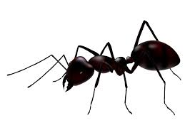
What`s this?
Ant
This is an -------
A
n
t
Write Ant on board
Spell
A-n-t =Ant

Slide 24
Write two words and ask ss to say pointed words repeatedly
Apple
Ant

Slide 25
Apple
It is an ………
What’s this?

Slide 26
A……A….A…..
Apple

Slide 27
a……a…..a…….
apple

Slide 28
Ball
Ball
What is it?
B…..B……B...
It is a Ball..

Slide 29
Cap
What is it?
Cap
C….C….C…
It is a Cap..

Slide 30
Dog
What is it?
Dog
D….D….D…
It is a Dog..

Slide 31
Activity-5: Combining letters to form words
Demonstration notes
1. Write the following on the board: ___a __ 2. Ask participants to say three letter words which have ‘a’ in the middle (for example ‘sad’) 3. Write words on the board, for example: sad, cat, bag, man, hat 4. Check participants understand the words – for example, they can mime sad, make the noise of a cat, show a bag… 5. Read the words, and ask participants to repeat as a group and individually (for pronunciation) 6. Write the following on the board: __e__ 7. Ask trainees to say three letter words which have ‘e’ in the middle (for example ‘hen’) 8. Write words on the board, for example: hen, pen, leg 9. Check participants understand the words – for example, they can mime hen, show a pen, point to a leg… 10. Read the words, and ask participants to repeat as a group and individually (for pronunciation) 5. Read the words, and ask participants to repeat as a group and individually (for pronunciation) 6. Write the following on the board: __e__ 7. Ask trainees to say three letter words which have ‘e’ in the middle (for example ‘hen’) 8. Write words on the board, for example: hen, pen, leg 9. Check participants understand the words – for example, they can mime hen, show a pen, point to a leg… 10. Read the words, and ask participants to repeat as a group and individually (for pronunciation)

Slide 32
when students are familiar with letters and the sounds they make, they can begin to put them together to make words, at the beginning of Class 2
Now you will experience an activity which helps students to combine letters to make words.

Slide 33
___a __
c t
s d
b g
h t

Slide 34
p n
l g
h n
___e__

Slide 35
1. What techniques did the teacher use to check that everybody understood the
meanings of the words?
2. What is the purpose of the activity?
Resource paper-27:
Q1. What techniques did the teacher use to check that everybody understood the meanings of the words? Answer: She gave clear examples, such as making a ‘miaow’ sound to check ‘cat’, holding up an example to check ‘bag’ and miming opening a ‘can’ of drink. Q2. What is the purpose of the activity? Answer: This activity has three purposes: It helps students think about how letters are put together to make words. It helps them to develop reading and writing skills. It checks the meanings of some words. It gives extra practice in listening, speaking and pronunciation.

Slide 36
Activity-5: Early reading and writing activities
Resource paper-28:
Early reading and writing activities
Here are some activities teachers can use in the classroom to help students to develop early reading and writing. They can be used for any of the letters or words in the lessons from English for Today, Class 1 and Class 2. Choose two or three of the activities and practise them in your groups.
Teaching single letters (Note: Teachers should use both capital and lower case letters)
Teacher writes five letters on the board. Teacher points to a letter and says the letter (or
the sound). Students shout ‘Yes’ if the teacher says the right letter, or ‘No!’ if the teacher
says a different letter (for example, teacher points to the letter ‘m’ and says ‘f’).
Teacher dictates some sounds/letters. Students write them down.
Teacher stands with their back to the class. Teacher mimes painting a letter (or a word)
as if using a big paintbrush. Students guess the letter or word.
Teacher puts students into pairs. Student A uses his/her finger to write a letter of the
alphabet on Student B’s back/palm. Student B must guess the letter.
Teacher writes some words on the board (eg Bangladesh). Teacher asks students to
find a certain letter (for example, point to the letter ‘a’).

Slide 37
Combining letters to make words ( Resource paper 28)
Teacher writes a letter on the board. Students must say a word beginning with the letter.
Teacher divides class into two teams. Teaches writes a letter on the board (eg A).
Teacher asks Team A for a word that includes a. Teacher then asks Team B, and so on.
Continue until nobody in a team can think of another word. At this point, the other team
is the winner. Play with letters or combinations of letters eg:
Teacher starts writing a word on the board slowly for example: a…p…p…. Students
must guess the word.
Teacher writes some letters on the board (egsh). Everybody must stand. Teacher says a
word from the current and previous lessons. If it contains sh, the students must sit down,
if not, they remain standing.
Students look at a lesson from English for Today Class 1 and 2 – books are open in front
of them. Teacher says a word. Students shout ‘Yes’ if the word is on the page, or ‘No’ if
the word is not on the page.
Teacher writes letters t-c-a on the board. Students have to write them in the correct
order: cat
Teacher writes words on the board, and gives students time to remember them. Teacher
rubs words out, students write the words from memory.
Teacher writes a pair of letters on the board (egth). In pairs or groups, In small groups,
students write as many words as they know using the letters. Teacher gives a time limit
(eg two minutes). This activity is useful for practising pairs of letters that make a new
sound. For example, ai, oo, ee, ou, ar, or, ay, ow, sh, th, ch, wh, ph.

Slide 38
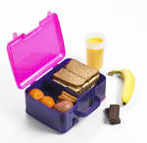

Slide 39
Day-4
Session-3
Introducing Reading
Activity-1: Identifying the ways to teach reading
This session will introduce the very important receptive skill – reading. It will start by discussing the two types of reading: ‘reading aloud and silent reading’. This session then analyses and discusses how to carry out reading activities in the classroom.
Teaching reading skills means to help students comprehend the reading text. For classroom practice, a teacher can do it through three stages of a reading lesson – pre, while and post reading. This session discusses how to carry out reading activities using the three stages in the classroom.

Slide 40
Tell the participants that teachers teach reading to their students in a number of ways. Give them Worksheet-15 and ask them to read 3 case studies that describe 3 teachers and the way they teach their students to read and think about the questions.
Which teacher is likely to be the most effective in developing his/her students’ reading skills? Why?
b) Would the situation be different in any way in the case of younger or older children?

Slide 41
Worksheet-15
Read the following 3 cases and identifying the ways to teach reading
Case study Teacher A thinks that the purpose of a reading lesson is to help students to read a text aloud. He starts the lesson by reading the passage aloud himself so that he can provide his students with a good model of pronunciation. He then asks different students to read the passage aloud – usually one or two sentences each. For him, correcting errors in pronunciation or getting students to practise saying new or difficult words are the most important parts of a good reading lesson.
Teacher B believes that reading is a silent activity. She believes her role as a teacher is to provide students with activities that will help them to practise different reading skills themselves. She sees reading as a way of getting information and wants to help her students develop the skills that they need to get this information easily. She plans tasks that help her students to understand a variety of texts. She never asks them to read aloud as she thinks that pronunciation should be something different.
Teacher C believes that his job is to help students understand information in the passage so that they will have no difficulty in answering comprehension questions. So he spends a lot of time explaining the content of the text. He also teaches the meanings of all the new words before students read the passage because he wants to make sure students don’t miss details as a result of meeting unfamiliar words in the text. He thinks that reading passages are useful as they give students the chance to learn a wide range of new words and structures.

Slide 42
Resource Paper _29 : Identifying the ways to teach reading
Possible answers 1. Teacher A is only using reading to improve students’ pronunciation. It is difficult to read aloud and understand a text at the same time. Pronunciation can be improved through oral fluency practice and dialogue work. He is not likely to be effective in developing his students' reading skills because he gives them no support in understanding the text. Teacher B is concerned with helping students to understand the text. She gives them tasks that they can complete by reading the text silently. She wants them to develop the skills that can enable them to read any text effectively. Teacher C only sees texts as an opportunity to teach new words and structures to his students. He is worried about unfamiliar vocabulary, so he explains everything to them before they read. This does not help their reading skills as it makes them feel that they can’t understand a new text without understanding every word. Part of the skill of reading is to guess unfamiliar words in context. He is only partly effective in developing his students’ reading skills. 2. However, these are mostly relevant for the upper primary classes. In the lower primary classes, the main purpose of teaching reading is to raise children’ phonological awareness. It is done in two ways: Familiarizing Phonics: Teaching the pronunciation of letters, sounds and the association of letters to make words; and Look and Say: It helps the students to say the words with comprehension. This method stresses the meaning of words.

Slide 43
Activity -2: Describing the 3 stages of reading (Revised using EIA video clip D4_S2_A2)
A reading lesson follows a similar format like listening: Pre-listening, while-listening and post listening.
Resource paper-30: Stages of reading
Pre-reading : In this stage teacher may do any or some of the following activities showing text pictures and ask to describe the picture showing title and then ask questions about what the text will be teaching new words which help understanding the text 2.While reading : Before students start reading, teachers may give any one of the following activities. Fill in the gaps- Keep the students attentive in reading and check understanding. Identify True or false- Keep the students attentive in reading. Exact meaning questions- Teacher can check the understanding of the text. 3. After reading : Teachers may provide some inferred meaning questions or questions related to students’ own experience or students’ lives . Students have to use their own words to answer these types of questions. These questions involve thinking about the text and understanding the links between ideas.

Slide 44
Identify the activities used in video (23 min) (Revised using EIA video clip D4_S2_A2)

Slide 45
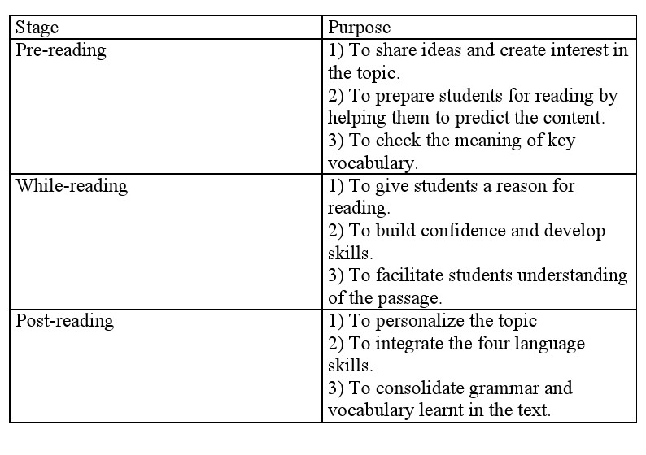
Checklist- 3

Slide 46
Organize the participants in 3 groups and give them EFT books 3-5.
Choose a lesson to prepare a lesson note showing 3 stages of reading

Slide 47
Activity 3: Describing the importance of silent reading
Questions: Why silent reading is important?
Eliciting the possible answer.
Silent reading skills are necessary for the students for studying, future work purposes and for pleasure. Reading aloud is un natural and not something we do in real life very often. We want to teach our students skills that will help them in real life. However, reading aloud is helpful for the beginning learners in order to familiarize with the letters, words and sounds.

Slide 48
Day -4
Session - 4
Writing Skills
Activity-1: Warm-up activity
Activity-2: Identify different writing activities in the EfT textbook:
Divide the class into 5 groups. Ask them to work on EfT book Class 4, Unit:35 P.70-71, Activity B, A and B. Ask them to grouped these activity into 3 categories-Controlled, Guided and Free writing activities. Give them 5 minutes for this activity.

Slide 49
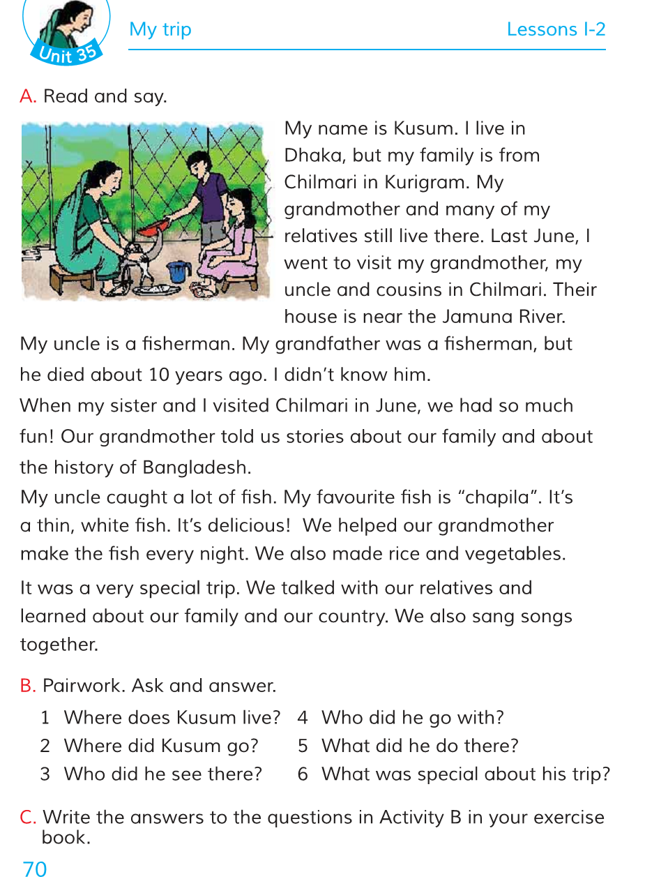

Slide 50
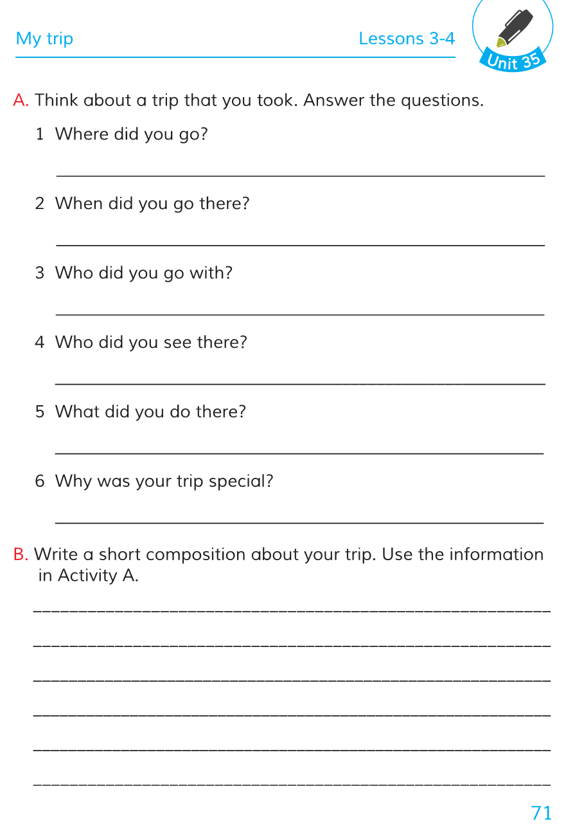

Slide 51
Group work presentation
Answer: A, 70 page controlled, A, 71 page, guided and B, 71 page- free writing.

Slide 52
Activity-3: Identifying the characteristics of controlled and guided writing activities
Do a demonstration. After demonstration they have find out the characteristics of controlled and guided writing activities.
Class 2, Unit 3, Lesson 3, E ( Ask the participants to play role class to students)
L.O: write the name of the parts of the body
Students, open page 25(Show the page) Point the picture and ask `What’s this?’ Do it chorus. Ask to write the words under each picture or in their exercise books. Walk around and monitor and mentor.
Class-5, lesson-28, B2 (Ask the participants to play role class 5 students)
Students, open page 89. Look at this form. Fill the form out with the information about yourself Walk around and monitor and mentor.

Slide 54
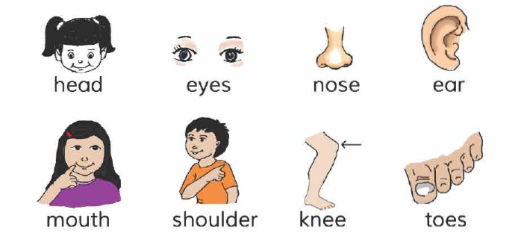
What’s this?

Slide 55
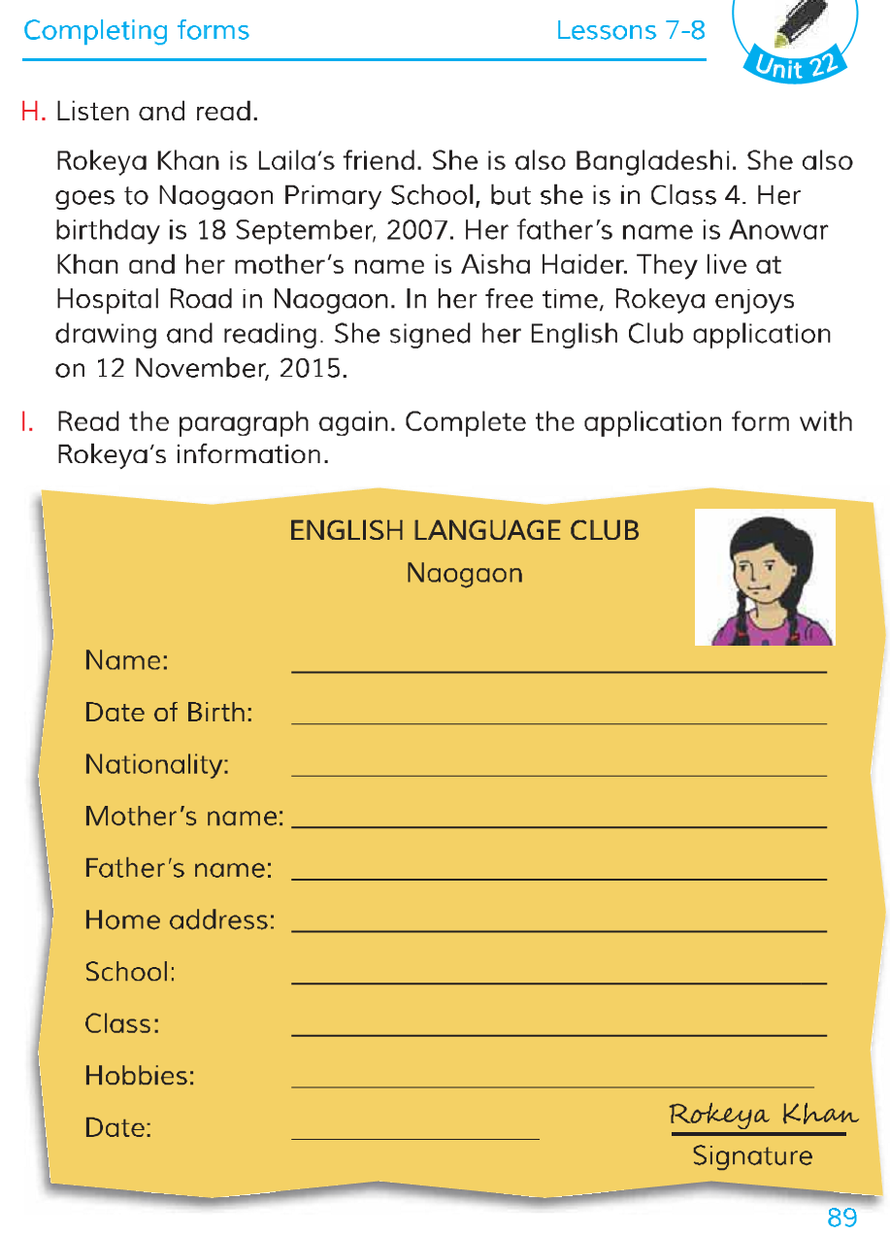

Slide 56
Discuss the following questions in groups.
a) How much support do students have with the language?
b) Who controls the language used? How much choice do students have?
c) Is the focus of the activities on developing accuracy or fluency? Should mistakes be
corrected?
Resource paper _31: Characteristics of controlled and guided writings
Controlled and guided writing activities have the following characteristics: Students have a lot of support with the language. The language is controlled by the teacher. Students have no choice in controlled writings but have a little choice in guided one. The focus of the activity is on accuracy. Mistakes should be corrected.

Slide 57
Activity-4: Identifying the characteristics of free writing activity (Revised using EIA video clip D4_S4_A4a, D4_S4_A4b )
While watching the video answer the following questions:
What characteristics of a free writing activity is the teacher following?

Slide 58
Organise participants into groups of 5. Read and discuss worksheet-17.
Worksheet-17:
Read the following questions in group and find out what are the characteristics of free writing?
In English for Today, there are examples of controlled, guided writing activities and also free writing activities. Look at this example of a free writing activity form Class 3, Unit 10, Lesson 2. Then answer the questions below. 1. What are the characteristics of free writing practice? Think about what you know about free speaking activities. They have some of the same characteristics. 2. English for Today has both controlled, guided and free writing activities. Why is it important to include controlled, guided AND free writing activities in the primary classroom? 3. Look again at the example of a free writing activity from Class 3 above. Imagine that you are teaching this lesson to Class 3. What problems do you think you might have? Think about any experience you have had or seen.

Slide 59
Resource Paper-32: Characteristics of free writing
1. Free writing activities have the following characteristics: Students have less support with the language. Some language may be controlled by the teacher. Students have some – or a lot of – choice over the language that they use. The focus of the activity is on fluency, creativity, and the message of the text. 2. It is important to include a variety of writing activities in the primary classroom: One of the main objectives of the English Primary Curriculum is to enable students to write the alphabet, words, numbers, simple sentences, passages, paragraphs, informal letters and numbers according to their age group and level. Children need to practise controlled, guided and free writing accurately and fluently. If children have lots of practice of different kinds of writing activities, they will develop skills in writing, and this will help them with exams and in their future lives. It is a good idea to give students some choice when they are writing. Creative writing is more motivating and meaningful. 3. Teachers might have the following problems: Students may not have many ideas for writing the paragraph. Students may not have enough language (for example, vocabulary) for writing the paragraph. There are many students in the class. It is difficult to help all of the students. Students will probably make many mistakes in this kind of writing. There are many students in the class. It is difficult to correct and grade all of the paragraphs.

Slide 60
Activity-5: Challenges of a free writing activity
Write on the board the ` Challenges of a free writing’ and collect the challenges on the board through Brainstorming. Talk about the possible solution for each challenge.
Then carry out the demonstration in the box below.
Demonstration: Try to use English as much as possible, and remember not to spend too long
on the final writing activity.
1. Tell participants that you are a teacher and they are Class 3 students. Tell them that they
are going to write something. They should make deliberate mistakes when they write –
they are Class 3 students!
2. Tell students that they are going to write a short paragraph about their mother.
3. Ask students what kind of information the paragraph could contain. Example: name, age,
work, what she does. This can be in Bangla.
4.Elicit words and phrases that students might need from the students, and write them on
the board. For example: My mother’s name is…She is X years old…She is a…She works, cooks, cleans…
5.Tell students to write a short paragraph about their mother. Remind students that they are Class 3 students and that they should make some mistakes.
6. Walk around the room and help students/correct their ‘mistakes’.
7. Stop the activity after 2-3 minutes. Trainees do not need to write full paragraphs – this is
an example.

Slide 61
Now you are Class 3 students
You are going to write something
You should make deliberate mistakes when you write
Because you are Class 3 students!

Slide 62
You are going to write a short paragraph about your mother
You have to inform your Mother’s name, age,
work, what she does.

Slide 63
Resource paper-33: Challenges and Possible solutions for free writing activity
Challenges for free writing activity | Possible solutions
Students may not have many ideas | Talk about the topic before students start for free writing. Give or elicit some ideas (for example, ask students what kind of information they would include in a paragraph about their mother. This can be in Bangla.)
Students may not have enough language (for example, vocabulary) for free writing. | Give or elicit words and phrases that students could use. Write them on the board. Ask them to read the text, model paragraph, letter, dialogue in the content. Some teachers need to write an example paragraph on the board that students can use as a model.
It is difficult to help all of the students. | Write words, phrases or a model on the board. Weaker students can use them; stronger students can use their own language. Walk around the room, and help students who are struggling.
Students will probably make many mistakes in this kind of writing. | Write words, phrases or a model on the board. Understand that it is difficult to write creatively in another language, and students will make mistakes. Only correct key language, and ignore less important mistakes. Students will learn from their mistakes.
It is difficult to correct and grade all of the written work. | Walk around the room and correct as many students’ work as you can. Take in written work from some of the students each time. Give grades and keep records. Just mark a few students’ work each time.

