Slide 1
Journal Presentation
What have you learnt?
What was new to you?
How could you apply those in the classroom teaching?
What was not clear to you?
Which one did you find difficult?
Which one is not relevant to the contents of EfT books?
Write your comments on that day’s sessions?

Slide 2
DAY- 6
Session-1
Constructing Competency Based Test Items
Activity-1: Warm up: (Revised using EIA video clip D6_S1_A1 )

Slide 3
Activity-2: Constructing MCQ and CRQ test items
Organise the participants into 5 groups. Ask them to choose their group name. Give 3 groups 3 different texts from English for Today Book of Class 5 and another 2 groups work on text that is not in the book. Supply them the format that is used item writing from the session-3 of day-5.

Slide 4
Now you have to construct 3 MCQ items.
1 Knowledge
1 understanding
1 inference/ application items
And 3 CRQ items
1 knowledge
1 understanding
1 inference/ application items

Slide 5
Ask them to construct 3 MCQ items (1 Knowledge, 1understanding, 1 inference/ application items) and 3 CRQ items (1 knowledge, 1 understanding and 1inference/ application items). Tell them they will get 30 minutes to do the group activity.
Group No | Group Name | Given Text
01 | Stem | Unit:24, Cyclone Aila, D, Look listen and read (First 2 Para)
02 | Options | Unit 21, It was a great day. Last--------station
03 | distracter | Unit:20, Life is beautiful. It`s-----------for school.
04 | key | Unit:17, Sport, (First 2 Para)
05 | MCQ | Unit: 10, My home district, My----------town

Slide 6
Types of Items | Domain | Items | Key

Slide 7
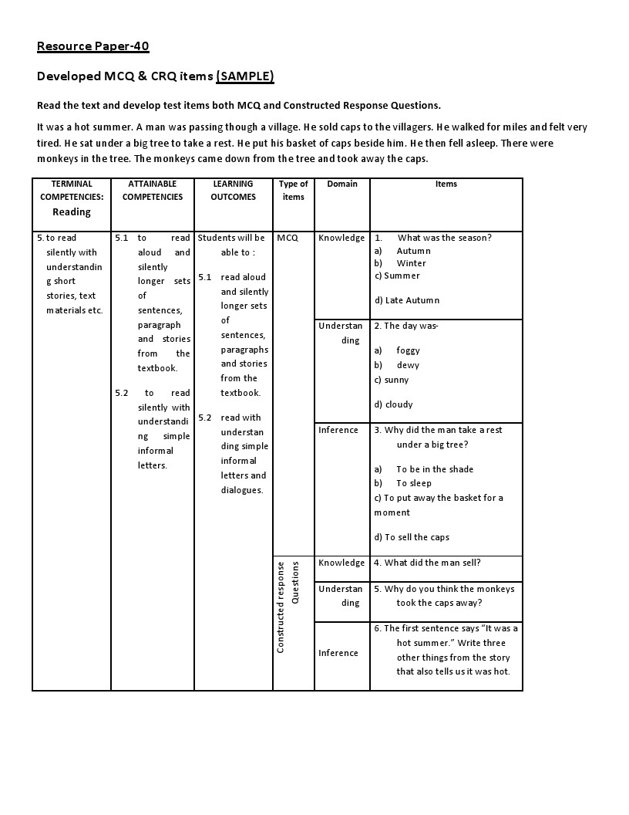

Slide 8
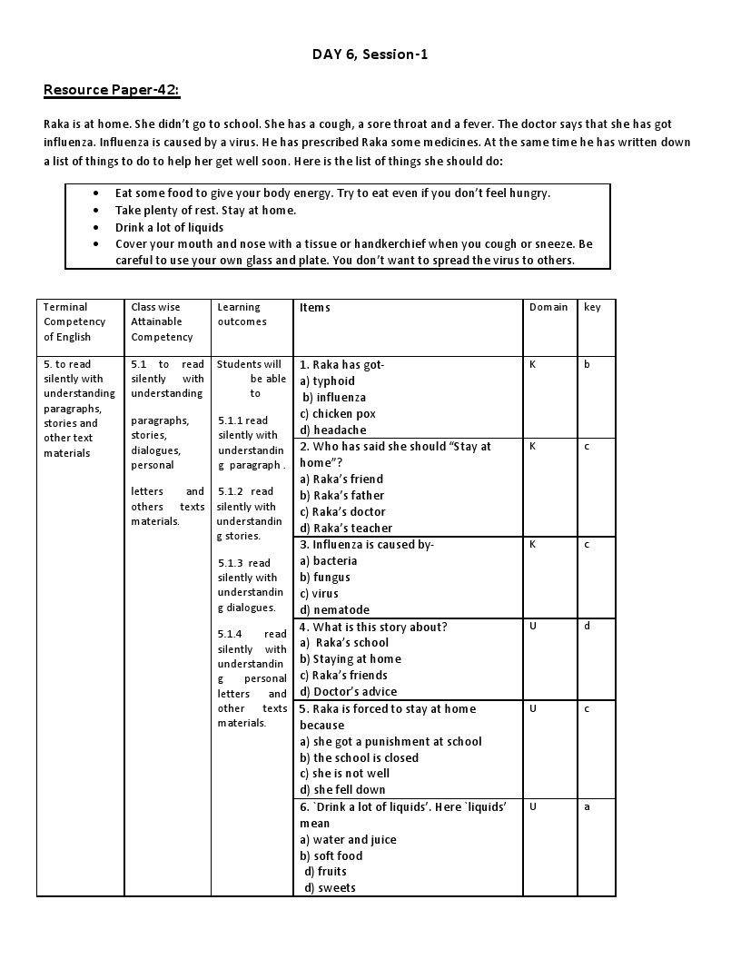

Slide 9
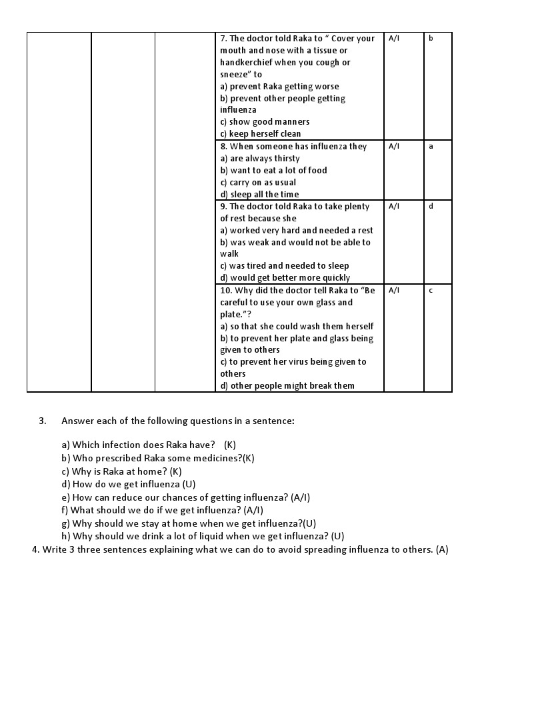

Slide 10
Develop MCQ and CRQ test items on the following lesson or given text
Group 1: Class 5, Unit:6: Eat Healthy. F. Page: 24
Group 2: Class 5, Unit 8: A. Write to me soon. Page: 30 Page:
Group 3: Class 5, Unit: 20: A. Life is Beautiful. Page: 78
Group 4: Text-1 (supplied)
Group 5: Text-2(supplied)

Slide 11
Text-1:
Anina was lying on her bed. She heard a strange noise like a quiet hissing coming from a pile of newspapers and they started to fall over. Anina could not believe her eyes as she watched a grunting and snorting crocodile come out from under the newspapers. Anina was frozen to the spot. Her eyes wide as saucers she watched the crocodile crawl completely out of the newspapers and slowly look around the room. It seemed to have just come out of the water because its whole body was dripping wet.
The crocodile moved its head back and forth letting out a hissing sound. Anina swallowed hard, looking at the crocodile’s snout with its terrible long row of teeth. It swung its tail slowly back and forth.
When Anina bent down and picked up the newspapers the crocodile whipped his tail so hard that he cracked the big vase of flowers on to the floor and they scattered everywhere. With a quick jump Anina ran out of the room and slammed the door shut and put a chair against the door.
Suddenly there was another loud crack and the door splintered. Anina ran out of the house screaming. Then…………..

Slide 12
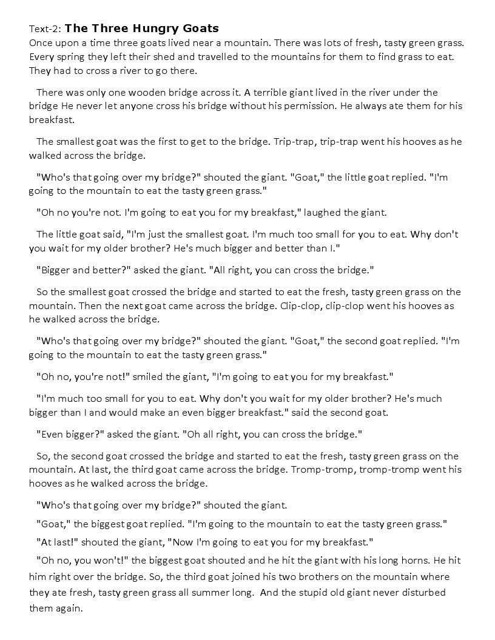

Slide 14
DAY- 6
Session-2 & 3
Practice Teaching
Activity-1: Warm up: By rhyme

Slide 15
Activity 1: Conducting lessons/classes on the prepared lesson plans:
Organize trainees into 6 groups. Distribute group work. Ask them to plan a lesson following the IPT framework on the assigned topic/lesson. Give them 20 minutes for preparation. Tell them every one of each group (or 2 persons from each group) has to present a part of the planned lesson. Also tell them the lesson will be recorded by video.
Tell each group to select who is going to present which part of the lesson. Tell when one member of a group presents the part of a lesson, the other 1 or 2 will have to make notes about how the activity is presented, how it was planned, why it was done differently

Slide 16
(Worksheet-20
Group | planning a lesson on:
A | Class 5, Unit: 20: Teaching Vocabulary
B | Class 5, Unit: 21: Reading
C | Class 4, Unit: 35: Listening
D | Class 4, Unit:41 Writing
E | Class 4, Unit 43: 4 skills
F | Class 5, Unit:18 Rhyme

Slide 17
Resources Paper-43:
OBSERVATION CHECK LIST
Serial No. | Questions | Answers
1 | What activities did the teacher use to give information/ present the input?
2 | What activities (practice activities) led the students for clear understanding of the input?
3 | Did the teacher use the materials appropriately? Give reasons in favour of your answer.
4 | What languages did the teacher use to set an activity in the class?
5 | What monitoring languages did the teacher use in the class?
6 | What assessing languages did the teacher use in the class?
7 | What are the Learning Outcomes?
8 | Areas for development with suggestions
8 | Others( if any )

Slide 18
Observation format for micro teaching
Name of the teacher (student): | Class: Session: Learning Outcome: Skill/activity to be demonstrated:
Strengths:
Areas for development:
Notes for feedback:

Slide 19
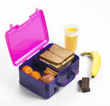

Slide 20
Day-6
Session-4
Closing of the Training Program
Activity-1: Identifying the participant’s attitude after 6 days training on English.
Distribute the opinion sheet (worksheet-21) to each participant. Ask them to give their opinions about teaching English in the primary classes. Give them 5 minutes to write their opinions.

Slide 21
Activity-2: identify the content area that required improvement and revision.
Give the training evaluation sheet (Worksheet-22) to each participant. Ask them to write their comments or put tick marks where necessary. Give them 30 minutes to write their opinions.

Slide 22
Worksheet-22
Think about these statements and ✓ the box that represents your opinion.
Sl. No. | I believe that | Strongly Agree | Agree | Disagree | Strongly disagree
1 | Language should be taught as a set of grammatical structures.
2 | Students should be corrected immediately when they make mistakes.
3 | English classes should always be taught in English.
4 | Students should be encouraged to work in groups and pairs in class.
5 | Using Bangla in an English class is an effective technique to check understanding.
6 | The teacher should maintain a quiet atmosphere in class.
7 | A good language lesson is one in which the teacher lectures well on the topic.
8 | The teacher is the main provider of knowledge in the class.
9 | Students must have excellent and correct pronunciation.
10 | Feedback to the students on their work should be positive.

Slide 23
Collect the evaluation sheets.
Analyse the comments and find out which contents need revision.
Look at the trainers/ facilitators evaluation section.
Analyse it and find out who needs professional development and which area.

Slide 24
Activity-3: Expressing participants and facilitator’s views
Ask 3-4 participants to express their personal opinions.
Note down the opinions and write a report incorporating the suggestions.
Express your overall feeling about the training.
Close the training saying thanks to all.

Slide 25
Thank you very much…

Slide 26
To make the session’s joyful & enjoyable we have tried our level best…

Slide 27
Special thanks for your great attention, participation & help to carry the session’s..

Slide 28
Thank you again..
Good bye & good luck..

Slide 29
This manual digitally developed & presented by…
Md. Lutfor Rahman
Assistant Teacher
Kundarampur Government Primary School,
Ghoraghat,
Dinajpur-5290
01717-137653
mlutfor81@gmail.com

