Slide 1
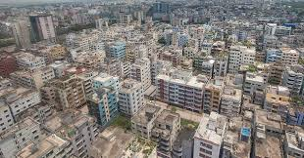

Slide 2
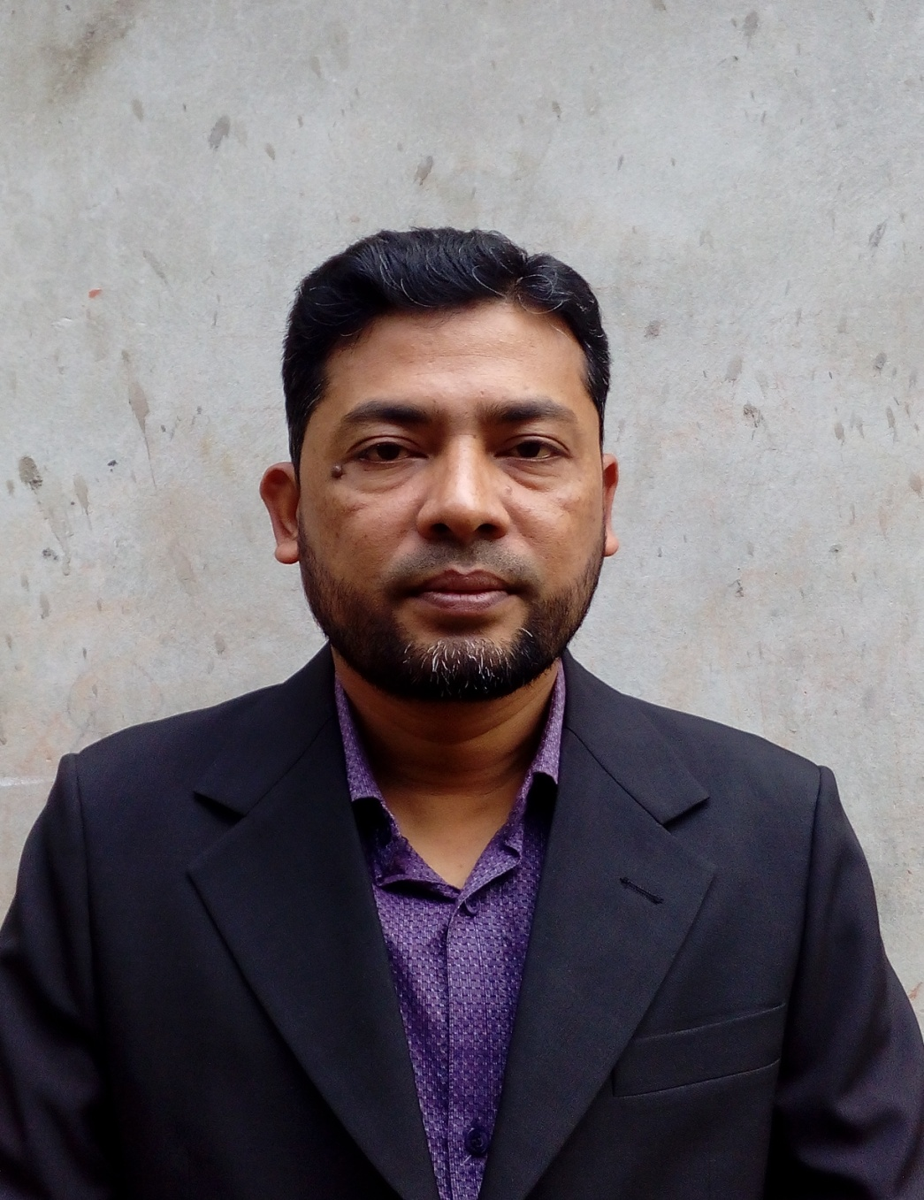
Presented by
NAME: SHAMSUDDIN.
SENIOR ASST. TEACHER.
VEDURIA SERAJIA FAJIL MADRASAH.
LALMOHAN,BHOLA.

Slide 3
LESSON IDENTITY
CLASS:SIX.
SUBJECT:ENGLISH FOR TODAY.
LESSON: 5
TIME:45 MINUTES .

Slide 4
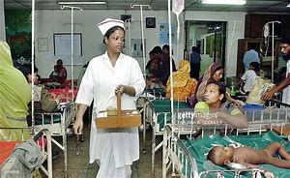
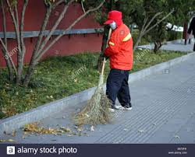
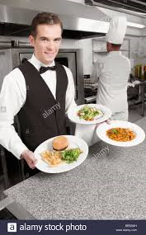
A NURSE
A SWEEPER
A WAITER

Slide 5
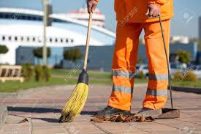
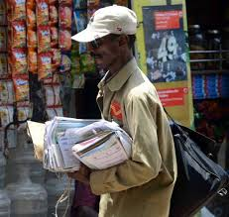
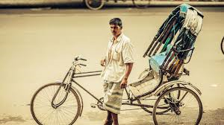
A CLEANER
A POSTMAN
A RICKSHAWPULLAR

Slide 6
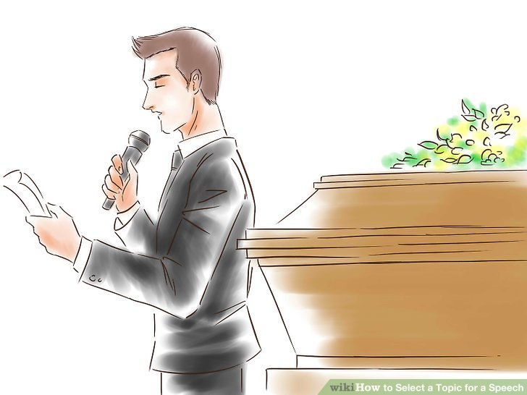
TODAY’S LESSON
‘THANKS FOR YOUR WORK’
LEARNING OUTCOME
At the end of the lesson students will be able to-
1.Describe the different occupations.
2.Narrate the importance of different occupations.

Slide 7
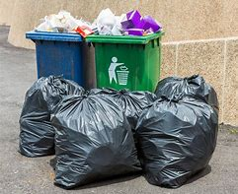
Rubbish

Slide 8
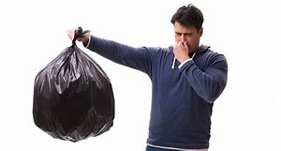
Bad smell

Slide 9
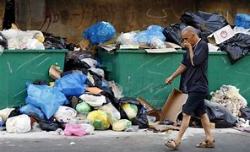
When bulbul became sick the whole area became dirty and unhygienic.

Slide 10
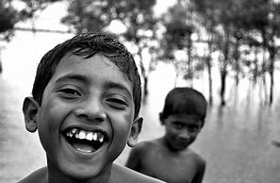
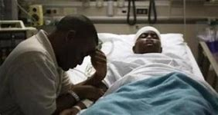
Does not mind
sick

Slide 11
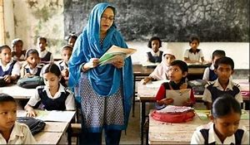
NOW OPEN YOUR BOOK AND READ THE TEXT SILENTLY

Slide 12
Answer the following questions-
1.What time does Bulbul wake up?
2.Where do the people of sankar put their rubbish?
3.What happened when Bulbul became sick?
4.Why does Bulbul think that all jobs are important?
5.What will you say to Bulbul,if you meet him?

Slide 13
LET’S WATCH THE VIDEO

Slide 14
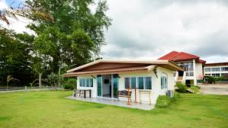
Think of a person who helps you live well.write a composition on this person.

