Slide 1
Good morning

Slide 2
Prepared by
Muhammad Jane alam
Assistant teacher
West Rashidabad Government primary school.patiya,chittagong.

Slide 3
Class:2
Subject:English
Duration:40 minutes

Slide 4
Mental Preparation

Slide 5
Do you like to eat egg?
Do you know any farmer?
Ackowledge

Slide 6
The Golden Goose Unit:29
Lesson:4-6
Page no:59
Declaration of lesson

Slide 7
At the end of the lesson,the students will be able to
1.read the text
2.tell about the story
3.write information from the story.
Learning outcomes

Slide 8
New words----- Goose,Lay,Golden,Idea,Kill,

Slide 9
Look at the following pictures carefully and discuss with your partner what you can see in the picture.

Slide 10
Listen to me and read after me.
A poor farmer has a goose.
Everyday,the goose lays an egg.It’s a golden egg.

Slide 11
Everyday,the farmer sells the egg.
The farmer thinks,”I want to be rich.I have an idea!” The farmer thinks all the eggs are inside the goose.

Slide 12
He kills the goose . He Opens its belly , but there are no eggs!
The farmer has no goose.He has no money . He is sad .

Slide 13
Open your book at page 59.

Slide 14
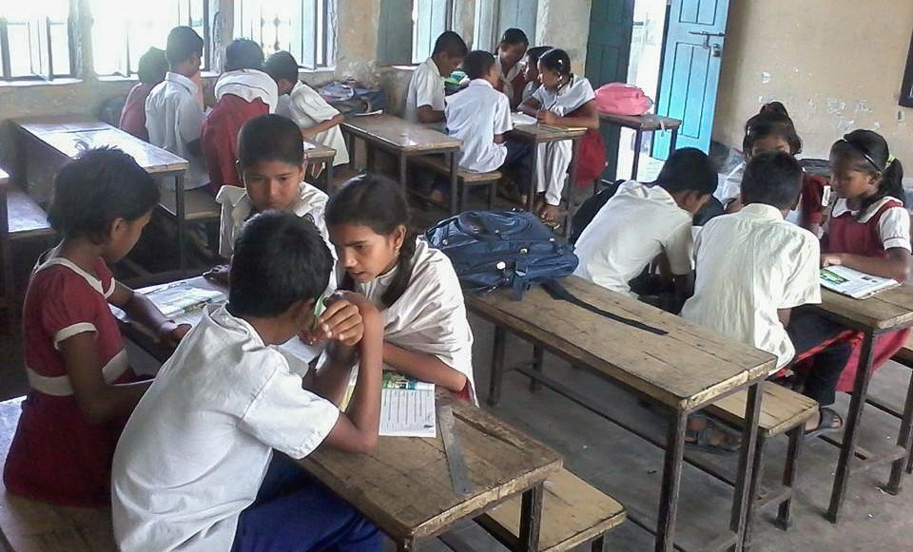
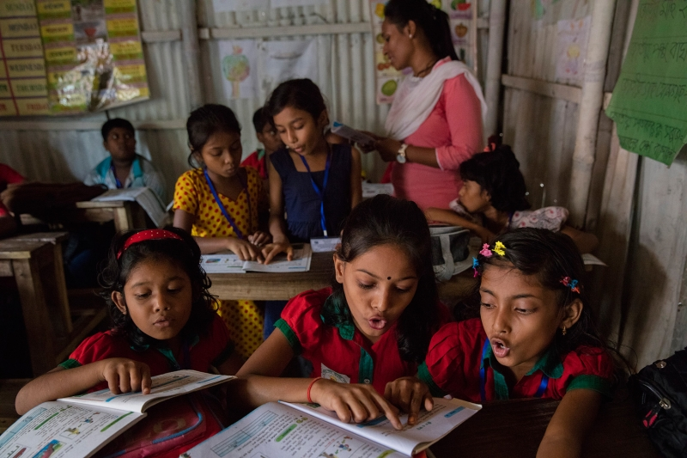
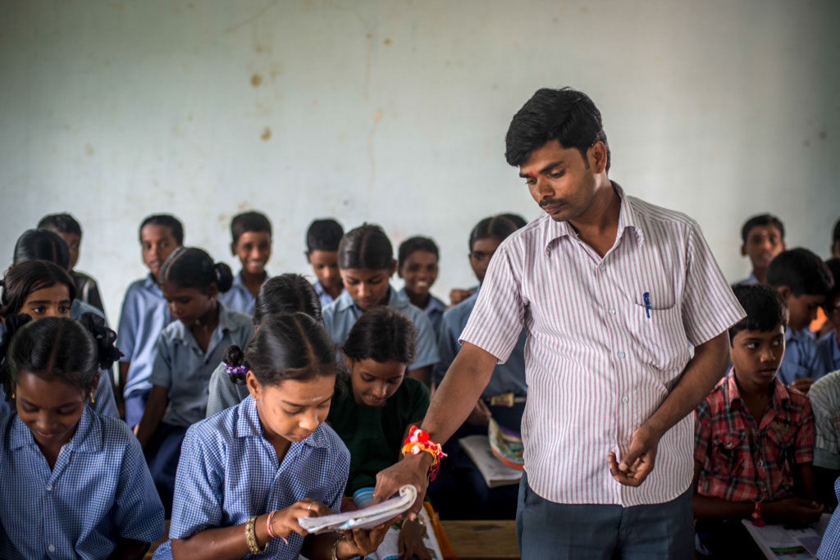
Group reading
Pair reading
Individual reading

Slide 15
Make sentence with the following words in group.
One is done for you.
Poor----Mr. Rahim is a poor farmer.
Goose---
Sell------
Think---
Kill------
Idea------

Slide 16
Write true or false in pair.One is done for you.
*Everyday,the farmer lays 5 eggs.
Answer.False.
1.The farmer sells the egg everyday.
2.The farmer buys eggs everyday.
3.The farmer is rich.
4.The farmer is sad at the end of the story.
5.There are many eggs inside the goose.

Slide 17
Answer the following questions individually.
One is done for You.
*How is the farmer?
Answer . The farmer is poor.
1.Who has a goose?
2.What does the goose lay everyday?
3.How is the egg?
4.What does the farmer sell?
5.How many eggs inside the goose?

