Slide 1
welcome

Slide 2
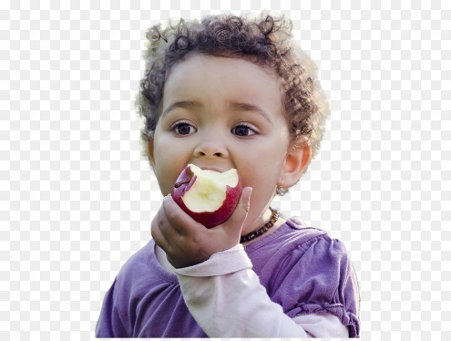
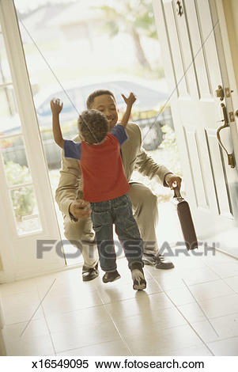
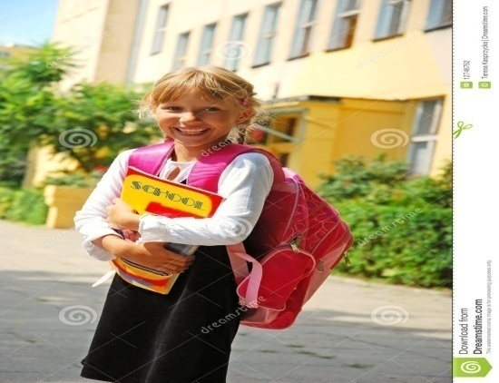
Let us see the pictures and discuss about the sentences.
He (eat) an apple.
eats
Father (come) home yesterday
comes
She (go) to school regularly
goes

Slide 3
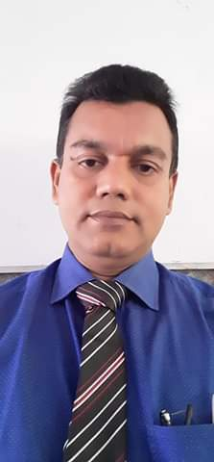
INTRODUCTION
CLASS: SEVEN
SUBJECT: ENGLISH SECOND PAPER
TOPIC: RIGHT FORMS OF VERBS (SUBJECT VERB AGREEMENT)
Nurul Amin Azad ASSISTANT TEACHER ( ENGLISH)
Jahangirpur T. Amin Govt. Pilot High School
Madan, Netrakona

Slide 4
Today our topic is
Subject Verb Agreement (Part 2)
(Right forms of verbs)

Slide 5
Learning Outcomes-
After the lesson the students will be able to –
use the right forms of the verbs in sentences.
Identify the correct form of verbs in a paragraph.

Slide 6
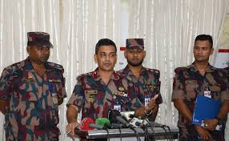
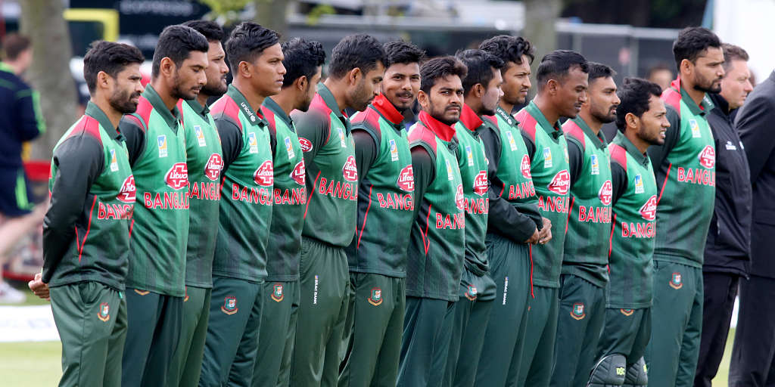
Can you choose the correct verb?
1. The Commander and soldiers was/were present.
The Captain and players is/are playing nicely.
If the nouns suggest the same person, only the first noun will take article “the” and verb will be singular.

Slide 7
Can you choose the correct verb?
1. The Commander and the soldiers was/were given reward.
2. The captain and the Players was/were playing nicely.
If the nouns suggest the different persons, both nouns will take article “the” and verb will be plural.

Slide 8
Choose the correct verbs.
1. The Inspector and constables was/were present.
2. The inspector and the constables was/were present.
Notes:
This slide is the evaluation of the previous two rules of the subject-verb-agreement.

Slide 9
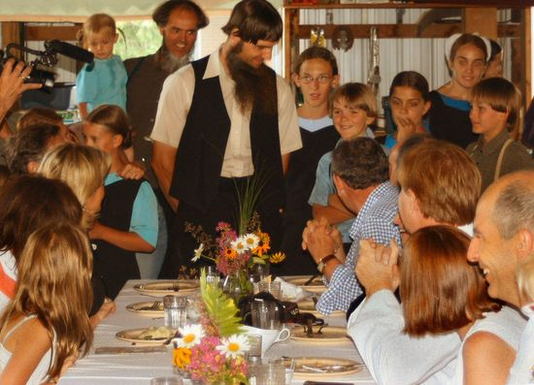
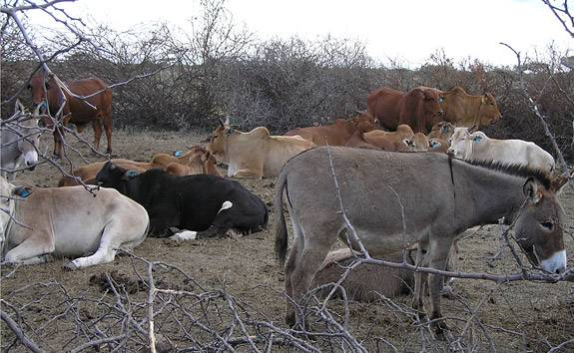
Can you choose the correct verb?
1. Each man and each woman has/have eaten.
2. Every donkey and every cow was/were given food.
When two or more nouns qualified by each / every /no, even though they are joined by and, will take singular verb.

Slide 10
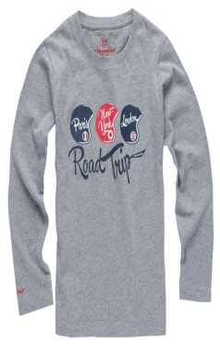
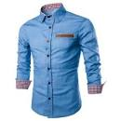
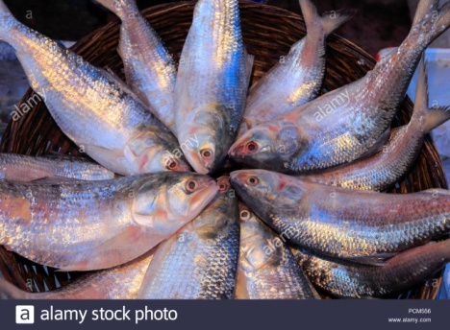
Give the answers using right forms of verbs.
1. Every shirt and every t-shirt ____ (be) made of cotton.
is
2. Each dove and each hilsha ____ (be) looking beautiful.
is
Notes:
This slide is the evaluation of the previous rule of the subject-verb-agreement in slide no. 8.

Slide 11
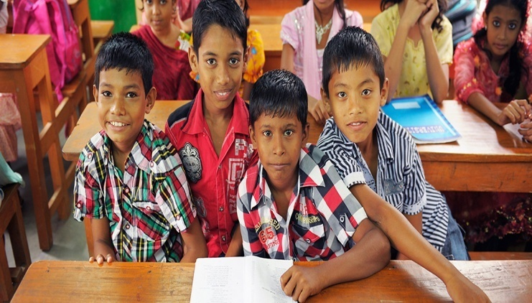
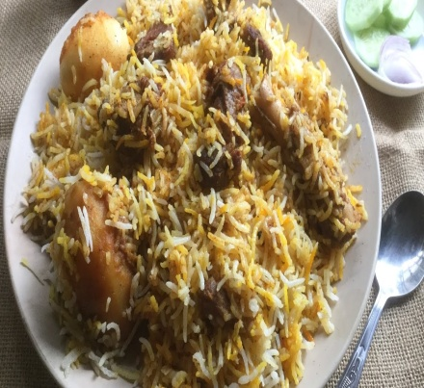
Can you choose the correct verb?
1. Rahim and not his friends has/have done the work.
2. The home made foods and not junk food is/are good for health.
If there is not + noun after and, the verb will follow the noun before and.

Slide 12
Choose the correct verb from the box and give the answers using right forms of verbs.
1. My brothers not my sister _____(be) with me yesterday.
were
2. His sister not his brothers usually ______ (sing) well.
draws
Notes:
This slide is the evaluation of the previous rule of the subject-verb-agreement in slide no. 10.

Slide 13
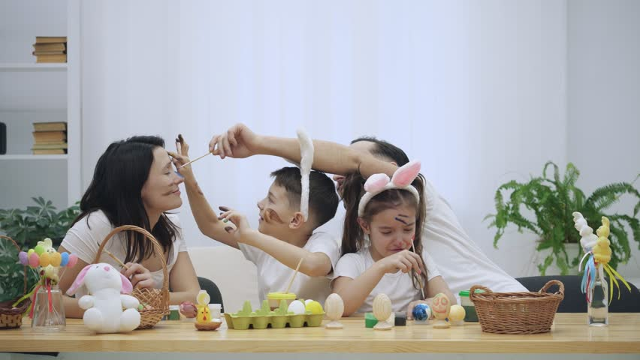
Can you choose the correct verb?
1. The Leader along with his workers is/are present in the picture.
2. The parents with their son is/are making basket.
If in the subject there is a noun or a pronoun followed by with, along with, together with, as well as, accompanied by + noun or pronoun, the verb will be according to the first noun or pronoun.

Slide 14
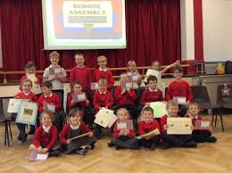
Choose the correct verb from the box and give the answers using right forms of verbs.
be, have
1. Jarif as well as his brothers _____ done well in the examination.
has
2. The students with their teacher _____ happy.
are
Notes:
This slide is the evaluation of the previous rule of the subject-verb-agreement in slide no. 12.

Slide 15
Choose the correct verbs and fill the gaps with right forms of verbs.(Pair/Group work)
have, be, read
has
1. The poet and writers _____ written the article .
have
2. The doctor and the nurse ______ treated the patient.
was
3. No rickshaw and no cycle ______ seen in the roads yesterday.
reads
4. Karim not his brothers ________ novel everyday.
Notes:
This slide is the evaluation of the previous all rules of the subject-verb-agreement in this lesson.

Slide 16
Choose the correct verbs and fill the gaps with right forms of verbs.(Pair/Group work)
have, be, draw
has
5. Tasin accompanied by his sisters ______done the work.
is/was
6. Each glass and each plate _______ of plastic.
has
7. Asif together with his friends ______ just left the village.
are
8. Jarif’s brothers not his sister ______ going to his friend’s house.
Notes:
This slide is the evaluation of the previous all rules of the subject-verb-agreement in this lesson.

Slide 17
Thank You All

