Slide 1
Welcome

Slide 2
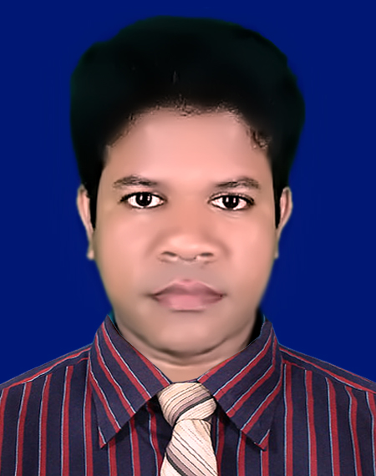
IDENTITY
Azizul Fakir
Assistant teacher
Dighijan Secondary School
Nazirpur, Pirojpur.
Email: azizul.nk@gmail.com
Mobile: 01710745128
Unit – Three
Lesson – 6
Health and hygiene
50 mins

Slide 3
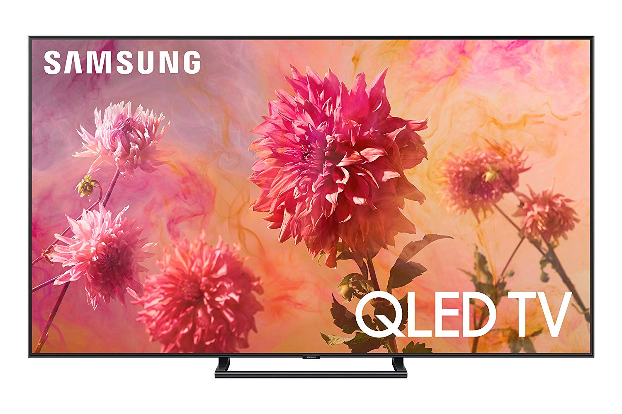
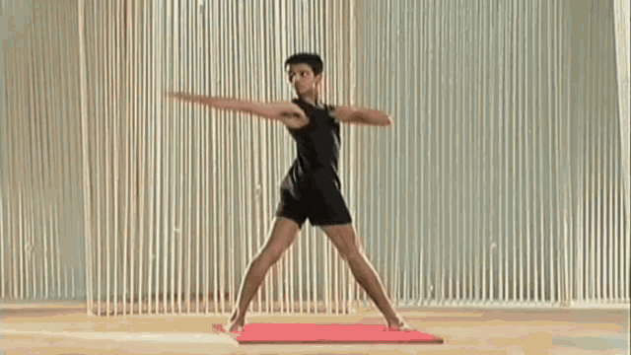
Dear students, lets enjoy a picture.
Dear students what is the picture about?
The man is doing physical exercise

Slide 4
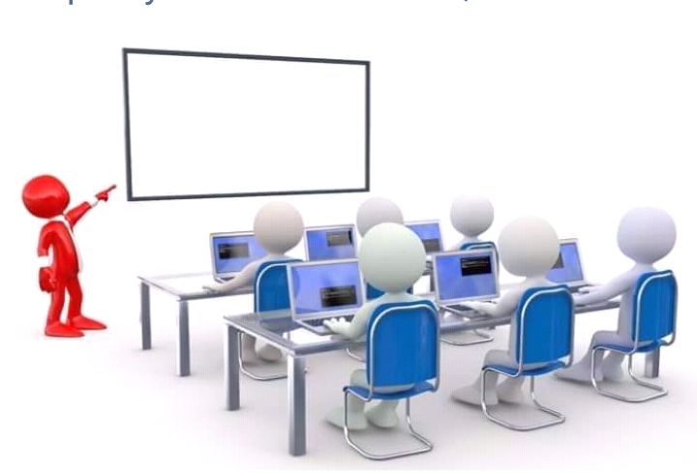
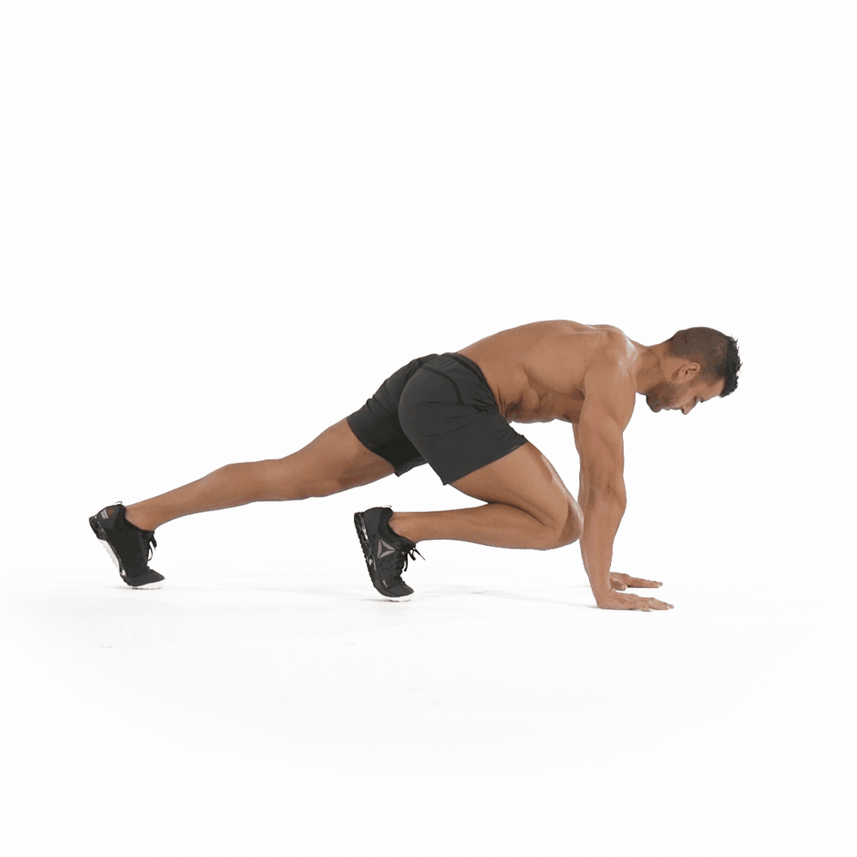
So our today’s topic is
Physical exercise
Unit – 3
Lesson - 6

Slide 5
Learning outcomes
After completing the lesson students will be able to
1
infer meaning from the context
2
talk about the pictures
write answers to the questions.
3
4
tick the best answers from the alternative
listen for information to the CD
5

Slide 6
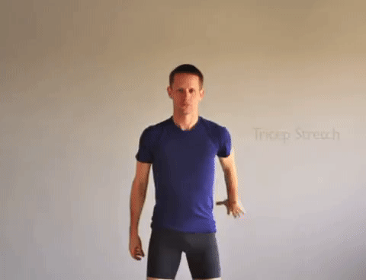
keyword
stretching
Part of speech – verb+ing
Meaning
enlarging
Stretching is a free hand exercise.

Slide 7
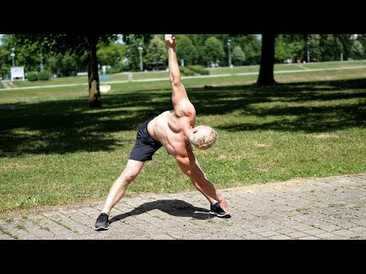
keyword
benefit
Part of speech – noun
Meaning
advantage
The benefits of physical exercise are many

Slide 8
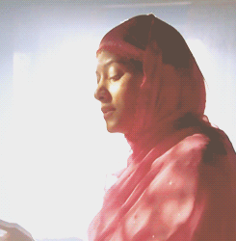
keyword
regularity
Part of speech – noun
Meaning
promptness
Physical exercise teaches us regularity

Slide 9
Open at page 27 in your text book and read the passage carefully.
Mr Pronoy Larma, the physical teacher of Roopur High School is talking about health to his students.
“What things are necessary for good health?” he asks the students.
We need a lot of things, teacher,” says Rushad. “We need healthy food, proper rest and sleep. We also have to be clean and tidy.”
“Good!” says Mr Larma. “These are the things you need for good health. But another thing that you also need is regular physical exercise.”
“What types of physical exercise can we do teacher?” asked Rayeed.

Slide 10
“Well,” says Mr Larma. “These are different kinds of physical exercise. You can do then indoors as well as out doors. In the house you can do some freehand exercises. That is, you can stretch different parts of your body. Outside, you can play, swim or simply walk.
“Why do we need physical exercise, teacher?” asks Ranjan.
“Well” , says Mr Larma, “The benefits of physical exercise are many. The greatest of them is that it keeps you fit for work. It also gives you energy, and makes you strong and cheerful. It teaches you regularly and discipline as well.”

Slide 11
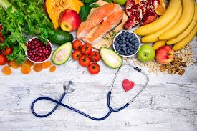
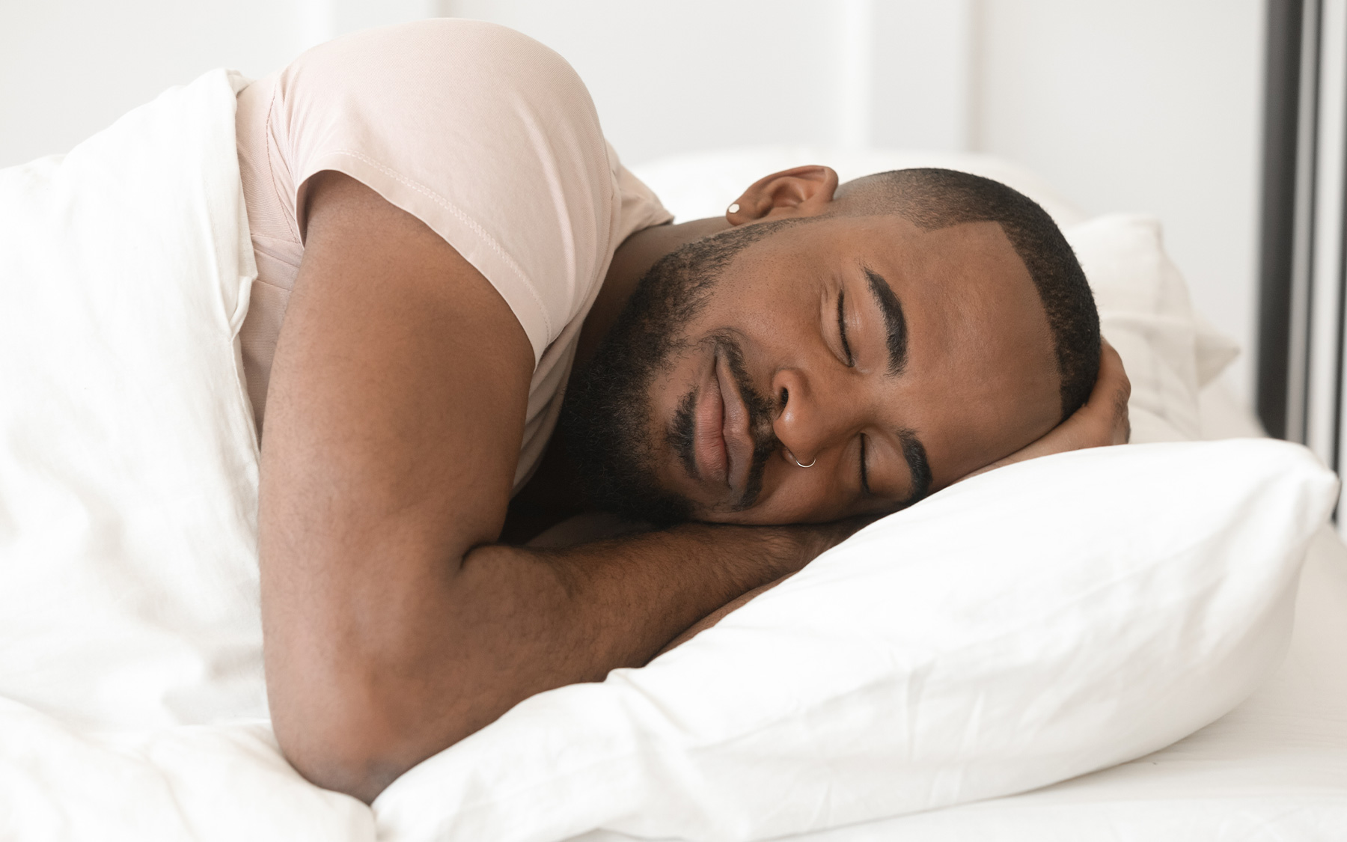
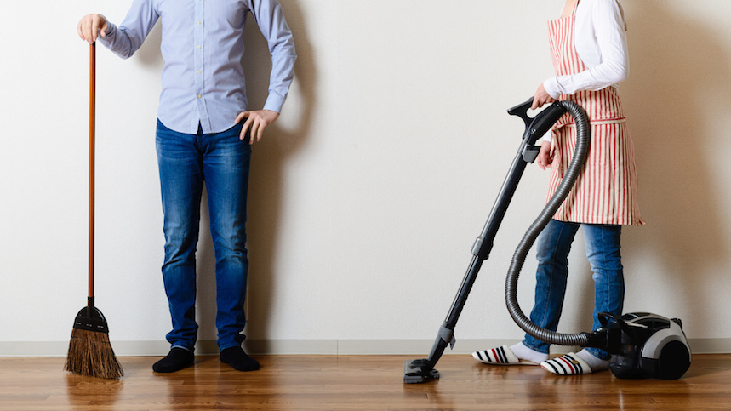
Dear students, look the pictures carefully
Dear students, what do you see in the pictures?
Good food
Sleeping
Cleaning

Slide 12
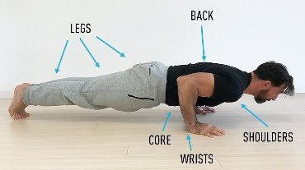
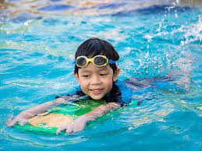
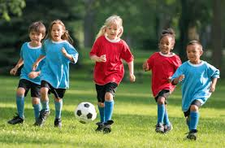
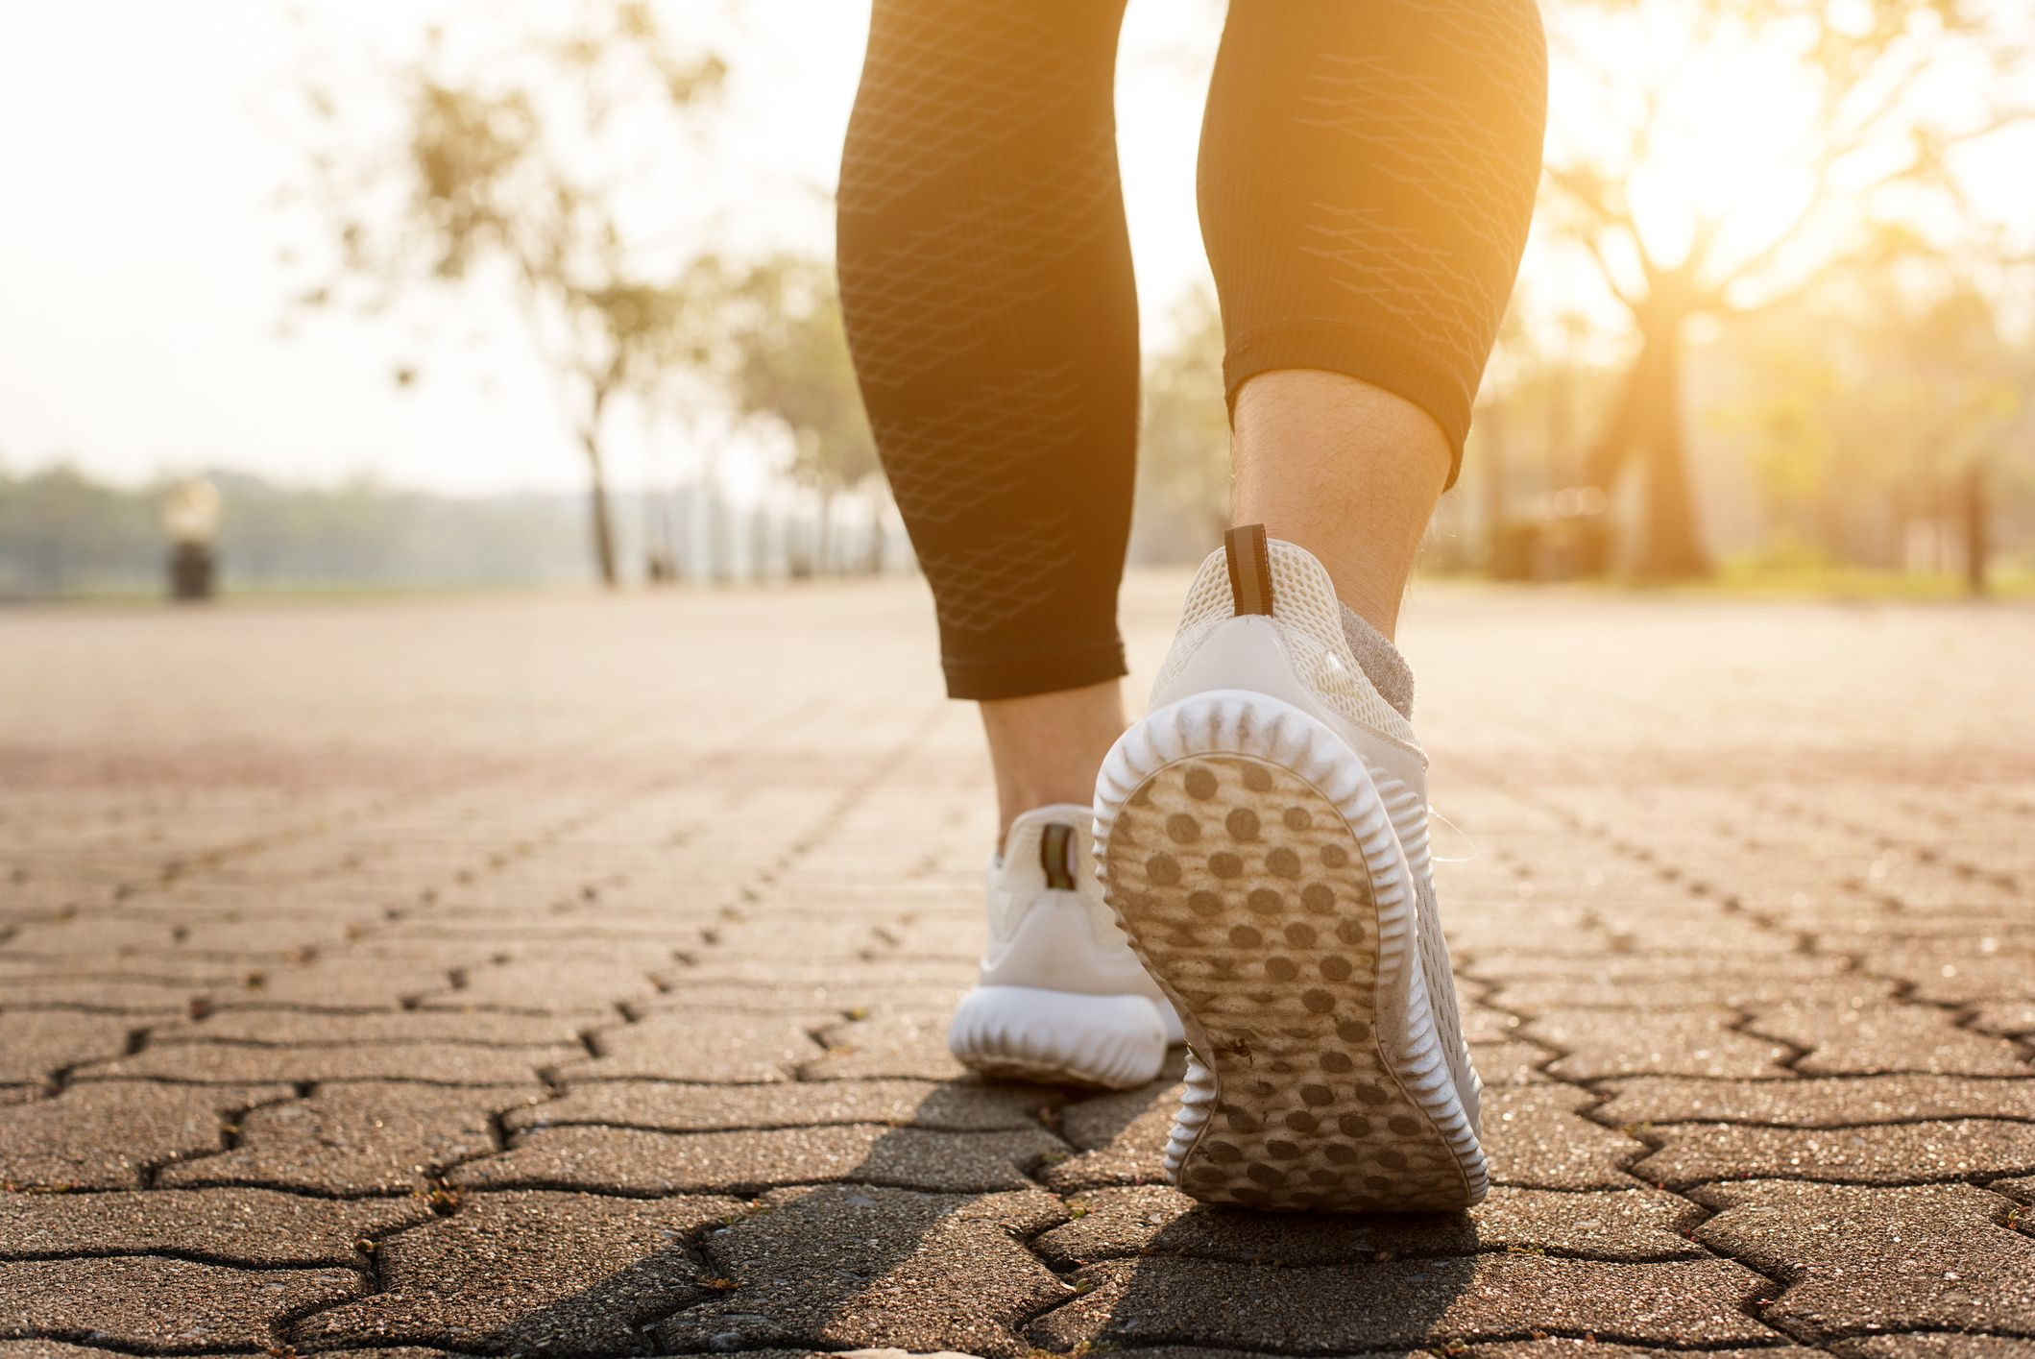
Dear students, look the pictures carefully
Dear students, what do you see in the pictures?
Free hand exercise
Swimming
Playing
Walking

Slide 13
Time 3mins
12
1
11
10
2
9
3
Individual works
8
4
7
5
6
Answer the following questions
Q1: What things are necessary for good health?
Q2: How many physical exercises are there?
Q3: Why do we need physical exercise?
Check your answers
Ans1: a lot of things are necessary for good health. These are healthy food, proper rest
and sleep, clean and tidiness, and above all physical exercise.
Ans2: There are different kinds of physical exercises, both indoors and outdoors like free
hand exercise, playing, swimming, walking etc.
Ans3: We need physical exercise to keep ourselves fit for work, to get energy, to be
strong and cheerful, to learn regularity and discipline etc.

Slide 14
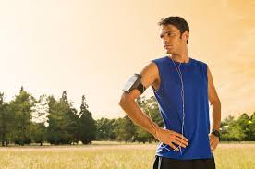
Keeping good health also need is regular physical exercise.
We can do then indoors as well as out doors. In the house we can do some freehand exercises. That is, we can stretch different parts of our body. Outside, you can play, swim or simply walk.

Slide 15
Pair works
Q1. Why do we need physical exercise?
Q2. What physical exercise do we do?
Q3. Do you have physical education teacher in your school? How does s/he help
you to do physical exercise?
12
1
11
10
2
5mins
9
3
8
4
7
5
6

Slide 16
Check your answers
Ans1: We need physical exercise to keep ourselves fit for work, to get energy, to be
strong and cheerful, to learn regularity and discipline etc.
Ans2: I do free hand exercise, swimming and walking.
Ans3: Yes, we have a physical education teacher in our school. He teaches us
various types of free hand exercises before we start our class. Thus he help us
to do physical exercise.

Slide 17
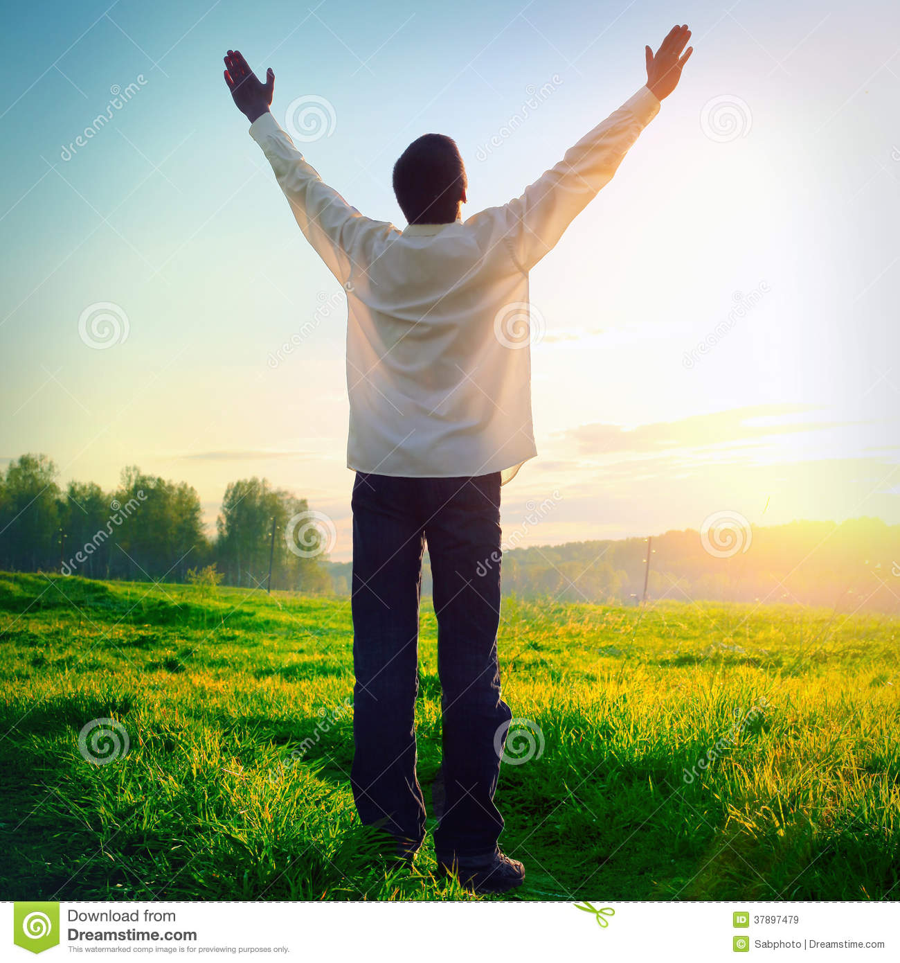
“The benefits of physical exercise are many. The greatest of them is that it keeps you fit for work. It also gives you energy, and makes you strong and cheerful. It teaches you regularly and discipline as well.”

Slide 18
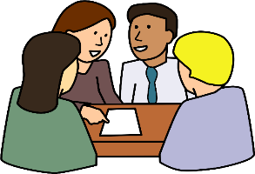
Time 6mins
Group works
12
1
11
10
2
9
3
8
4
7
5
6
Q1: Why do you need regular physical exercise?
Q2: What’s your favorite sport? Do you take part in it? If, so, where
do you play it and who with?
Group A
Q1: What does physical exercise teach you?
Q2: Do you do physical exercise every day? What sort of exercise do
you do?
Group B

Slide 19
Check your answers
Ans1: We need physical exercise to keep ourselves fit for work, to get energy, to be strong and cheerful, to learn regularity and discipline etc.
Ans2: My favorite sport is cricket. Yes, I take part in it. I play it in the school playground with my friends.
Group A:
Ans1: Physical exercise teaches us regularity and discipline.
Ans2: Yes, I do physical exercise every day. I do free hand exercise, walking, swimming etc.
Group B:

Slide 20
Tick the best answer.
What does the word ‘necessary’ mean?
i. valueless ii. Expensive iii. urgent iv. Desired
(b) Which one is a indoor physical exercise?
i. foot ball ii. cricket iii. hockey iv. table tennis
(c) What is needed to work?
i. strength ii. Smartness iii. Cleanliness iv. dress
(d) The word ‘proper’ means ----
i. accurate ii. local iii. global iv. rare
(e) People need regular exercise. ‘Regular’ is the opposite of ---
i. irregular iii. iregular iv. Irregularity iv. unregular
(f) What does the word ‘tidy’ refer to?
i. dirt-free ii. dirty iii. bright iv. dark
(g) What kind of food should we eat?
i. healthy food ii. adultareted food iii. fast food iv. junk food
$$$$
$$$$
$$$$
$$$$
$$$$
$$$$
$$$$

Slide 21
Listen to the CD
Evaluation
Now fill the passage from your listening.
There are different things that are (a) --- for good health. Physical exercise is (b) --- of them. It is very important. It keeps our body (c)---for work. It also gives us (d) ---, and makes us strong and cheerful. So we all should (e) --- physical exercise.

Slide 22
Check your answers
There are different things that are (a) necessary for good health. Physical exercise is (b) one of them. It is very important. It keeps our body (c) fit for work. It also gives us (d) energy, and makes us strong and cheerful. So we all should (e) take physical exercise.

Slide 23
Homework
Stay home
Stay safe
Here a is list of some physical exercises. Tick which one/ones you like. Then tell the class the reason/s for your liking. Finally write in your notebook which ones are indoor exercises and which are outdoors, and which ones can be done both indoors and outdoors.
List of exercises 4. jogging
playing 5. walking
Swimming 6. stretching
skipping

Slide 24
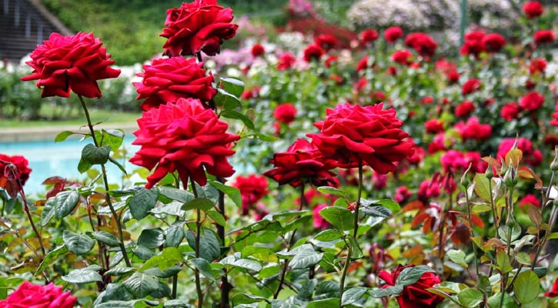
Thanks

