Slide 1
Welcome

Slide 2
Teacher’s Identity
Name: Md.Bul bul Husain Post: Assistant Teacher (English) School’s Name: Chantara Gano High School Upazilla: Ghatail
Dist.: Tangail.
Email : bulbulhusain2@gmail.com

Slide 3
Lesson Information
Class- Eight
Sub: English second Paper
Unit- Four, Lesson-one
Time: 50 minutes
Date:07.07.2020

Slide 4
Look at the following pictures and try to guess what our today’s lesson is.....
.
Tallest
Taller
Tall

Slide 5
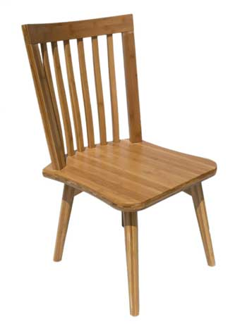
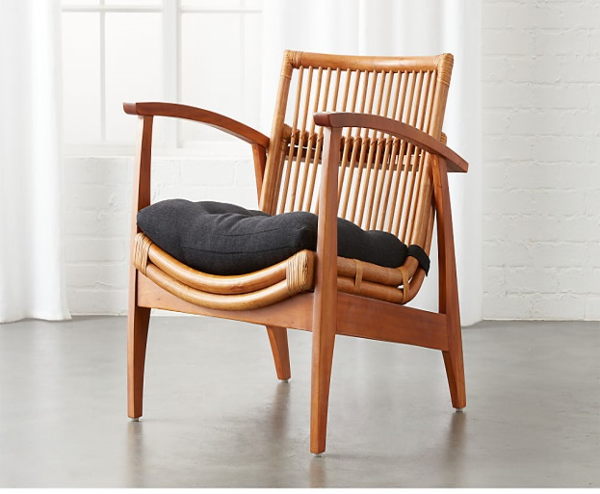
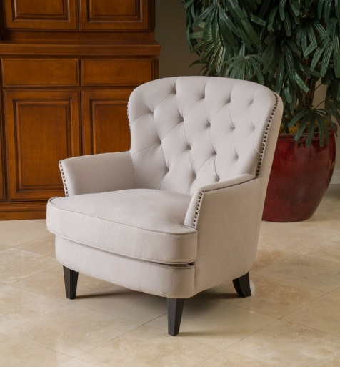
Beautiful
More beautiful
Most beautiful
Comfortable
More comfortable
Most comfortable

Slide 6
Today we will learn about ‘Comparison of adjectives/Degree of adjectives’.

Slide 7
Learning outcomes
By the end of the lesson, learners will have to-
know the various kinds of degrees .
use different kinds of degrees in their real life.
learn the structure of various kinds of degrees.

Slide 8
‘Degree of adjectives’.
A degree in English grammar refers to the level or intensity of an adjective or adverb. There are three degrees of comparison.

Slide 9
Positive degree
Kinds of degree
Superlative degree
Comparative degree

Slide 10
How to identify various kinds of degrees?
Positive | Comparative | Superlative
(a) Start with ‘No other’ | (a) Than any other | (a) The +superlative
(b) Start with ‘Very few’ | (b) Than all/most other | (b) One of the +superlative
(c) As/so adjective as | (c) Comparative form of adjective | (c) Superlative form of adjective
(d) As……As/So….As | (d) Than | (d) X

Slide 11
Rule - 01
Sup: Sub + verb + the + sup. form of adjective + extension.
Example: He is the best boy in the class.
Com: Sub + verb + com. form of adjective + than any other + extension.
Example : He is better than any other boy in the class.
Pos: No other + extension +verb + as/so +
pos. form of adjective + as + sub.
Example: No other boy in the class is as good as he.

Slide 12
Rule:02
Sup: Sub + verb + one of the + sup. form of adjective + extension.
Example: He is one of the best boy in the class.
Com: Sub + verb + com. form of adjective + than most other + extension.
Example : He is better than most other boy in the class.
Pos: Veryfew + extension +verb + as/so +
pos. form of adjective + as + sub.
Example: Very few boys in the class are as good as he.

Slide 13
Individual Work
Find out the correct answer from the alternatives.
1. Computer is one of ..........inventions of modern science.
a. the great
b. the greater
c. the greatest
2. Padma is.....................than any other river.
a. large
b. larger
c. the largest
3. She is a ...............house wife.
a. good
b. well
c. the best
4. Tangail is ................than any other district in Bangladesh.
a. famous
b. more famous
c. most famous

Slide 14
Pair Work
Fill in each gap with correct form of degree using the words from the box below.
Happy tall fast hot interesting
1. A horse runs --------than a cow.
2. The weather is -----today than yesterday.
3. Tanvir is one the ------ men in the village.
4. Sumi is the -----of all the girls in our class.
5. This book is -------I have ever read.
1.faster
2.hotter
3.tallest
4.happiest
5.interesting

Slide 15
Evaluation
Fill in the gaps with appropriate forms of adjectives given in the parenthesis.
I meet a.......................(taller) boy in a bazar. He is not .............(tall) than my brother. My brother is the................(tall) boy in the village. He is also a good player. No other boy in the village is as ..................(cleverer) as my brother. He is one of the .................(honest) boys in the village.

Slide 16
Home work
Transform the following sentences as directed in bracket.
1. Akbar is one of the greatest kings in India. (comparative)
2. No other man in the village is as wise as Fuad. (superlative)
3.He is stronger than I. (positive)
4. Very few girls in the class are as intelligent as Jui. (superlative)
5. Tanvir is cleverer than any other boy in the school.(comparative)

Slide 17
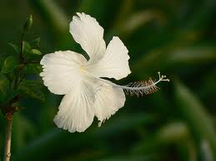
Thank You, every body.

