Slide 2
Prepared by:
Muhammad Noore Alam
Chandgaon Government Primary School.
Laksam, Cumilla.
Today’s Lesson:
Class:5
Lesson:9 ;A Firefighter
(Raju is a……departments.)
Lesson’s Unit: 9
Time: 45 minutes

Slide 3
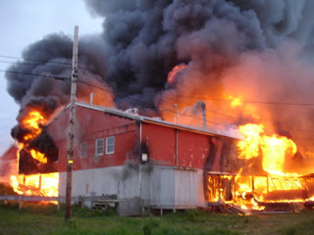
Creating emotion
What will you do if you see a house set on fire ?
What do you see in the picture?

Slide 4
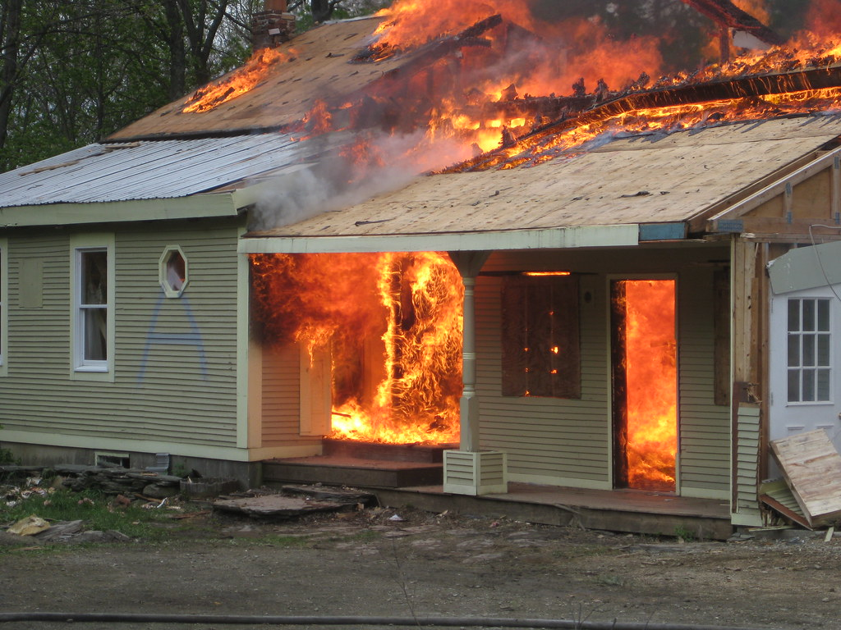
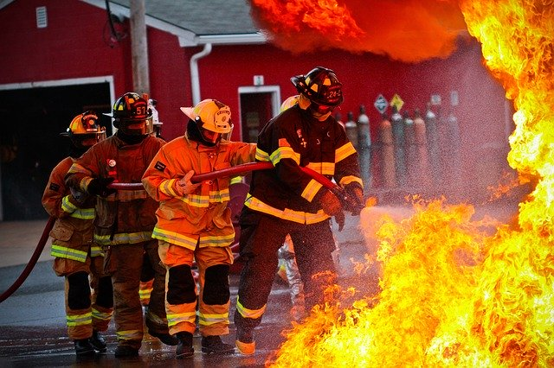
Today’s Lesson
What do you see in the picture?
Who put out the fire?
A firefighter
A house is burning.
Firefighters

Slide 5
Learning outcome
Students will be able to-
1.read words, phases and sentences in the text with proper punctuation, stress and intonation
2.ask and answer Wh question .
3.say what others are doing.

Slide 6
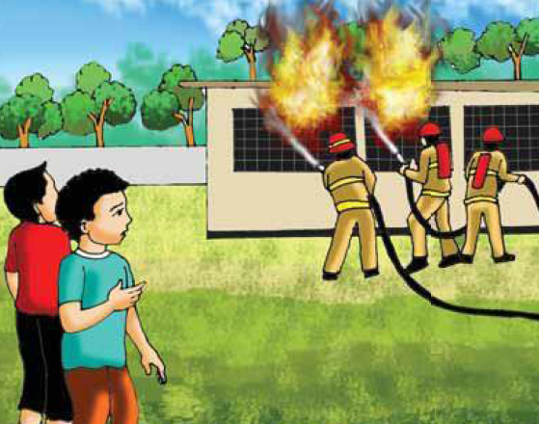
Long time ago,
when Raju was in class 5,
there was a fire in his school building.

Slide 7
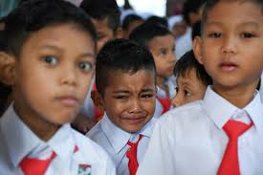
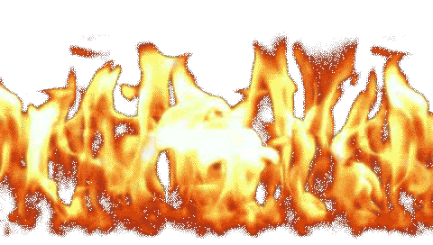
Everyone was afraid but no one panicked.

Slide 8
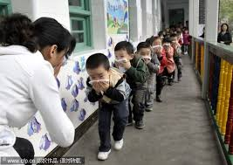
Teacher help the student to leave the building quietly and safely.

Slide 9
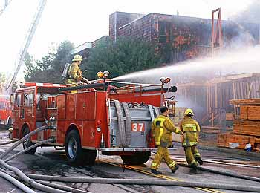
Soon a fire brigade came and put out the fire.

Slide 10
Raju watched the firefighter from the school yard.

Slide 11
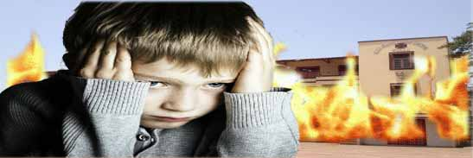
He thought about the fire and the firefighters for a long time.

Slide 12
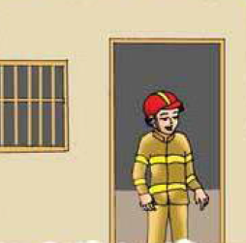
AS a volunteer, he didn’t get any money for his work. But Raju didn’t mind.

Slide 13
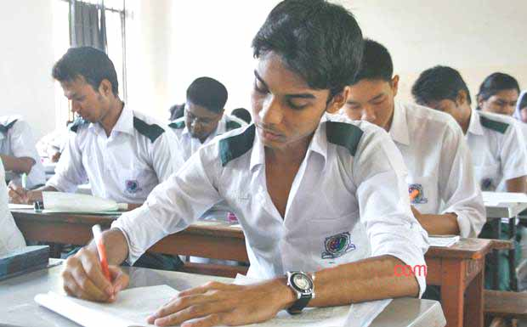
After college, Rajujoined a volunteer fire department.

Slide 14
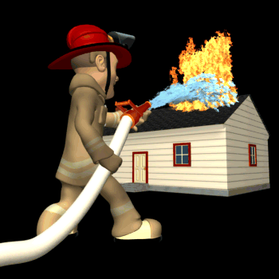
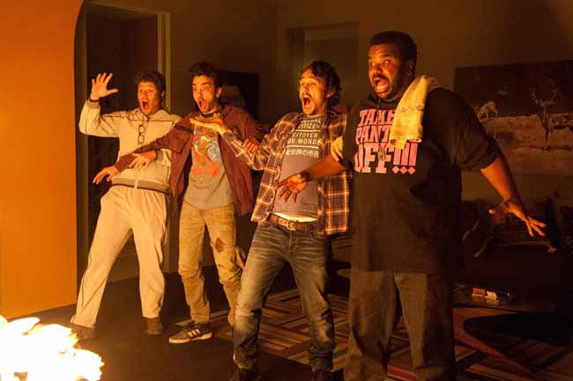
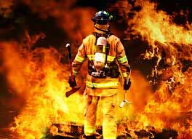
Vocabulary
Meaning
A sudden feeling of great fear that can not be controlled
to stop something from burning
Firefighter
A person whose job is to put out the fire
Panicked
Put out

Slide 15
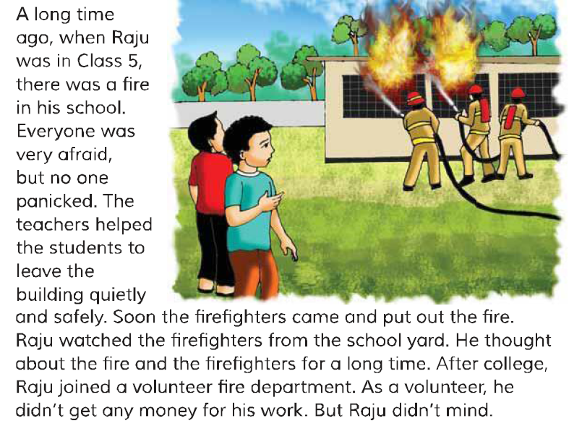
Open your book at page 34. And read after me.

Slide 16
Read the text again silently.

Slide 17
Work in pair
Say true or false.
Raju’s school got a fire, when he was in class 2
Everyone got panicked to see the fire.
Raju could not forgot the incident of the picnic.
Raju is a Firefighter
Trure
False
False.
False

Slide 18
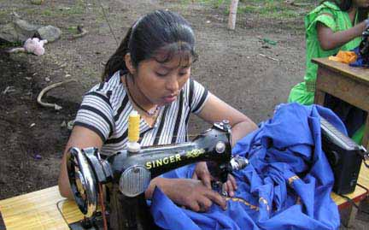
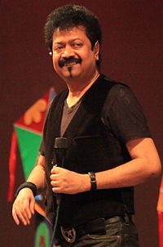
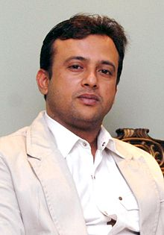
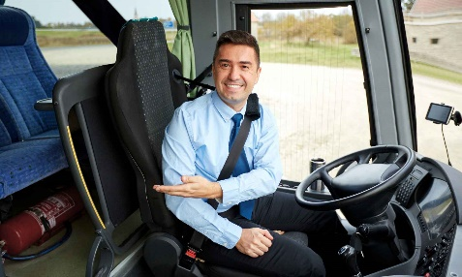
Group work
dressmaker
group
What does a …….……..do?
singer
group
film actor
group
bus driver
group

Slide 19
Questions
Answer the following questions
(a)Who is a firefighter?
(b)What is the work of the firefighter?
(c)When was there a fire in his school building?

Slide 20
Home work
Write 5 lines about Raju.

Slide 21
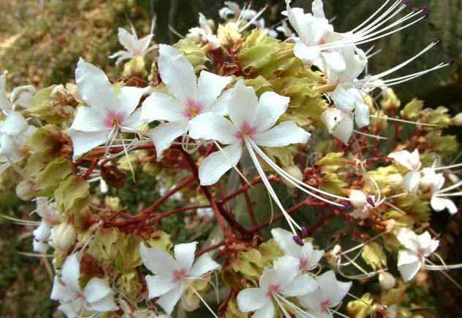
Don’t play with fire.
See you again

