Slide 1
Welcome to this class
Dear students.

Slide 2
Md. Alamgir Hossain
Assistant Teacher (Computer)
Rahimapur Fazil Madrasha.
Patnitola, Naogaon
Subject : English 2nd paper
Introduction
Notes:
Introduction of the teacher & the class.

Slide 3
Class- vi-x
Story writing
Time:60 minutes
Date:20/06/2020
Lesson Introduction

Slide 4
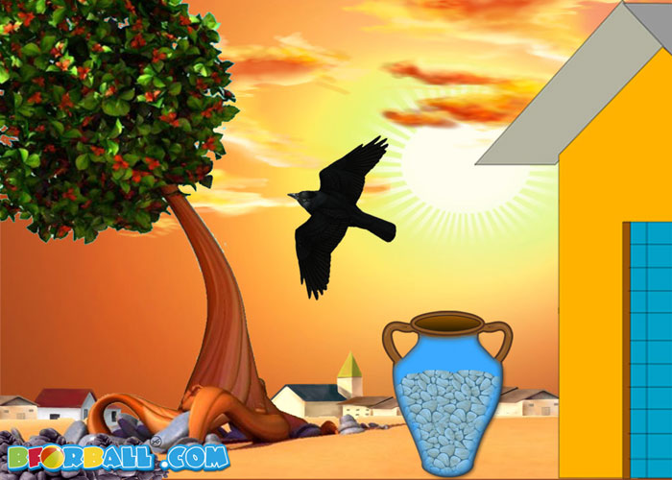
Let’s see the pictures and say by thinking
Can you guess what are we going to learn today?

Slide 5
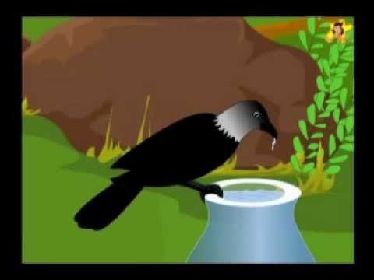
The story about “A Thirsty Crow”

Slide 6
Learning Outcomes
After completing this lesson , students will be able to-
Write the story about Thirsty Crow and so on.
Apply their creativity.
prepare themselves .

Slide 7
Lets enjoy a vedio

Slide 8
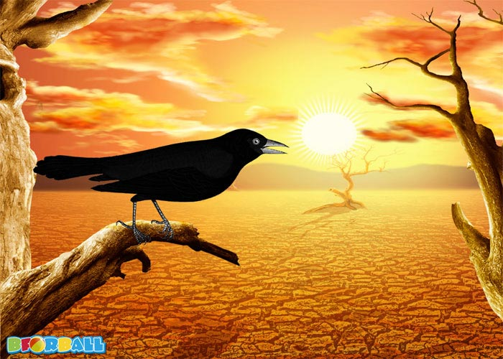
Once there was a crow, which was very thirsty.

Slide 9
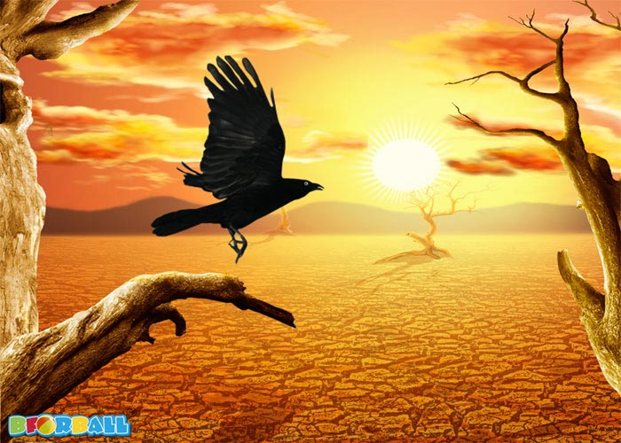
It started searching for water.

Slide 10
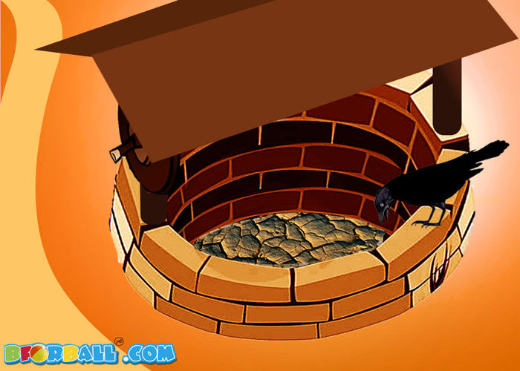
For a long time it could not find the water.

Slide 11
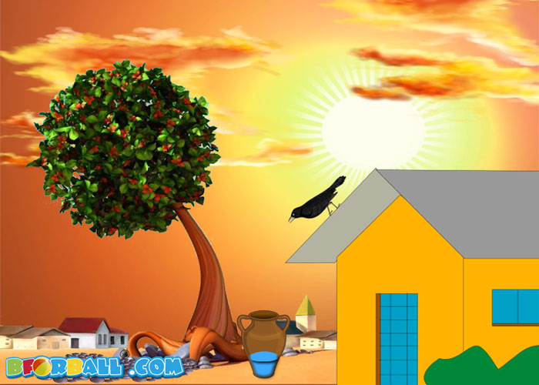
Suddenly it saw a pot with water.

Slide 12
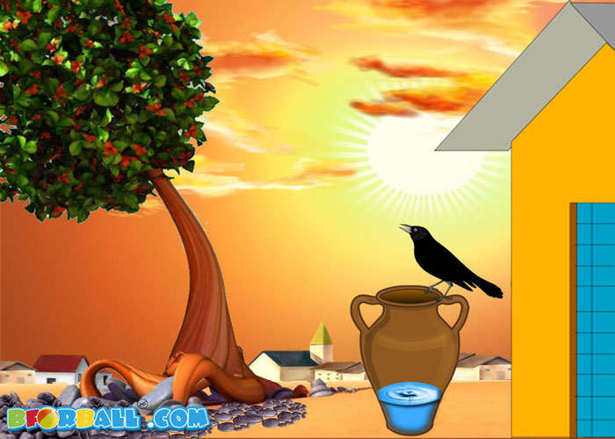
But, there was only little water in the pot.

Slide 13
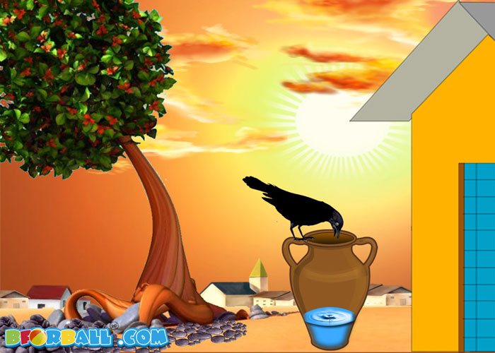
The crow could not reach the water.

Slide 14
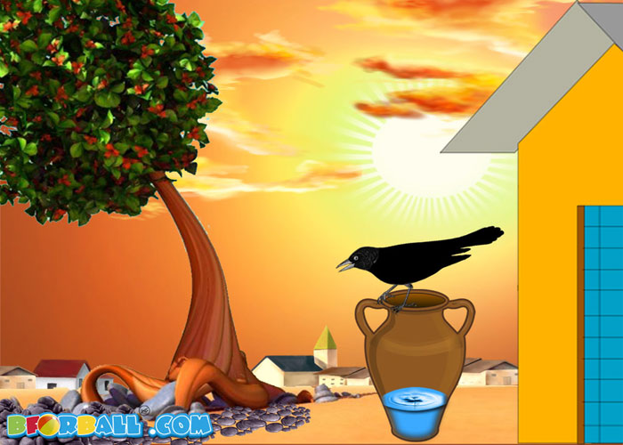
The crow saw some pebbles around the pot and suddenly got an idea.

Slide 15
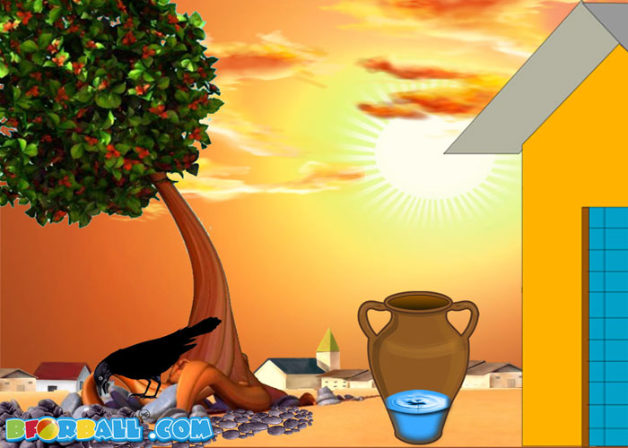
The crow picked the pebbles.

Slide 16
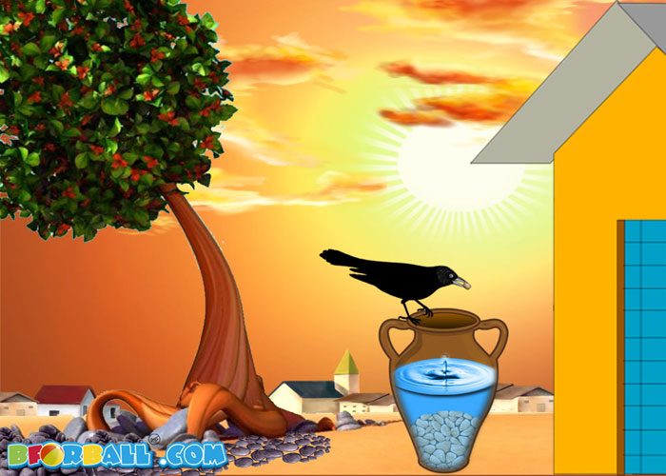
The crow dropped the pebbles into the pot.The water is raise up and the crow drink it.

Slide 17
The crow flew away happily.

Slide 18
Pair Work
1.Why was the crow gather pebbles?
2.What is the result?

Slide 19
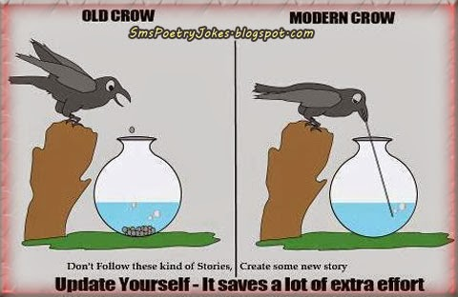
Group Work
Give your idea about the picture

Slide 20
Home Work
Complete the following story and give title
One day two friends were going through a jungle. ……….

Slide 21
Moral of the thirsty crow story is 'Where there is a will there is a way'

Slide 22
Thank you to all

