Slide 1
Welcome

Slide 2
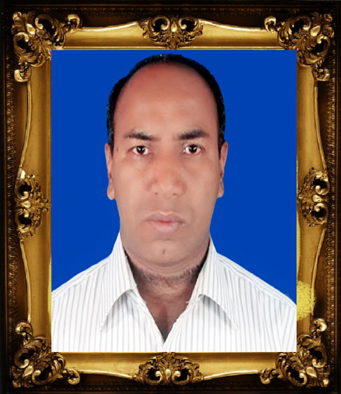
Introduction
Md. Alamgir Hossain
Assistant Teacher of
Rahimapur Fazil Madrasha, Patnitala, Naogaon.
G-mail: alamgirchz@gmail.com
Lesson’s Identity
ClassIX
English 2nd-(Grammar)

Slide 3
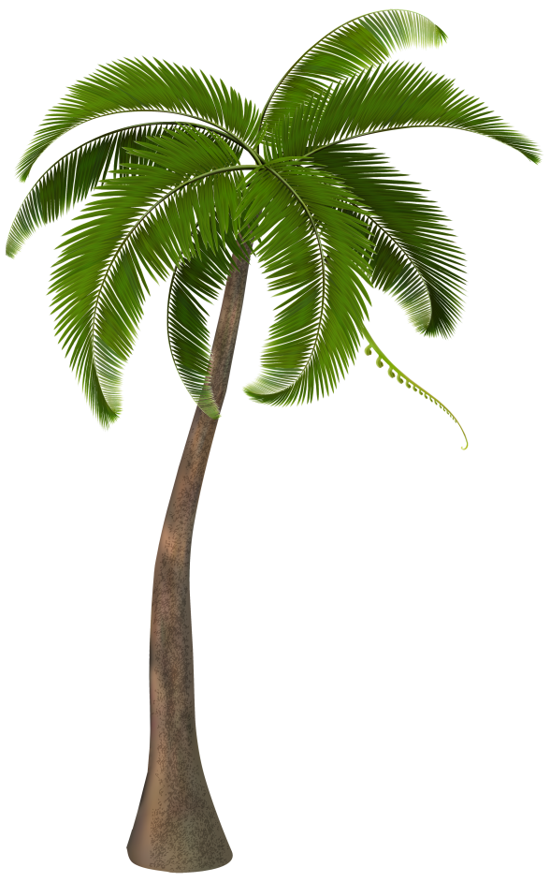
Upper Part
Lower Part
A complete tree

Slide 4
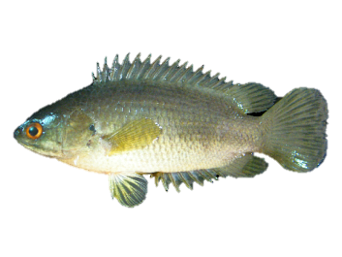
Front part
Back part
A complete fish

Slide 5
First part
2nd part
The war of 1971
brought our freedom.
Sentence
Notes:
Two parts of a sentence shown.

Slide 6
What do you mean by the image and text?
Sentence and its parts.
Notes:
Taking out the subject of today’s class.

Slide 7
Our today’s lesson is-
Part of a sentence
Unit-1, Lesson-1
Notes:
Lesson declaration.

Slide 8
Learning outcomes
After studied this lesson, we will be able to---
define sentence
know the parts of a sentence
identify the parts of a sentence
to match subject and predicate
Notes:
Target to achieve from this lesson.

Slide 9
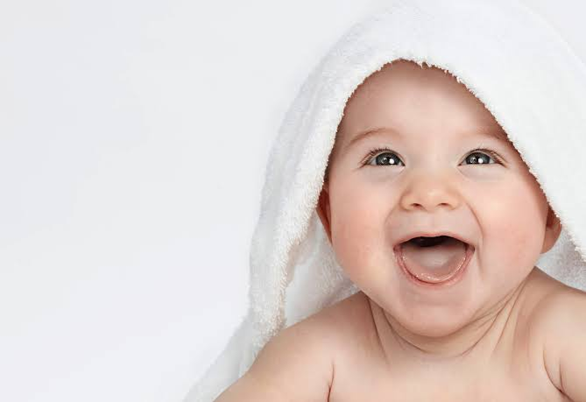
A baby is laughing.

Slide 10
Follow
First part
2nd part
A baby
is laughing.
Subject
Sentence
Predicate
Notes:
How sentence is formed with two parts.

Slide 11
So we can see, there are two parts of a sentence.
Sentence
Subject
Predicate
Notes:
Diagram of subject & predicate.

Slide 12
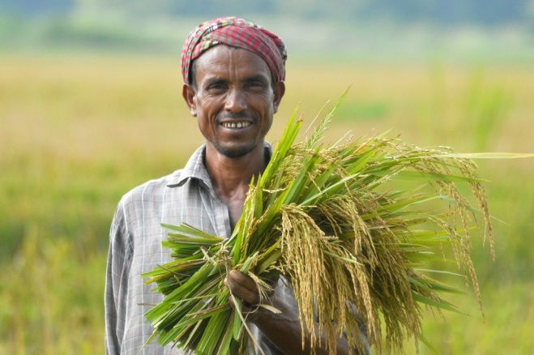
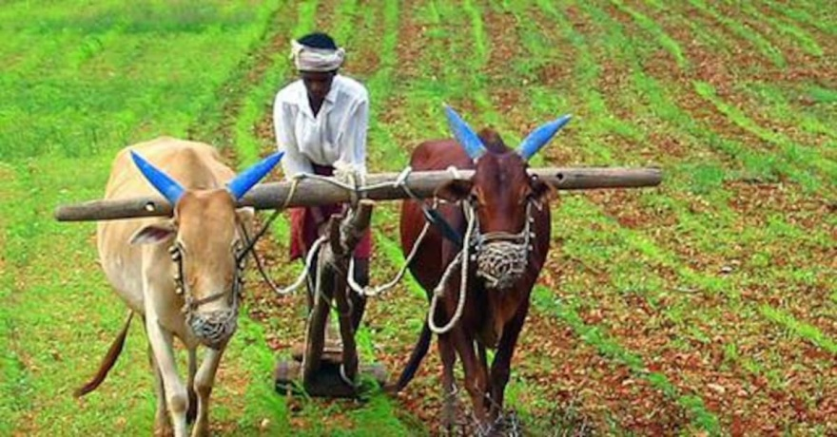
Farmer
ploughs his land
Notes:
Showing subject & predicate.

Slide 13
Subjects
Farmer
Subject may be a single word or more than a single word.

Slide 14
We can find out a subject by asking a question to verb with ‘who’ or ‘what’.
Farmer ploughs his land.
Follow
Who ploughs?
Farmer
So, It is subject.
Notes:
How to find out subject.

Slide 15
We can find out a predicate asking question to subject about his activity (What does the subject do?)
What do the subjects do?
ploughs his land
So, they are predicates.
Notes:
How to find out predicate.

Slide 16
Always remember
A subject always contains a person or a thing or equivalent of a person or a thing.
A predicate always contains a verb along with other words.
Notes:
Content belonging to subject & predicate.

Slide 17
Let us practice some subjects & predicates.
Subject | Predicate
Birds | fly.
Birds | fly in the sky.
Some birds | don’t fly in the sky.
Good boys | are always punctual.
The little child | is sleeping.
To err | is human.
Our class captain | is a brilliant student.
It | is terrible.
You | have done well.
You | love your enemies.
God | may have mercy on us.
Notes:
Teacher may ask individually to engage the students.

Slide 18
Oral Test (Individually)
Notes:
Practice.

Slide 19
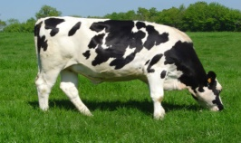
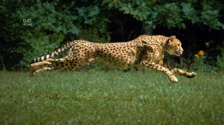
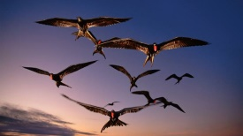
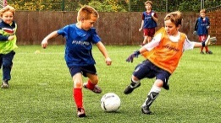
Subject | Predicate
Notes:
Class activities.

Slide 20
Evaluation
Separate the subject & predicate:
God is the Almighty.
He has created us.
A blind man cannot see anything.
Barking dogs seldom bite.
A thing of beauty is joy for ever.
No man can serve two masters perfectly.
Seven days make a week.
Let us go for a picnic.
Our heroic soldiers fought bravely against our enemies.
All the members of our family went to the zoo.
Notes:
Feedback of this class.

Slide 21
Home Work
Match the number in column B with the letters in column A and write complete sentences (Text Book Page No-03).
Sl | A | Sl | B
a. | Industry | i. | howls at night.
b. | A man of will | ii. | cannot stand.
c. | An eagle | iii. | is a bird of prey.
d. | A mad dog | iv. | may bite anybody.
e. | The wolf | v. | succeeds in life.
f. | A house divided itself | vi. | is the mother of good luck.
g. | Birds | vii | is required for the post.
h. | Thirty of the tender aged boys | viii | spoke in a clear voice.
i. | A young man of character | ix. | fly at large in the sky.
j. | The leader of the party | x | are playing in the field.
Notes:
Assignment at home.

