Slide 1
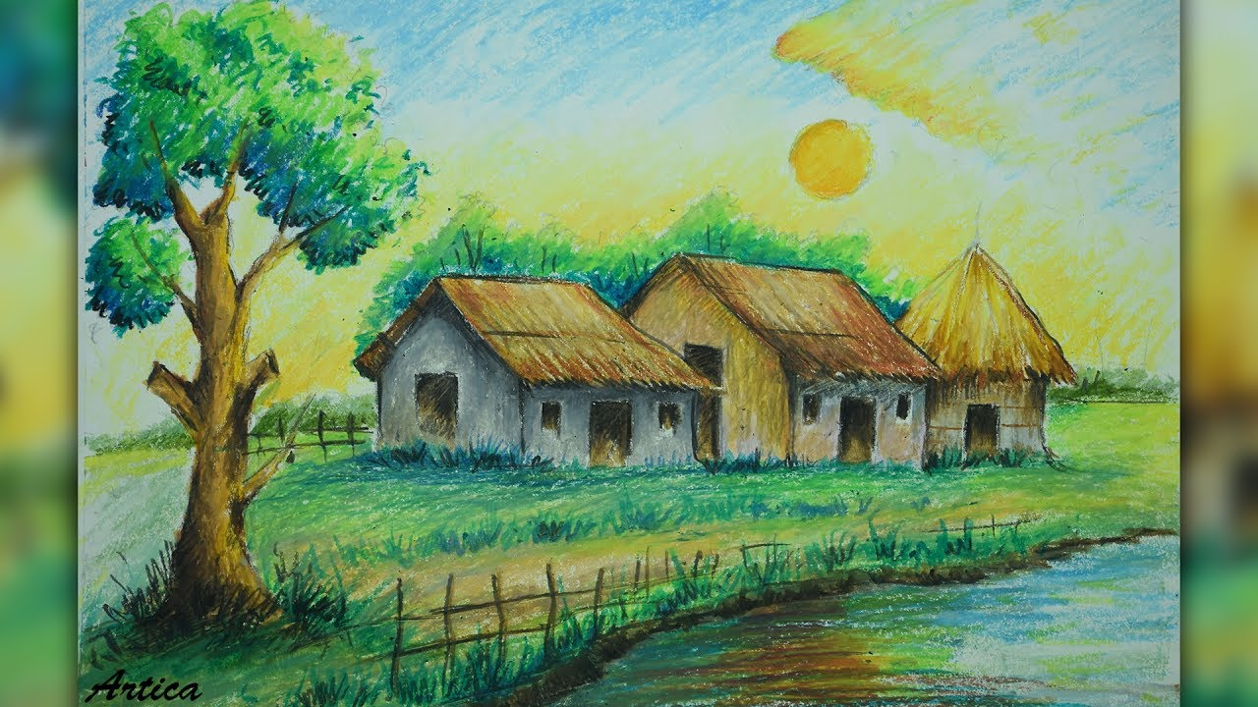
Welcome

Slide 2
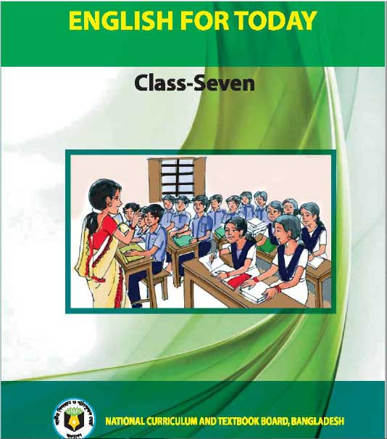
Introduction
Abdul Aziz
Assistant Teacher (English)
Madhaia Bazar Sadim High School
E-mail : azizabidpur@gmail.com
Class –Seven
English First Paper
Unit -08, Lesson -02, Sec: B
Kabita’s Village

Slide 3
Look at the pictures
What can you see in the picture?
In the picture, I can see a beautiful village home. There are two trees and a very nice street goes to this home. It looks very charming.

Slide 4
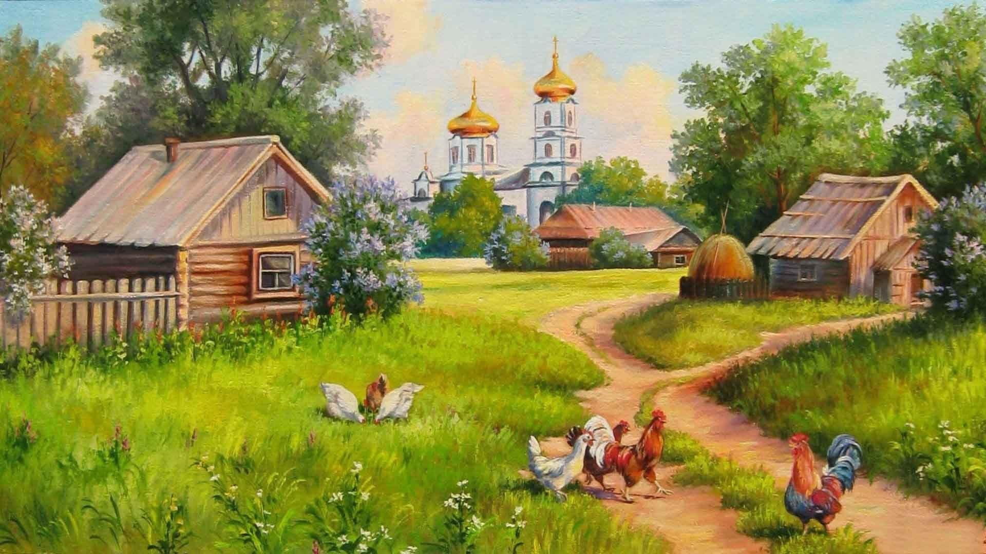
So, Our Today’s Lesson is
Kabita’s Village

Slide 5
Learning Outcomes
After the end of the lesson, Students will be able to –
Talk about a village
Infer vocabulary
Ask and Answer Questions

Slide 6
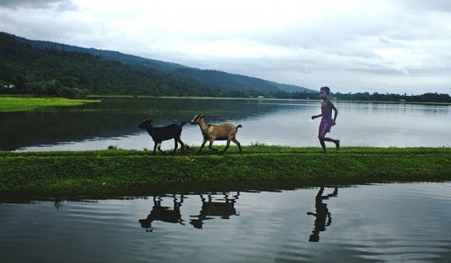
The name of Kabita’s village is Sundarpur. It is a small village on the bank of the river Kalini. The beautiful river flows through the village. There are one high school, three primary schools and one vocational training centre in this village.
Read the text. Page :87 Sec: B
Individual Work

Slide 7
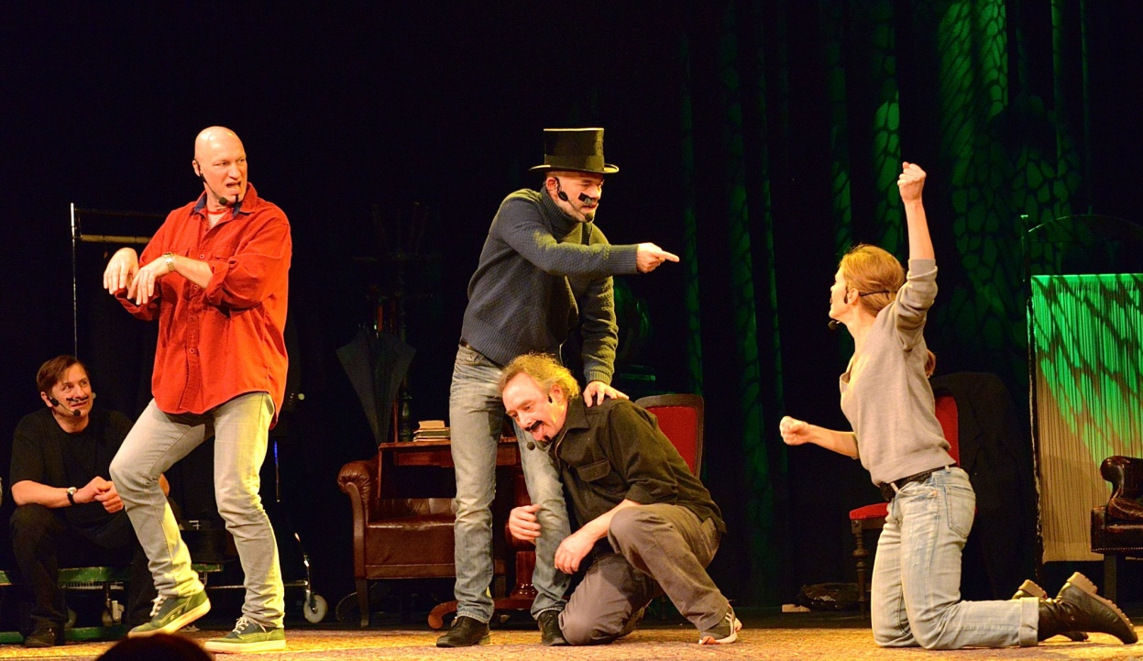
Kabita and her friends learn computer at this center. There is a theatre club and a small library too. Kabita can borrow books from the library. She borrows books from the library. She borrows books on history, poetry and children’s classics. The theatre club stages plays regularly. Last month Kabita enjoyed the Mohua deama dance performed by the theatre club.
Read the text. Page :87 Sec: B
Individual Work

Slide 8
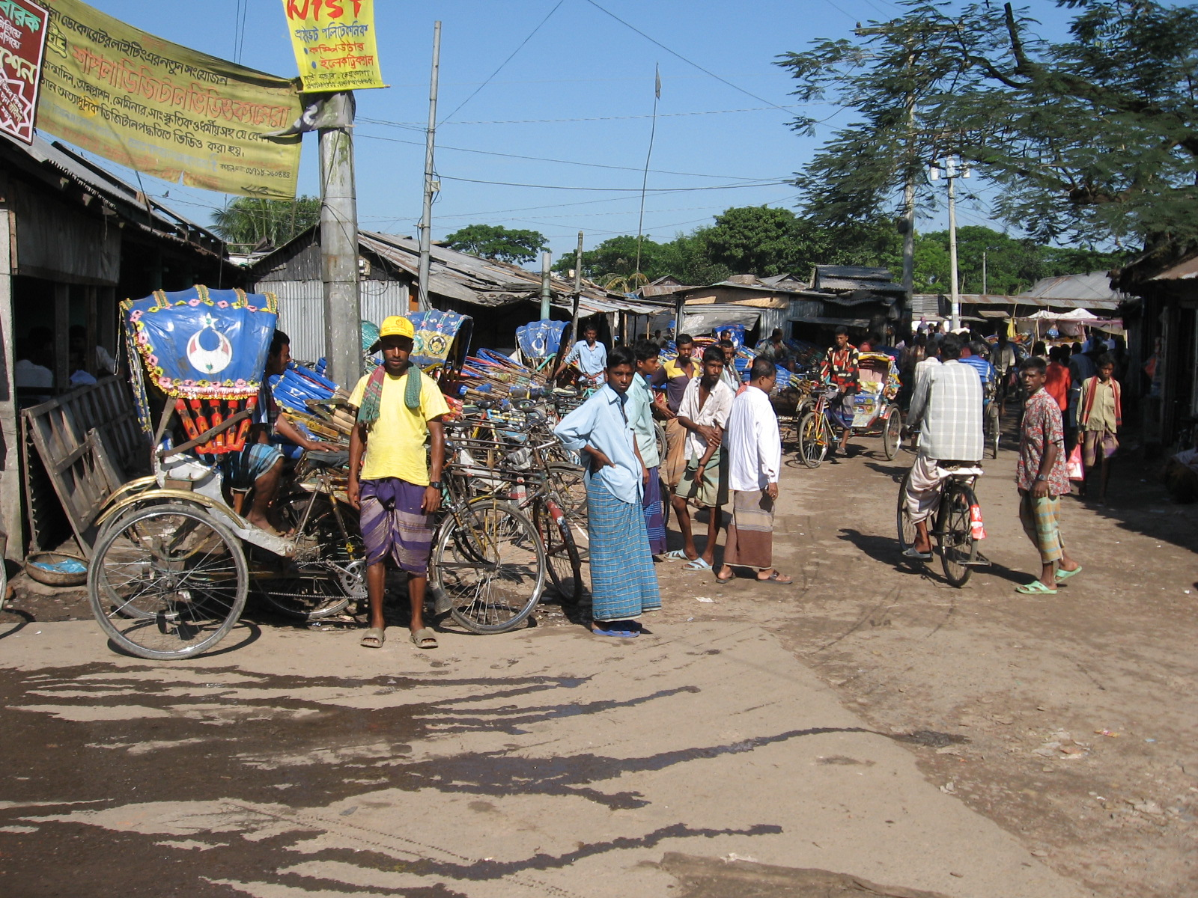
The village has a bazar on the river side. This is a very noisy and dirty place. Kabita never goes to the bazar. The village roads are also narrow and dirty. Although there is electricity in Sudarpur, the villagers experience frequent load shedding in summer.

Slide 9
Key Words
Main Words | Meanings
Vocational | Connected with the knowledge required to do a particular job.
Theatre | Playhouse where plays are performed
Stage | Perform, to organize and present a play
Bank | Shore of rivers
Flow | Move smoothly
Through | From one end to the other
History | Study or record of past events
Noisy | Full of hue and cry

Slide 10
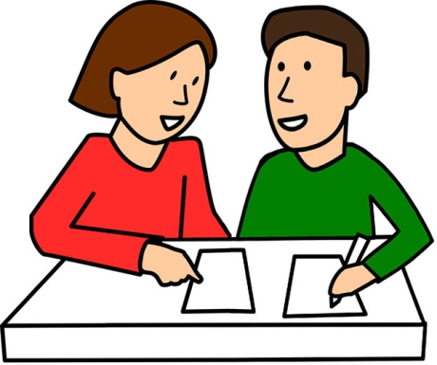
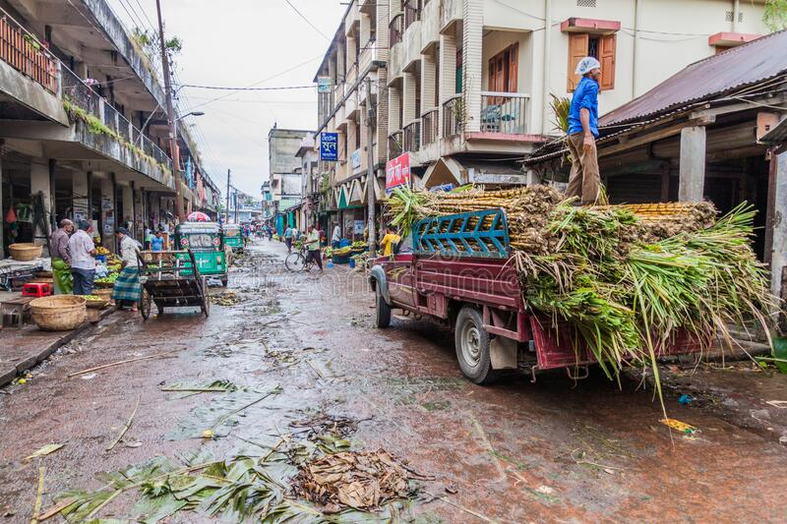
Pair Work
Ask and answer the questions in pairs.
1. What do you like about Kabita’s village?
Ans: I like its river as it is very beautiful
3. What do you dislike then?
Ans: I dislike its roads because they are narrow and dirty

Slide 11
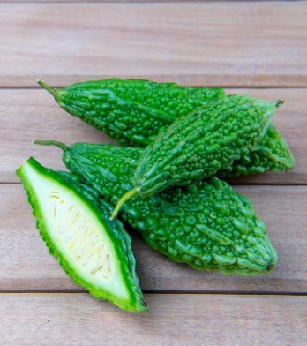
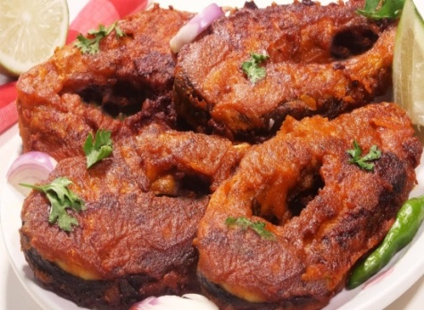
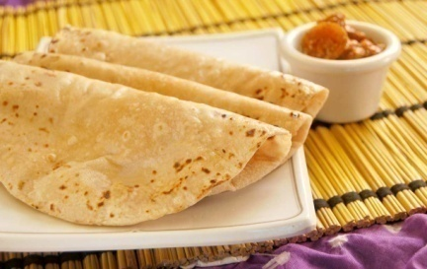
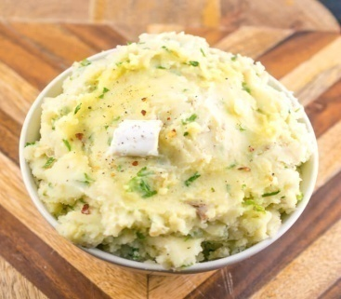
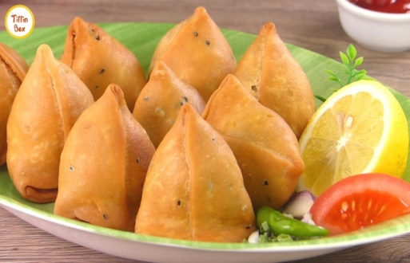
Evaluation
Look at the food that Kobita usually eats at home. In pairs match
the names of the food items given below with the pictures.
1………………
2………………
3………………
4………………
5………………
6………………
Bitter gourd
chapatti
Fish Fry
Singara
Egg fry
Mashed potato

Slide 12
Write a short paragraph about Kabita’s Village by using your own language.
E-mail: azizabidpur@gmail.com

Slide 13
Thank you

