Slide 1
Welcome to my English class

Slide 2
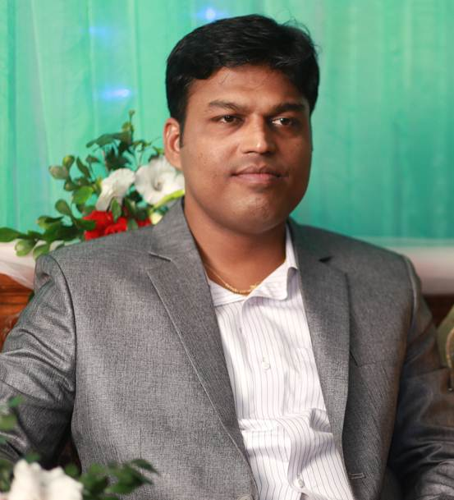
IDENTITY
Teacher
Lesson
Hirendra Debnath
MA(English),Bed
Assistant Teacher(English)
Puran Bazar Girls’ High School
01789-916684
Hirendra Debnath
hirendra0501@gmail.com
English For Today
Class : IX-X

Slide 3
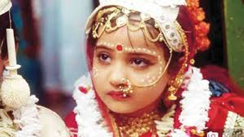
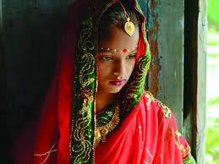
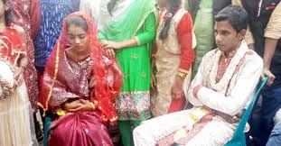
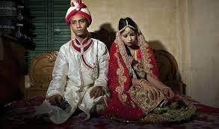
Look at pictures and talk about them
Are you familiar with these pictures?
Do you think it is a social problem?
What is the name of this problem?
Notes:
Teacher will ask questions to know their previous knowledge

Slide 4
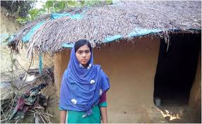
So , dear we are going to discuss about such a social problem …………
The story of Lipi
Unit : 4
Lesson : 4

Slide 5
Learning outcomes
After the end of the lesson, the students will be able to…
a) ask and answer about problems,
b) seek and give suggestions,
c) listen for specific information,
d) make conditional clause, [using- If + sub + had + verb(past
participle) + Sub + would/could / might have +verb(P.P) + Ext.]
e) write paragraph on “Early Marriage.”

Slide 6
A: Discuss in groups and suggest how we can control the high growth rate of our population. Check whether your suggestions include any of the following.
1. Raise awareness among the people particularly in the rural areas, about the bad consequences of having more children in the family.
2. Stop child marriage.
3. Keep the size of the family small with two children.

Slide 7
Key word
Raise
look after, bring up
Impose
make sb to do sth in a forceful way
Pursue
carry out
Upset
make someone unhappy
Arable
capable of growing crops
Influential
having great influence on sb or sth, powerful
Inevitable
certain to happen, unavoidable

Slide 8
Teacher’s model reading
Keep silent and listen attentively

Slide 10
Individual work
What do you think Lipi should do? Why?
Elicit answer from the students.

Slide 11
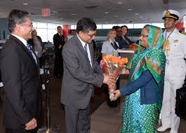
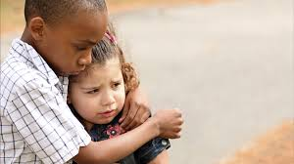
Word meaning and sentence making
Respectable person
Honorable person
Sentence: The Headmaster invited the respectable persons of the locality in the meeting.
Sympathetic
compassionate
Sentence : The boy is sympathetic to his sister.

Slide 12
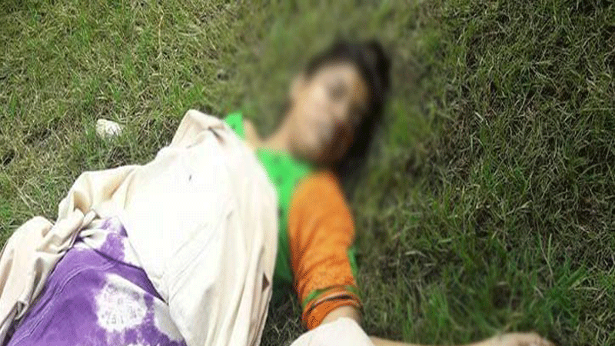
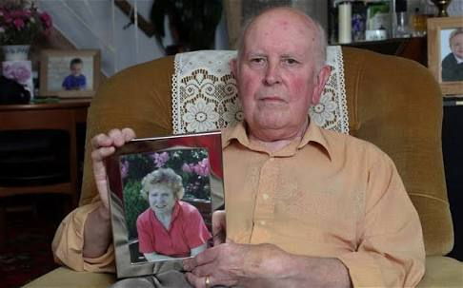
Premature death
Untimely death
Sentence: Early marriage causes premature death.
Whose wife died and not married again
Widower
Sentence : The man lost his wife. Now he is widower.

Slide 13
Teacher’s model reading
Keep silent and listen attentively

Slide 14
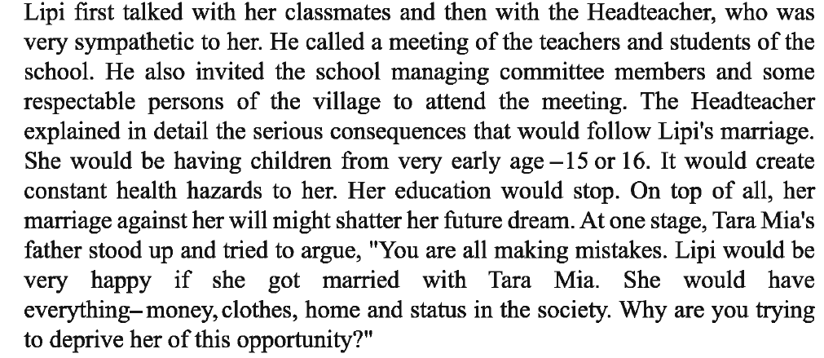

Slide 15
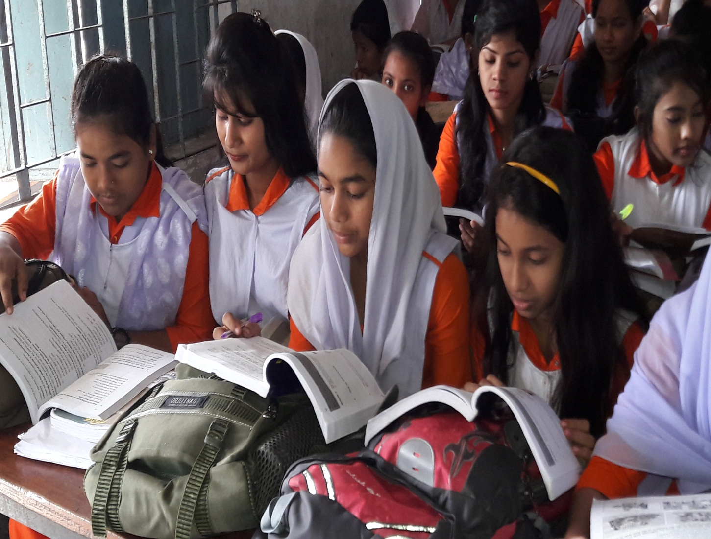
Students’ model reading
Go to the section ‘A’ and start silent reading

Slide 16
A discussion of Grammatical point on Conditional clause
If + sub + had + verb(P.P) + sub + would/could /might + have + verb (P.P) + Ext ( Follow the examples)
a) If + Lipi had married Tara Mia that time she would have become
mother of one or two children.
b) If + Lipi had married Tara Mia that time her health would have
broken down
c) If + Lipi had married Tara Mia that time her study could have
stopped
d) If + Lipi had married Tara Mia that time she might have died
for giving birth to child at an early age.

Slide 17
Individual work -2
Now complete the sentences
a) If I had known him I would have ………………… .
b) If I had bought a car I would have………………… .
c) If I had seen her before I could have……………. .
d) If She had got chance she might have ……….. .

Slide 18
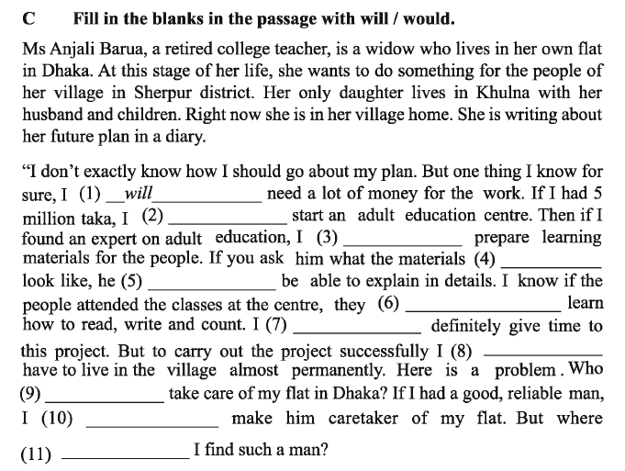
Pair work
Answer
3) would
1) will
8) will
6)would
2) would
7) would
₅₎ would
4) would
₁₀₎ would
₁₁₎ will
9) will

Slide 19
Evaluation
a) Who is lipi and how old is she now?
b) How many brothers and sisters had lipi?
c) What did she do to escape from early marriage?
d) Where is lipi studying now?

Slide 20
Home work

Slide 21
Child is not bride

