Slide 1
Welcome

Slide 2
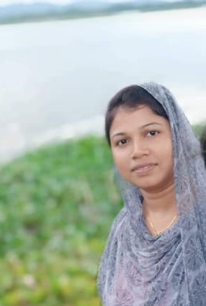
Rupa Mollik Rupu
Assistant Teacher
T and T gate Government Primary School, Khagrachari.

Slide 3
Today’s Lesson is----
Sport
Olympic Games
Unit:17
Lesson: 7-8
Page no: 69

Slide 8
10th
Italy
Germany

Slide 9
5th
19th
London
8th

Slide 10
Let’s match the answer with the audio

Slide 11
Home Task
Complete the sentences of K from your text.

Slide 12
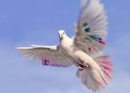
Good Bye

