Slide 1
WELCOME
Notes:
Teacher can greet by any other processes.

Slide 2
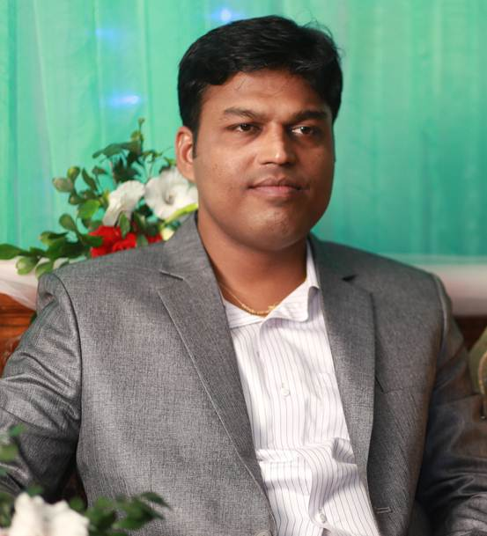
Introduction
Hirendra Debnath
MA(English), Bed
Assistant Teacher(English)
Puran Bazar Girls’ High School
01789-916684
Hirendra Debnath
hirendra0501@gmail.com
English For Today
Class : IX-X
Notes:
Teacher can hide this slide.

Slide 3
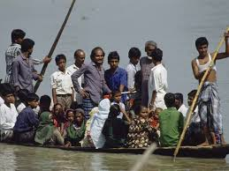
What about the picture?
Discuss with your partner then answer the following questions.
Where can you fine this kind of boat?
Why does the boatman carry passengers across a river?
Why do people use country boats?
Notes:
This slide only for mind set up. Teacher can ask another questions for grow class arrange.

Slide 4
Can you guess what our today’s topic might be?
The ferry boat
Notes:
This slide is for taking out the lesson declaration from the students.

Slide 5
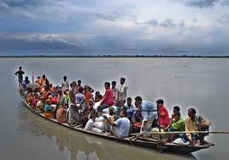
So today we’ll discuss about
The ferry boat
Unit: 4, Lesson: 1

Slide 6
Learning outcomes
After completing this lesson, students will be able to-
a) ask and tell about problems.
b) seek and give suggestions.
c) listen for specific information.
d) narrate something in writing.

Slide 7
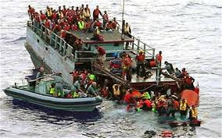
Let’s watch a video clip
Discuss in pair. What were the causes of this accident? And say how we can avoid it.
Notes:
Showing the video teacher can ask question to the whole class. SS will raise their hands. Teacher can ask 5/6 students to narrate the video.

Slide 8
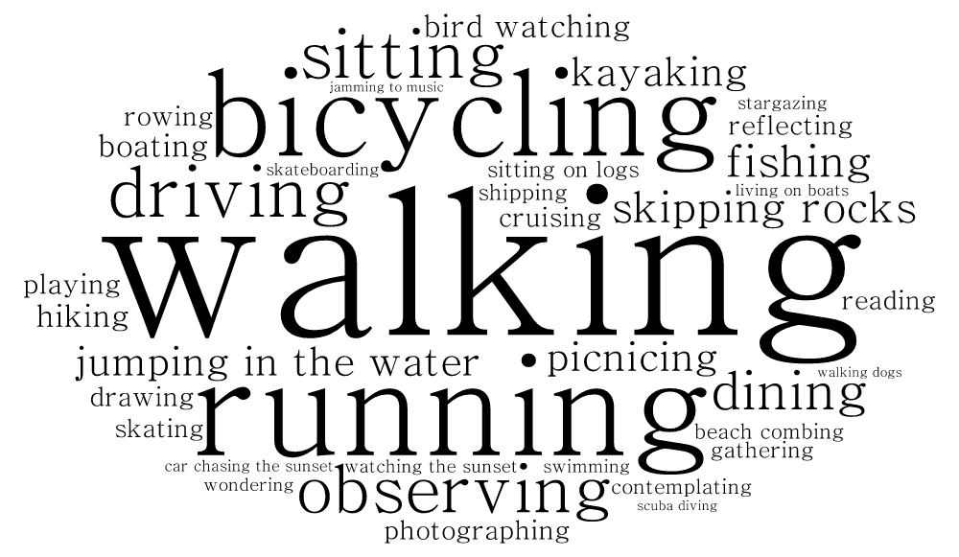
Key
Let’s know some……...…………………………………...
Words

Slide 9
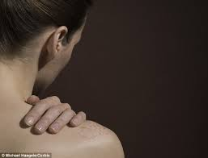
Shoulder
A organ of human body
Often country people carry their bags on shoulder.
Notes:
At first teacher will show the words then ask his/her students to tell the meaning and making sentences. If they fail teacher will show the picture again. For feedback click on meaning button.

Slide 10
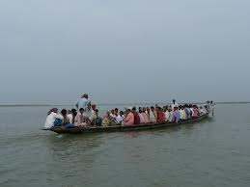
Cross the river
To go another side of a river.
They are crossing the river by boat.
Notes:
At first teacher will show the words then ask his/her students to tell the meaning and making sentences. If they fail teacher will show the picture again. For feedback click on meaning button.

Slide 11
Ferry boat
A kind of boat by that`s people cross the river to paying fare.
After shopping they are returning home by a ferry boat.
Notes:
At first teacher will show the words then ask his/her students to tell the meaning and making sentences. If they fail teacher will show the picture again. For feedback click on meaning button.

Slide 12
Teacher’s model reading
Keep silent and listen attentively

Slide 13
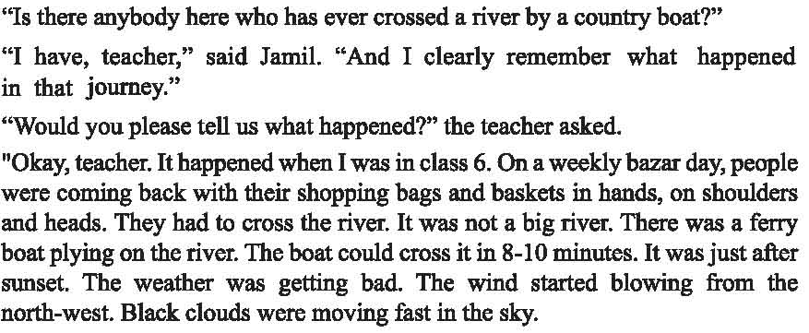

Slide 14
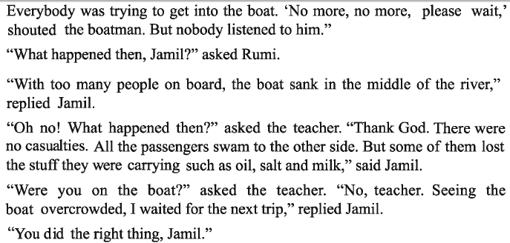

Slide 15
$$$$
$$$$
$$$$
$$$$
$$$$
$$$$

Slide 16
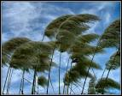
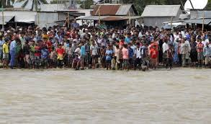
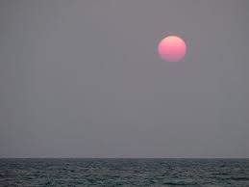
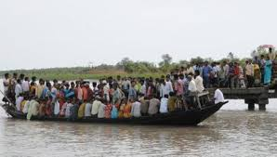
Individual/Pair works.
Look at the pictures and guess why do many people have little or no patience in situations as in the ferry boat?
Notes:
Students will see the pictures, they can discusses it with their partner and will write minimum five sentences, teacher also can help them if necessary.

Slide 17
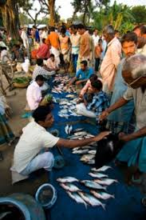
Individual Work
Guess if we have too many buyers of fish in the market, what is likely to happen?
Notes:
Teacher cam make easy specially for the girl students.

Slide 18
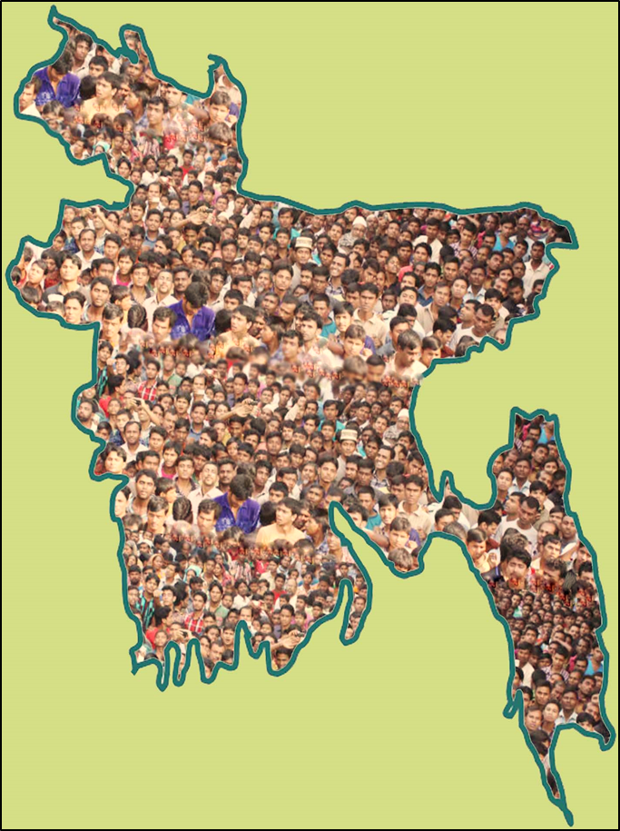
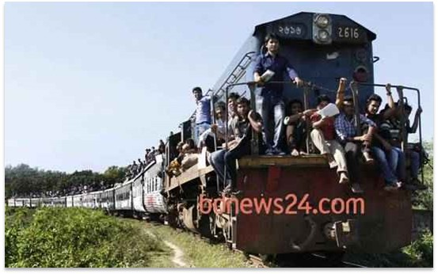
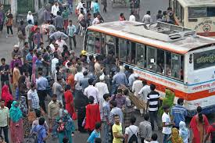
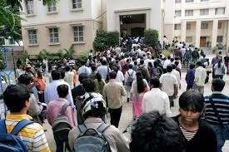
Population problems?
Look at the above pictures and guess if we have too many people in a town, bus and train then what will happen?
Notes:
Teacher can discusses about our population problems.

Slide 19
Home work
Read the above text and fill in the gaps with contextually appropriate words.
Many of us have a tendency to get into a boat (a) ---- with passengers. This results in (b) ---- consequences. Such is the story of Jamil. In his story, the victims of the boat sinking managed to (c) ---- . However, some of them (d) ---- possessions as well. Jamil witnessed the disastrous event from the bank of the river while waiting for the following (e) ---- .

Slide 20
The end
Notes:
Teacher can use any other language.

