Slide 1
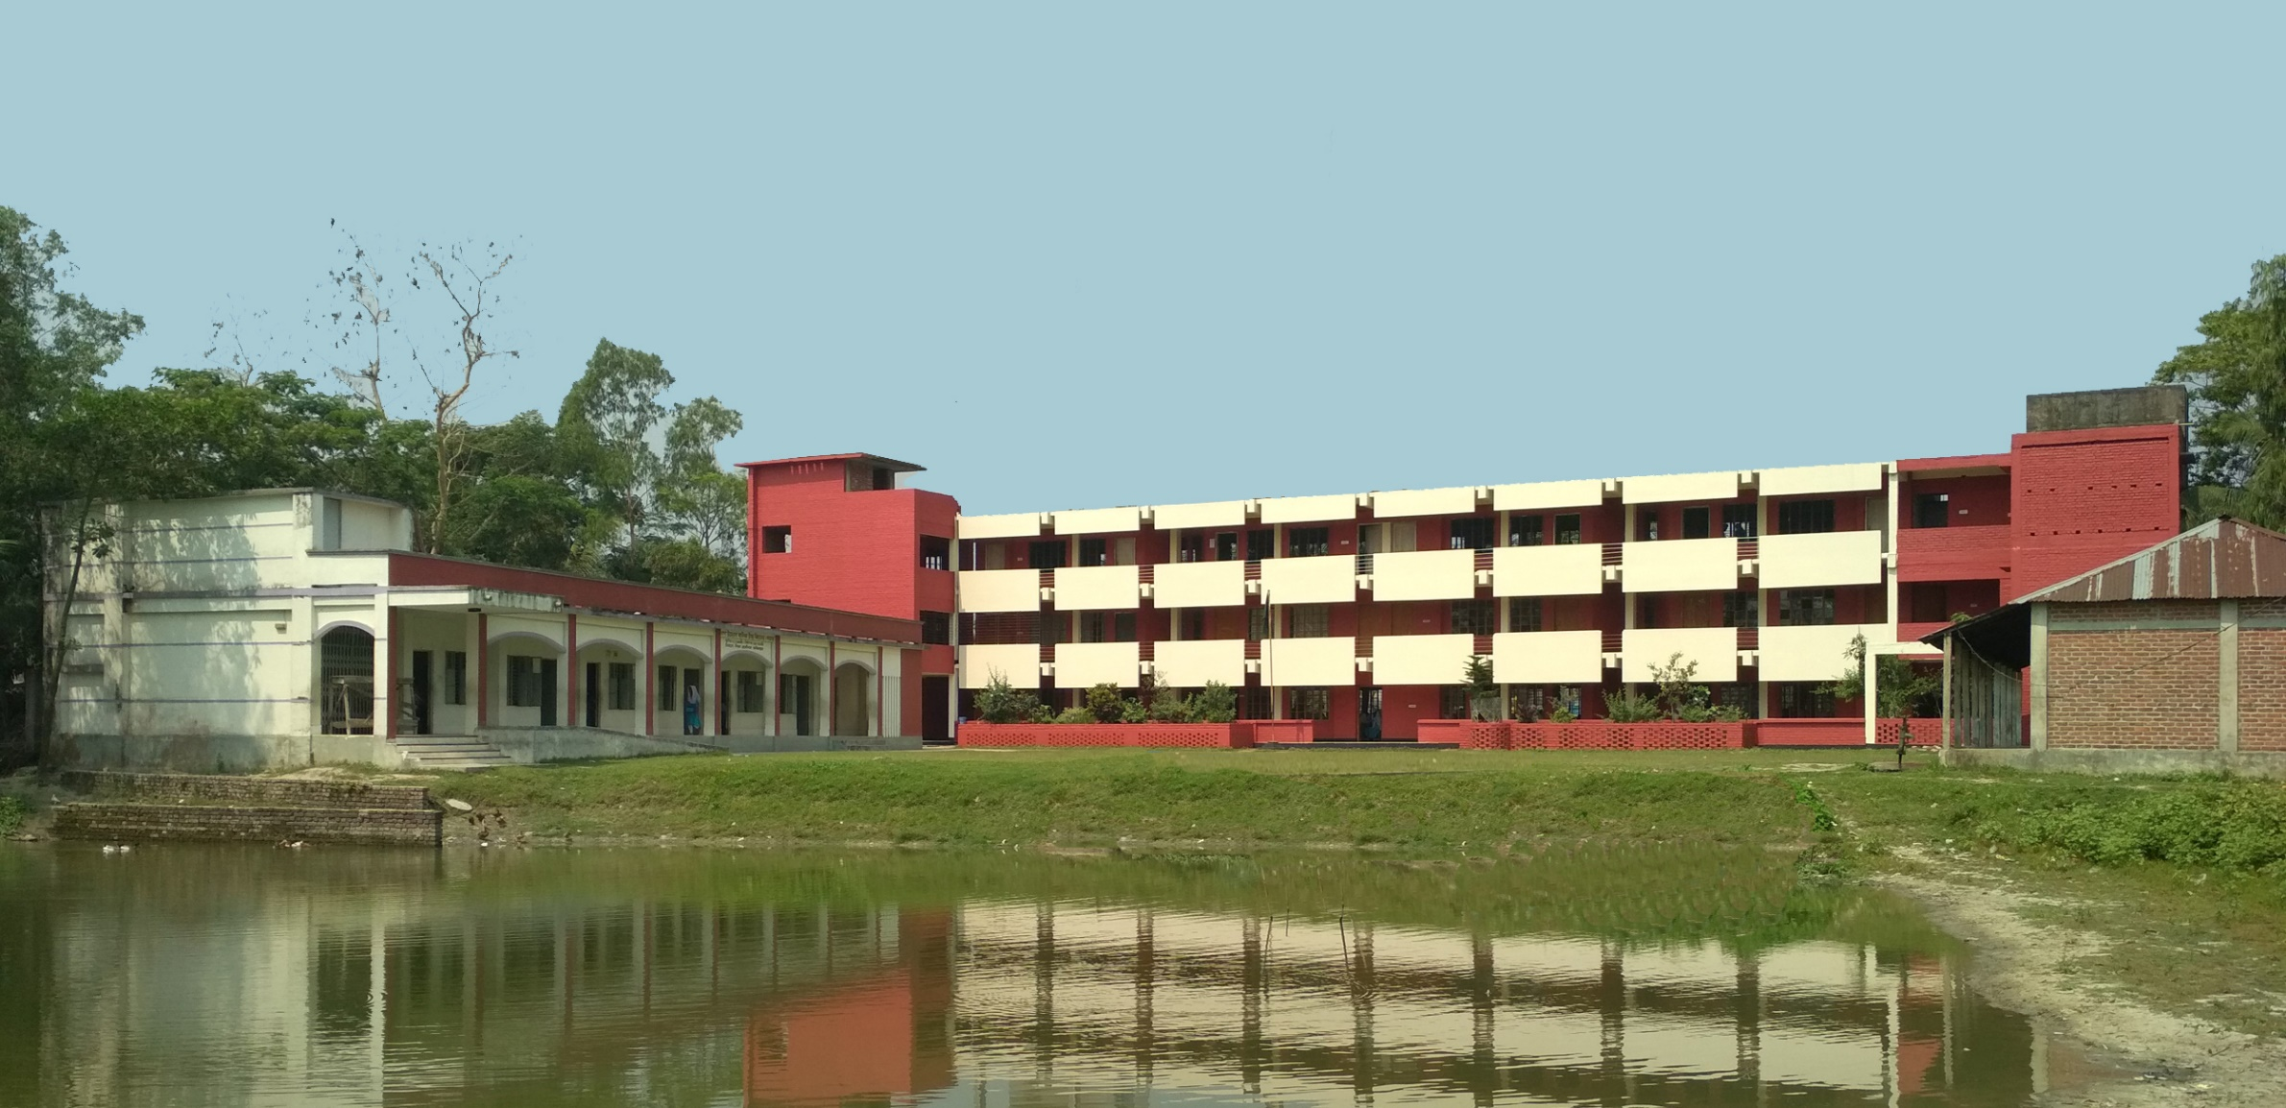
WELCOME
To
Ganauddog Online school

Slide 2
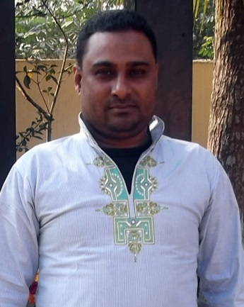
Introduction
Mijanur Rahman
Assistant Head Teacher
Ganauddog Girls’ High School and College
Laksam, Comilla
mijan41@yahoo.com
Mobile: 01814366124

Slide 3
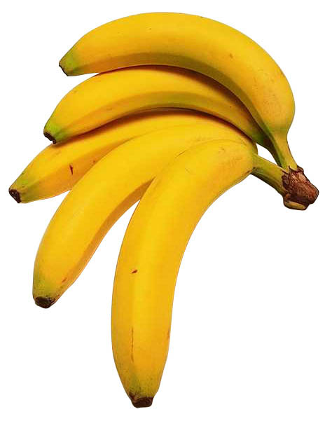
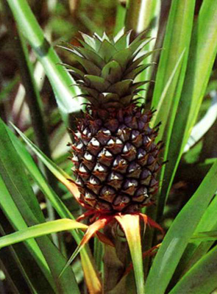
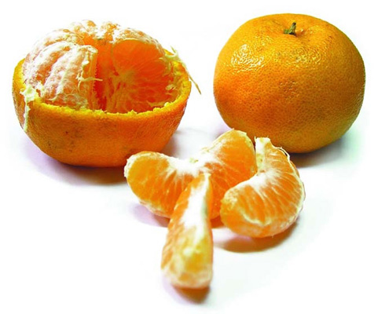
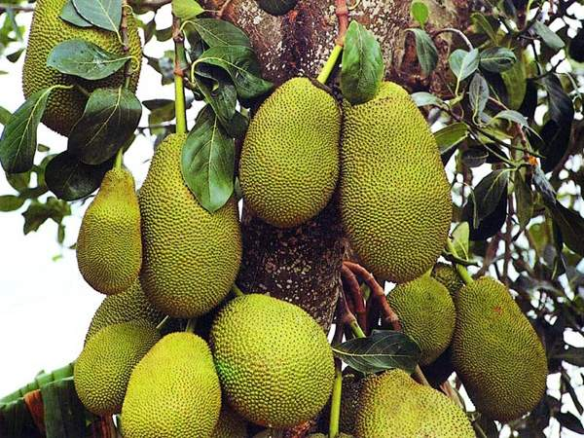
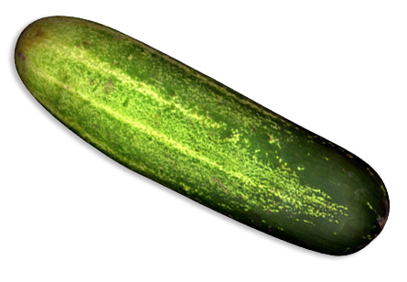
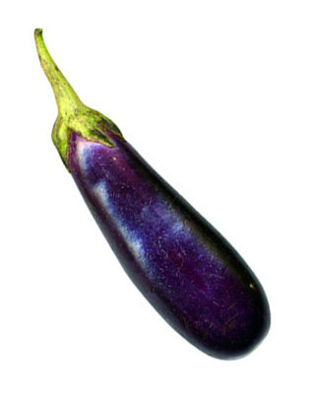
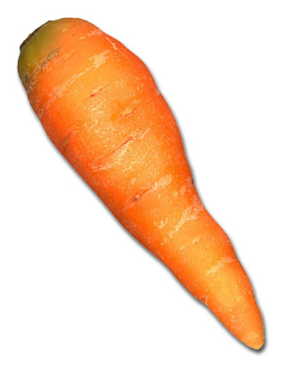
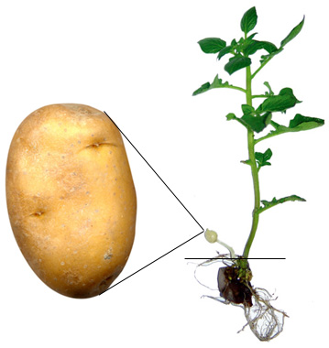
Click the images to get the fruits name:
Pineapple
Banana
Jackfruit
Orange
Write the name of the vegetables:

Slide 4
Today’s Lesson :
Gap filling with clues & without clues

Slide 5
Objectives:
By the end of the lesson, students will be able to:
tell the rules of using Noun, Adjective & verb in the gap
discuses the rules of filling out gap with/without clues
fill out the gaps using with/without clues

Slide 6
Lessons to be discussed:
Rules of using Noun in the gap
Rules of using Verb in the gap
Rules of using adjective in the gap
Phrasal use / Compound use:

Slide 7
Rules of using Noun in the gap:
1. _______Verb (Noun) [if the bracket’s word is verb, (v+ing) if it is adjective, (noun)
a) ___________(Honest) is the best policy.
Ans: Honesty is the best policy.
b) ___________(Walk) is the best exercise.
Ans: Walking is the best exercise.
2. Article __________ preposition. (Noun)
a) Mother has made a kite for me.
3. Adjective _____________ preposition. (Noun)
I have bought a nice gift for you
4. Preposition ___________ priposition. (Noun/Gerund)
We believe in _________(work) for the development of the country. (working)
5. Some/any/few/a few/little/ a little/many/ more/much/only/ every/each/ no _____________(Noun)
He has done many Jobs
6. Verb _________ preposition (Noun)
He helped _________________ for complete improvement. (me/us/Salma)
7. Article+adjective _________________ (Noun)
A good (decide) is the pre-condition of success. (decision)

Slide 8
Rules of using Adjective in the gap:
1. M.Verb ________ noun (adjective)
He is doing _____________ (complicate) works. (complicated)
2. Subject ___________ preposition+noun (adjective)
The students ________ at math can get better marks. (good)
3. Article _______ noun (adjective)
An _______ man can never tell a lie. (honest)
4. Be verb _______ preposition (adjective)
She is ________ in English. (expert)
5. Adverb ________ (adjective)
The man is very ________ now. (strong/weak)

Slide 9
Rules of using Verb in the gap:
1. Adverb ______ other words (verb)
Some people are _______ in the fields. (working)
2. Sub ________ other words (verb)
Ranjijt Dash _________ the students properly (teaches/guides)
3. _____________ other words (verb-1) (imperative)
___________ the poor. (Help)
4. Adverb __________ noun phrase (Article + adj +N) (verb)
A balanced application always _________ the post. (qualifies)
5. Passive form (two verb in a sentence) [2nd verb+ing/ to+2nd verb]
They aren’t permitted ______out of home. (to go/going)
They aren’t ______(permission) to go/ going out of home. Permitted
[if 1st verb is in the gap than it will be v3]

Slide 10
Some other Shourcut Rules of filling out gap:
Determiner (a/an/the/any/many/a lot of) + _________(noun).
Adjective + _________(noun).
Preposition + __________[noun/gerund (verb+ing)].
Sub + verb + ___________[obj (noun/pronoun)]
Sub + A.V/Modals + verb + _________[obj (noun/pronoun)]
Sub + verb + obj + ________ (object)[direct object]
Sub + verb + obj + _________(adverb).
Phrasal use/ Compound use.
Phrasal use:
eg: Because of
According to
Compound use:
eg: Band party
Selection body
Note: Phrase will not be used in any gap

Slide 11
Fill out the gaps with suitable words from the box (make any grammatical changes if necessary). There are more words in the box than you need.
A traffic police is a very familiar figure in cities and towns. We see him on (a) ______. The weather is uncertain. None (b)_______ predict properly how the day (c)______ be. In any weather, he (d)_____ to do his duty. His (e)_______ hurts and his head aches (f)________of the sound of the (g)________. He always cares for our (h)______ on the roads. He faces (i)_____ unfavorable situations to ensure our (j)______ or movement. So, we should respect them.
vehicles | road | safety | return | will | ear
much | because | can | many | has | journey
roads
can
will
has
ear
because
vehicles
safety
many
journey
Notes:
প্রথম শুণ্যস্থানে যৌক্তিক নাউন হিসেবে রোডস বসবে।

Slide 12
Fill out the gaps with suitable words.
Sports can give us (a) __________. International sports (b)____________ organize different sporting events in different (c)____________ . Most off those events are sponsored by multinational manufacturing companies and business firms. They pay for the sport event. They do it because in (d)________ they get the right of (e)__________ their products (f))________ the events. The satellite channels (g)____________ the events (h)___________ . As a (i)_____________ people all over the world can (j)_____________ them live.
amusement
organizations
times
exchange
advertising
during
telecast
live
result
watch
Notes:
প্রথম শুণ্যস্থানে যৌক্তিক নাউন হিসেবে রোডস বসবে।

Slide 13
Fill out the blanks with the words from the box. You may need to change the forms of some of the words. You may need to use one word more than once.
Man has an (a) — thirst for knowledge. In fact, he is never satisfied (b) — what he has (c) — known and seen. He wants to know and see more and more. This (d) — to know more, coupled (e) — his bold spirit (f) — adventure, has (g) — him to undertake and carry (h) — difficult and dangerous tasks. In (i) — field of science and technology man has already achieved what was once (j) —.
already | of | conceive | inspired | curious
out | quench | the | with

Slide 14
Fill out the blanks with suitable words.
Hard work with sincerity is (a) — to be happy in life. It is such a (b) — that touches everyone's (c) —. Honesty is also very important to lead a happy life. It also ensures one's (d) — satisfaction. One who (e) — these two qualities is liking to be (f) — almost everywhere (g) — honest are clear to their (h) —. They work hard and rely on Allah for making their (i) —. (j) — of these virtues not only enlighten one's individual life but also ensure one's peace in life.

Slide 15
THANK YOU

