Slide 1
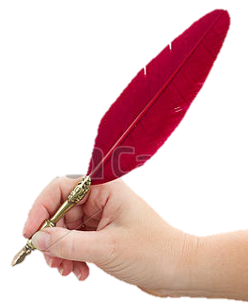
Technological knowledge
Welcome to my class
Pedagogical knowledge
Content knowledge
A girl
Md. Abdur Razzaak, Head Teacher, Dhalhara Westpara Secondary Girls’ School, Sadar, Magura. Contact: 01721588402

Slide 2
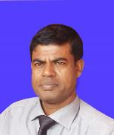
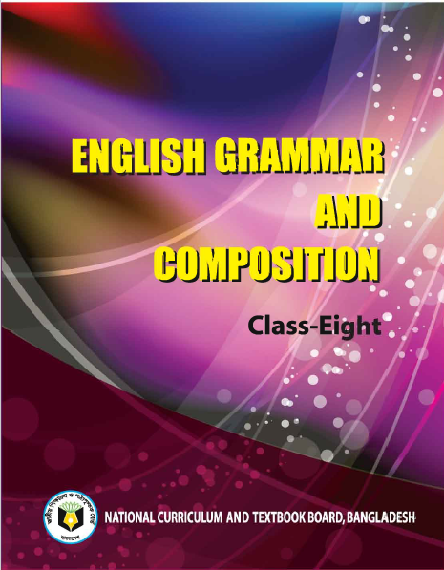
Technological knowledge
ARTICLE
Introduction
MD. ABDUR RAZZAK
Head Teacher
Dhalahara westpara Secondary Girls’ School
E-mail: abdurrazzakmt@gmail.com
Phone number: 01721588402
Pedagogical knowledge
Content knowledge
Class: 8
U-3_L-1
Page-70
Time: 50 min
Md. Abdur Razzaak, Head Teacher, Dhalhara Westpara Secondary Girls’ School, Sadar, Magura. Contact: 01721588402

Slide 3
Technological knowledge
Look at the pictures
Pedagogical knowledge
Content knowledge
A girl
Md. Abdur Razzaak, Head Teacher, Dhalhara Westpara Secondary Girls’ School, Sadar, Magura. Contact: 01721588402

Slide 4
Technological knowledge
Now enjoy a video clip
Pedagogical knowledge
Content knowledge
Md. Abdur Razzaak, Head Teacher, Dhalhara Westpara Secondary Girls’ School, Sadar, Magura. Contact: 01721588402

Slide 5
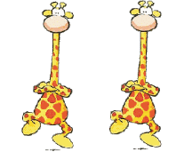
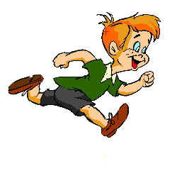
Technological knowledge
Observe, think and say.
giraffes are dancing.
A
The
If so, what is the mistake?
Do you find any mistake in this sentence?
Pedagogical knowledge
Content knowledge
A
An
smart boy is running.
Now, could you tell me what is the name of A, An and The is ?
ARTICLE
If so, what is the mistake?
Do you find any mistake in this sentence?
Md. Abdur Razzaak, Head Teacher, Dhalhara Westpara Secondary Girls’ School, Sadar, Magura. Contact: 01721588402

Slide 6
Technological knowledge
Could you guise what we are going to learn today?
ARTICLE
Pedagogical knowledge
Content knowledge
Md. Abdur Razzaak, Head Teacher, Dhalhara Westpara Secondary Girls’ School, Sadar, Magura. Contact: 01721588402

Slide 7
Technological knowledge
Learning outcomes
After the end of the lesson the learners will be able to---
1.
define article.
2.
select the omission of article.
Pedagogical knowledge
3.
use article in their real life.
Content knowledge
Md. Abdur Razzaak, Head Teacher, Dhalhara Westpara Secondary Girls’ School, Sadar, Magura. Contact: 01721588402

Slide 8
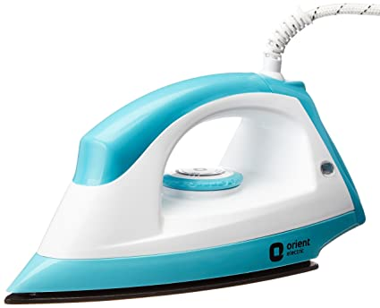
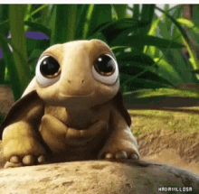
shows noun definite or not
Technological knowledge
Observe the following sentences.
If so, let’s do some work on it.
iron
An iron is a useful thing.
A Rokhsana is coming..
Rokhsana is coming..
noun
shows noun definite or not
Here Rokhsana is unknown person
Here Rokhsana is known person
So, Article plays an important role in English language.
So, what is an article and what role does it play?
Pedagogical knowledge
The tortoise is the slowest animal.
Content knowledge
noun
A, An and The are Article. An article is a word that is used before a noun to show the noun is definite or not.
Md. Abdur Razzaak, Head Teacher, Dhalhara Westpara Secondary Girls’ School, Sadar, Magura. Contact: 01721588402

Slide 9
Technological knowledge
Kinds of Article
indefinite
definite
Pedagogical knowledge
the
a
an
Content knowledge
Md. Abdur Razzaak, Head Teacher, Dhalhara Westpara Secondary Girls’ School, Sadar, Magura. Contact: 01721588402

Slide 10
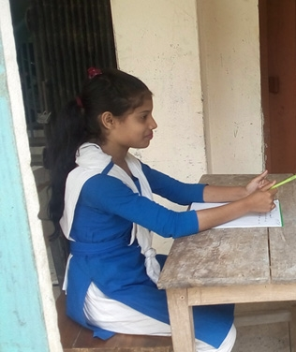
Technological knowledge
Individual Work 3 min.
click left side writing to check
Pedagogical knowledge
What is an article?
A, an and the are article.
Content knowledge
The position of article ?
before noun
kinds of article ?
2
What are indefinite article?
A and an
Which one definite article?
the
Md. Abdur Razzaak, Head Teacher, Dhalhara Westpara Secondary Girls’ School, Sadar, Magura. Contact: 01721588402

Slide 11
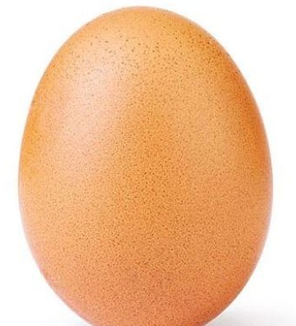
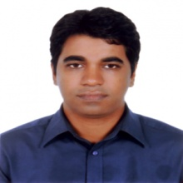
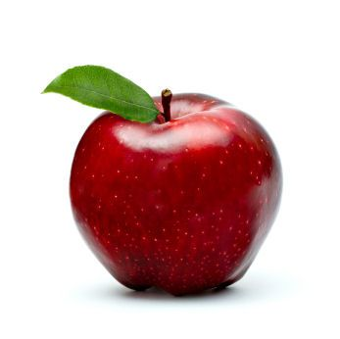
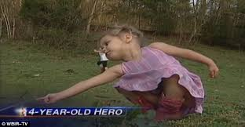
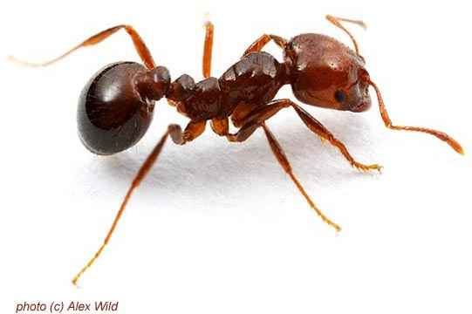
Technological knowledge
use of A and An
An is used before vowel based word (the word begins with consonant). as:
A is used before consonant based word (the word begins with consonant). as:
Similarly
vowel based word
consonant based
an
Umbrella
Ink pot
Orange
Elephant
animal
a
Boy
Girl
Pen
Bag
box
Pedagogical knowledge
an
Content knowledge
a
an
a
an
consonant
A b ook
A m an
An a pple
An a nt
consonant
vowel
vowel
A b aby
An e gg
consonant
a
vowel
an
consonant based word
a
vowel based word
vowel based word
consonant based word
vowel based word
consonant based word
Md. Abdur Razzaak, Head Teacher, Dhalhara Westpara Secondary Girls’ School, Sadar, Magura. Contact: 01721588402

Slide 12
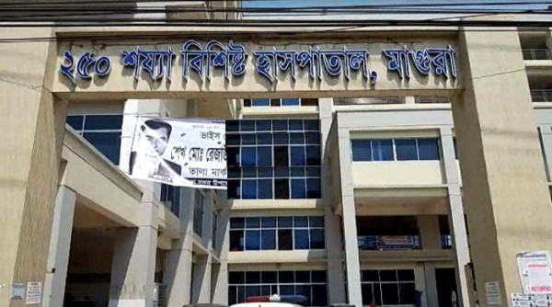
Technological knowledge
A - before consonant sound word
An - before vowel sound word
A h ospital
Pedagogical knowledge
Consonant sound
Content knowledge
An h o nest man
vowel sound
similarly
similarly
A
A
Hotel
Home sick
An
An
Hour
Honourable person
Md. Abdur Razzaak, Head Teacher, Dhalhara Westpara Secondary Girls’ School, Sadar, Magura. Contact: 01721588402

Slide 13
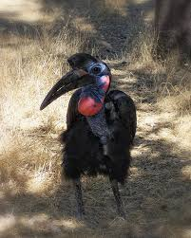
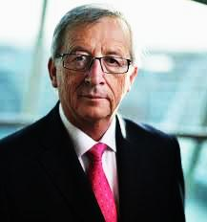
Technological knowledge
A before “U” sound word (not an) as:
But an before vowel sound word
similarly
similarly
An
An
Untidy girl
Unsafe tube-well
A
A
A
A
Ewe
Unique game
Unit
Union
Pedagogical knowledge
Content knowledge
A Eu ropian
An u gly bird
‘U’ sound word
‘vowel’ sound word
Md. Abdur Razzaak, Head Teacher, Dhalhara Westpara Secondary Girls’ School, Sadar, Magura. Contact: 01721588402

Slide 14
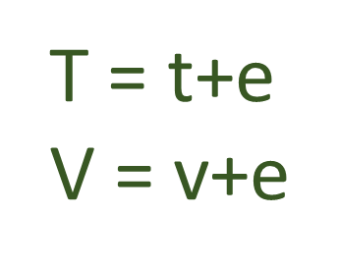
Technological knowledge
An – before vowel sound letter
A - before consonant sound letter
For example:
A
A
A
A
A
A
A
A
B = b+e
C = c+e
D = d+e
G = g+e
J = j+a
K =k+a
P = p+e
Q = q+u
An
An
An
An
An
An
An
An
F = a+f
H = a+h
L =a+l
M =a+m
N =a+n
R = a+r
S = a+s
X = a+x
A
A
A
A
A
A
A
A
B. A
C. A
T. O
T. P. O
G. M
D. C
An
An
An
An
An
M. A.
F. R. C. S
S. D. O
L. L. B
H. M
Pedagogical knowledge
Content knowledge
Md. Abdur Razzaak, Head Teacher, Dhalhara Westpara Secondary Girls’ School, Sadar, Magura. Contact: 01721588402

Slide 15
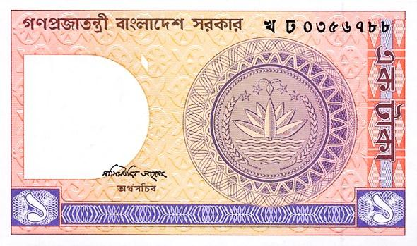
Technological knowledge
A BEFORE “ONE” as:
Pedagogical knowledge
Content knowledge
A one taka note
similarly
A
A
ONE EYED MAN
ONE LEGGED CHAIR
Md. Abdur Razzaak, Head Teacher, Dhalhara Westpara Secondary Girls’ School, Sadar, Magura. Contact: 01721588402

Slide 16
Technological knowledge
Pair work 5 min
Complete the following story with appropriate article.
Pedagogical knowledge
My brother is ----MA. He works in ---- private bank. He leads ----honest life. He has -----Europian friend who serves in---- hospital.
Content knowledge
an
a
an
a
a
Md. Abdur Razzaak, Head Teacher, Dhalhara Westpara Secondary Girls’ School, Sadar, Magura. Contact: 01721588402

Slide 17
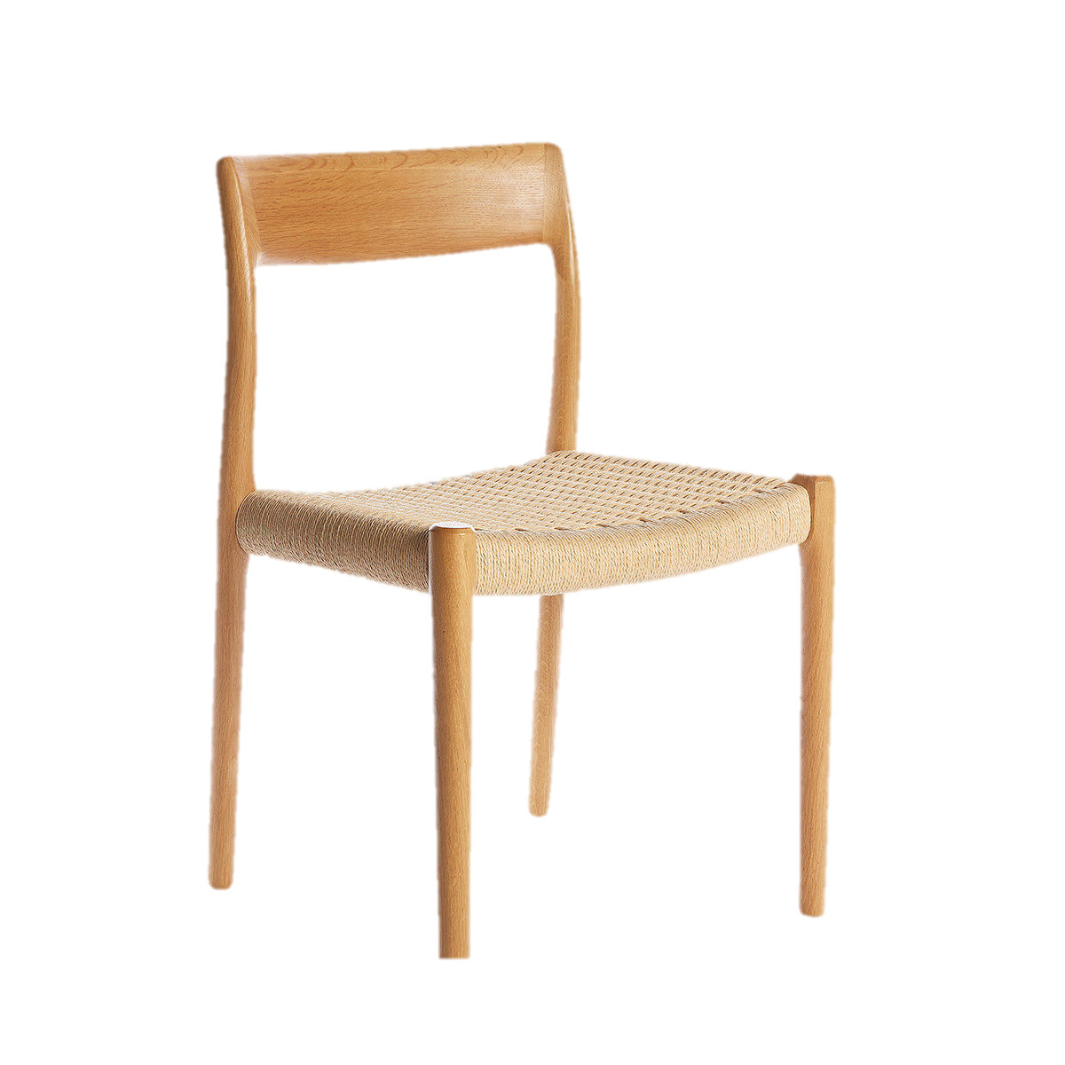
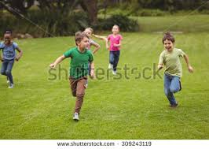
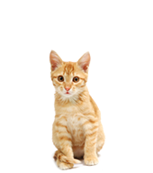
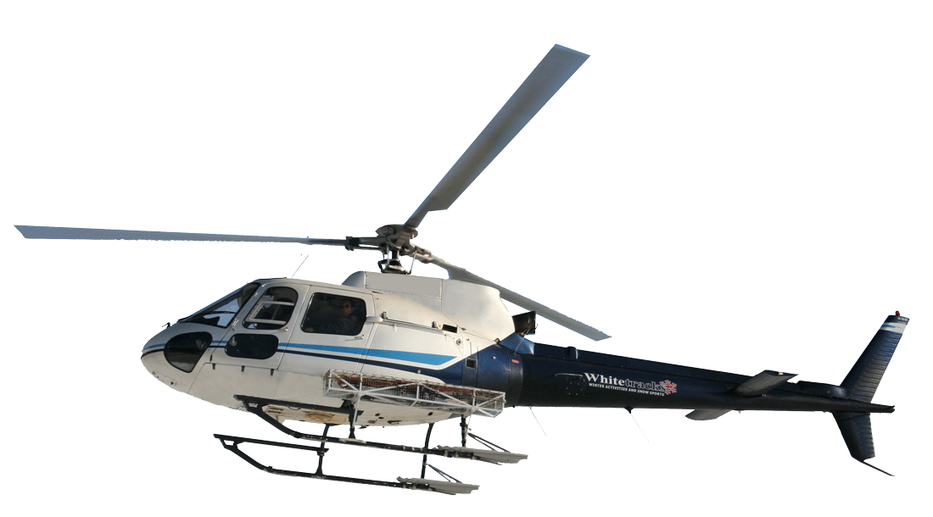
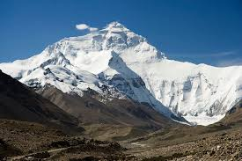
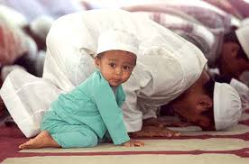
The before plural number not A or An
Technological knowledge
use of the
The before particular person or object.
The cat jumped over the chair.
The boys are plying.
(a particular cat not any cat)
plural
Pedagogical knowledge
The Andamans island is in India.
Content knowledge
plural
Nepal is called the Himalayas’ daughter.
The plane is flying above the cloud.
plural
cloud
The Muslims are praying
(a particular plane not any plane)
plural
Md. Abdur Razzaak, Head Teacher, Dhalhara Westpara Secondary Girls’ School, Sadar, Magura. Contact: 01721588402

Slide 18
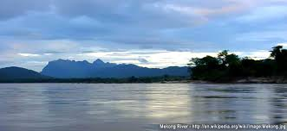
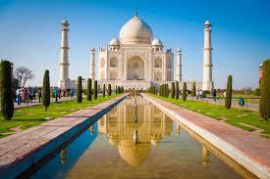
Technological knowledge
The is used before only one thing in the world.
Similarly:
The Bay of Bengle
The north
The south
The west
The east
The pacific
The noorjahan road
The Shat Gombuj mosjid
The national park
The Gita
The earth
The before superlative degree
The Agnibina
The moon
The best boy
The cleverest girl
The most beautiful sight
The happiest man
The largest station
Pedagogical knowledge
Content knowledge
The Jamuna
The Tajmahal
The Quran
The Everest
Md. Abdur Razzaak, Head Teacher, Dhalhara Westpara Secondary Girls’ School, Sadar, Magura. Contact: 01721588402

Slide 19
Technological knowledge
The is used before the thing/person comes second time.
I have a dog. The dog is very faithful.
The is used before the word of of.
The name of my country is Bangladesh.
Pedagogical knowledge
Content knowledge
When noun is plural, always the is used not a or an. As:
The boys are playing.
Md. Abdur Razzaak, Head Teacher, Dhalhara Westpara Secondary Girls’ School, Sadar, Magura. Contact: 01721588402

Slide 20
Technological knowledge
Omission of article
before proper noun. As:
$$×$$
Bangladesh is our motherland.
a or an is not before plural form. As:
Pedagogical knowledge
$$×$$
$$×$$
a or an the boys are playing.
Content knowledge
before language. As:
$$×$$
Bangla is our mother tongue.
article is not used before material noun. As:
$$×$$
Rice is my favourite dish.
Md. Abdur Razzaak, Head Teacher, Dhalhara Westpara Secondary Girls’ School, Sadar, Magura. Contact: 01721588402

Slide 21
Technological knowledge
before subject. As:
$$×$$
He is good at mathematics.
before possessive case. As:
$$×$$
My pen is blue.
Pedagogical knowledge
Content knowledge
before game. As:
$$×$$
Cricket is my favorite game.
before human beings. As:
$$×$$
man is mortal.
Md. Abdur Razzaak, Head Teacher, Dhalhara Westpara Secondary Girls’ School, Sadar, Magura. Contact: 01721588402

Slide 22
Technological knowledge
Group work 6 min
Fill in each gap with suitable article and put ( ) where article is not necessary
$$×$$
an
English is (a) — international language. It is spoken all over (b) — world. So the importance of (c) — English cannot be described in words. All (d) — books of higher education are written in English. Today organizations need employees who can speak and write (e) — standard form of (f) — English.
the
$$×$$
Pedagogical knowledge
Content knowledge
the
a
$$×$$
Md. Abdur Razzaak, Head Teacher, Dhalhara Westpara Secondary Girls’ School, Sadar, Magura. Contact: 01721588402

Slide 23
Technological knowledge
Evaluation
Tick ($√$) the correct answer from alternatives.
1. Mr. Atiq is ---MA.
(b) an
(a) a
$√100$%
$$×$$
(d) the
Pedagogical knowledge
(c) $×$
$$×$$
$$×$$
Content knowledge
2. He is ----banker.
(a) an
(b) the
$$×$$
$$×$$
(c) a
(d) $×$
$√$100%
$$×$$
Md. Abdur Razzaak, Head Teacher, Dhalhara Westpara Secondary Girls’ School, Sadar, Magura. Contact: 01721588402

Slide 24
Technological knowledge
3. He leads -----honest life.
(a) a
(b) an
$$×$$
$√100$%
(c) the
(d) $×$
$$×$$
$$×$$
4. He lives in -----Dhaka.
(a) a
(b) an
$$×$$
$$×$$
Pedagogical knowledge
Content knowledge
(c) $×$
(d) the
$√$100%
$$×$$
5. He is respected to all for his ---honesty.
(a) a
(b) the
$$×$$
$$×$$
(c) $×$
(d) an
$√$100%
$$×$$
Md. Abdur Razzaak, Head Teacher, Dhalhara Westpara Secondary Girls’ School, Sadar, Magura. Contact: 01721588402

Slide 25
Technological knowledge
Homework
Pedagogical knowledge
Content knowledge
Write a short composition within ten sentences about yourself using article.
Md. Abdur Razzaak, Head Teacher, Dhalhara Westpara Secondary Girls’ School, Sadar, Magura. Contact: 01721588402

Slide 26
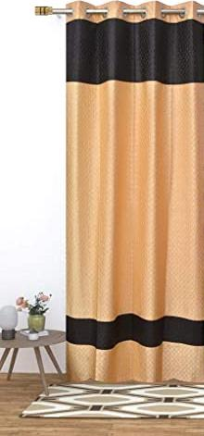
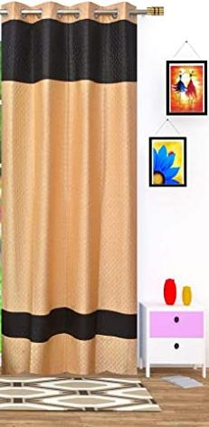
Technological knowledge
See you next class
Pedagogical knowledge
Content knowledge
A girl
Md. Abdur Razzaak, Head Teacher, Dhalhara Westpara Secondary Girls’ School, Sadar, Magura. Contact: 01721588402

