Slide 1
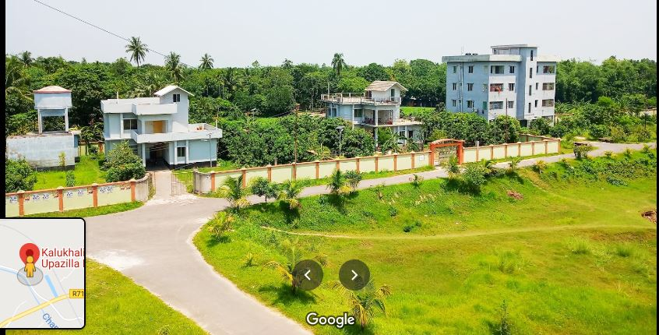
Kalukhali Upazila Online School
WELCOME

Slide 2
Kalukhali Upazila Online School
NOKIA-4G
Md. Sulyman Hossain
Asst. teacher (Ict)
Alhaj Amena Khatun Bidyapith
Kalukhali,Rajbari.
01303800430.

Slide 3
Kalukhali Upazila Online School
Let us enjoy some image and texts to guess something.

Slide 4
Kalukhali Upazila Online School
He said, “ Shot the ball.”

Slide 5
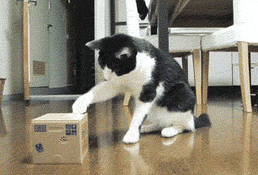
Kalukhali Upazila Online School
One said to another, “Don’t disturb me.”
One requested another not to disturb him.

Slide 6
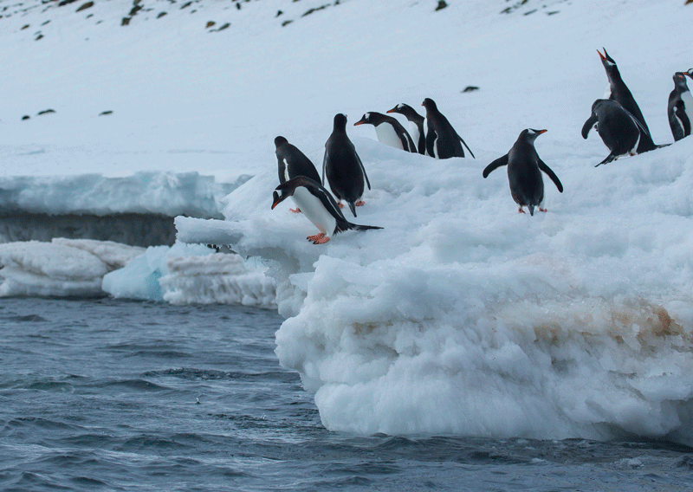
Kalukhali Upazila Online School
The penguin said,” Let’s jump into the sea.”
The penguin proposed that they should jump into the sea.

Slide 7
Kalukhali Upazila Online School
Tell me what are
we going to discuss today?
Direct and indirect speech of Imperative sentence.

Slide 8
Kalukhali Upazila Online School
Our today's lesson is---
Converting imperative sentence from direct to indirect speech.

Slide 9
Kalukhali Upazila Online School
Learning outcomes
After we have studied this lesson, we will be able to--
define imperative sentence
identify the patterns of imperative sentence
convert imperative sentence into indirect speech.

Slide 10
Kalukhali Upazila Online School
Basic in indirect
How reporting verb changes in pattern -1
To mean | Direct | Indirect
order | said to | ordered + object + to + reported speech
command | said to | commanded + object + to + reported speech
request | said to | requested +object + to + reported speech
advice | said to | advised +object + to + reported speech

Slide 11
Kalukhali Upazila Online School
He said to me, “Do your duty.”
He ordered me to do my duty.
The commander said to
the soldiers , “March on.”
Direct speech
Indirect speech
The commander commanded
the soldiers to march on.

Slide 12
Kalukhali Upazila Online School
He said to me, “Please help me.”
He requested me to help him.

Slide 13
Kalukhali Upazila Online School
Direct speech
He said to me, “Obey your parents.”
He advised me to obey my parents.
Indirect speech

Slide 14
Kalukhali Upazila Online School
He said to me, “Let me drop the matter.”
Begins with | Direct | Indirect
Let | said to | requested+ object +that + subject + might +V₁ +Extension
He said to me, “Let us play the match.”
Let us/Let’s | said to | proposed to +object+ that we/they should + verb + extension
He proposed to me that we should play the match.

Slide 15
Kalukhali Upazila Online School
Convert into indirect
He said to me ,” Let him go.”
My friend said to me,” Let us settle the dispute.”
The teacher said to the student, “ Follow elders.”
Rahim said, “ Let us swim in the pond.”
The man said to the boys,” Let them enjoy the game.”

Slide 16
Kalukhali Upazila Online School

Slide 17
Kalukhali Upazila Online School
He said to me, “Don’t disobey your parents.”
He advised me not to disobey my parents.
Mother said, “Don’t follow the bad.”
Mother advised not to follow the bad.
Notes
If the reported speech begins with imperative ‘Don’t’, you have to write ‘not to’ before reported speech while changing a direct speech into indirect speech.

Slide 18
Kalukhali Upazila Online School
Group Work
Group-1& 3
Write the structure of imperative sentence, pattern-1 and how the reporting verb changes. Write two examples.
Group-2 & 4
Write the structure of imperative sentence, pattern-2 and how the reporting verb changes. Write two examples.

Slide 19
Kalukhali Upazila Online School
Evaluation
Answer the following questions.
What do you mean by imperative sentence?
What is to be written in place of ‘don’t’?
How is it to be changed with Let’s sentence?
What are the structures of imperative sentence?
Where does ‘that’ use in imperative sentence?

Slide 20
Kalukhali Upazila Online School
Home
Task
Change the following speech from direct to indirect—
The teacher said to me, “ Never tell a lie.”
Father said to his son, ”Go to school regularly.”
He said to me,” Please give me a hundred taka.”
“Get out,” said he.
“Let’s enjoy the match,” said my friend.

Slide 21
Kalukhali Upazila Online School
Stay Home
Good Bye !

