Slide 1
W
E
L
C
O
L
E

Slide 2
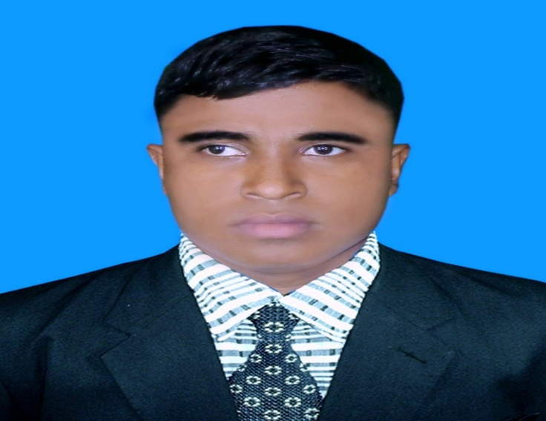
Teacher’s Identity A. Sukur Ali Khan B.A hons.M.A In English Assistant Teacher(English)
Naldha Secondary School
Naldha,Fakirhat,Bagerhat.
Email : sukur360720@gmail.com Mobile no-01922-360720
Class Introducing
Class : Nine
Unit : 03
Lesson : 03
Time : 50 Minutes.
Date :

Slide 3
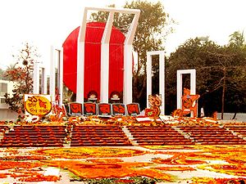
Look at the picture and the questions below.
What is the picture about?
Where do you think it is?
Why was it built?

Slide 4
International Mother Language Day-1
So our today’s topic is...?
Dear students write down the lesson’s headline.

Slide 5
LEARNING OUTCOMES OF THE LESSON
At the end of the lesson, the students will be able to ….
know the history of Language Movement of 1952 .
read the text and infer the meaning of the text.
choose the correct answer.
ask & answer questions.
fill in the gaps.
write a paragraph.

Slide 6
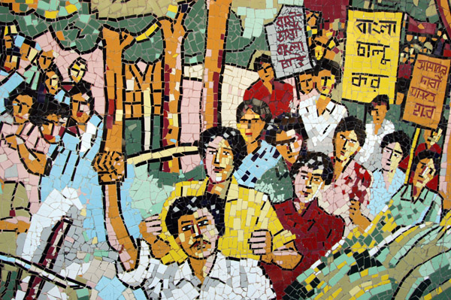
Vocabularies
Movement
To raise for something/struggle

Slide 7
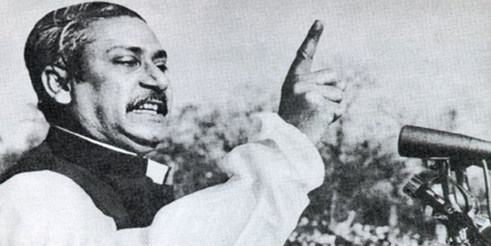
Declare
Announce

Slide 8
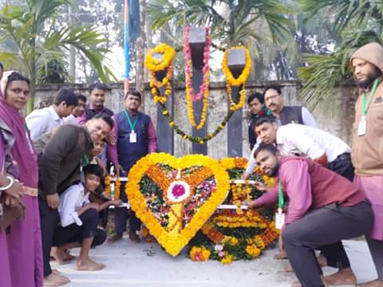
Observe
Celebrate

Slide 9
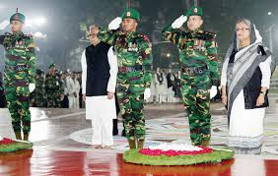
Tribute
An act of showing respect

Slide 10
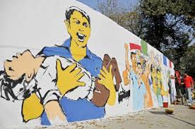
Martyr
who makes sacrifices.

Slide 11
Kindle
Lighten

Slide 12
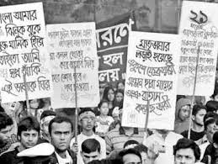
A group of people moving in an orderly manner
Procession

Slide 13
Pay
To give (something)

Slide 14
21 February is a memorable day in our national history. We observe the day every year as International Mother Language Day. The day is a national holiday.
On this day, we pay tribute to the martyrs who laid down their lives to establish Bangla as a state language in undivided Pakistan in 1952. It is known as the Language Movement.
The seed of the Language Movement was sown on 21 March 1948 when Mohammed Ali Zinnah, the then Governor General of Pakistan, at a public meeting in Dhaka declared that Urdu would be the only state language of Pakistan. The declaration raised a storm of protest in the eastern part of the country. The protest continued non stop, gathering momentum day by day. It turned into a movement and reached its climax in 1952. The government outlawed all sorts of public meetings and rallies to stop it.
The students of Dhaka University defied the law and they brought out a peaceful protest procession on 21 February 1952. When the procession near Dhaka Medical College, the police opened fire on the students, killing Salam, reached Rafiq, Barkat, Safiur and Jabbar. As a result, there were mass protests all over the country and the government had to declare Bengali too as a state language. This kindled the sparks of independence movement of Bangladesh.
Reading the passage silently

Slide 15
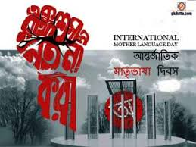
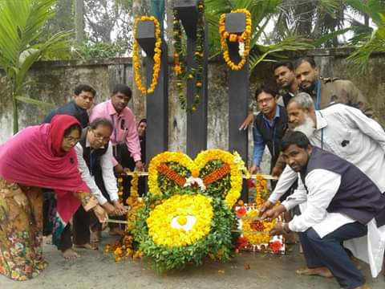
We observe the day every year as International Mother Language Day.

Slide 16
Choose the best answer from the alternatives .
1. When was the seed of the Language Movement sown ?
21st February 1952 ii. 21st February 1971
iii. 21st February 1948 iv. 21st March 1948
2. Language Movement was held in--------.
Bangladesh ii. India
iii. Pakistan iv. Undivided Pakistan.
3. The martyrs who are mentioned in the passage were martyrs.
freedom ii. language
iii. democratic iv. Socialist.
4. Police open fire on the
workers. ii. students iii) singers iv. teachers.
Individual
work

Slide 17
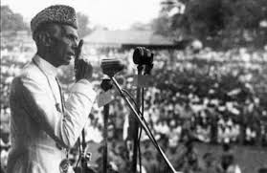
21 March,1948. Mohammed Ali Zinnah, the then Governor General of Pakistan at a public meeting in Dhaka declare that .
“Urdu would be the only state language of Pakistan”

Slide 18
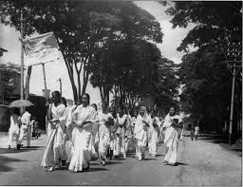
The declaration raised a storm of protest in the eastern part of the country.

Slide 19
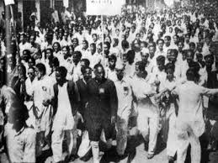
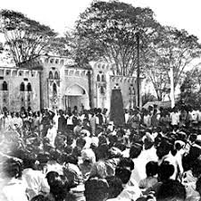
The students of Dhaka University defied the law and they brought out a peaceful protest procession on 21 February-1952

Slide 20
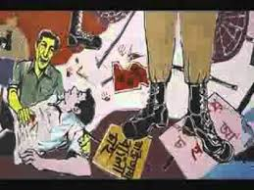
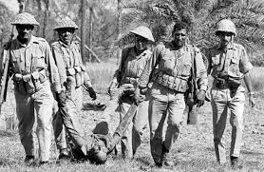
The police opened fire on the students

Slide 21
Killing Salam, Rafiq, Barkat ,Jabbar & Sofiur

Slide 22
At last the government had to declare Bengali too as a state language.

Slide 23
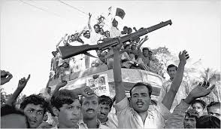
This kindled the sparks of Independence Movement of Bangladesh.

Slide 24
Answer the following questions.
Why do we observe 21 February as the
International Mother Language Day?
2. Who were killed in the movement ?
3. How do you see the Language Movement ?
4. Who were killed in the movement ?
Group Work

Slide 25
Fill in the gaps with a suitable words .
Evaluation
21 February is a (a) ------------day in our national history. On this day, we pay (b)-------- to the martyrs. The seed of the Language Movement was sown on (c) ---------March(d) -----------.This kindled the (e ) -------- of independence movement of Bangladesh.
memorable
tribute
21st
1948
sparks

Slide 26
Home Work
Write a paragraph on how you observed “The International Mother Language Day” in your school this year.

Slide 27
THANK YOU ALL

