Slide 1
G
G
Welcome
G
G

Slide 2
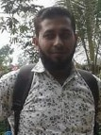
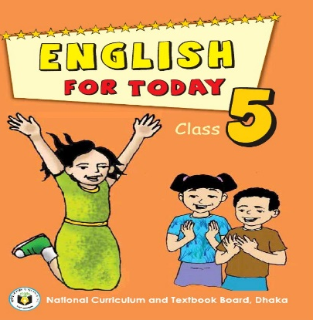
G
G
Mohammad Abdul Gafur Mojumder,
Assistant teacher
Gaiar Bhanga G.P.S
Lalmai, Cumilla.
I D
E
N
T
I
T
Y
Subject: English
Class: Five
Unit:21
Lesson:Last…station.
Date:13/09/2019
Time: 40 Minutes.
G
G

Slide 3
G
G
Good morning students.
How are you today?
Let’s sing the good morning song.
G
G

Slide 4
G
G
Can you tell me what we had learnt last class?
Several job descriptions.
Very good
G
G

Slide 5
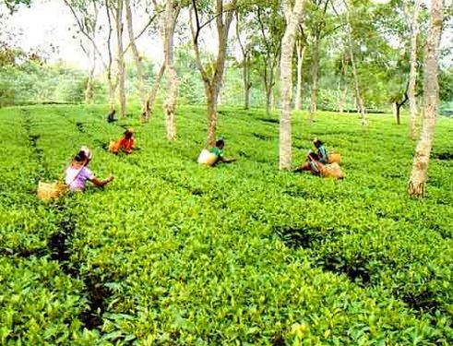
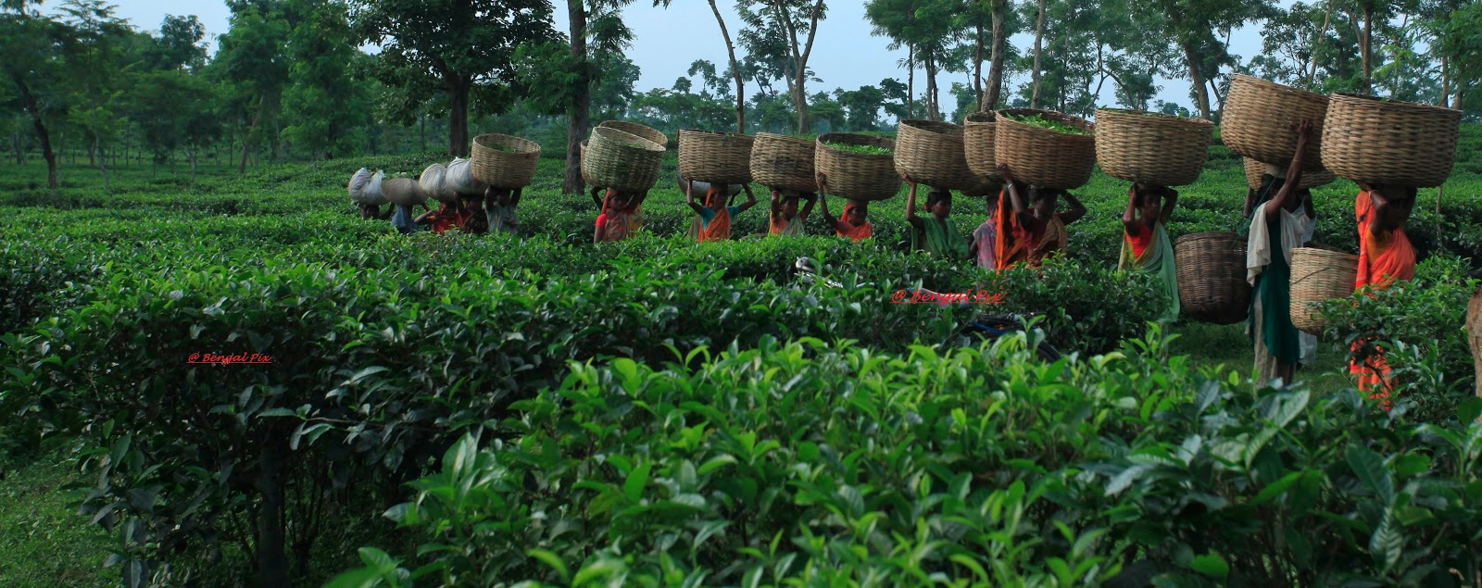
G
G
Have you ever been to a tea garden?
How was your experience?
G
G

Slide 6
G
G
Our today’s lesson is…
It was a great day!
G
G

Slide 7
G
G
Learning Outcomes
By the end of this lesson students will be able to…
# 4.2.1 understand and enjoy simple stories.
# 6.2.1 talk about people,objects,events etc.
# 1.5.1 read words,phrases and sentences
in the text with proper pronunciation
stress and intonation.
G
G

Slide 8
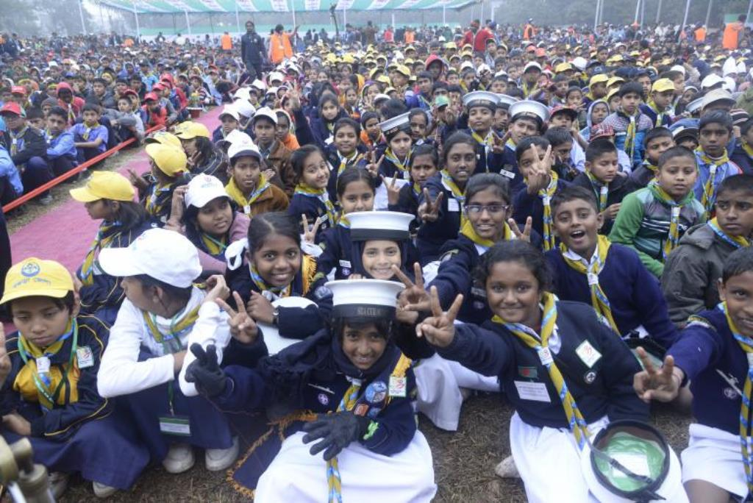
G
G
What is the logo about?
What is the picture about?
Scout logo
Cub camporee
G
G

Slide 9
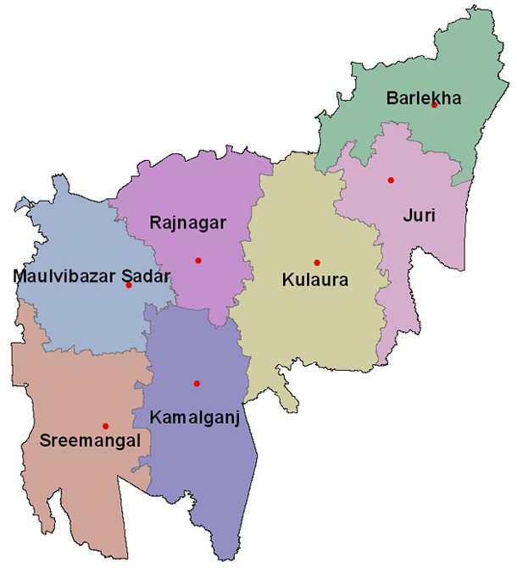
G
G
Look at the map of Moulvibazar district.
Sreemangal upozila.
G
G

Slide 10
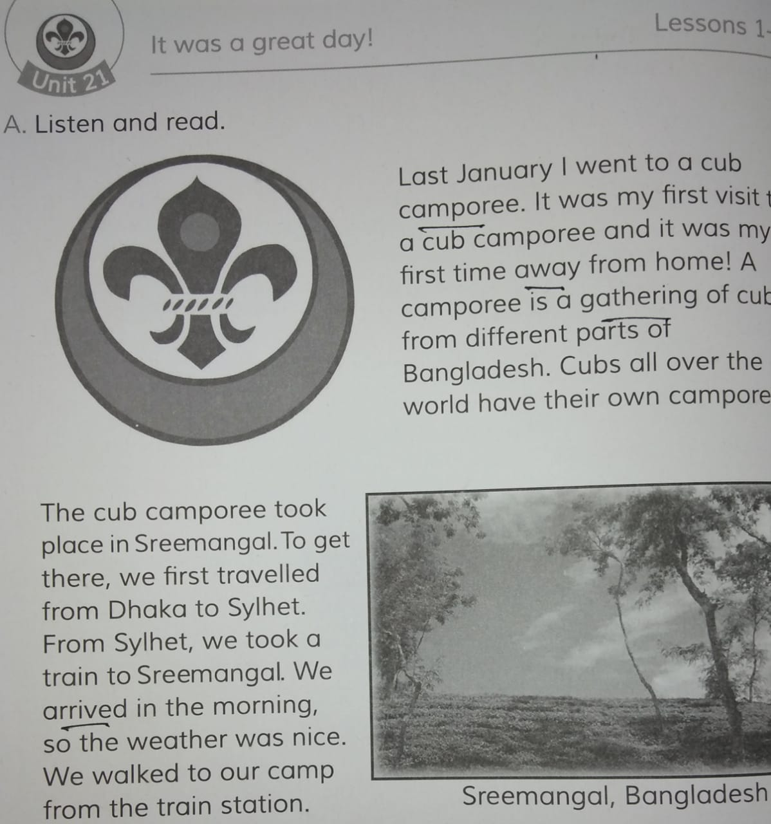
G
Open at page 82 0f your EFT book.
G
I’ll read the text and you will repeat after me.
G
G

Slide 11
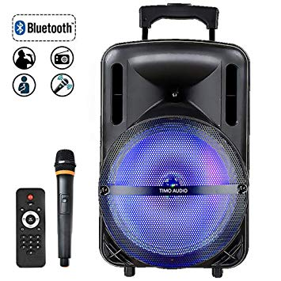
G
G
Dear students, now I’ll play the audio of the text.
You will listen very carefully and then repeat aftet it.
I’ll play the audio of the
text with sound system
From my mobile.
G
G

Slide 12
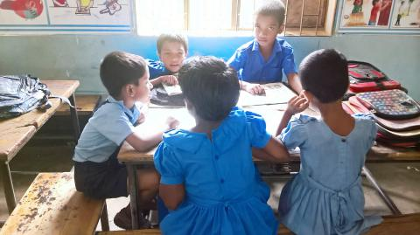
G
G
Group reading.
Every five students will make a group
and read out the text among themselves.
G
G

Slide 13
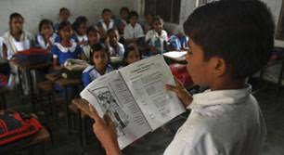
G
G
Some students will read out the
text by turns before the class.
G
G

Slide 14
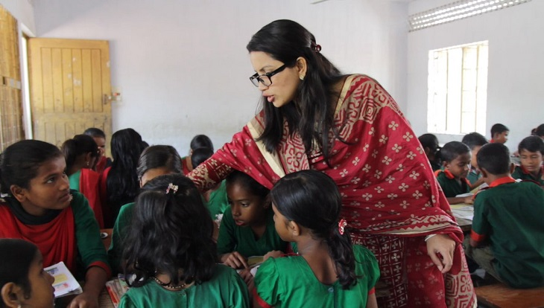
G
Students will read the text in pair.
G
Teacher will observe and evaluate
G
G

Slide 15
G
G
New words
Camporee
(Meeting of cubs)
Away
(Far)
Gathering
(Conference)
Arrived
(Reached)
I
N
D
I
V
I
D
U
A
l
W
O
R
k
G
G

Slide 16
G
G
Evaluation
Write the answers of the following questions in your notebook.
(1) What is a camporee?
(2) Where did the cub camporee take place?
(3) How was the weather?
G
G

Slide 17
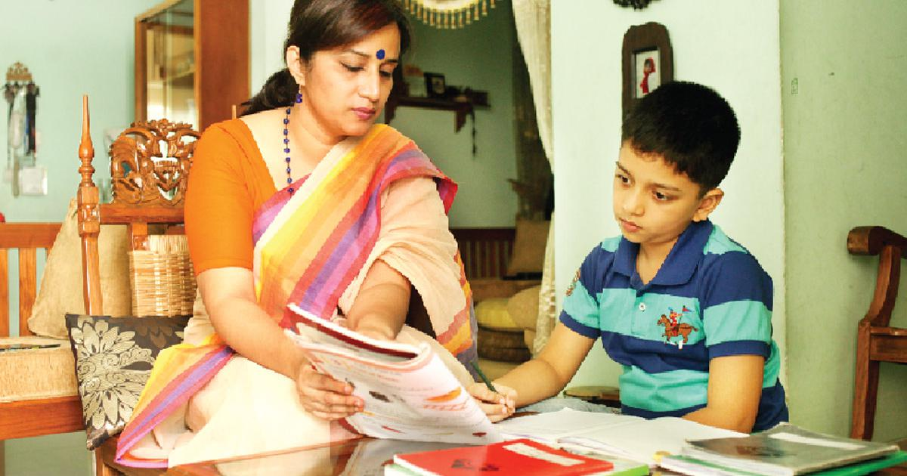
G
Home work
G
You will write a letter to your best friend
describing a great day you enjoyed ever.
G
G

Slide 18
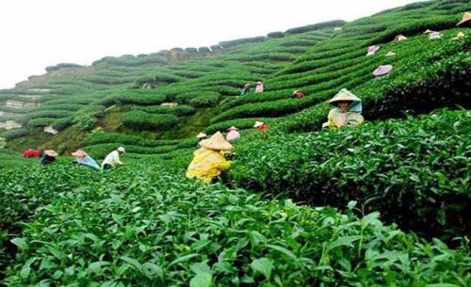
G
G
Thank you very much.
G
G

