Slide 1
Well -come

Slide 2
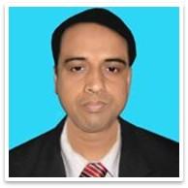
IDENTITY
Mohammad Abdul Malek
Assistant Teacher (Computer)
Kazi Abdul Majed Academy
Pangsha, Rajbari. Mob- 01717-002151
E-mail: abdulmalek1972p@gmail.com
Website. www.teachersnews24.com
Class: Nine
Subject: English First Paper

Slide 3
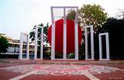
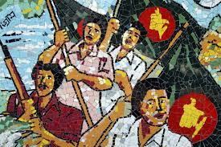
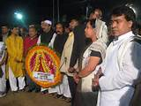
Shahed Miner
Celebrate the Mother Language Day
Music
Morning procssion

Slide 4
“International Mother Language Day”

Slide 5
Learning Outcomes:
By the end of the lesson the students will be able to…
1.Learn some new vocabulary
2. Speak about International Mother Language day
3.Write some information Shaded Miner

Slide 6
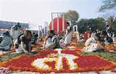
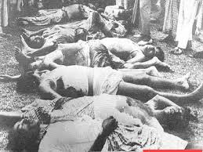
Let’s introduce some synonyms
Observe
Celebrate
Sacrifice
Lay down

Slide 7
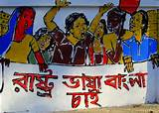
procession
March
Gather
Gain

Slide 8
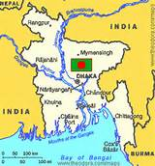
Shahed Miner built up near Dhaka Medical Collage.

Slide 9
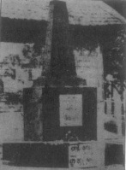
The first shaded Miner build up D. Syed Hayder in 22 February 1952.

Slide 10
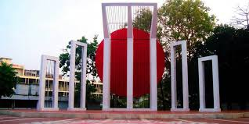
The second Shahed Miner built Hamidor Bahaman In 1972

Slide 11
Choose the best answer:
1.Our state festival is
a.Pahela Baishaki.
b.Shaheed Dibosh.
c. May Day.

Slide 12
2.The International Mother Language Day celebration begin
22 February
16 December
21 February
26 March

Slide 13
Match the words in the table with their meanings.
Words Meanings
wreath
encourage
In remembrance of
In appreciation of
proclaim
Practice of using several
promote
An arrangement of flowers in the shape of a circle
diversity
declare
multilingualism
In memory of
In recognition of
variety

Slide 14
Complete the passage with words.
Symbol, Movement, Blood, And, In order, Language,
On 21Fevruary …………….was shed at a place between Dhaka Medical Collage and Dhaka University…………… to establish Bangla a state………Of Pakistan.
All subsequent movements……………. the struggles for independence had their origin from the historic language……………,Shaded Miner is the ………..of the supreme sacrifice………….. The mother tongue.

Slide 15
Group Work
Why is 21 February now observed throughout the world every day?

Slide 16
Evaluation:

Slide 17
Where it is?

Slide 18
Who declare the International Mother Language Day?

Slide 19
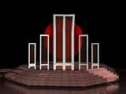
Who is the deigned?

Slide 20
When was the first shaded Miner build?

Slide 21
When was the second shaded Miner build?

Slide 22
Home Work
Write a paragraph about the International Mother language day in 10 Sentences.

Slide 23
Thank You

