Slide 1
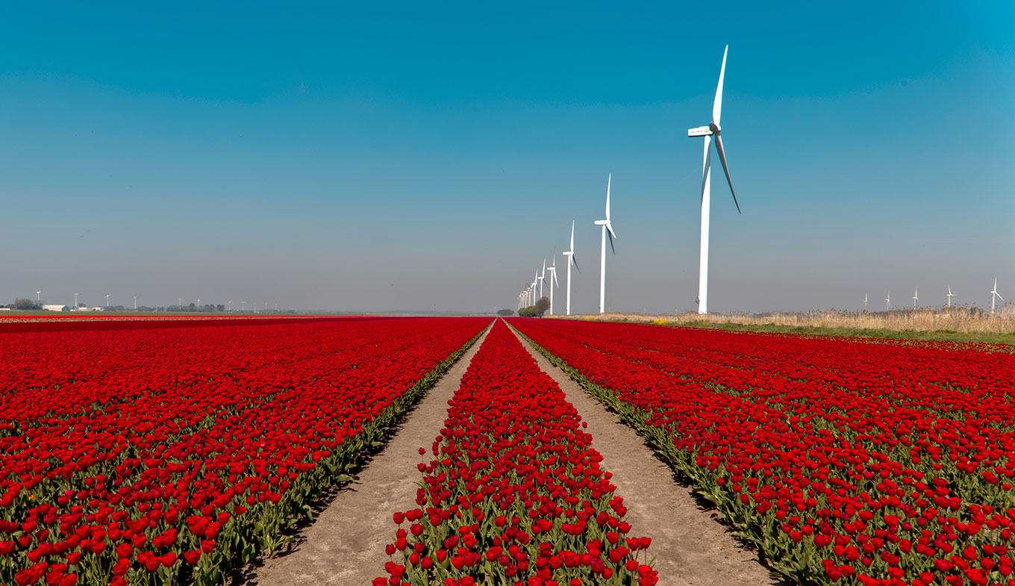
Welcome to all students

Slide 2
Teacher Identification
MD. Aowalul Islam ( Aowal)
Assistant Teacher
Panchurchak High School
Joypurhat Sadar.
Email: aowalulislam@gmail.com

Slide 3
Dear students
Welcome to today`s class

Slide 4
our today’s lesson
Transformation of sentence
Positive to Superlative

Slide 5
How to change simple positive into superlative
Subject +verb +the + superlative form +extension.
1.It is a big tree
It is the biggest tree
2.The Padma is a deep river.
The Padma is the biggest river.

Slide 6
How to change positive (with ‘No other’ ) into superlative.
Last object`s subject + verb + the +superlative form+ “after other word to before verb word.”
No other man in the village is as old as he.
He is the oldest man in the village .
No other bird is as nice as the parrot.
The parrot is the nicest bird.

Slide 7
Class activities
1.No other boy in the orphanange is as good as Jamal.
Jamal is the best boy in the orphanange.
2. No other girl in the class is so fair as Ruma.
Ruma is the fairest girl in the class.
3.No other city in Bangladesh is as big as Dhaka.
Dhaka is the biggest city in Bangladesh.
4. No other woman was as clever as the lady guest.
The lady guest was the cleverest woman.
5.No other animal is so useful as the cow.
The cow is the most useful animal.

Slide 8
How to change positive (with ‘very few’ ) into superlative.
Last object`s subject + verb + one of the +superlative form+ “after few word to before verb word.”
1. Very few boys in the village are as small as Shohel.
Shohel is one of the smallest boys in the village.

Slide 9
Class activities
1.Very few restaurants are so expensive as Sonargaon.
Sonargaon is ,one of the most expensive restaurants.
2.Very few pictures in the world are so great as this.
This is one of the greatest pictures in the world.
3.Very few metals are so preciousas gold.
Gold is one of the most precious metals.
4.Very few animals are so ferocious as a lion.
A lion is one of the most ferocious animals.
5.Very few players in the team are as good as he.
He is one of the best players in the team.

Slide 10
Home work
1.No other city in Bangladesh is as big as Dhaka.
2. No other woman was as clever as the lady guest.
3.Very few pictures in the world are so great as this.
4.Very few metals are so preciousas gold.
5. It is a long tower

Slide 11
Thanks to all students

