Slide 1


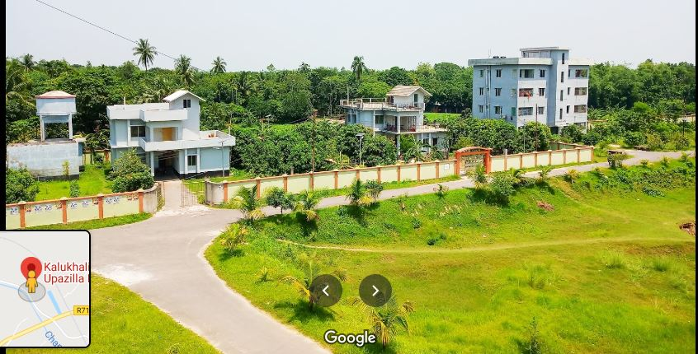



Kalukhali Upazila Online School
WELCOME

Slide 2

Kalukhali Upazila Online School
NOKIA-4G
Md. Sulyman Hossain
Asst. teacher (ICT)
Alhaj Amena Khatun Bidyapith
Kalukhali,Rajbari.
01303800430.

Slide 3
Kalukhali Upazila Online School
Let us enjoy some image and texts to guess something.

Slide 4

Kalukhali Upazila Online School
He said , “Do you like marshal art?”
He asked if I liked marshal art.

Slide 5

Kalukhali Upazila Online School
The dog said to the cat,” Why do you disturb me?”
The dog asked the cat why he disturbed him.

Slide 6
Kalukhali Upazila Online School
Can you guess what we are
going to discuss in our class?
Direct and indirect speech of Interrogative.

Slide 7
Kalukhali Upazila Online School
Our Today’s lesson is-
How to change the speech of Interrogative, Optative and Exclamatory sentences.

Slide 8
Kalukhali Upazila Online School
Learning objectives
After completing this lesson, students will be able to---
define interrogative sentence.
identify the structures of changing speech.
change direct speech into indirect

Slide 9

Kalukhali Upazila Online School
What is Interrogative sentence?
The sentence which is used to know something is interrogative sentence.

Slide 10
Kalukhali Upazila Online School
Follow
Do you like to follow your parents?
What is the aim of your life?
There are two categories
of Interrogative sentence
Yes/No Question
Wh Question
Are you well?
Who is he?

Slide 11
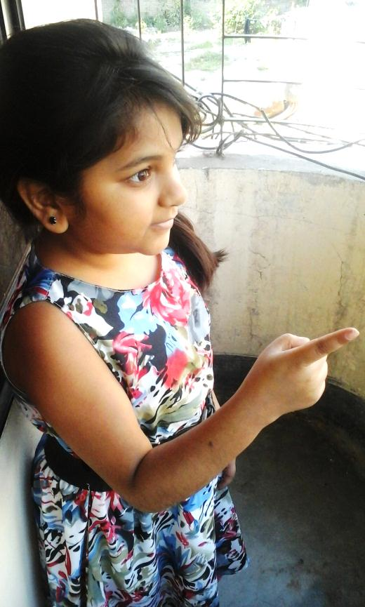
Kalukhali Upazila Online School
How to change ‘Yes/No’ question from direct to indirect speech.
Subject + asked + object + if/whether+ subject + verb + extension.
“Do you like my song?” Asha said to Disha.
Asha asked Disha if she liked her song.

Slide 12
Kalukhali Upazila Online School
How to change ‘Wh’ question from direct to indirect speech.
Subject + asked +object + ‘Wh’ word + subject + verb + extension .
He said to me, “Why did you call me yesterday?”
He asked me why I had called him the previous day.

Slide 13


Kalukhali Upazila Online School
She said to me, ”Where does Asha live in?”
Direct Speech
Indirect Speech
She asked me where Asha lived in.

Slide 14

Kalukhali Upazila Online School
Let’s practice.
Mother said,” Have you done your home work?”
The doctor said to the patient, “What is your problem?”
The man said to me, ” Would you give me your pen?”
He said to me, “Can you solve the problem?”
The headmaster said to the boy, ” Do you obey your parents?”
The father said to the son, ”Are you sure to get A+ in the annual exam?”
The son said to his mother, ” How can I overcome the situation?”

Slide 15
Kalukhali Upazila Online School
Group 1 & 3
Write the structure how to make indirect from ‘yes/no’ question with example.
Group 2 & 4
Write the structure how to make indirect from ‘wh’ question with example.

Slide 16
Kalukhali Upazila Online School
Evaluation
What do you mean by ‘yes/no’ question?
What can you know from ‘Wh’ question?
He said to me, “What is your name?”
Mina said to them, : Are you gossiping?”

Slide 17
Kalukhali Upazila Online School
H
O
M
e
T
A
S
k

Slide 18

Kalukhali Upazila Online School
See you again ! Bye!

