Slide 1
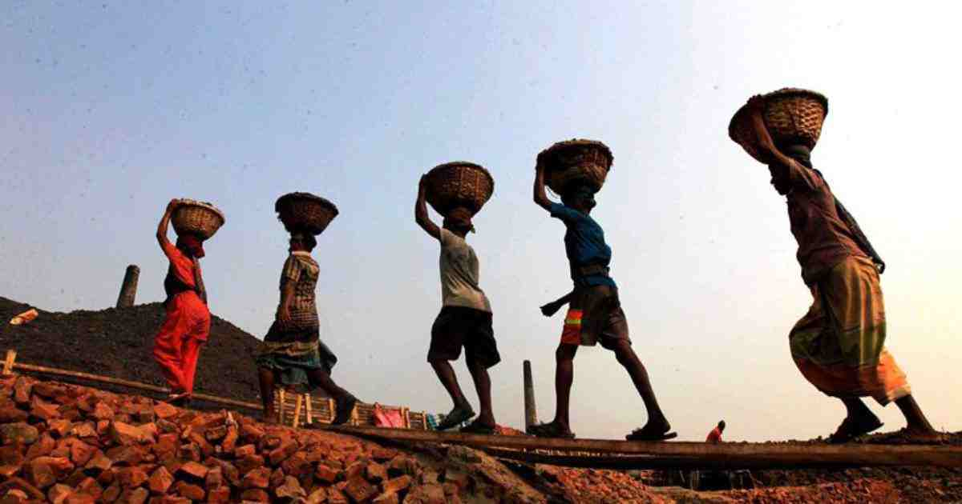
Welcome

Slide 2
Abdul Aziz
Assistant Teacher (English)
Madhaia Bazar Sadim High School
E-mail : azizabidpur@gmail.com
Mobile : 01921767310
Class –Nine
English First Paper
Unit -06, Lesson -05
Bhutan : The land of happiness

Slide 3
Look at the picture and talk about it
Pair Work
In the picture, I see a man’s hand holding a hammar on the background of blood. Below the hand, “May Day” is inscribed. This picture reminds the historical struggle and sacrifices of working class people.
Notes:
s

Slide 4
So , Our today’s topic
May Day

Slide 5
Learning Outcomes
After the end of the lesson, students will be able to-
Talk about May Day
Infer vocabulary
Ask and Answer Questions.

Slide 6
Key words
Recall and show respect sombody
or something
Commemorate
স্মৃতিচারণ করা
Historical
Connected with the past
ঐতিহাসিক
To start or create a system,
an organization etc
Establish
প্রতিষ্ঠা করার
To make a formal speech to a
group of people
বক্তৃতা দেওয়া
Address
Suddenly
Qickly or unexpectedly
হঠাৎ

Slide 7
Key words
immediatly
instantly
সঙ্গে সঙ্গে
Wound
To be injured in any part of the body
আহত হওয়া
Injure
To harm somebody physically
আহত করা
Exploit
To treat somebody unfairly
শোষণ করা
Demand
To ask for something very firmly
দাবি করা

Slide 8
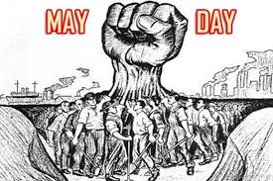
Read the text.
May day or International Worker’s Day is observed on May 1 all over the world today to commemorate the historical struggle and sacrifices of the working people to establish an eight-hour workday. It is a public holiday in almost all the countries of the world

Slide 9
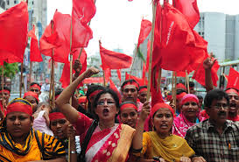
Since the industrial Revolution in the 18th and 19th centuries in Europe and the US, the workers in mills and factories had been working a long shift fourteen or even more hours a day On May 1st in 1886, inspired by the trade unions, half of the workers at the McComick Harvesting Machine Company in Chicago went on strike demanding an eight –hour workday.

Slide 10
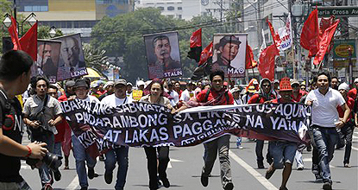
Two days later, a workers’ rally was held near the McComic Harvesting Machine Company and about 6000 workers joined it. The rally was addressed by the labour leaders.They urged the workers to stand together, to go on with their bosses. At one point of the rally, some strikebreakers started leaving the meeting place.

Slide 11
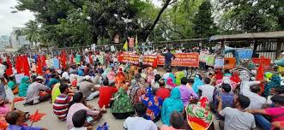
The strikers went down the street to bring them back. Suddenly about 200 policemen attracted them with clubs and revolvers. One sticker was killed instantly, five or six others were seriously wounded and many others were badly injured.

Slide 12
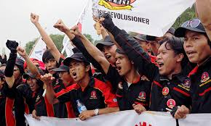
The events of May 1, 1886 are a reminder that workers will continue to be exploited until they stand up and speak out to gain better working conditions, better pay and better lives.

Slide 13
Group Work
Choose the correct answer from the alternatives
What was workers prime demand_____
Better working condition b) better pay c) yearly increment d) Eight –hour workday
2. What does the phrase mean_____
a) Fight b) argue c) surrender d) admit
3. The word ‘strike’ means_____
a) refuse b) attack c) assault d) walkout
4. The word ‘exploit’ means_____
a) employ b) apply c) abuse d) handle

Slide 14
Individual Work
Write short answer to the following questions
What is May Day?
May Day is an International Workers’ Day.
How is May Day observed
May Day is observed as an international workers’ day.
When is May Day celebrated ?
May Day is celebrated on May 1st.

Slide 15
Individual Work
Fill in the gaps from the text.
throughout
May Day is observed a) __________ the world. It is a b)____________ day specially for the workers. Many workers went on c)________to gain an eight hour workday. They d)_________ for a better working condition with better wages. At last the workers e)_________ their rights.
red letter day
strike
demanded
gained

Slide 16
Write a short paragraph on
“May Day”

Slide 17
Thank you all

