Slide 1
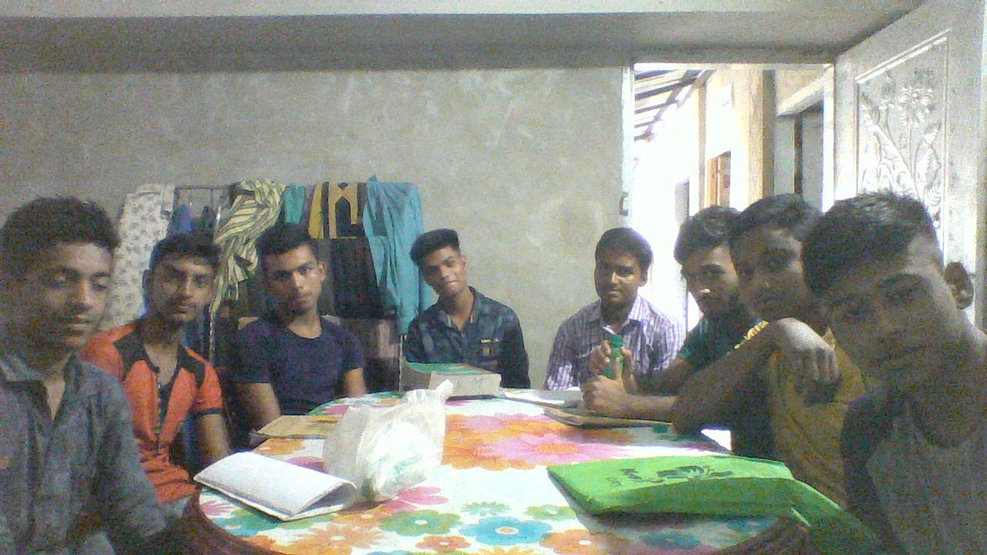
Dear students
Welcome to my class

Slide 2
Introduction
Abul Kashem Miah
Assistant Teacher(English)
Shaheed Alauddin High School
Mirzapur, Pakundia, Kishoreganj
Class-10
Subject: English 2nd Paper
Topic: grammar

Slide 3
Rule: Generally, we follow this order 2nd 3rd 1st person.
Example:
You, he and I saw the bird.

Slide 4
Rule: we follow this order in admitting faults -1st 2nd 3rd person.
Example:
I, you and he are guilty.

Slide 5
3. Adjective+ noun.
Example:
Communicative competence refers to the ability to use language appropriately.
Environmental pollution has increased recently.
Noun
Adjective

Slide 6
4. A/an/ the+ Noun.
Example:
A constitution is essential for a nation.
The necessity of learning English can not be described in words.

Slide 7
5. Rule: possessive adjective-
Possessive Adjective +Noun
Possessive Adjective + (not `the’) +noun.
Possessive Adjective +verb(ing).
Example:
a. This is my book
b. The boy broke his arm yesterday.
c. He insisted on my going there.

Slide 8
6 Rule: Who, whom-(definite)
Who/whoever +verb
Whoever/whomever+ noun/pronoun.
Note: whoever/whomever(indefinite)
Example:
a. He is the person who is honest.
b. He is the person whom you want.

Slide 9
Rule-5: Preposition + noun/ verb(ing).
Example:
Television is a source of (entertain)
Children are of fond of (use) mobile phone.

