Slide 1



Slide 2

Today’s Lesson
Topic: Parts of Speech (PART-1)
Class: Nine (Vocational)
Subject: English-1

Slide 3

Parts
অংশগুলো

Slide 4

Speech
কথন বা কথা

Slide 5
Parts Of
Speech
কথার
অংশগুলো
We are really happy to join this online class.

Slide 6
Parts of Speech
Noun
Pronoun
Verb
Adverb
Adjective
Preposition
Conjunction

Slide 7

Nouns
Ramim is a student of Bliss School
Meherpur. Next month, there will
be a sports competition. He has built
up a football team. However, they do
not have any football to practise during their free time. So, Ramim has bought a football for his team. Everyday, they practise hard. They have their own plan to set the players.

Slide 8
Noun is a naming word
Ramim = Definite name (Proper)
Football = Name of a thing (Material)
Student = Common name represents whole group (Common)
Team = Name of a group of players as ONE (Collective)
Plan = Name of Something which cannot be seen, but felt (Abstract)

Slide 9
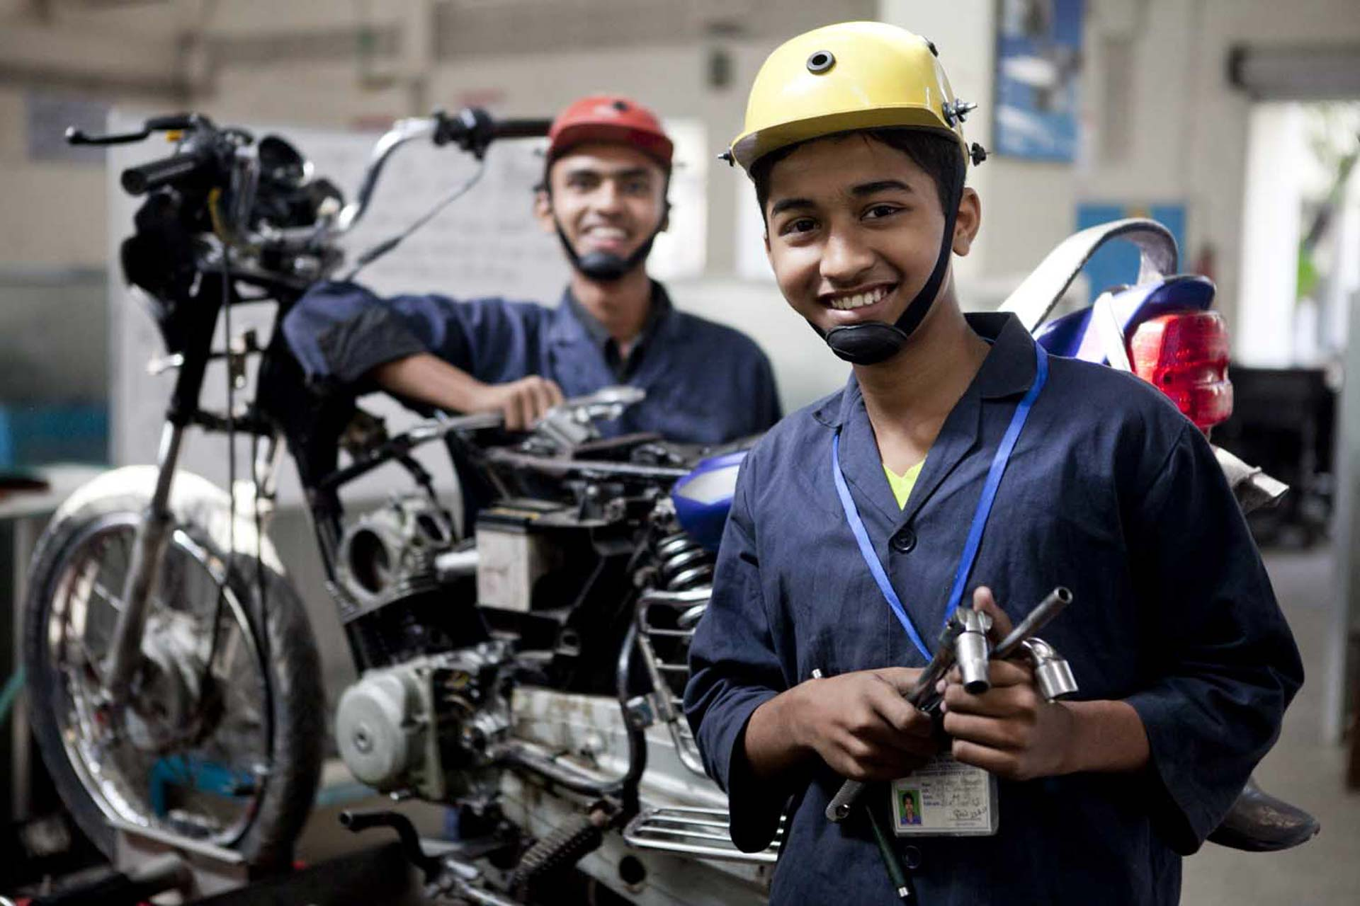
Pronoun
Karim is a student of class nine. He is my friend. We study in General Mechanics. I have some good friends. They study in Building Maintenance .

Slide 10
Types of Pronoun
Person | Singular |  |  | Plural
 | Subject | Object | Possessive | Subject | Object | Possessive
First | I আমি | Me আমাকে | My /Mine আমার | We আমরা | Us আমাদের | Our / Us আমাদের
Second | You আপনি/ তুমি | You আপনার/ তোমার | Your / Yours আপনার/ তোমার | You আপনারা তোমরা | You আপনারা /তোমার | Your/ Yours আপনাদের/ তোমাদের
Third | He/ She সে | Him/ Her তাকে/তার | His/ Hers তার | They তারা | Them তাহাদিগকে | Their/ Theirs তাদের
 | It ইহা | It ইহা | Its ইহার

Slide 11

Verbs
Emon is a student. He has a laptop. He practises programming five hours a day.

Slide 12
Verbs
is = Being- হওয়া
has = Having- থাকা
Practises = Doing- কিছু করা বোঝায়
যে word -এর দ্বারা হওয়া (কোনো বস্তু বা ব্যক্তি কি হয়), থাকা, অবস্থা বা কোনো কিছু করা বোঝায়, সেগুলিই Verb .

Slide 13
Types of verbs
Intransitive
(without object)
Verb
Auxiliary Verb
Main Verb
Transitive
(with object)
Modal
Tense
Based

Slide 14
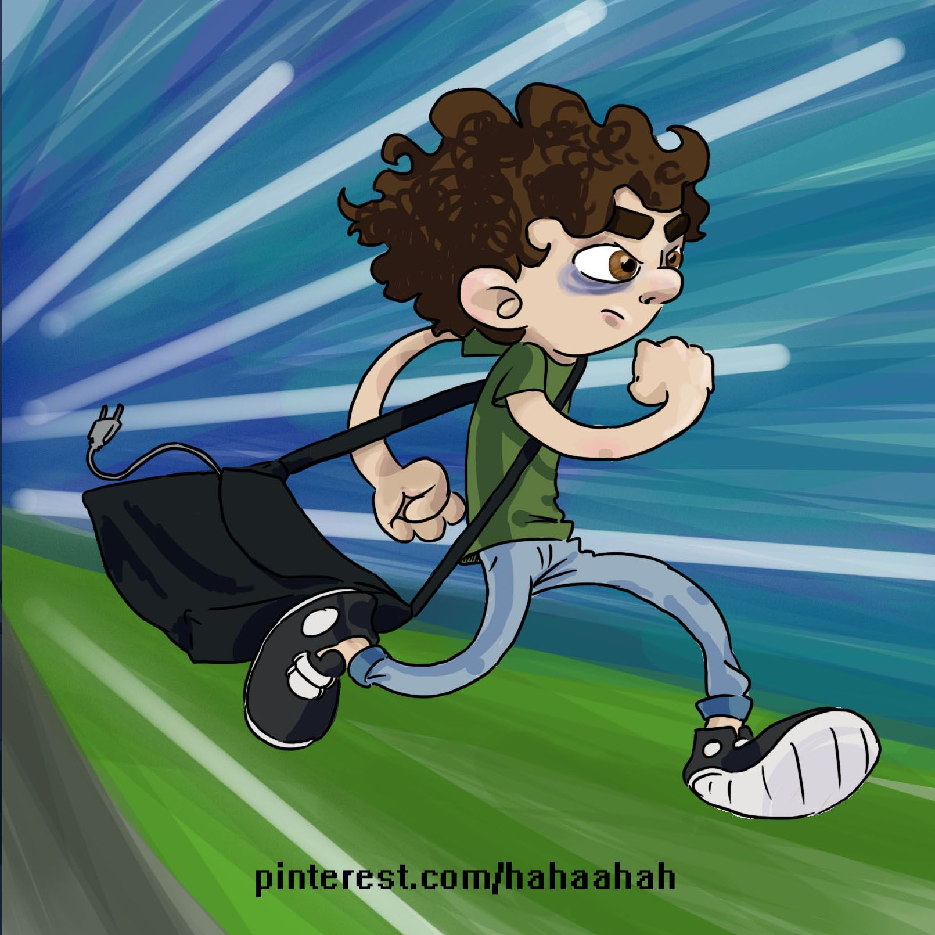
Main Verb Vs Helping Verb
He is a very lazy boy.
He runs fast.
He is running fast.
He can run fast.

Slide 15
Main Verbs
He is carrying a bag.
Transitive
He is running fast.
Intransitive

Slide 16

Let’s work out!
Dhaka is a big city.
The food tastes delicious.
Water the plant.
Everybody likes him for his honesty.
He has no love for the poor.

Slide 17
Let’s Wrap Up!
What have we learnt today?
Marks distribution of new syllabus
Defination of Parts of Speech
Noun and Its types
Pronoun and its types (Personal)
Verb and its types
Differences – Main Vs Helping verb, Transitive vs Intransitive Verbs

Slide 18
Upcoming Class!
Definition and List of Most Common
Adverb
Adjective
Preposition
Conjunction
Interjection

Slide 19



