Slide 1
ACTIVITY NUMBER: 01
SUBJECT: DAILY ASSEMBLY
PHOTO ALBUM OF: SHARING ACTIVITIES
School’s Name: Ranachandi School and College, Kishoreganj, Nilphamari, Bangladesh
Coordinator’s name: Ebnulhassan Tushar
E-mail: tusharbd89@gmail.com
Partner School’s Name: Central Model School, Khanewal, Pakistan
Coordinator’s name: Ayat Fatima
E-mail: umardrazkwl@gmail.com
Sharing activities between Ranachandi School and College, Bangladesh and Central Model School, Khanewal, Pakistan.

Slide 2
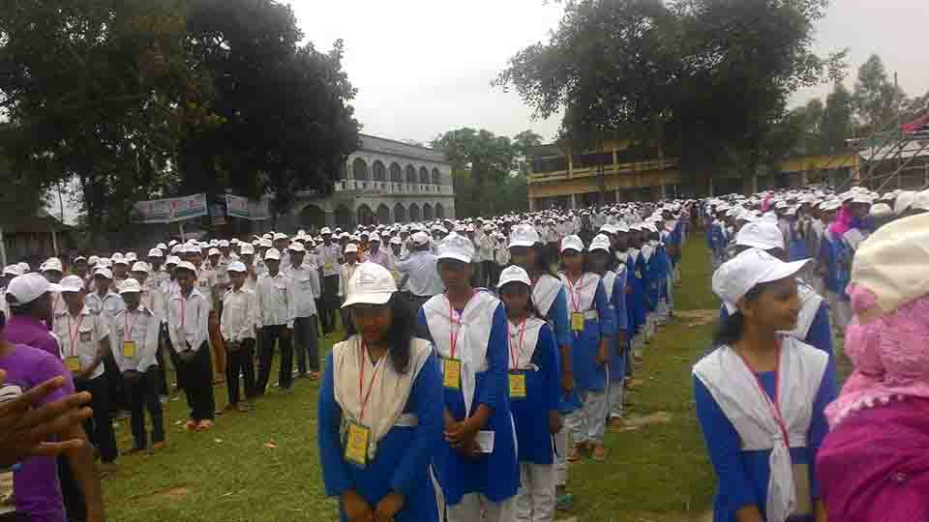
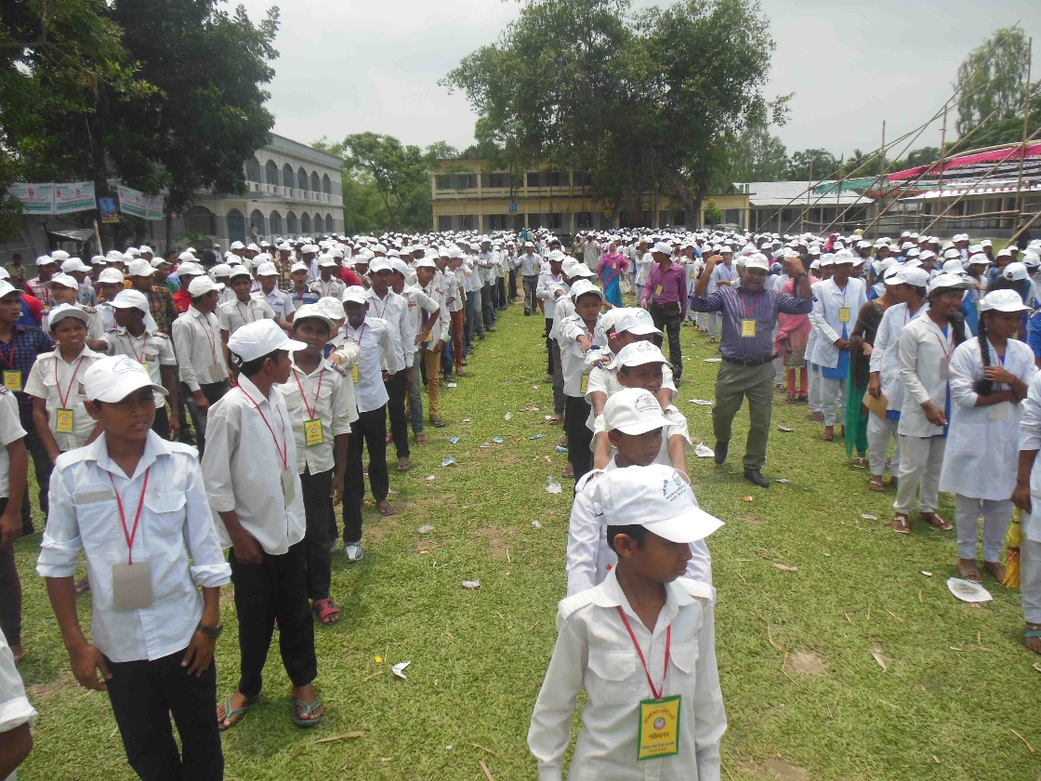
ACTIVITY NO: 01 (DAILY ASSEMBLY)
SCHOOL: RANACHANDI SCHOOL AND COLLEGE

Slide 3
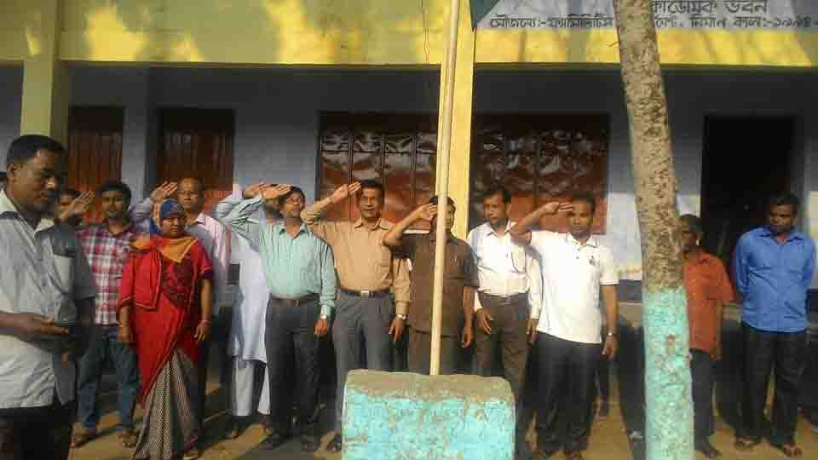
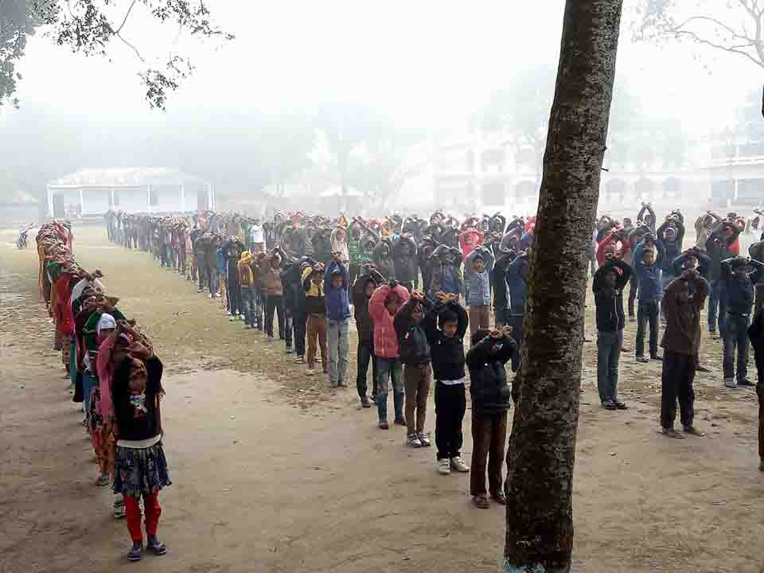
ACTIVITY NO: 01 (DAILY ASSEMBLY)
SCHOOL: RANACHANDI SCHOOL AND COLLEGE

Slide 4
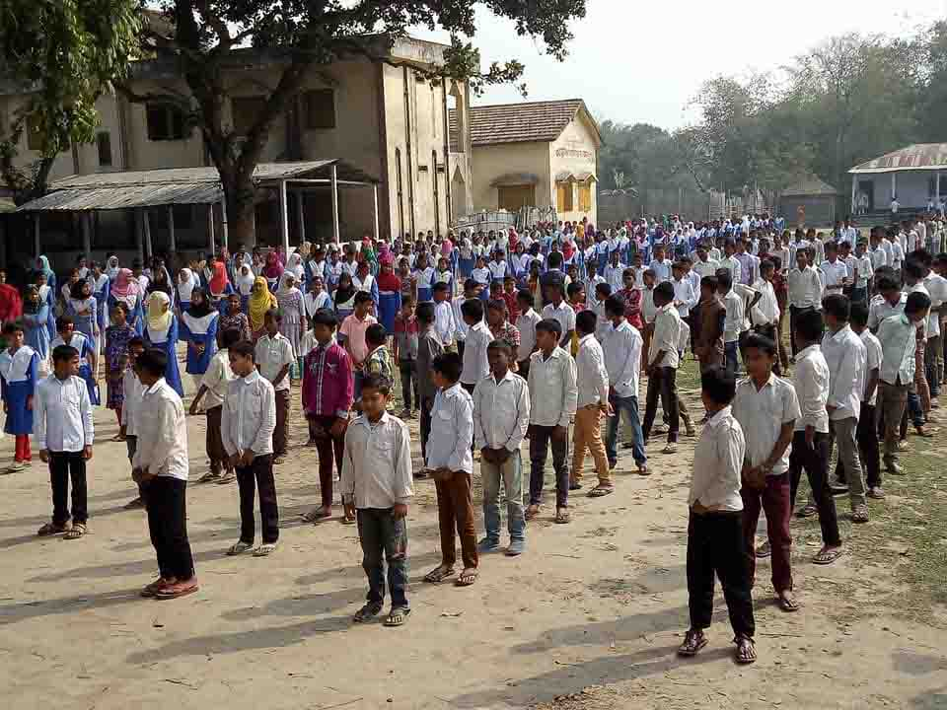
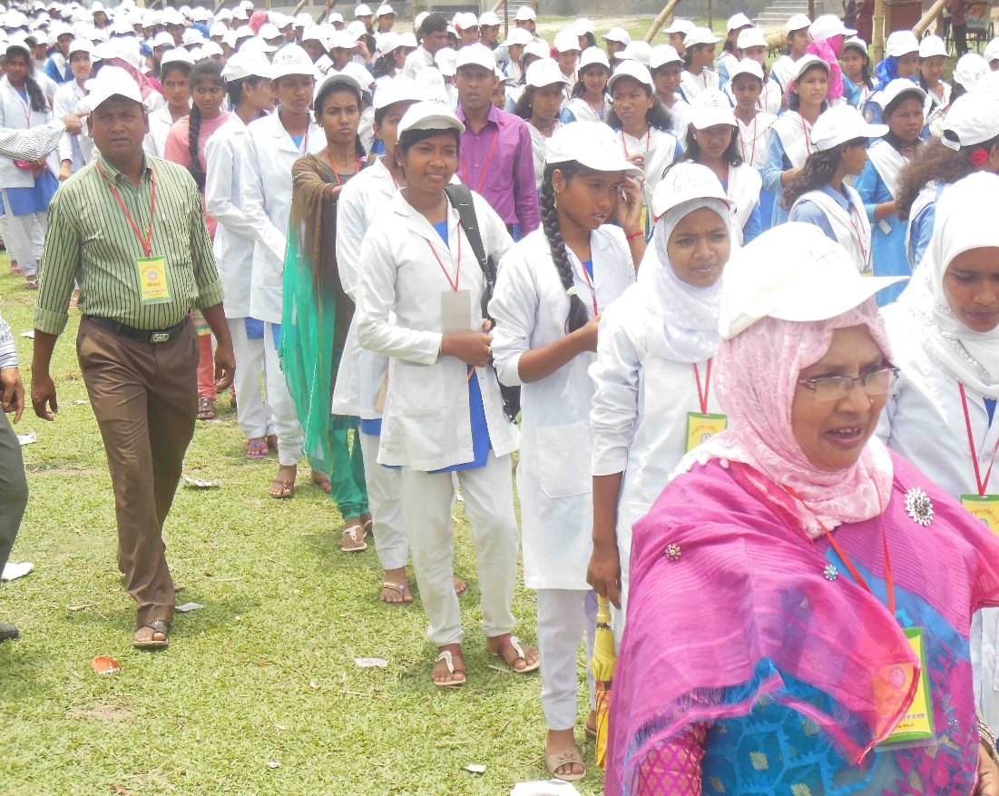
ACTIVITY NO: 01 (DAILY ASSEMBLY)
SCHOOL: RANACHANDI SCHOOL AND COLLEGE

Slide 5
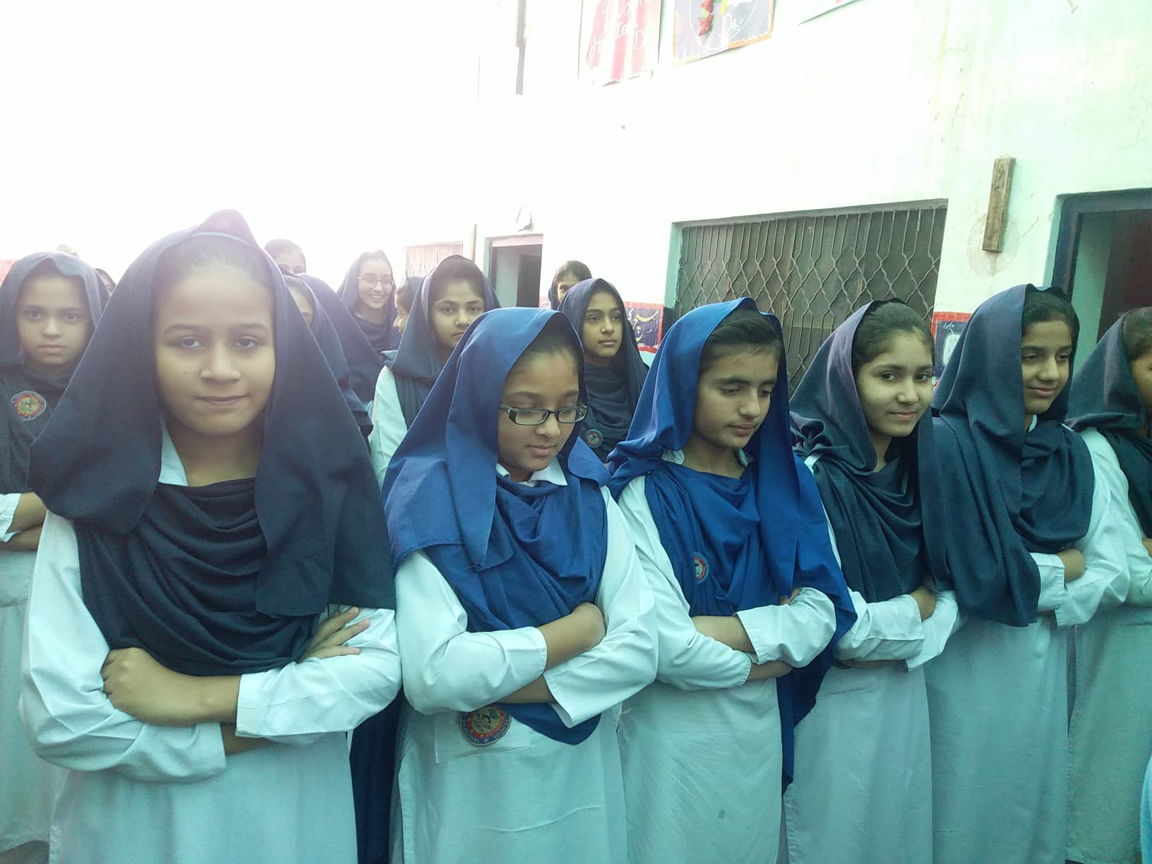
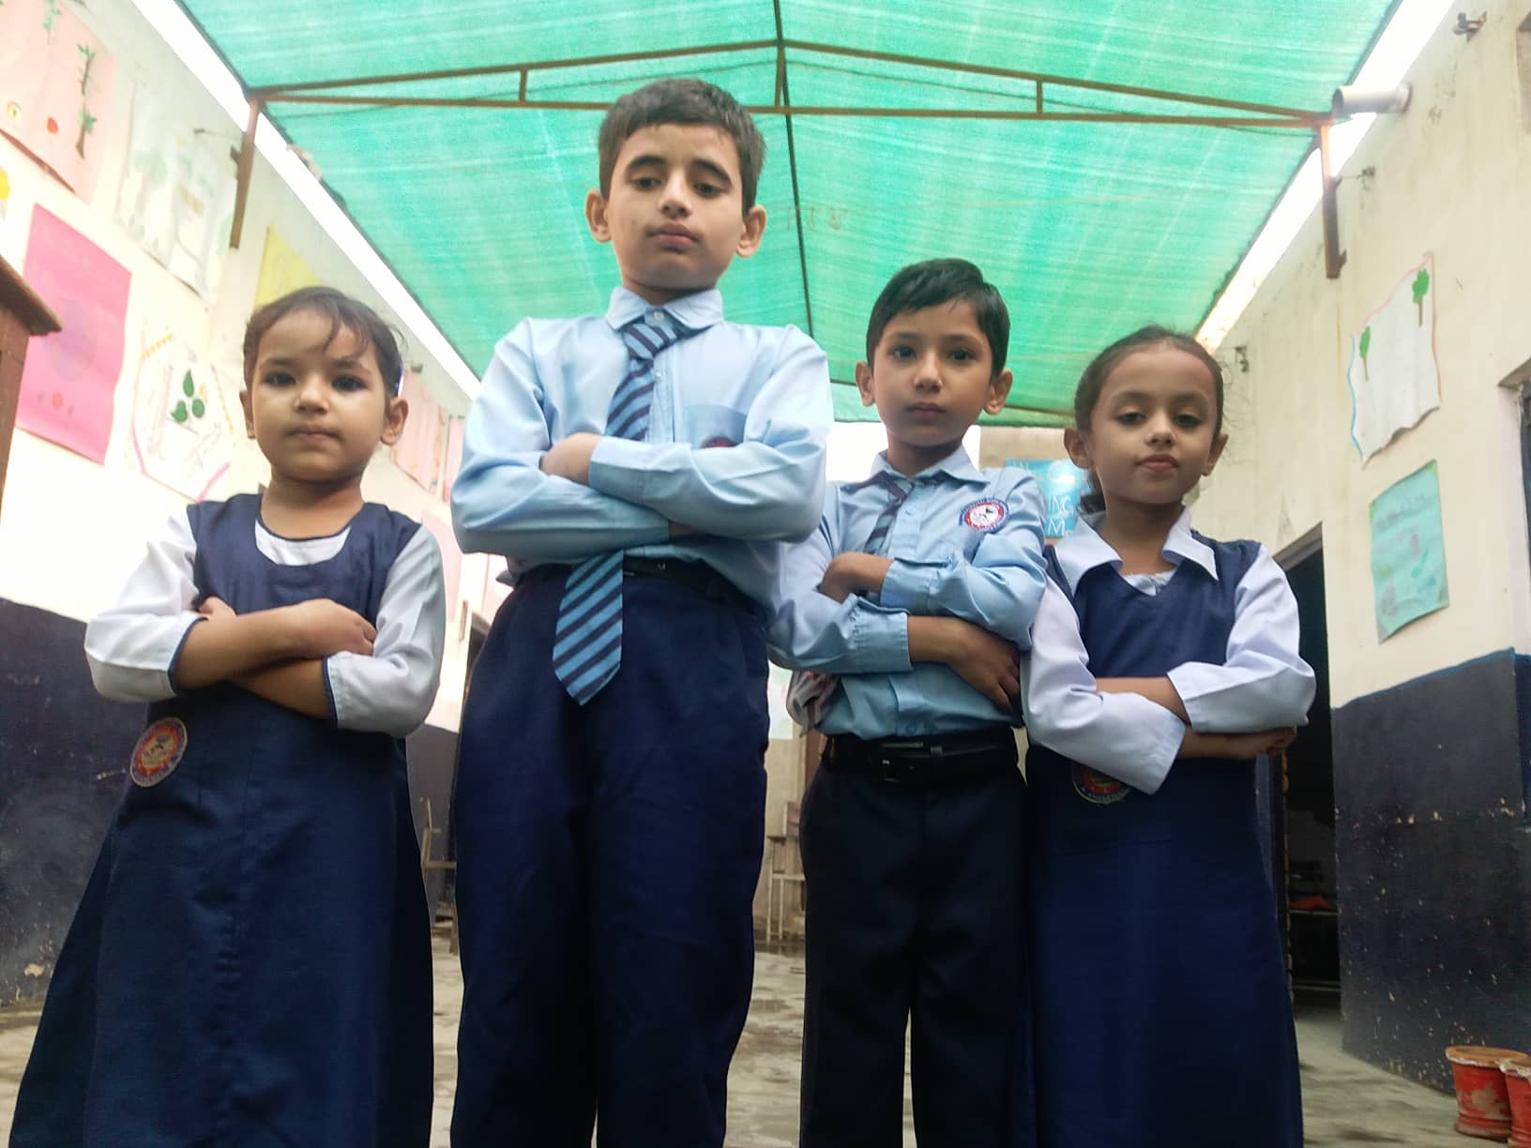
ACTIVITY NO: 01 (DAILY ASSEMBLY)
SCHOOL: CENTRAL MODEL SCHOOL

Slide 6
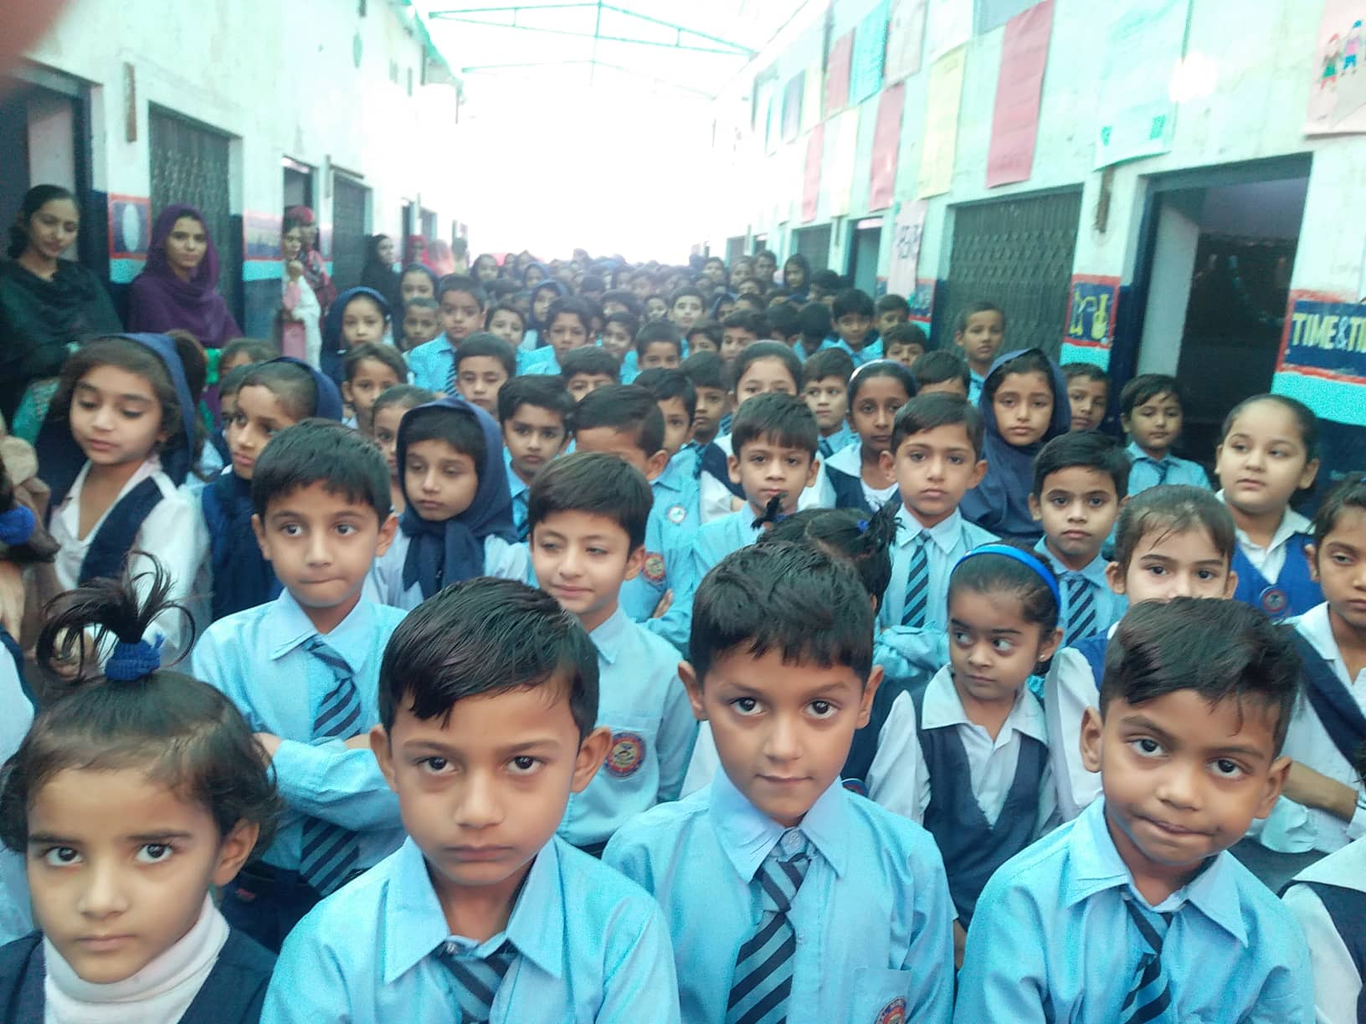
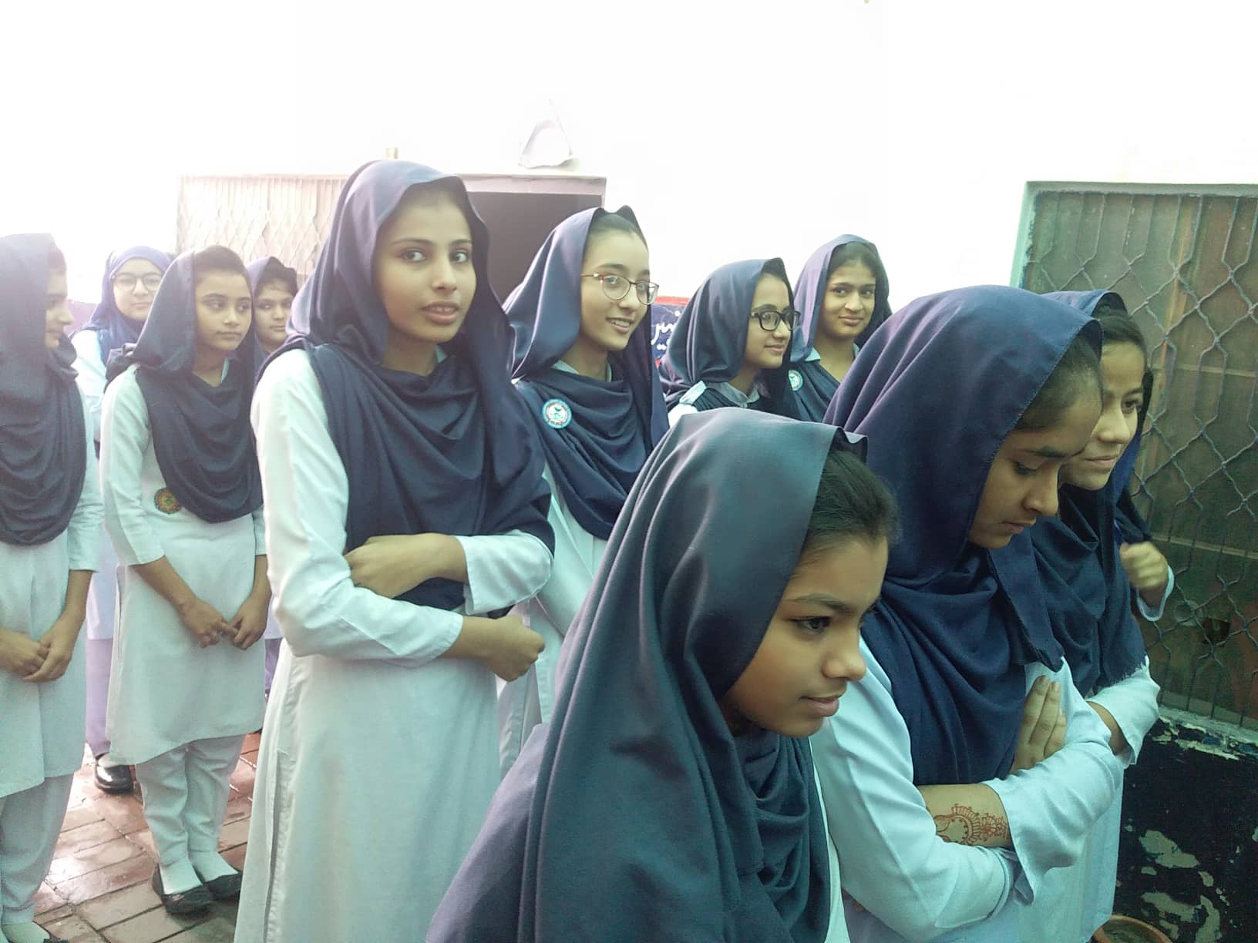
ACTIVITY NO: 01 (DAILY ASSEMBLY)
SCHOOL: CENTRAL MODEL SCHOOL

Slide 7
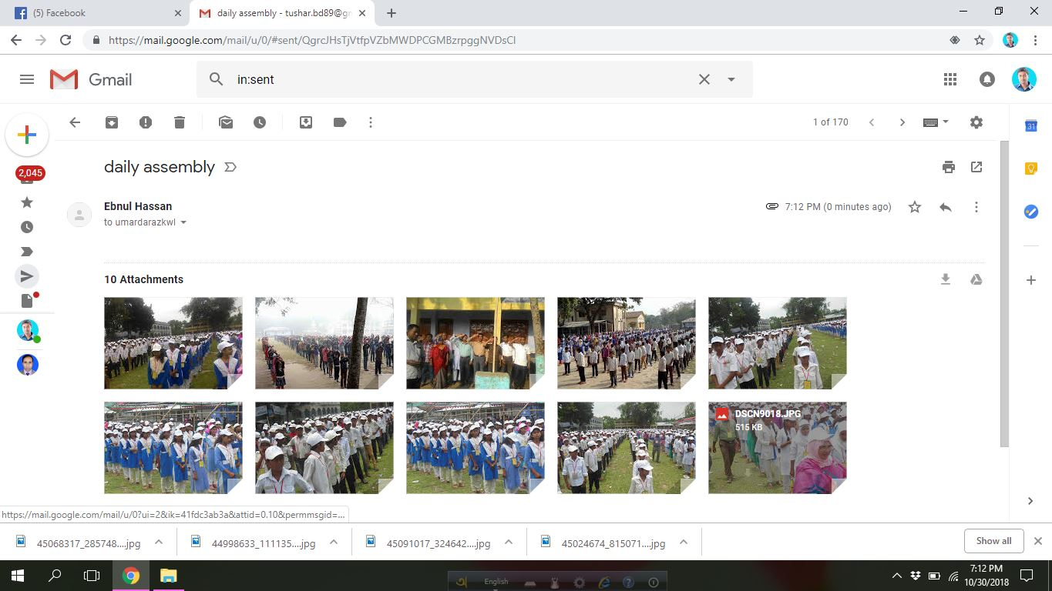
Evidence Of Activities

Slide 8
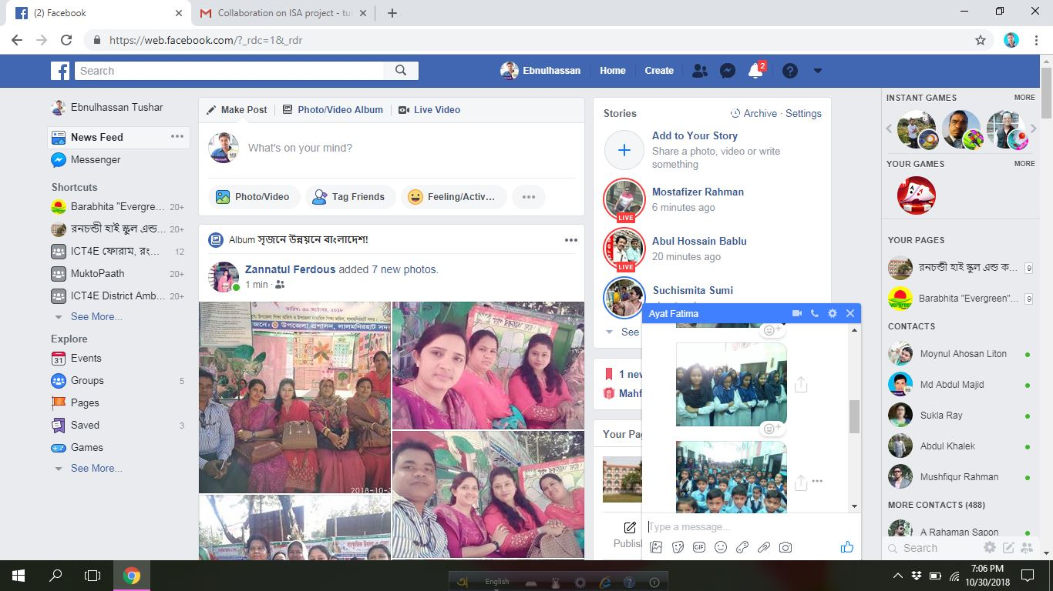
Evidence Of Activities

