Slide 1
ACTIVITY NUMBER: 02
SUBJECT: OUR CLASSROOM
PHOTO ALBUM OF: SHARING ACTIVITIES
School’s Name: Ranachandi School and College, Kishoreganj, Nilphamari, Bangladesh
Coordinator’s name: Ebnulhassan Tushar
E-mail: tusharbd89@gmail.com
Partner School’s Name: Swami Vivekanand Public School, Sector17, huda , jagadhri , Haryana,India
Coordinator’s name: Gaurav Kumar
E-mail: gauravwaliasvps@gmail.com
Sharing activities between Ranachandi School and College, Bangladesh and Swami Vivekanand Public School, India

Slide 2
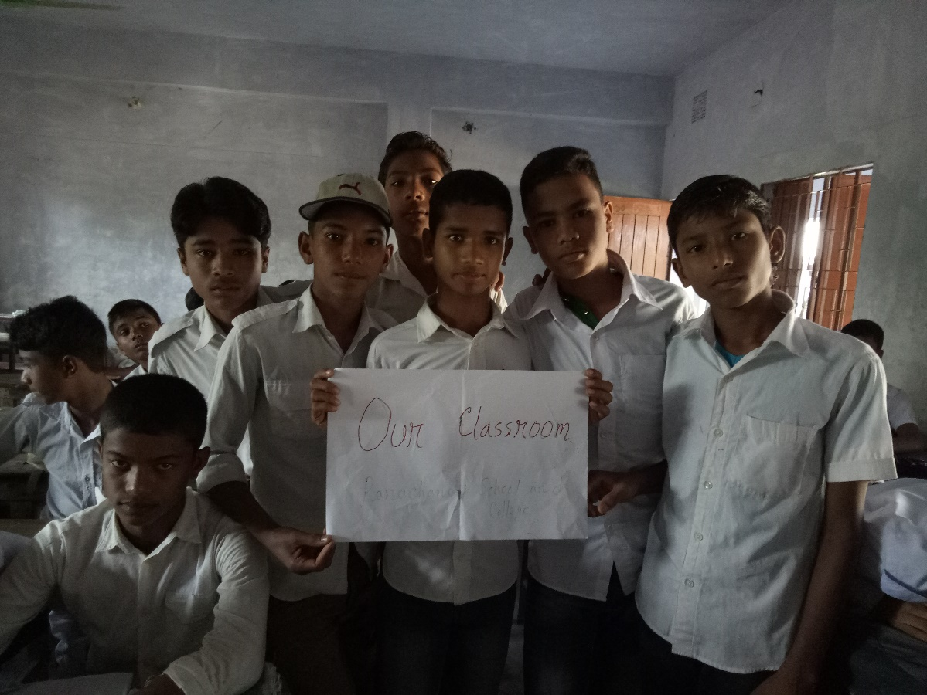
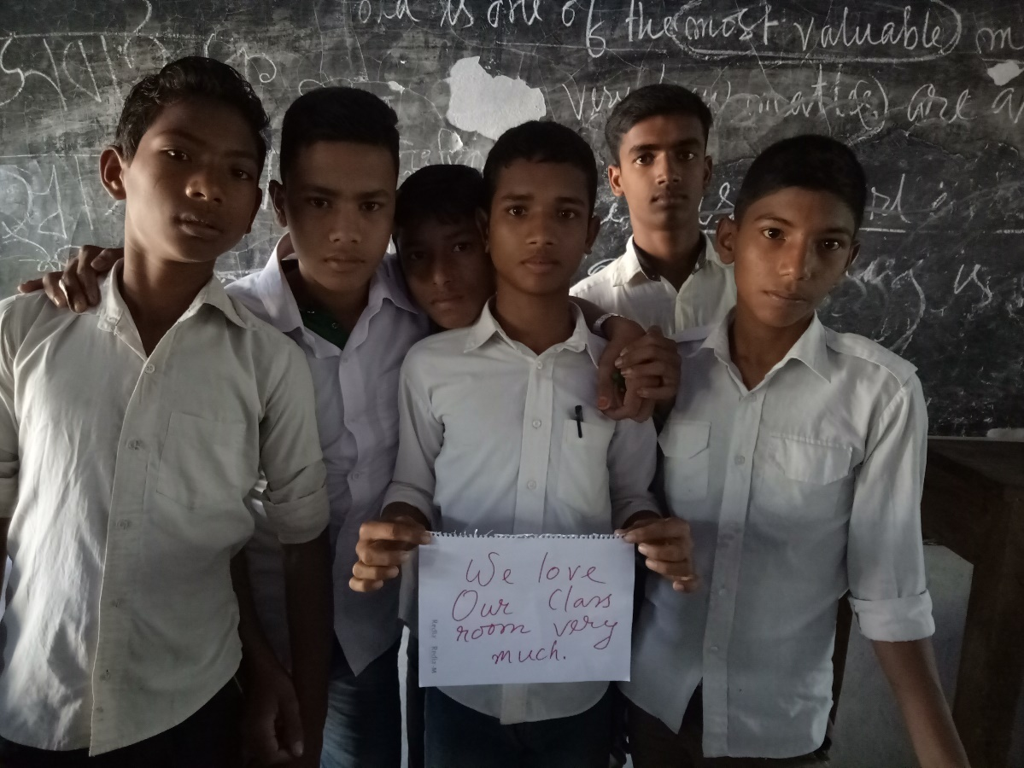
ACTIVITY NO: 02 (OUR CLASSROOM)
SCHOOL: RANACHANDI SCHOOL AND COLLEGE, BANGLADESH

Slide 3
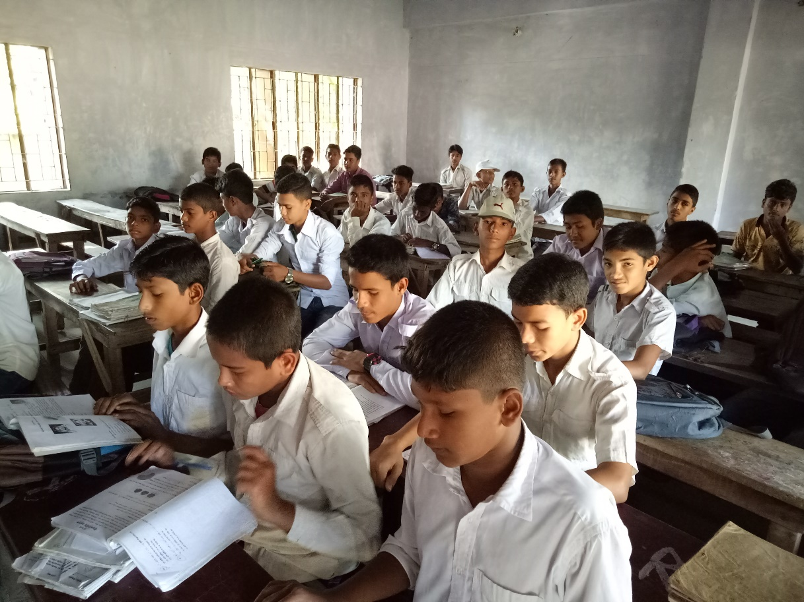
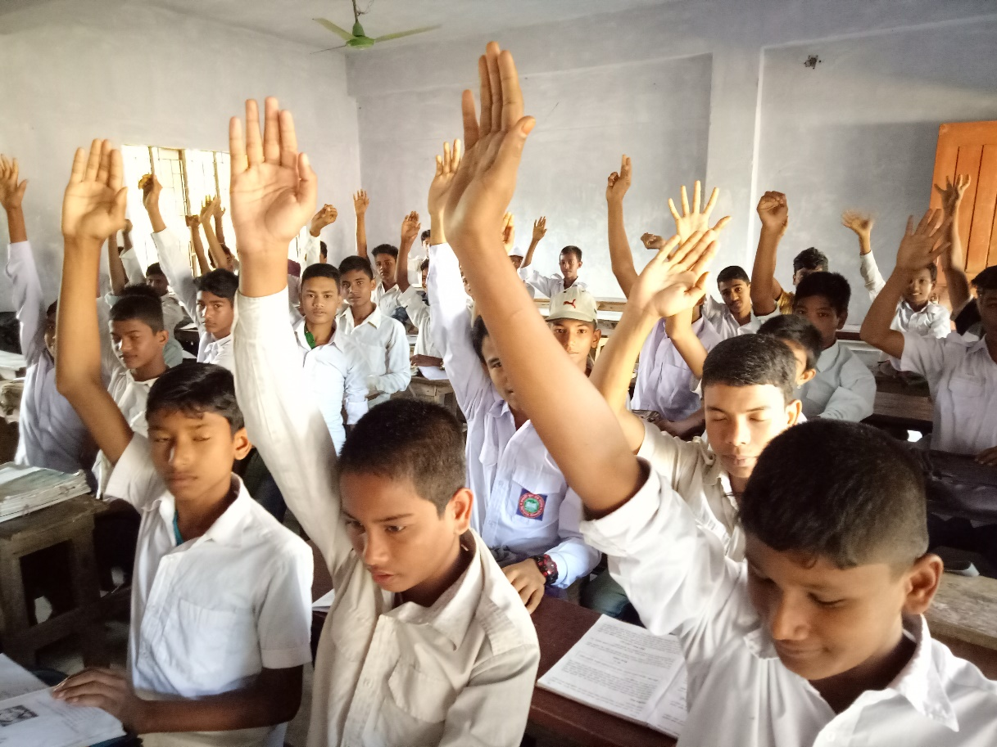
ACTIVITY NO: 02 (OUR CLASSROOM)
SCHOOL: RANACHANDI SCHOOL AND COLLEGE, BANGLADESH

Slide 4
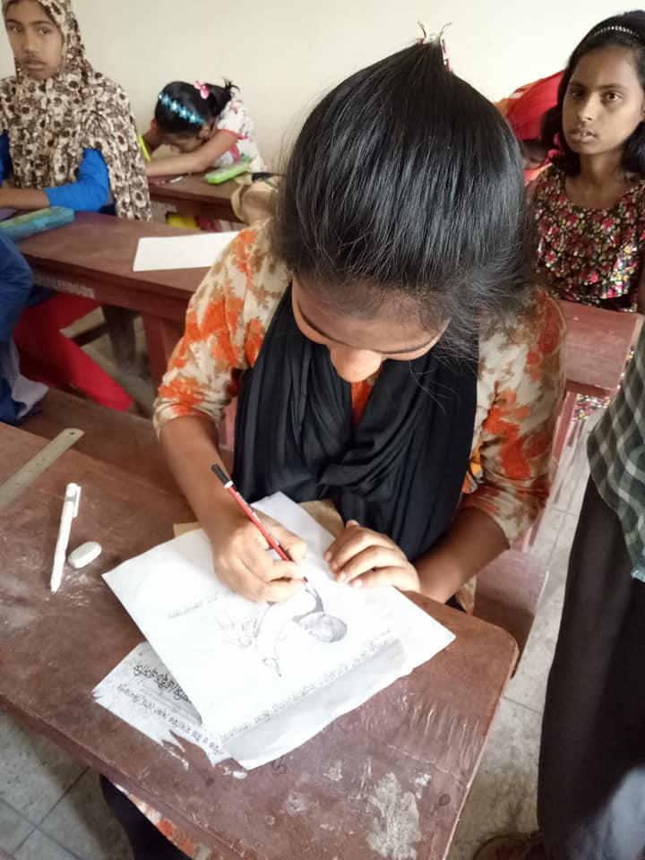
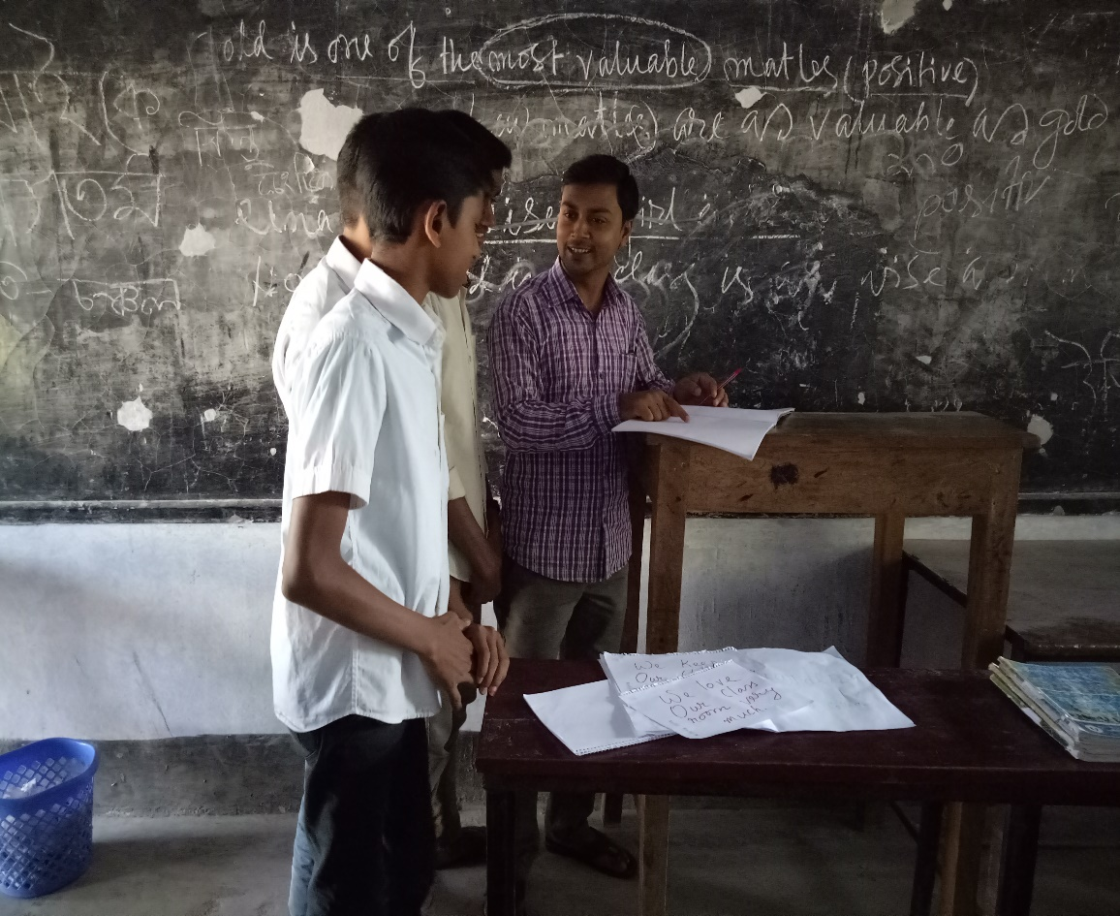
ACTIVITY NO: 02 (OUR CLASS ROOM)
SCHOOL: RANACHANDI SCHOOL AND COLLEGE, BANGLADESH

Slide 5
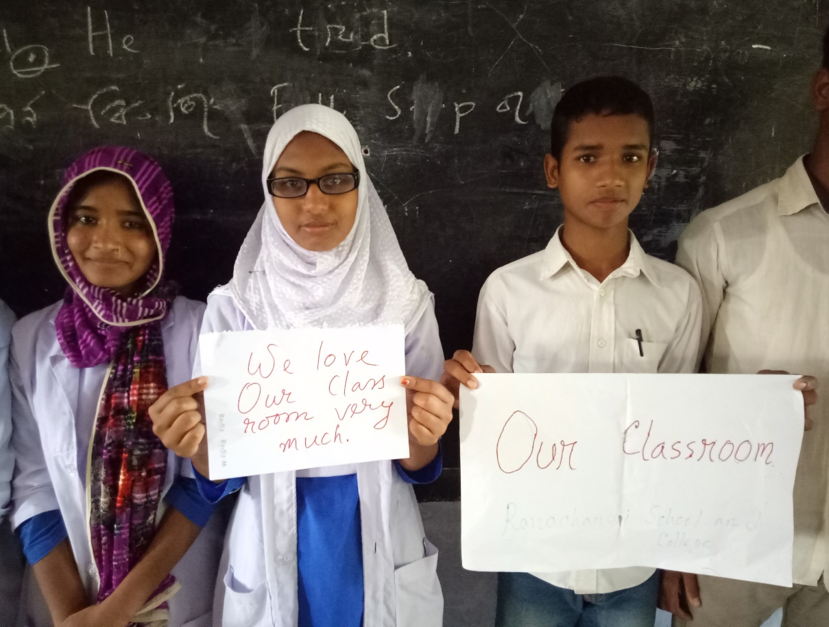
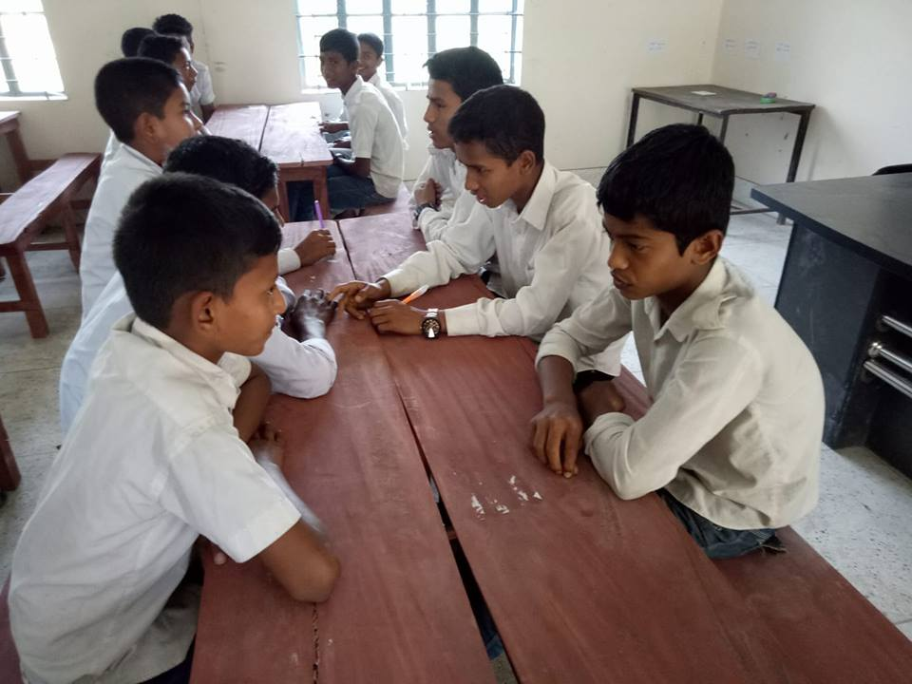
ACTIVITY NO: 02 (OUR CLASSROOM)
SCHOOL: RANACHANDI SCHOOL AND COLLEGE, BANGLADESH

Slide 6
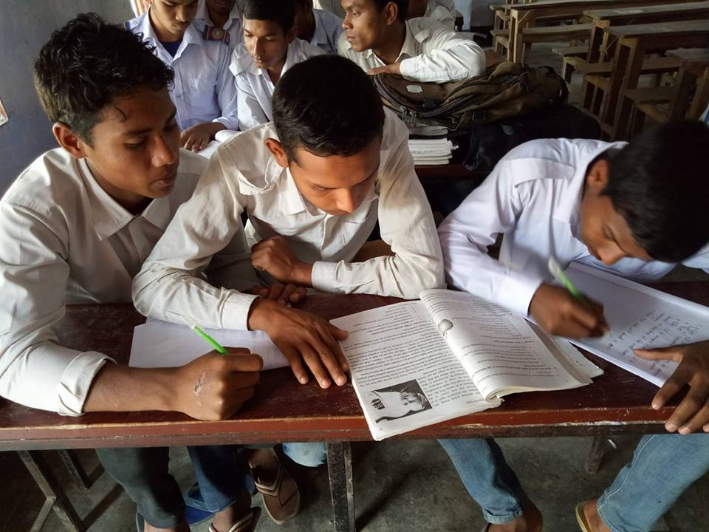
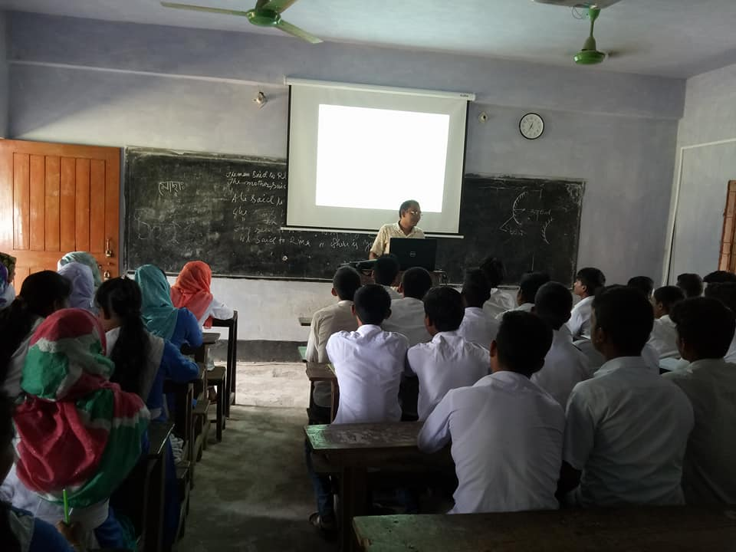
ACTIVITY NO: 02 (OUR CLASSROOM)
SCHOOL: RANACHANDI SCHOOL AND COLLEGE, BANGLADESH

Slide 7
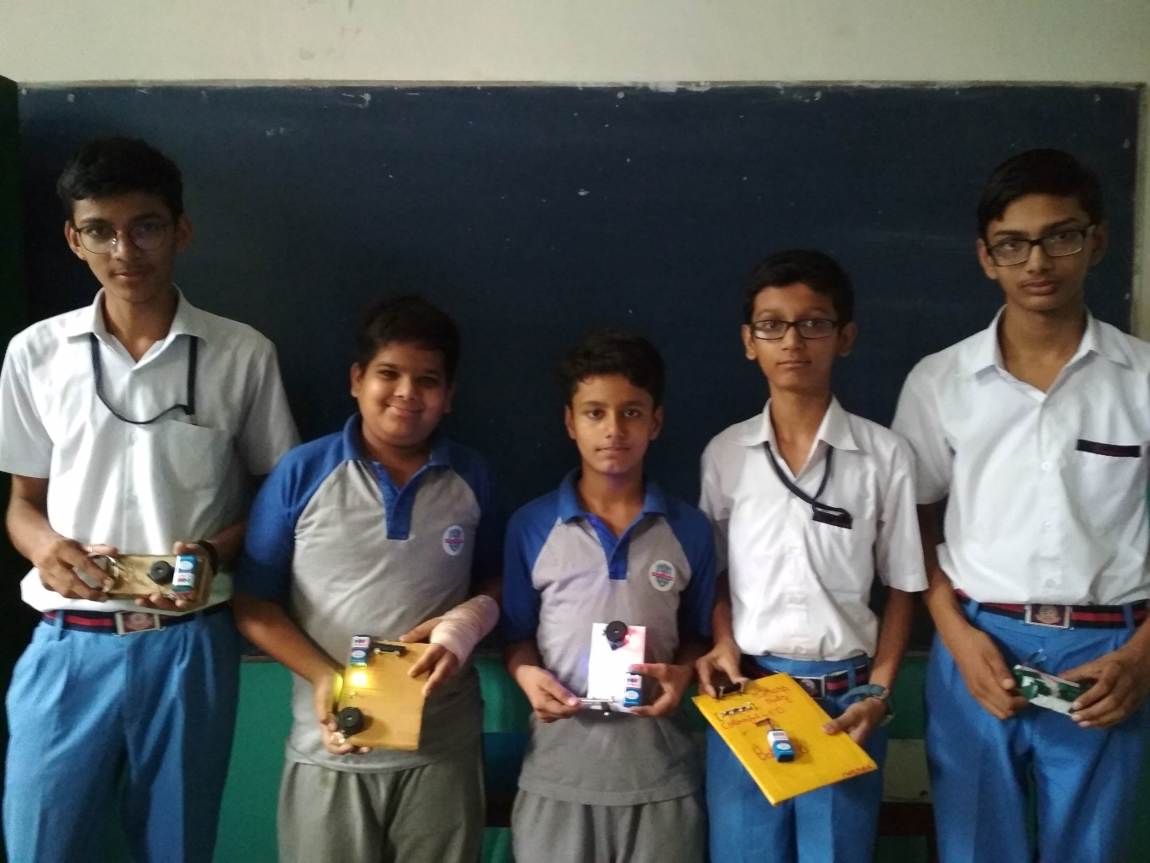
ACTIVITY NO: 02 (OUR CLASSROOM)
SCHOOL: SWAMI VIVEKANAND PUBLIC SCHOOL, INDIA

Slide 8
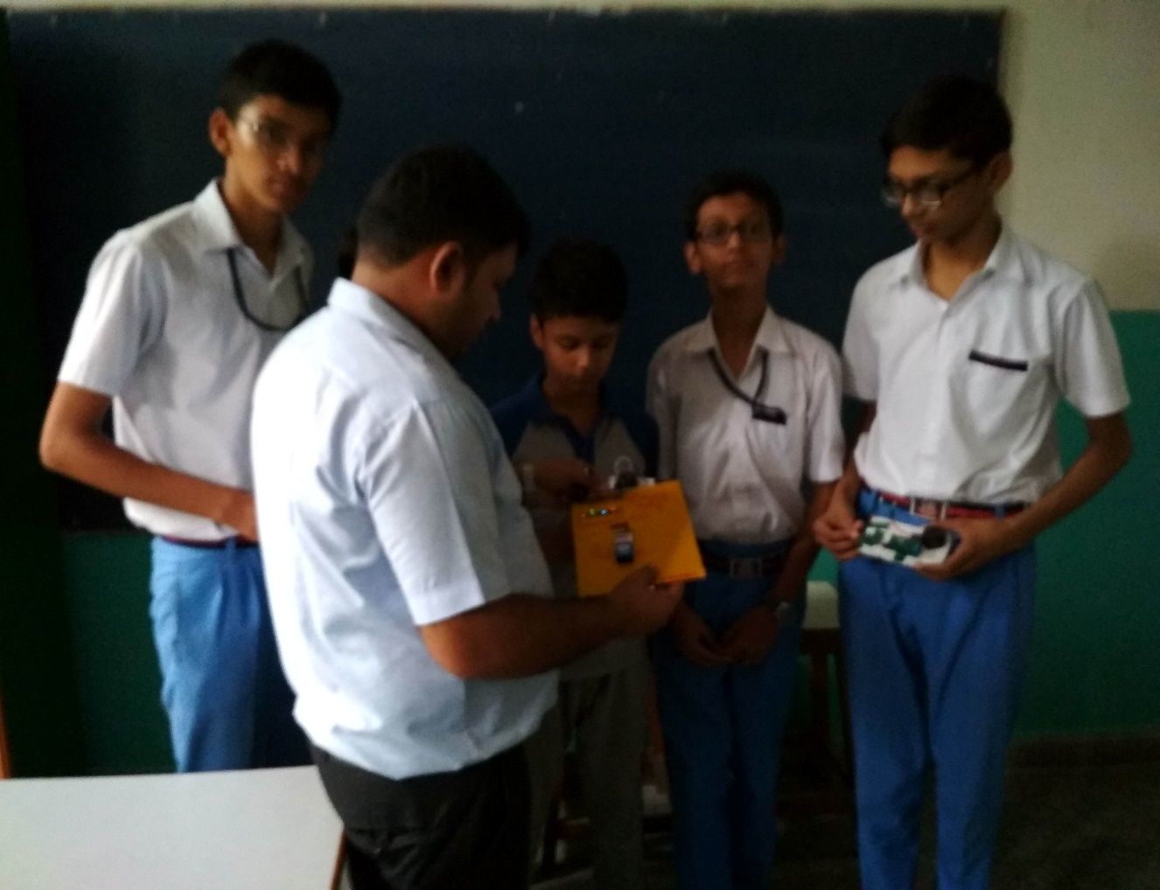
ACTIVITY NO: 02 (OUR CLASSROOM)
SCHOOL: SWAMI VIVEKANAND PUBLIC SCHOOL, INDIA

Slide 9
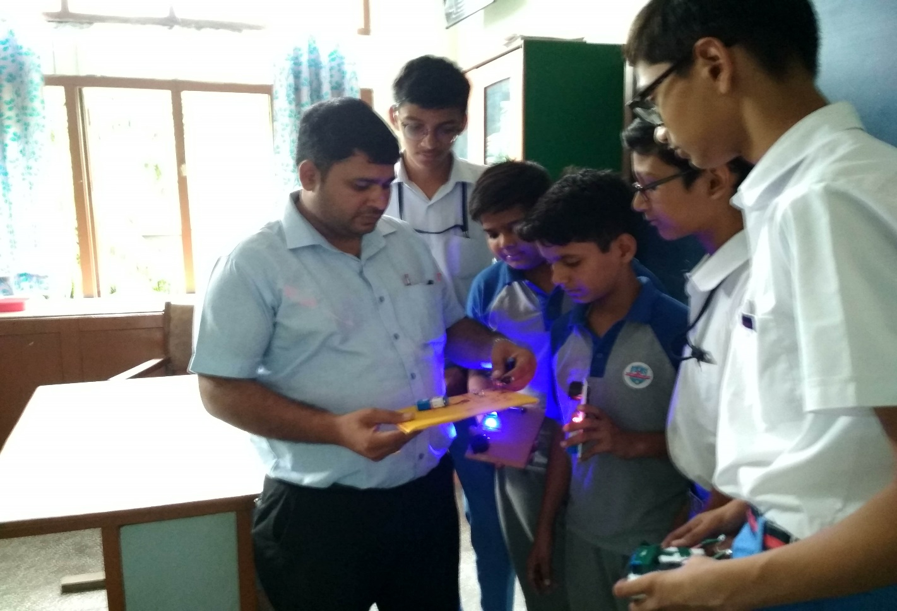
ACTIVITY NO: 02 (OUR CLASSROOM)
SCHOOL: SWAMI VIVEKANAND PUBLIC SCHOOL, INDIA

Slide 10
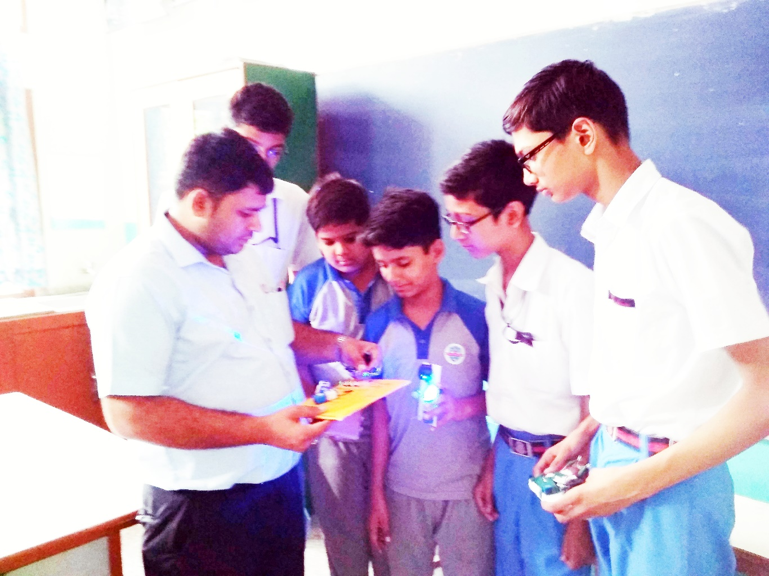
ACTIVITY NO: 02 (OUR CLASSROOM)
SCHOOL: SWAMI VIVEKANAND PUBLIC SCHOOL, INDIA

Slide 11
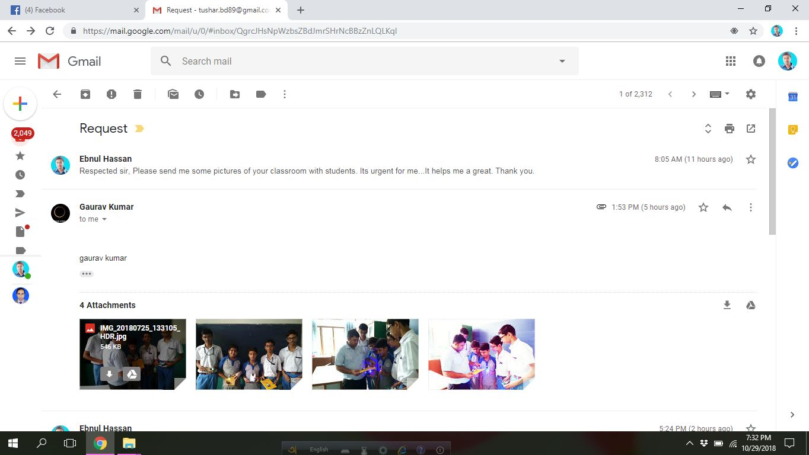
Evidence Of Activities

Slide 12
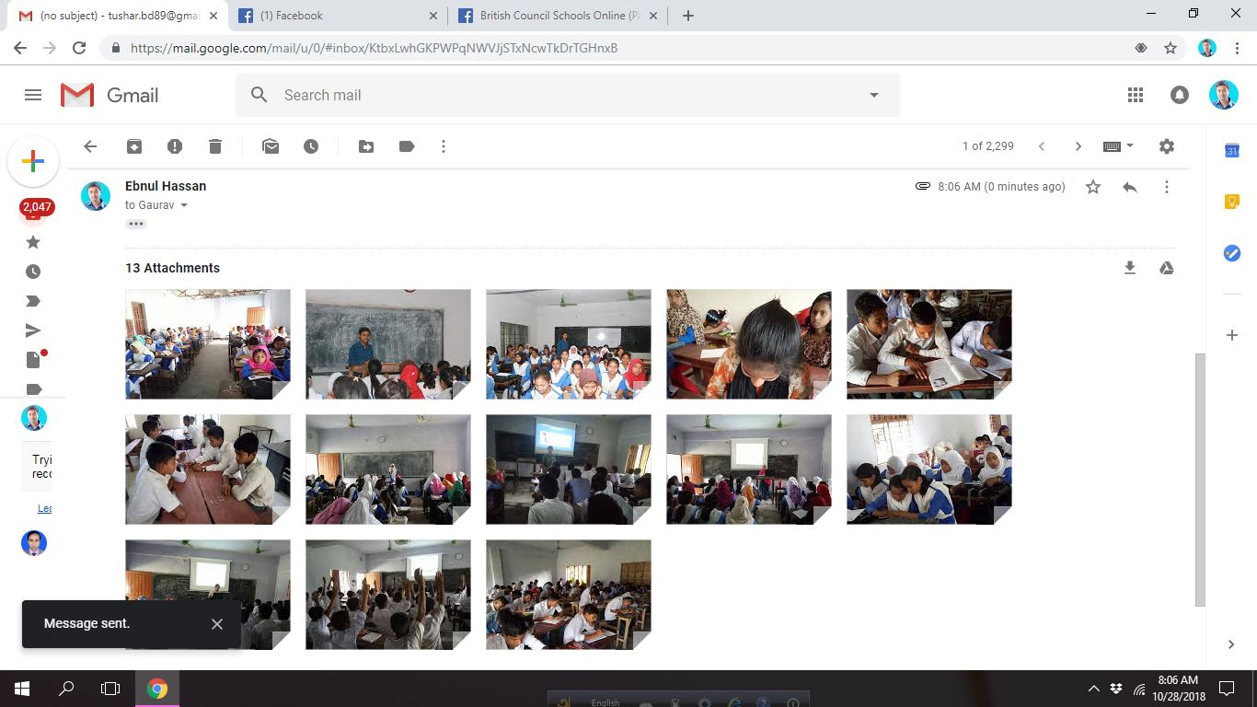
Evidence Of Activities

