Slide 1
Welcome

Slide 2
Identity
Ebnulhassan Tushar
Assistant Teacher (English)
Ranachandi High School and College
Kishoreganj, Nilphamari.
District Ambassador(ICT4E),Best content maker of the week (Teachers Portal), MIE Expert (2018-2019)
E-mail: tusharbd89@gmail.com
Contact no: 01719-245814
English For Today
Class: Seven
Time: 50 minutes

Slide 3
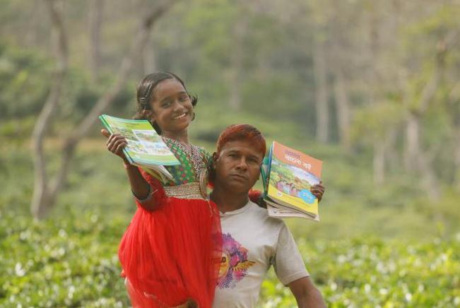
What can you see in the picture?
A girl is going to school with her father.

Slide 4
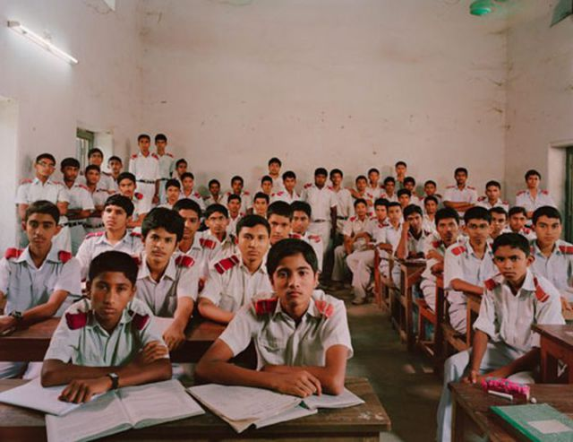
What can you see in the picture?
Some students are setting in their class and this is their first day at school.
So, can you guess what is our todays topic?

Slide 5
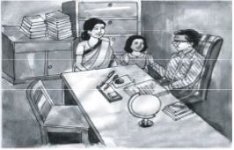
Today`s topic
Unit: Three
Lesson: 03
Flora’s first day at school (2)

Slide 6
After we have studied this unit, we will be able to—
Read and understand texts
Write answers to question
Learning Outcomes

Slide 7
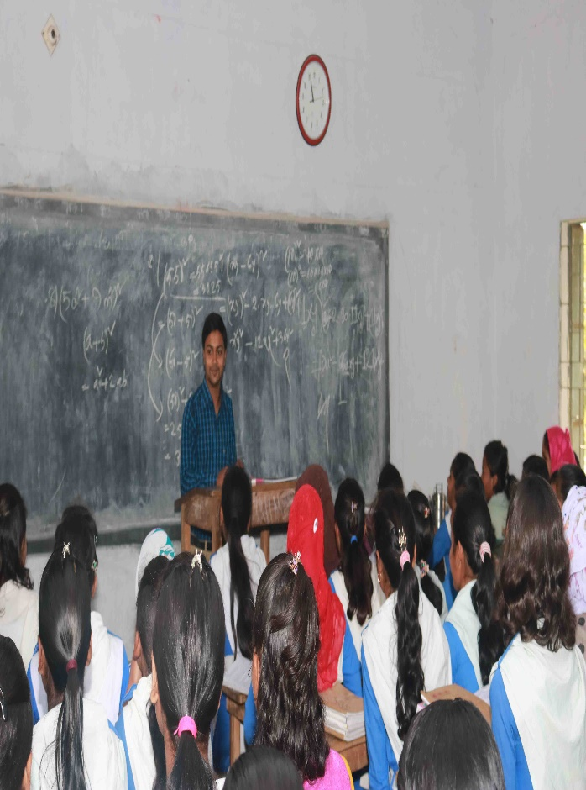
Teachers model reading
Listen attentively

Slide 8
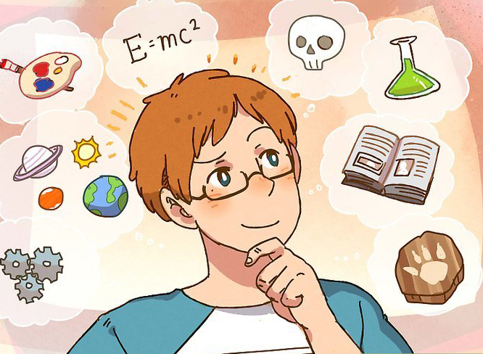
Key words
Intelligent
Meaning:
Clever/ bright / brilliant.
Flora is a clever girl.

Slide 9
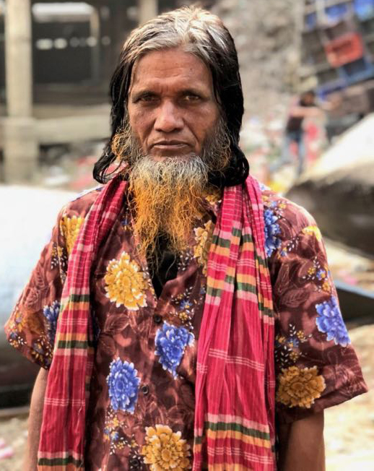
Key words
Stare
Meaning:
a long fixed or vacant look.
The students of class were staring at Flora.

Slide 10
Key words
Nervous
Meaning:
anxious or fearful.
Flora felt a bit nervous at her first day at school.

Slide 11
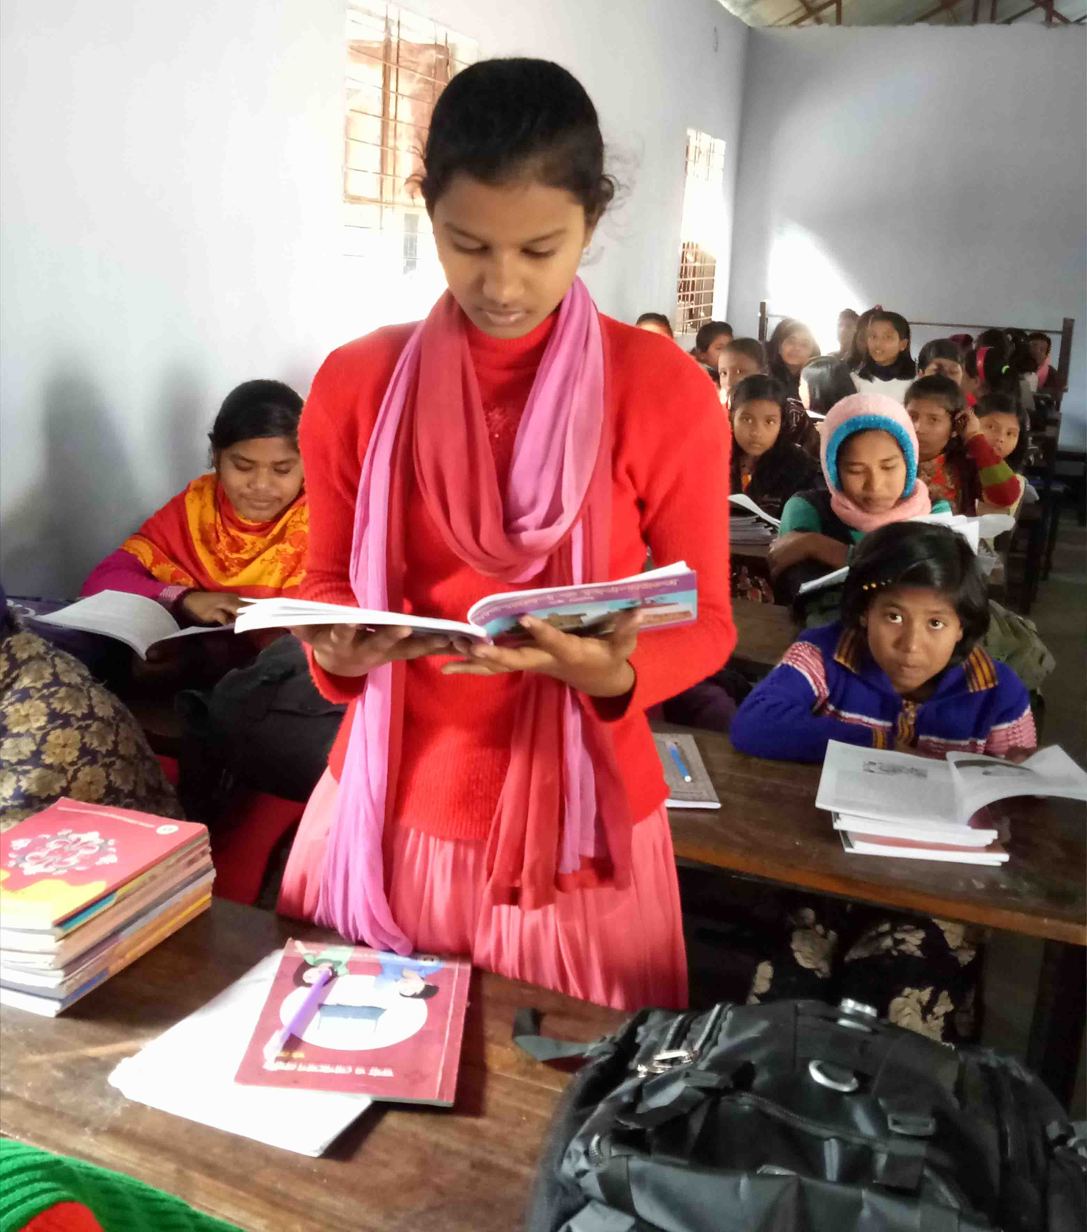
Students model reading
Go to the section a and read aloud.

Slide 12
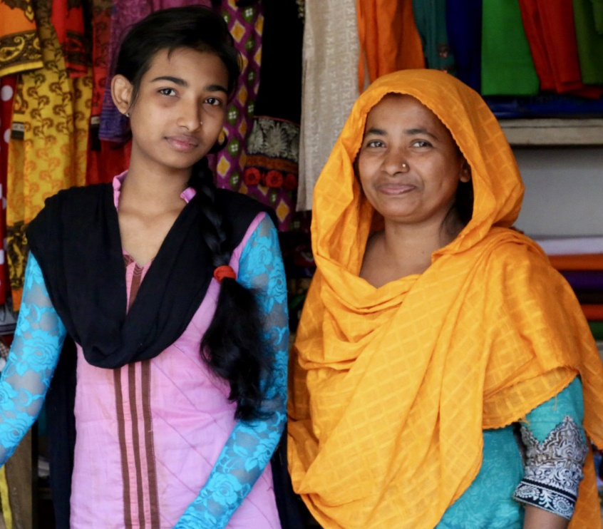
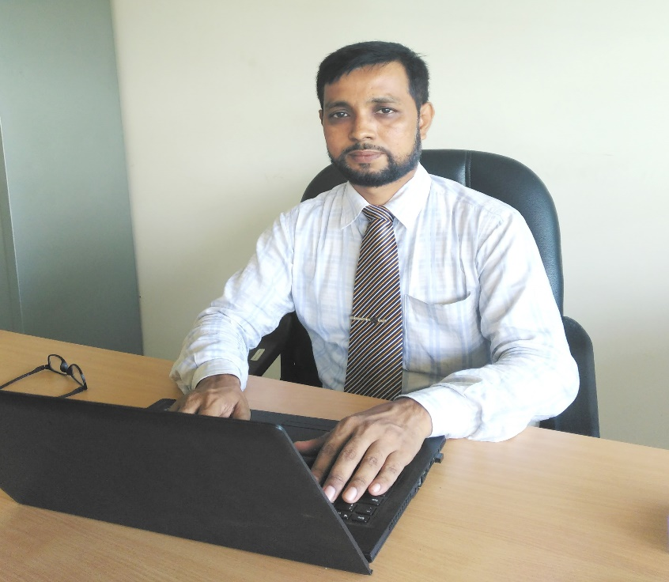
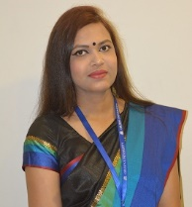
Look at the pictures
Flora go to the Head teacher with her mother.
The Head teacher asked Flora some questions.
Ms Laila took Flora to the class.

Slide 13
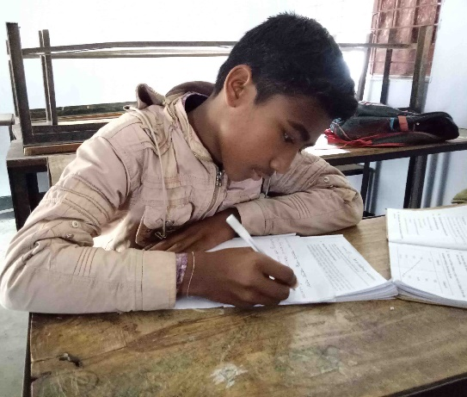
Individual Works
Time: 04 minutes
Make sentences from this table.
Flora’s mother
at Flora.
asked
Ms Laila
made
friends with few students.
The Head teacher
stared
her to the teacher.
took
The students to the class
Flora some questions.
her to the class.
Flora

Slide 14
Match the answer
i) Flora’s mother took her to the Head teacher.
ii) Ms Laila took her to the class.
iii) The Head Teacher asked Flora some question.
iv) The students in the class stared at Flora.
v) Flora made friends with few students.

Slide 15
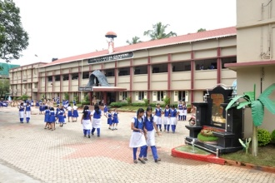
Look at the pictures
It took Flora half an hour to reach the school.
The Headmaster was very pleased with Flora.
Flora felt nervous in her new class to see all the new faces .

Slide 16
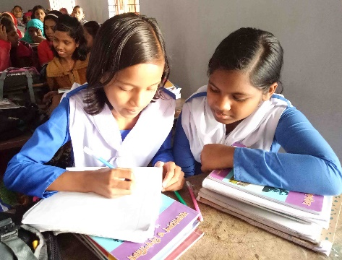
Pair works
Time: 05 minutes
Answer the following question.
1. How long did it take Flora to reach the school?
Answer: Half an hour.
2. Why The Head Teacher was pleased with Flora?
Answer: Because she could answer the Head teacher’s questions.
3. Why Flora felt nervous in the class?
Answer: Because she did not know any student in the class.

Slide 17
Home works
How did you feel about the students and teachers on your first day at school? Write about it in short.

Slide 18
Assessment of Learning
Choose the correct answer.
1. Flora was a little afraid when she reached the school campus because
a) The campus was full of students.
b) It was the first time she went there.
c) All the people there were unknown.
d) The school was a long way from home.
2. Who took Flora to the class after admission?
a) A teacher
b) A peon
c) Her mother
d) The Head teacher
Answer:
1
2

Slide 19
3. The Headmaster was-
a) Very shocked
b) Very pleased
c) Very angry
d) in great pain
4. Who put his hand on Flora’s shoulder?
a) The peon
b) Her father
c) Her Uncle
d) The Head teacher
5. Who took Flora to the class?
a) Ms Laila
b) Ms Fatema
c) Ms Rozina
d) Ms Feroza
Answer:
3
4
5

Slide 20
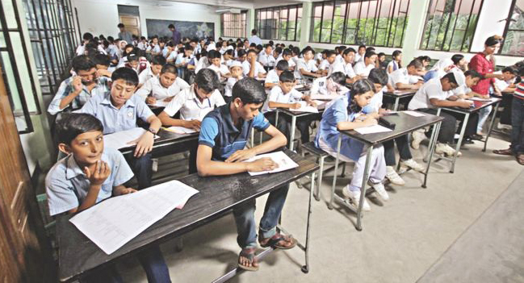
Thanks all

