Slide 1
Welcome

Slide 2
Md.Saifuddin Khan
Lecturer in English
Haji Goyes Uddin Mohila Fajil Madrasah
Bhangura ,Pabna .
Mobile :01710449379 .
Email :skhan84bd@gmail.com .

Slide 3
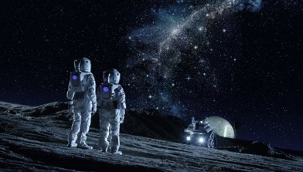

Slide 4
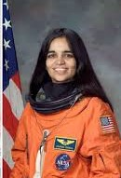
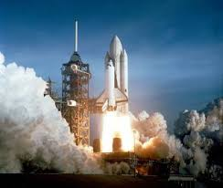
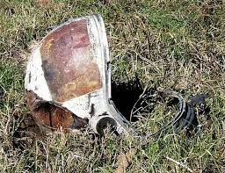
What does the following pictures remind us ?

Slide 5
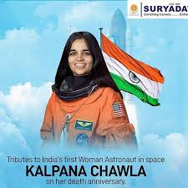
Our Today’s Topic is
Unit one:
People or Institutions Making History.
Lesson three:
Two Women.
KALPANA CHAWLA
Alim First Year
English First Paper
Time : 45 Minutes

Slide 6
Learning outomes
After reading the text student will be able to
a.Tell about extraordinary achievements of Kalpana Chawla.
b.Tell the meaning of some new words .
c.Tell about her education
d. Tell about the tragedy of Columbia.

Slide 7
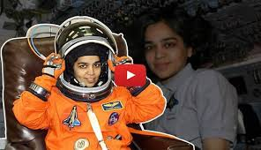

Slide 8
Single work
Write the name of first indian born woman and second person in space from this subcontinent.

Slide 9
Read the text silently
Kalpana Chawla (17 March 1962 - 1 February 2003)
Chawla was born in Karnal, India. She completed her earlier schooling at Tagore Baal Niketan Senior Secondary School, Karnal. She is the first Indian-born woman and the second person in space from this sub-continent. After graduating in Aeronautical Engineering from Punjab Engineering College, India, in 1982, Chawla moved to the United States the same year. She obtained her Masters degree in Aerospace Engineering from the University
of Texas in 1984. Later she did her Ph.D. in Aerospace Engineering in 1988 from the University of Colorado.
Determined to become an astronaut even in the face of the Challenger disaster 1986 that broke apart 73 seconds into its flight, leading to the deaths of its seven crew members, Chawla joined NASA in 1988. She began working as a Vice President where she did Computational Fluid Dynamics (CFD) research on vertical take-off and landing. In
1991 she got U.S. citizenship and started her career as a NASA astronaut in 1995. She was selected for her first flight in 1996. She spoke the following words while travelling in the weightlessness of space, ÔÔ You are just your intelligence”. She had travelled 10.67 million miles, as many as 252 times around …………………..to break down.

Slide 10
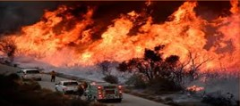
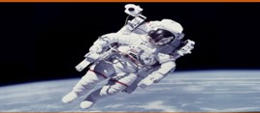
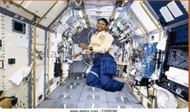
Disaster
Misfortune
Astronaut
A person who is trained to travel in spacecraft
Weightless
Feeling light in the space

Slide 11
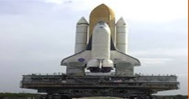
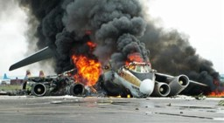
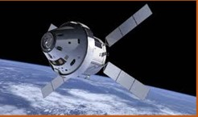
Budge horn
Shuttle
Misadventure
Accident
Satellite
Source of trouble

Slide 12
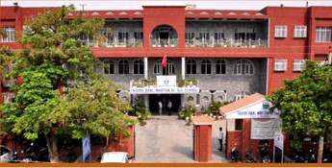
Tagore Ball Niketan

Slide 13
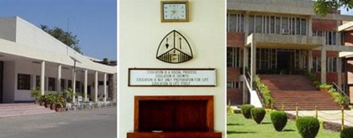
Panjab Engineering College

Slide 14
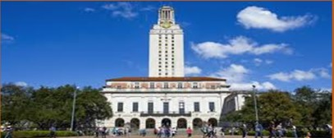
University Of Texas

Slide 15
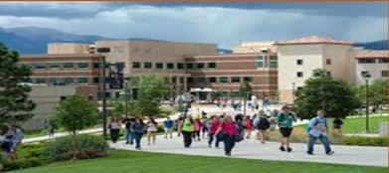
University Of Colorade

Slide 16
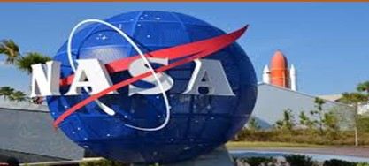
Chawla joined NASA in 1988.

Slide 17
Pair work
1.Kalpana Chawla completed her earlier schooling at ……….
(a) Tagore Ball Niketan (b) colorado school. (c) Texas (d) kalkata college .
2.Chawla moved to the United States in ……….
(a) 1980 (b) 1981 (c) 1981 (d) 1982
3.In 1984, from the university of Texas , Chawla got her ………… degree.
(a) Ph.D (b) B.sc(c) Master’s (d) B.A
4.She got her Ph.D degree from …………
(a) University of Texas (b) Cambridge university(c) Dhaka university (d) University of Colorado.
5. Chawla did her Ph.D in ………
(a) Aerospace Engineering (b) civil Engineering (c) Philosophy (d) literature .

Slide 18
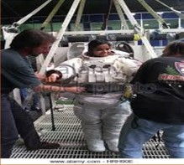
Kalpana Chawla was selected for her first flight in 1996.
It
was
her
first
flight.

Slide 19
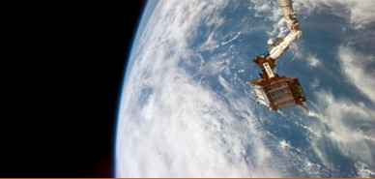
Spartan Satellite
In her first space mission, Chawla was responsible for deploying the Spartan satellite.

Slide 20
Group Work
Write the responsibility of Chawla
in her first space mission.

Slide 21
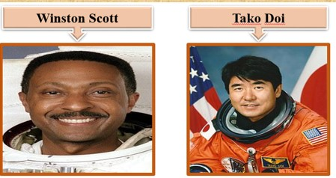
Winston Scott
Tako Doi

Slide 22
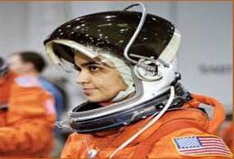
In 2000 Chawla was selected for her
second space mission STS 107.

Slide 23
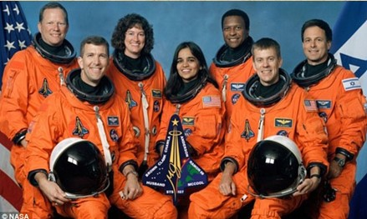
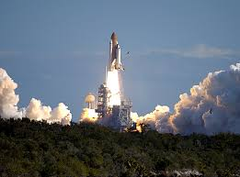
Kalpana Chawla
On 16 January 2003 , kalpana Chawla finally started her new mission with six other space crew on the ill fated space shuttle Colombia .

Slide 24
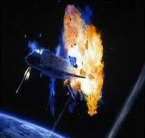
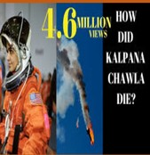
What do the pictures remind us.
All the crew in Columbia including Chawla died only 16 minutes prior to their scheduied landing.

Slide 25
Evaluation
What do you know about Chawla’s first space mission ?
Why was Chawla’s second space mission delayed?
Why was the space shuttle termed ‘ill-fated’ by the author?
Explain the sentence “You are just your intelligent”.
When did Chawla join NASA?

Slide 26
Home task
Briefly comment on
the tragedy of space
shuttle Columbia.

