Slide 1
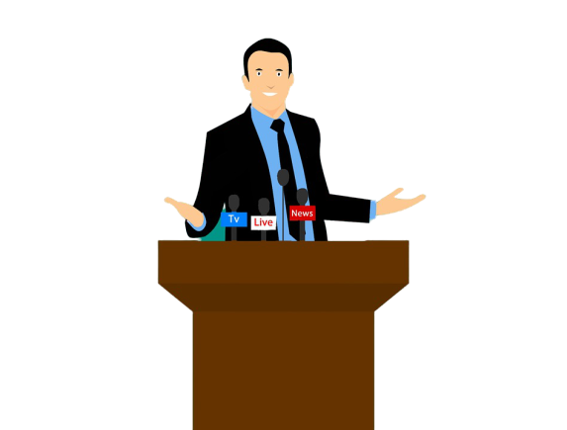
Pronunciation and Presentation
Ebnulhassan Tushar
Assistant Teacher (English)
Ranachandi School and College
Kishoreganj, Nilphamari.
District Ambassador (Nilphamari)
E-mail: tusharbd89@gmail.com

Slide 2
Pronunciation and Presentation
There are two difficult things in the world.
To give speech (Public speech) in front of the people
To die
There are three parts of Public speech
Starting: Not traditional but it should be in the dramatic way.
Body of the presentation: It should be with climax (Jocks or crying)
Concluding: ……………….
Note: Exiting knowledge should not deliver to the students.

Slide 3
What –Subject Knowledge
How-- Presentation
Class Introduction should be in the dramatic Introduction.
Class should be in the learners point of view and try to give them self learning motivation.
Learning must be a fun.
Winner don’t do different thing they do things differently.

Slide 4
If you tell me, I forget (Talent Killing System)
If you teach me, I remember (50% talent killing system)
If you involve me, I learn (100% ok system)
TBL- Task Based Learning (Traditional)
ABL- Activity Based Learning
Lecture system kills education system.
There are three types of students in our classroom-
2% super performance
Struggling students
Disturbing element
TTTM- Teachers talk too much. We should avoid it. Teacher should talk 20% and students involvement should 80%

Slide 5
How to read a text out loud?
Read in Chunks (শব্দগুচ্ছ)
Stress the key words
Give natural pauses
Pronounce aspirated sounds (/p/,/t/,/k/) properly
Tune your sentences with tone
Add emotion.
Pushing between words is called stress and Pushing between sentence is called Intonation.

Slide 6
How to improve spoken English?
We need to learn grammar from native writers grammar books (Remond Marphy).
Thing in English
Speak aloud
Use a mirror
No need grammar but fluency
Pay attention to stress
Sing a song on English with Lyrics
Learn vocabulary with English
Conscious about the Collocation
Phrase and Expression learn like the native speaker
The words that we usually use in Bengali have to be found in English
Prepare for specific purpose
Jokes in Bengali have to be translated into English
Tongue twister (Word to word, set to set)
Everything has to be learned through comfort and fun.

Slide 7
THANKS
EVERYBODY

