Slide 2
Teacher Introduce
Shamimara Begum
Asst. Teacher
Town Model Boys Govt.Primary
School.
Habiganj pourosobha,Habiganj.

Slide 3
Lesson introduce
Class : Three
Sub : English
Lesson-1 : Numbers. Unit - 4
Part of lesson : 1 to 40.
Time : 40 minutes.

Slide 4
Learning outcomes : students will be able to
A..Recognize and read cardinal numbers up 100
2.1.1 write cardinal numbers up to 100 in figures
4.1.1 copy cardinal numbers up to 30 in figures and in words. 4.1.2 write cardinal numbers up to 30 both in figures and in words.

Slide 5
Now look at the pictures
Let’s see some picture….
4 1 6

Slide 6
Today’s our lesson is….

Slide 7
Say and Count the pictures

Slide 8
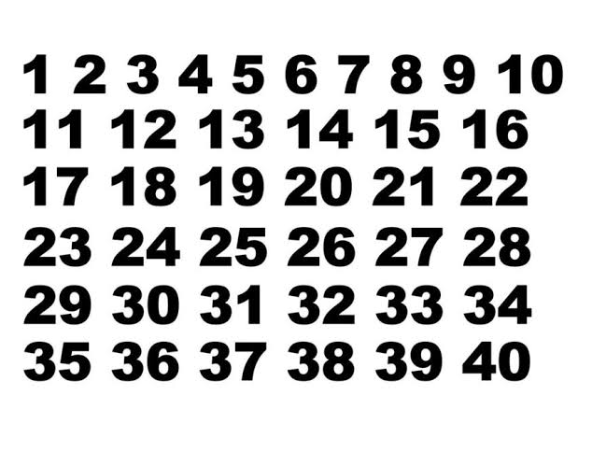
let’s watch chart

Slide 9
Pair work….
Read and write the numbers…

Slide 10
4
3
2

Slide 11
What do you see in the pictures
1
4
2
5
3

Slide 12
Group work
Write down the missing number 10……….15……….20………25
A
Write down the missing number 10……….15……….20………25
B
Write down the missing number 10……….15……….20………25
c

Slide 13
Individual work
Writing Practise and count down word and number 1 to 10

Slide 14
Evaluation
Five, Four One Three Two
1 5 3 4 2

